Slide 1

AABD Cash
Gwynne kizer Mashon
gmashon@legalaidchicago.org
www.legalaidchicago.org
September 2026

Slide 2



WITH SUPPORT FROM
This training series is made possible by HETAC, a program of SHPA, supported by the Illinois Office to Prevent and End Homelessness (OPEH).

Slide 3
TAKEAWAYS
AABD Cash is a complicated program, but you don't have to fully understand it to help others get the cash assistance they need and qualify for.
Apply early and often
If AABD Cash is denied or is low, it’s often worth spending some time to figure out if that decision is correct
When in doubt, consult with a legal aid attorney.
In our experience, decisions are more prone to errors than other programs (including inactions!)
Esp. if they are getting SSI, apply at each application or redetermination for SNAP/Medicaid (it’s free!)
Ensure clients get help they qualify for
Identify who might be eligible for AABD Cash
Navigate the Application Process
Tell DHS and send doctors notes if they have special dietary needs or conditions that limit their ability to climb stairs or are blind
Interview with local office required
Other common verifications needed:
Non-SSA income
Overpayments
Rent/Housing costs
Spouse’s income

Slide 4

What is aabd cash?
Great question!
Most people (including some DHS staff) don’t know either.​
Many people miss benefits they need because…
  People who qualify don’t apply
  Applications often aren’t properly processed
  Applications are erroneously denied
Notes:
People who qualify don’t apply
They don’t know about or understand the program
They abandon or withdraw applications because DHS staff or ABE tells them that the program has work requirements
They withdraw applications because DHS staff tell them that they don’t qualify (Don’t do this!)
Applications often aren’t properly processed
Applications are erroneously denied
AABD Cash determinations are among the most difficult for FCRC staff.
Notices are complicated and often do not have enough information for people to assess whether the denial was correct
Based on our experience, those who need the benefits the most are the likely to have benefits erroneously denied, or miscalculated

Slide 5
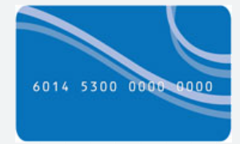
What is aabd cash?
Monthly state-funded cash benefit
Issued on a LINK card or directly deposited into a bank account*
No work requirements; No “clock” like in TANF
Benefit amounts vary from $1 to hundreds of dollars per month
How does AABD cash impact eligibility for other benefits?
Income not counted for | Counts as Income for | It’s Complicated
Social Security benefits – including SSI and Disability Medicaid | SNAP Medicare Savings Programs Many Subsidized Housing Programs | TANF
PM 22-01-02: Upon request, the customer can choose to have all cash benefits, except child care and replacement checks, deposited directly into a checking or savings account in a bank, savings and loan or credit union

Slide 6
Who is eligible?
General:
US Citizen or eligible immigrant
Illinois resident
Persons in certain kinds of institutional care are ineligible PM 03-10

Slide 7
Who is eligible?
Unlike other DHS programs, there is no income limit. Instead, income is compared with individualized “allowances” to determine eligibility and the monthly benefit.
Categorically eligible?
1
Asset eligible?
3
Financially eligible? And Monthly Benefit calculation.
4
Maximized other income?
2
Note: This is how I apply the law to cases, not a sequential process like you see with SSA.

Slide 8
1. Categorical eligibility
A. Must be one of these:
Elderly (65 years old or older)
Blind* (under SSA rules)
Disabled* (under SSA rules: Unable to engage in substantial gainful employment because of medical/psychiatric conditions that will last at least 12 months or result in death.)
B. AND one of the these:
Receiving SSI
“Over-Income” for SSI
Rare: Refugee/asylee ineligible for SSI because of 7-year SSI limit or certain noncitizens eligible for AABD Medical and over 65. (Rules are different from what we are discussing today. See PM 11-04-00.)
* No medical determination is required if Social Security has already found the applicant disabled.
PM 11-01-00: Categories of eligibility for AABD Cash
PM 01-02-03: Clients must apply for and receive any other financial benefits that they may qualify for.
Notes:
Figuring out if you are getting SSI or are over-income for SSI is more complicated than it seems because people often don’t know what they are getting.

Slide 9
Are you getting or “over-income” for ssi?
Are you receiving SSI or over-income for SSI?
Receiving SSI
No other proof needed to prove categorical eligibility.
Over-income for SSI
? Might need to prove that SSA found them over-income for SSI, especially if income is under SSI max + $20
If ineligible for SSD and over-income for SSI and under 65, will need to submit medical records to prove you are blind or disabled.

Slide 10
Clues: Are you getting or “over-income” for ssi?
When does SSA Pay?
1st of the month = SSI; Any other day = Not SSI
What does your letter say?
Sometimes, the letter will state Supplemental Security Income”, “SSI”, or “Retirement Disability or Survivors Insurance”
How much are you paid?
SSI max
If they get paid the 1st and some other day, they have SSI and some other SSA benefit
SSI max + $20/person
> SSI max + $20
< SSI max
Most likely SSI and something else
Not SSI
Unclear but likely eligible for additional SSA benefits and/or AABD Cash
Under 65: Do you have Medicare (“red, white, and blue” card)?
Probably not SSI, unless they get two SSA checks
Most likely SSI
SSI Max in 2026
$994 (single) or $1,491 (couple)

Slide 11
4 steps to determine eligibility:
Categorically eligible?
1
Asset eligible?
3
Financially eligible? And Monthly Benefit calculation.
4
Maximized other income?
2
Applicants must “avail themselves of all potential income”, so if no SSI and income is under SSI max, they must provide proof they were denied SSI because of income.*
PM 01-02-03 (exception for VA Aid and Attendance.)
*DHS Policy an SSA/RRB disability benefit more than $20 above the SSI maximum establishes SSI ineligibility due to income; otherwise, an SSI application or denial evidence is required. However, DHS might require a letter for all cases where income is more than $20 above the SSI maximum.

Slide 12
4 steps to determine eligibility:
Categorically eligible?
1
Asset eligible?
3
Financially eligible? And Monthly Benefit calculation.
4
Maximized other income?
2
Only includes “countable” assets of the person applying and anyone living with that person who is legally responsible for taking care of that person. There are many asset exemptions.
Countable Asset limit: One person: $2,000
Two people: $3,000

Slide 13
4 steps to determine eligibility:
Categorically eligible?
1
Asset eligible?
3
Financially eligible? And Monthly Benefit calculation.
4
Maximized other income?
2
Eligibility and monthly benefit determined through the same process.
Add “Allowances” together = AABD Cash Standard
Subtract “Countable income.”
If monthly assistance payment < $1, then ineligible for AABD Cash benefits.

Slide 14
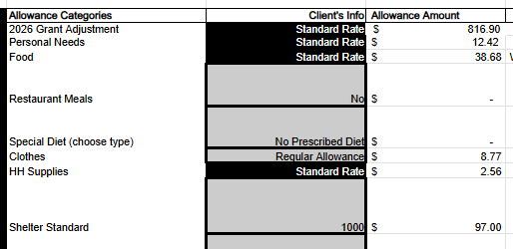
allowances
AABD Allowances
- Countable Income
Monthly assistance payment
Food
Clothing
Housing Supplies
Laundry
Personal Essentials
Phone
Rent/Mortgage
Utilities
Allowances are set by state regulation.
Allowances are fact specific: Which allowances and the value of allowances vary from person to person based on their circumstances.
Shelter allowance is only given if you pay rent or mortgage.
Thus, those who are homeless are more likely financially ineligible for AABD Cash.
Fun fact
Most allowances have not been updated since the 1980s!

Slide 15

allowances for families
Couples both on SSI
AABD Cash can somewhat make up for the “marriage penalty in SSI.” However, married couples living together are eligible for less AABD Cash than they would if they lived separately.
Need to prove/submit:
Apply for AABD Cash for both family members to maximize cash for the household
Ineligible Spouse and/or Child
Non-SSI income only can be diverted to help support needs of ineligible spouse or child in the home. This results in larger AABD Cash awards.
If SSA is reducing SSI amount because of income deeming, this can help make up the difference.
Need to prove/submit:
Proof of relationship
Proof of income for spouse and/or child
Because of shared household rules, single parents with minor children receiving only SSI may be financially ineligible for AABD Cash.
Also, income of parent or ineligible spouse might make someone financially ineligible.

Slide 16
allowances for housing and medical conditions
Restaurant Meals
$102.63 food allowance ($63.95 net increase for individual in separate household without a prescribed diet)
Need to prove/submit:
Has no facilities for preparing food OR
Is unable to cook and has no one who will prepare their meals.
No specific forms to submit
Therapeutic Diet
Up to $17.82 food allowance in addition to the standard food allowance
Need to prove/submit:
Doctor’s note for prescribed the diet and/or signed Request for Therapeutic Diet Allowance (Form 146)
Excess Shelter Allowance
Additional allowance on top of the standard shelter allowance equal to the difference between actual rent paid and the standard shelter allowance.
Need to prove/submit:
Letter or form signed by doctor stating that the client has conditions that prevent then from navigating stairs
Proof that no suitable housing is available for $97/month, if on appeal.
If asked, a description of why accommodation is needed, but should not have to provide that a special accommodation was installed for client (e.g. is unit on the first floor? Does building have an elevator?)
PM 11-01-01-a: Restaurant Meals & Therapeutic Diet Allowances
PM 11-01-02-b: Excess Shelter Allowances; Ill. Admin. Code tit. 89, § 113.308

Slide 17
Countable income
AABD Allowances
- Countable Income
Monthly assistance payment
Countable Unearned income
+ Countable Earned income
minus generous disregards for work-related expenses
+ Income deemed to applicant
if they live with a spouse or parent who has large enough income
- Exempt Income
e.g. income used to pay court-ordered child support, or Social Security overpayments
- Income diverted from applicant
if they live with a spouse or minor child who has little or no income
Deductions
Countable Income

Slide 18
Countable income
AABD Allowances
- Countable Income
Monthly assistance payment
Some special rules for income that can have a big impact:
SSA Overpayments
AABD Cash might help, also:
Appeal the overpayment (if SSA is wrong)
Request a Waiver (waives overpayment even if recipient does not dispute the overpaid)
Overpayment repayment plan (doesn’t change overpayment but can spread payments out to reduce monthly deduction.)
SSI reduced because someone else is paying for shelter & food
AABD Cash might help, also:
SSI recipient can start paying some money for rent – best to have a written contract to prove they are a boarder and report that expense to SSA
SSA miscalculations, mischaracterizations
AABD Cash might help, also:
Appeal SSA decisions. I recommend consulting someone with expertise in SSA rules for these situations.
SSA reduced because of child-support or other federal debt
AABD Cash might help, also:
Consult expert regarding underlying debt

Slide 19
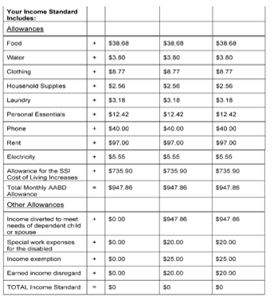

Reviewing the notice

Slide 20
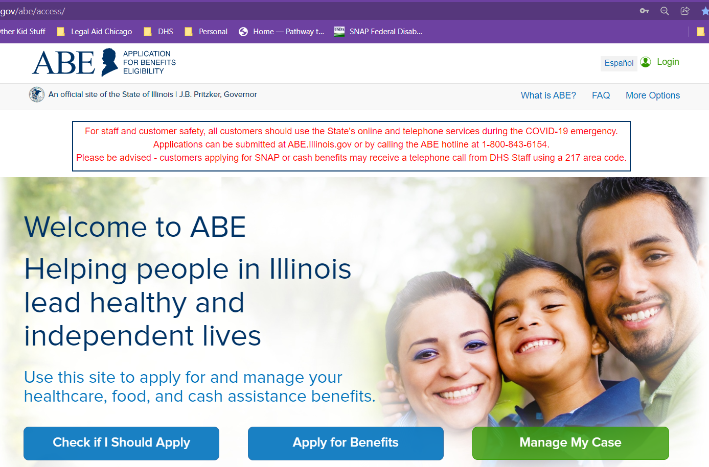
Getting and keeping benefits
Apply for “cash” Ignore TANF work requirement warnings.
Interview
Verifications
Income
Rent/Mortgage
Medical conditions preventing use of stairs
Dietary limitations
Dependent family members
Proof of income for spouse, if any (even if they are not applying for cash)
Notice of Decision
Should be issued within 45 days after application (60 days if DHS has to make disability finding)
If denied “TANF”, contact DHS office to point out they still need to issue a decision regarding AABD Cash eligibility; file inaction appeal if needed.
Review to make sure it’s correct if possible! Appeal deadlines are 60 calendar days after date on notice of decision. (See Appeals Training)

Slide 21

Is Ben eligible for AABD Cash?
Is Ben receiving or over-income (both otherwise eligible) for SSI?
Ben is living in an encampment in Chicago. He says he’s been homeless for a year now because he cannot afford an apartment. He tells you that he can’t work because he has a hard time getting around because of back pain. He’s never been married. He has one son who is 25 years old and doesn’t live with him.
Income: $994 in SSA benefits
Expenses: Laundry and Phone ($35/month)

Slide 22

Ben is most likely categorically eligible. $994/month is most likely SSI.
You can confirm by looking at his SSA notices.
Is Ben eligible for AABD Cash?
1
2
3
4
Categorically eligible?
Maximized other income?
Asset eligible?
Financially eligible? And
Monthly Benefit calculation.

Slide 23
Ben is already receiving SSI so DHS will find he has maximized other income.
Is Ben eligible for AABD Cash?
1
2
3
4
Categorically eligible?
Maximized other income?
Asset eligible?
Financially eligible? And
Monthly Benefit calculation.

Slide 24
SSI has the same asset limits as AABD Cash so Ben is most likely asset-eligible.
If you learn he is over-asset for AABD Cash, consult a legal aid attorney to discuss potential SSI overpayment issues, and to learn how to safely reduce assets.
Is Ben eligible for AABD Cash?
1
2
3
4
Categorically eligible?
Maximized other income?
Asset eligible?
Financially eligible? And
Monthly Benefit calculation.

Slide 25

Is Ben eligible for AABD Cash?
AABD Cash Allowances: $917.51
Countable income: $969.00
Because Ben does not currently have shelter costs, his income exceeds his allowances.
1
2
3
4
Categorically eligible?
Maximized other income?
Asset eligible?
Financially eligible? And
Monthly Benefit calculation.

Slide 26
Is Ben eligible for AABD Cash?
You help Ben get a 1st floor apartment! He’s responsible for paying $330/month in rent. You help him apply for AABD Cash and submit a letter from his doctor saying he has difficulty with stairs.
AABD Cash Allowances: $1248
Countable income: $969
AABD Cash: $279/month
1
2
3
4
Categorically eligible?
Maximized other income?
Asset eligible?
Financially eligible? And
Monthly Benefit calculation.

Slide 27

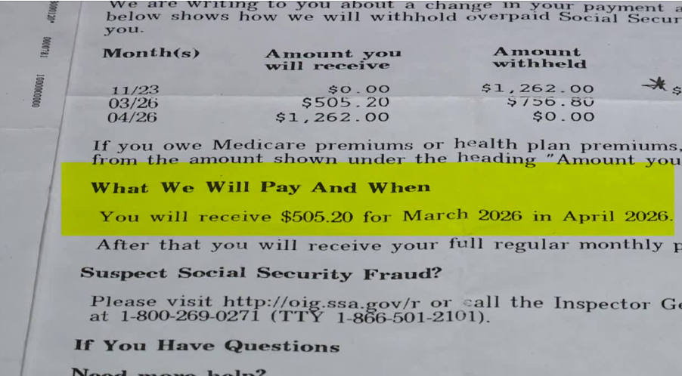
Is Julia eligible for AABD Cash?
Julia, who is 70 years old, tells you that she’s scared she will lose her apartment in Tinley Park, IL because she can’t afford rent. Her rent is $500/month. She has no disabilities. She is only getting $505 in SSA retirement. You look at her notice and see this:

Slide 28
Yes, she’s over 65 years old.
Is Julia eligible for AABD Cash?
1
2
3
4
Categorically eligible?
Maximized other income?
Asset eligible?
Financially eligible? And
Monthly Benefit calculation.

Slide 29
Yes, she’s “over-income” for SSI. She might need to get a letter from SSA to prove it.
Is Julia eligible for AABD Cash?
1
2
3
4
Categorically eligible?
Maximized other income?
Asset eligible?
Financially eligible? And
Monthly Benefit calculation.

Slide 30
Julia tells you that the only assets she has are a life insurance policy with a cash surrender valye of $1,000 (exempt asset), her clothes, furniture, and other personal items in her home (exempt asset), and $1200 in the bank.
Her countable assets are $1200, below the asset cap for AABD Cash.
Is Julia eligible for AABD Cash?
1
2
3
4
Categorically eligible?
Maximized other income?
Asset eligible?
Financially eligible? And
Monthly Benefit calculation.

Slide 31
Is Julia eligible for AABD Cash?
You help her apply for AABD Cash and submit a copy of the notice from SSA showing they are withholding her benefits to pay an overpayment.
AABD Cash Allowances: $1039
Countable income: $525
AABD Cash: $514/month
1
2
3
4
Categorically eligible?
Maximized other income?
Asset eligible?
Financially eligible? And
Monthly Benefit calculation.

Slide 32



Legal Aid Resources
Apply online: https://www.illinoislegalaid.org/get-legal-help
312-341-1070
630-580-3357
618-398-0574

Slide 33
Questions?
Gwynne Mashon
gmashon@legalaidchicago.org
To signup for our mailing list and to access slide decks for this and previous trainings:
https://legalaidchicago.org/public-benefits-training-materials/

Slide 34
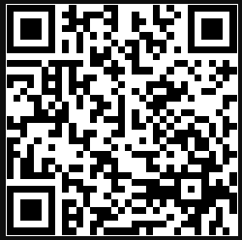
BEFORE YOU GO
Stay connected
with HETAC
1
Complete the evaluation
2
Visit our website
3
Join the peer directory
Scan to do it all in one place
4
Subscribe to the newsletter
hetac-il.org

