Slide 1
Navigating Manage My Case
Gwynne Mashon
8.17.2026

Slide 2
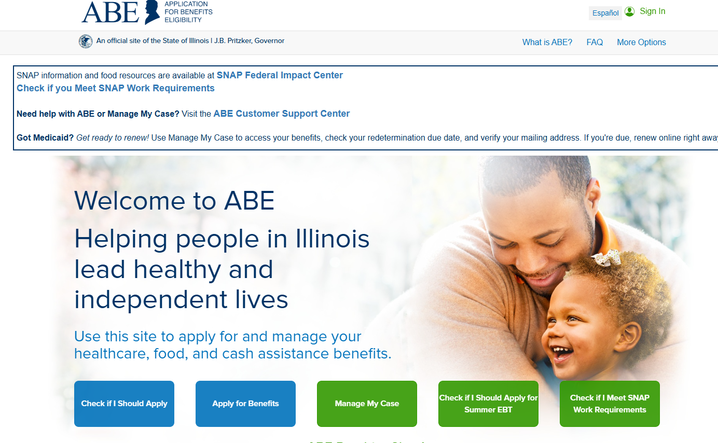
agenda
Manage My Case
General Account Issues
Taking Action
Getting Information
Notes
If you can, I recommend logging into a Manage My Case account to follow along
Please feel free to ask questions at any time
Slides will be available at https://legalaidchicago.org/public-benefits-training-materials/ soon.

Slide 3
What is MMC?
Online platform to apply for and manage certain food, cash, and medical benefits from the Illinois Department of Human Services
abe.Illinois.gov
DHS Troubleshooting guide: https://www.dhs.state.il.us/page.aspx?item=98456
Pros
Generally accessible 24/7 Can help avoid long waits in offices or on the phone Once you understand how to use the system, can provide more reliable information than you might get otherwise Written evidence! Download notices, Save pdfs as proof of applications and uploads, Take screenshots
Cons
System can be glitchy Pay attention to the banner at the top of the page for updates and maintenance updates Not intuitive Not accessible for all people You cannot accomplish all tasks or get all information you want on MMC. Often, interaction with staff is still required.

Slide 4
Manage My Case
General Account Issues
Taking Action
Getting Information
FAQ
I can’t get into Manage My Case. What can I do?
I’m in Manage My Case, but I don’t see anything about my benefits.
How do I change how DHS communicates with me and what are the best options?
Manage My Case isn’t showing updated information. What can I do?

Slide 5
I can’t get into mmc. What can I do?
There are three points of ID verification required to successfully access Manage My Case
Setting up ILogin (make sure you access through ABE site): Contact Info Verification
Connecting ILogin to the Manage My Case account associated with your DHS account: Linking ILogin to MMC
Getting access to your DHS account: Identity Verification
Notes:
[Sources]
2025_06 SHPA ABE and MMC.pdf

Slide 6
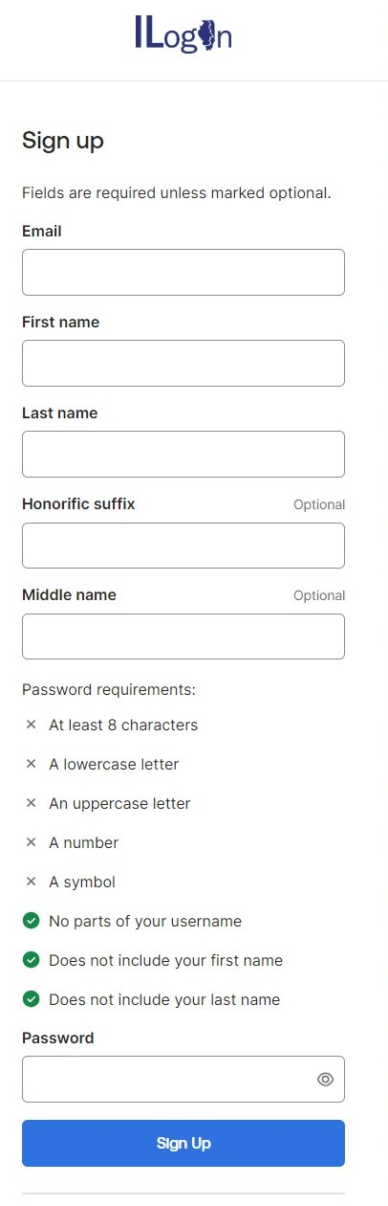
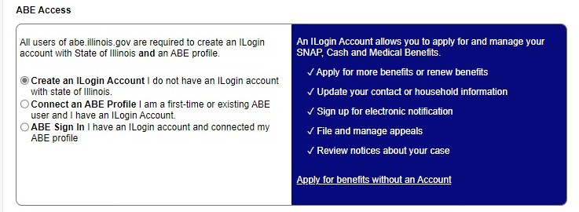
I can’t get into mmc. What can I do?
ID Verification
Contact Info Verification
Linking ILogin to MMC
Identity Verification
“I have not set up my ILogin Account.”
Notes:
[Sources]
2025_06 SHPA ABE and MMC.pdf

Slide 7
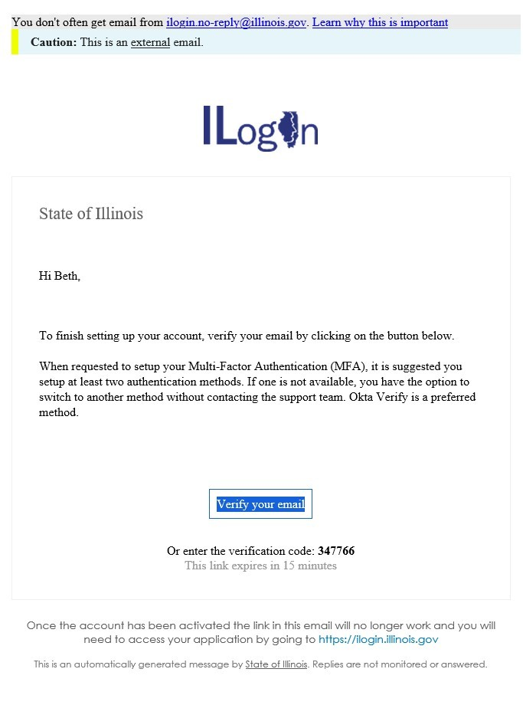
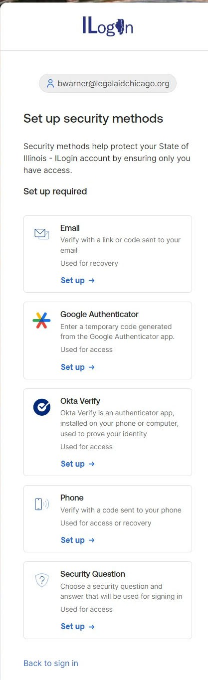
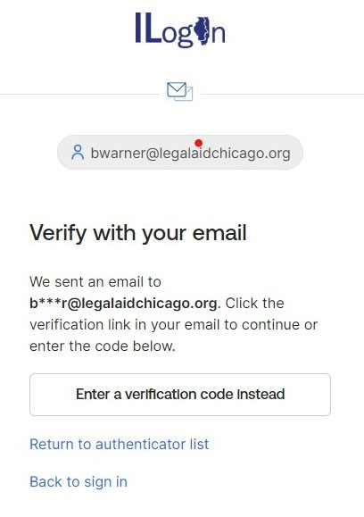

I can’t get into mmc. What can I do?
ID Verification
Contact Info Verification
Linking ILogin to MMC
Identity Verification
Step 1
Step 3
Step 2
Notes:
[Sources]
2025_06 SHPA ABE and MMC.pdf

Slide 8
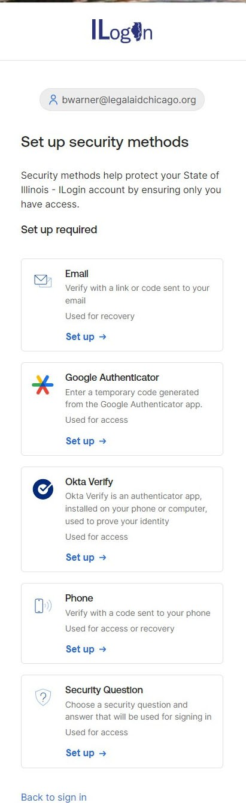
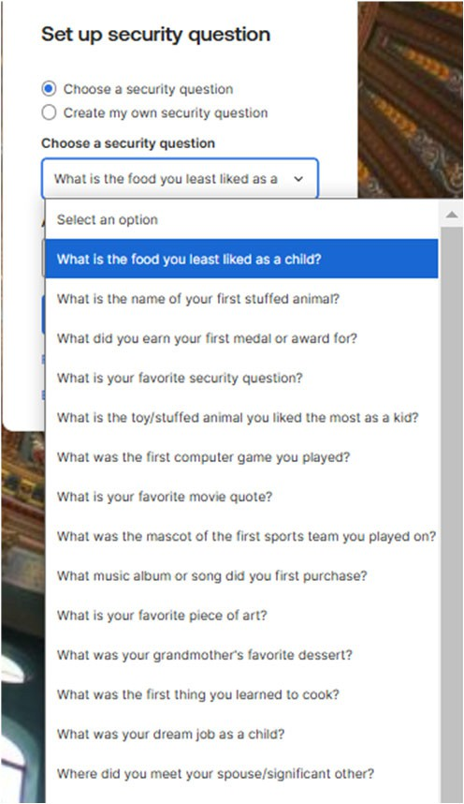
I can’t get into mmc. What can I do?
ID Verification
Contact Info Verification
Linking ILogin to MMC
Identity Verification
Step 4 – Option 3
This is likely the best option for someone with limited tech skills or inconsistent access to their phone and/or email.
Notes:
[Sources]
2025_06 SHPA ABE and MMC.pdf

Slide 9
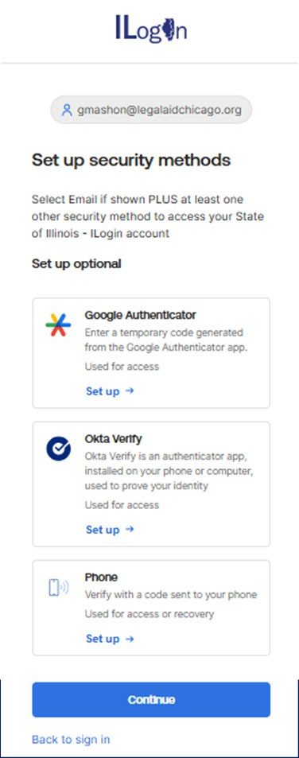
I can’t get into mmc. What can I do?
ID Verification
Contact Info Verification
Linking ILogin to MMC
Identity Verification
Step 5
The system will ask you to set up more security methods. If you don’t want to do that, just click “Continue”
Notes:
[Sources]
2025_06 SHPA ABE and MMC.pdf

Slide 10
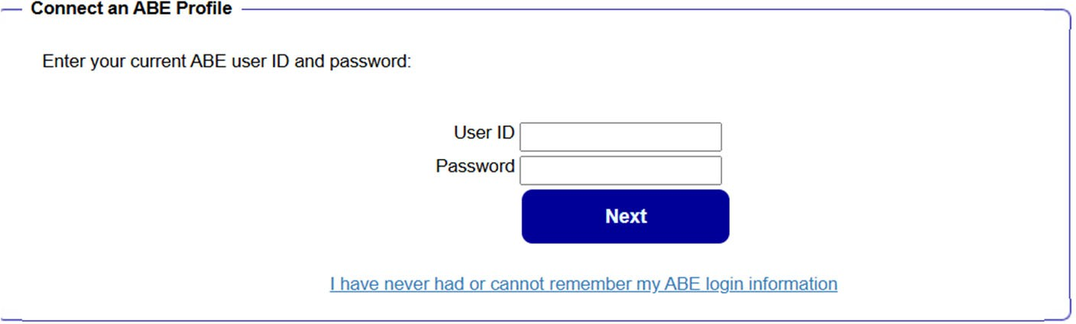
I can’t get into mmc. What can I do?
ID Verification
Contact Info Verification
Linking ILogin to MMC
Identity Verification
Option 1: “I already have a MMC username and password that I want to use.”
Option 2: “I never set up an MMC username and password or I don’t remember what it is or don’t want to use it.”
Notes:
[Sources]
2025_06 SHPA ABE and MMC.pdf

Slide 11
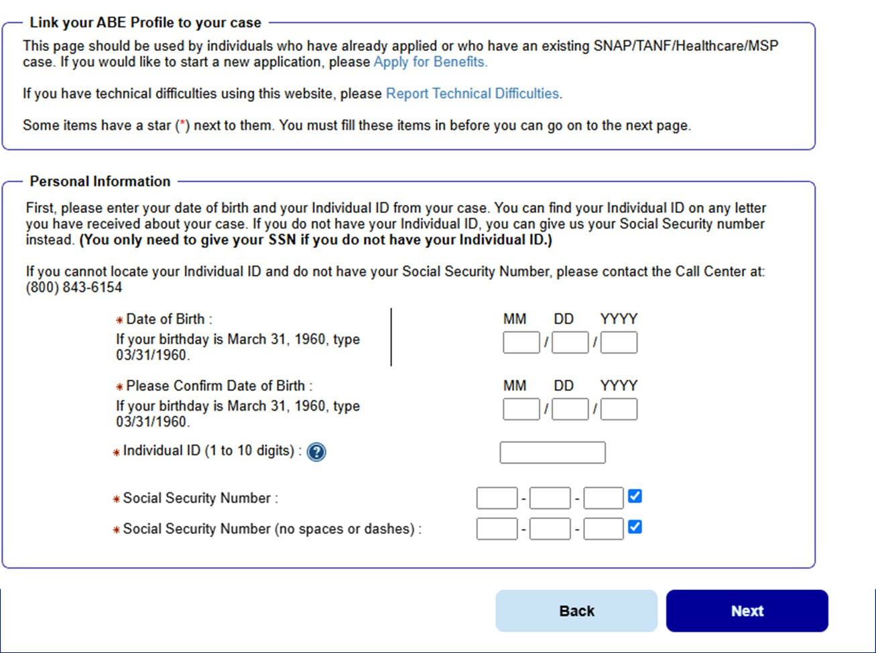
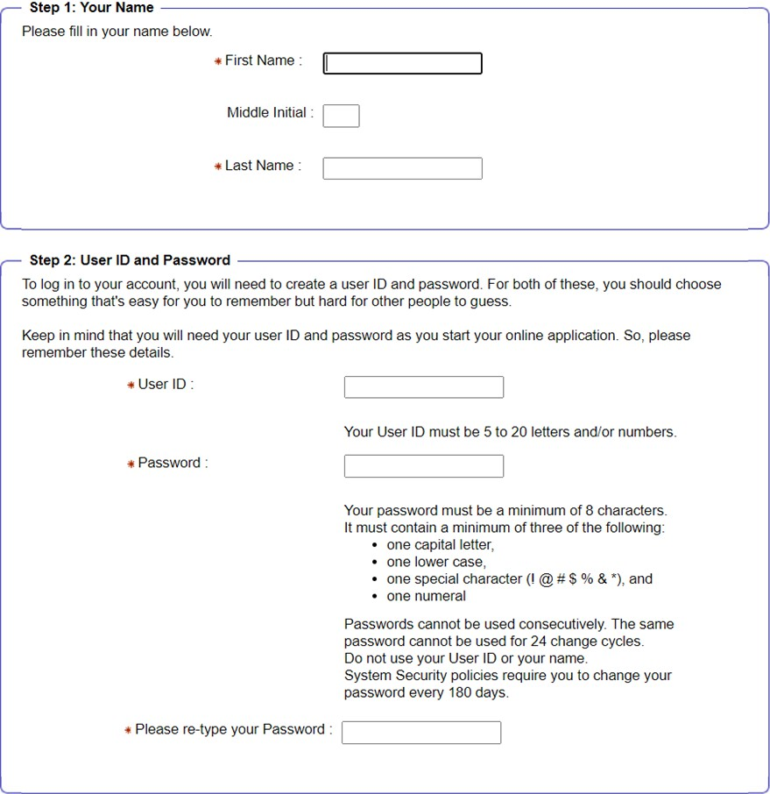
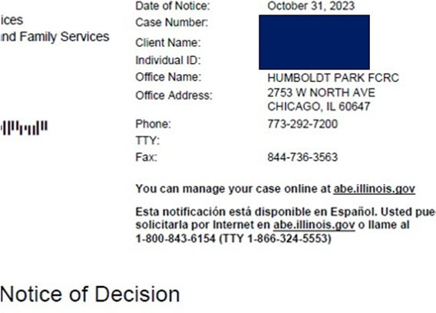
I can’t get into mmc. What can I do?
ID Verification
Contact Info Verification
Linking ILogin to MMC
Identity Verification
Name, Date of Birth, and either Individual ID or SSN must match.
Notes:
[Sources]
2025_06 SHPA ABE and MMC.pdf

Slide 12
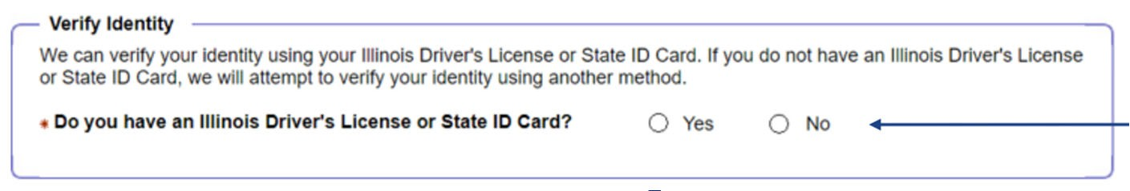
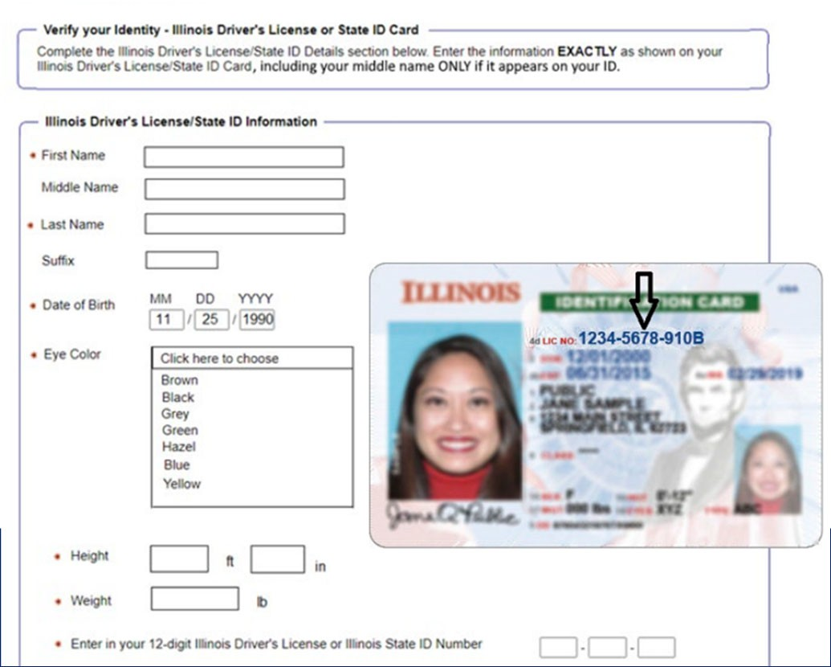
I can’t get into mmc. What can I do?
ID Verification
Contact Info Verification
Linking ILogin to MMC
Identity Verification
They will advance to the Experian Identity Proofing process
They will advance to the Secretary of State ID Proofing process.
Notes:
[Sources]
2025_06 SHPA ABE and MMC.pdf

Slide 13
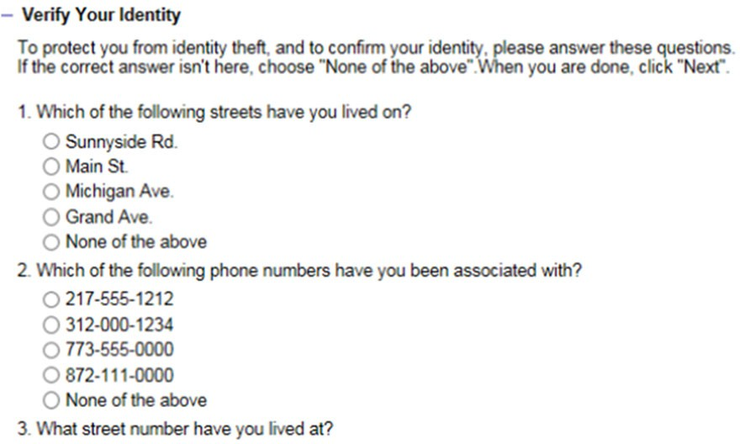
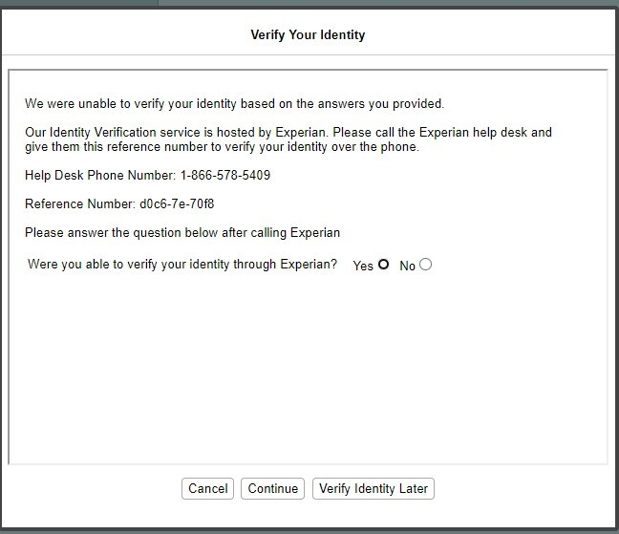
I can’t get into mmc. What can I do?
ID Verification
Contact Info Verification
Linking ILogin to MMC
Identity Verification
Choose the best answer.
If identity is verified, the system will advance to Manage My Case.
If identity is not or cannot be verified, you go this screen.
Notes:
[Sources]
2025_06 SHPA ABE and MMC.pdf

Slide 14
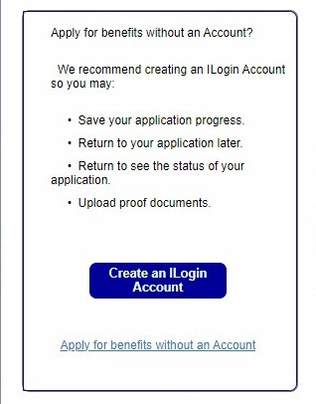
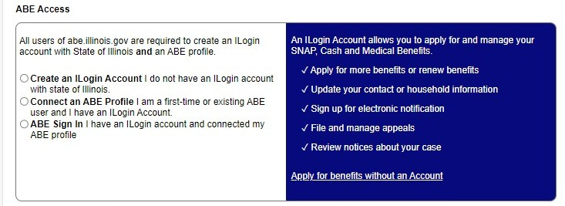
I can’t get into mmc. What can I do?
ID Verification
Contact Info Verification
Linking ILogin to MMC
Identity Verification
What to do if you can’t get through these steps?
Review resources on ABE Customer Support Center - https://www.dhs.state.il.us/page.aspx?item=98456
Email abe.questions@illinois.gov
Manual ID Proofing for “Identity Verification” Step only (instructions: https://www.dhs.state.il.us/page.aspx?item=164879)
Submit an application online without an account; but quickly follow-up with your FCRC
Notes:
[Sources]
2025_06 SHPA ABE and MMC.pdf

Slide 15
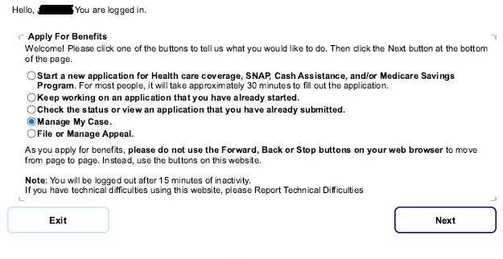
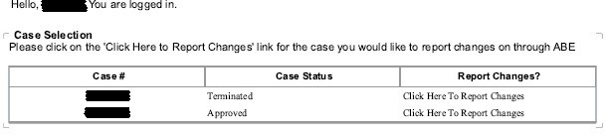
I’m in manage my case, but I don’t see anything about my benefits.
Notes:
[Sources]
2025_06 SHPA ABE and MMC.pdf

Slide 16
I’m in manage my case, but I don’t see anything about my benefits.
MMC – TABS OVERVIEW
The Manage My Case landing page is divided into four (4) tabs:
Apply for new benefits or report case changes
View correspondence for past 12 months.
View the status of application, redetermination, or reported case change
Reschedule an Appointment
View the type of assistance received by month
View current benefits and when they’re up for redetermination
View historical benefit information
View how to contact someone about their case
Send an email to the FCRC
Adjust access permissions for household members and third party reps
View/change communication preferences
Change a password
Notes:
[Sources]
2025_06 SHPA ABE and MMC.pdf

Slide 17
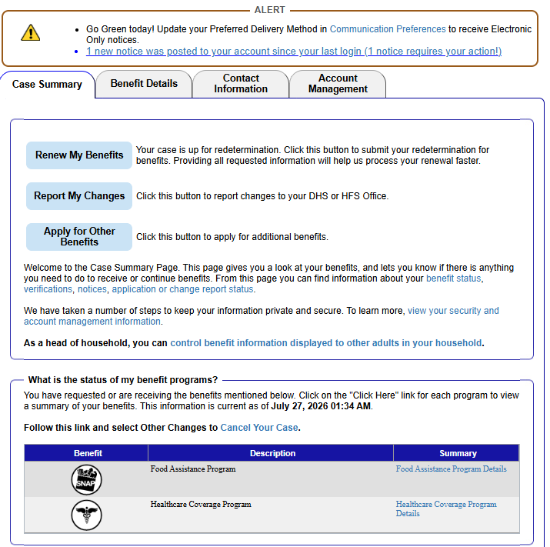
Manage My Case isn’t showing updated information. What can I do?
As we’ll discuss later, some times you will be expecting a change to happen but the change is not reflected in Manage My Case.
Be sure to look at the “current as of” date. If this date is older, then there might be activity on your case that has not yet been reflected in Manage My Case.
If MMC has not been updating, you might:
Email abe.questions@illinois.gov
Set up a new ILogin/MMC access account
Contact the local FCRC for an update
Notes:
[Sources]
2025_06 SHPA ABE and MMC.pdf

Slide 18
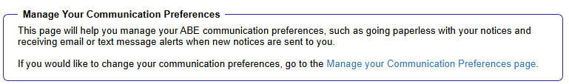
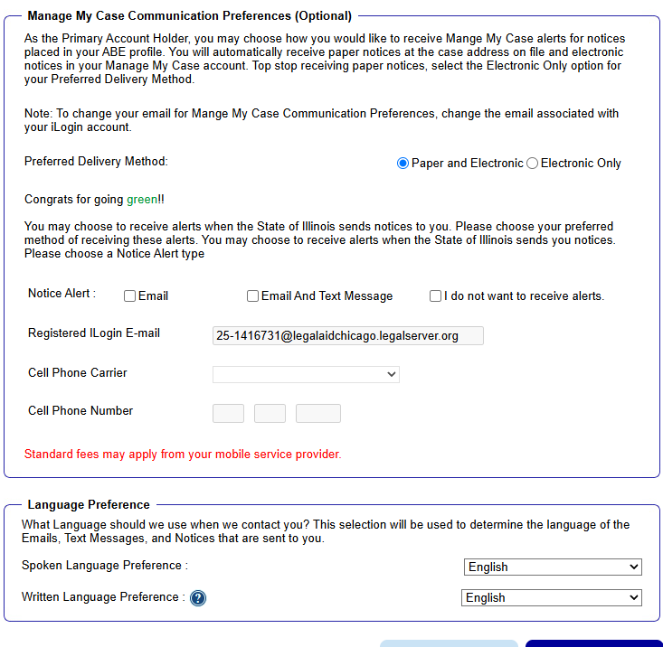
How do I change how DHS communicates with me and what are the best options?
Here, you can change HOW you get notices.
Changing your contact information here will not change the contact information associated with your account, but will change where MMC notifications go.
If you have reliable access to texting service, we highly recommend setting up the text notification system.
If you change your email address, we generally recommend starting over, setting up a new account access.

Slide 19
Manage My Case
Account Options
Taking Action
Getting Information
FAQ
Where can I find contact information for the DHS office handling my case?
Where can I find my case number?
What information can I find about my benefits and where do I find it?
My benefits stopped and I don’t know why. How can Manage My Case help?
What insurance company handles my Medicaid and how do I contact them?
When is my redetermination due?
How much cash/SNAP should I be getting?
Why did DHS deny my application?
I haven’t gotten a response to my application. What should I do?

Slide 20
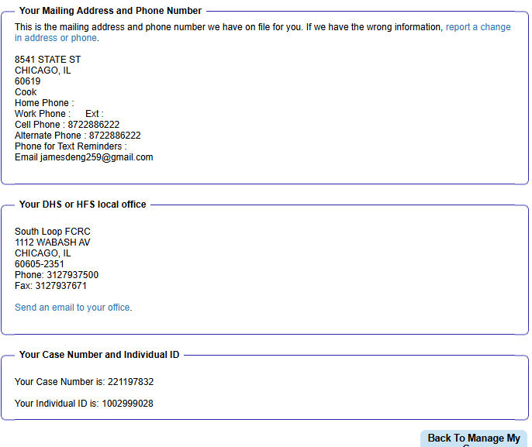
Where can I find contact information for the DHS office handling my case? Where can I find my case number?

Slide 21
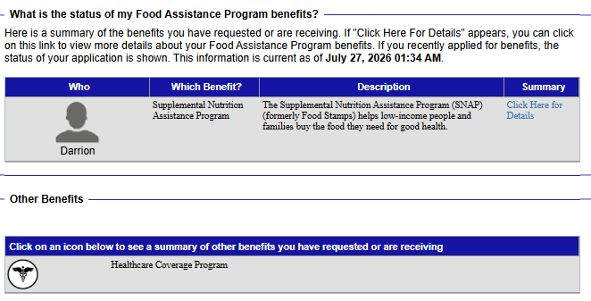
Where can I find information about my current benefits?
Benefit Details page can provide helpful information but can also be misleading if you’re not sure what to watch out for.
Click here to get detailed information
Click here to get information about other benefits. If you applied for a benefit but do not see if here, either MMC does not have updated information or the application has not yet been processed.
Notes:
[Sources]
2025_06 SHPA ABE and MMC.pdf

Slide 22
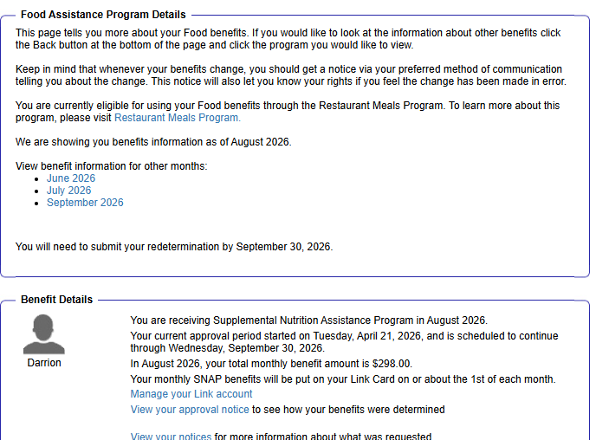
Where can I find information about my current benefits?
Benefit Details page can provide helpful information but can also be misleading if you’re not sure what to watch out for.
Food Assistance
If DHS has recorded that you or someone else in your SNAP household is homeless, elderly, or disabled. MR #25.26.
This information is not reliable in some circumstances.
When you started getting SNAP.
Current Certification period.
Current benefit amount.
Link to information about the EBT Account (not managed on this site because it is controlled by an outside vendor.)
Notes:
[Sources]
2025_06 SHPA ABE and MMC.pdf

Slide 23
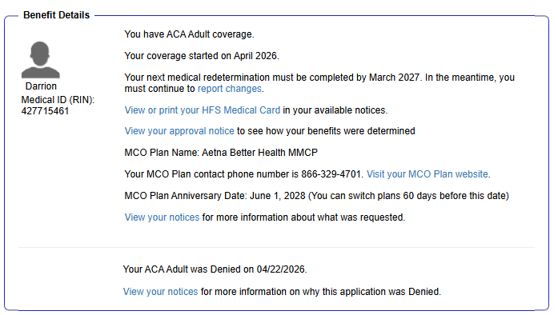
Where can I find information about my current benefits?
Benefit Details page can provide helpful information but can also be misleading if you’re not sure what to watch out for.
Medical Assistance
When benefits started
We’ll get to this shortly
MCO = Managed Care Organization
This is who you should contact regarding how to use your medical benefits
Confusing! Generally, in the Benefits Details section, whenever you see benefits denied, check your notices. The information here is not the legal decision. You have a right to a notice laying out the factual basis for any denial.
Notes:
[Sources]
2025_06 SHPA ABE and MMC.pdf

Slide 24
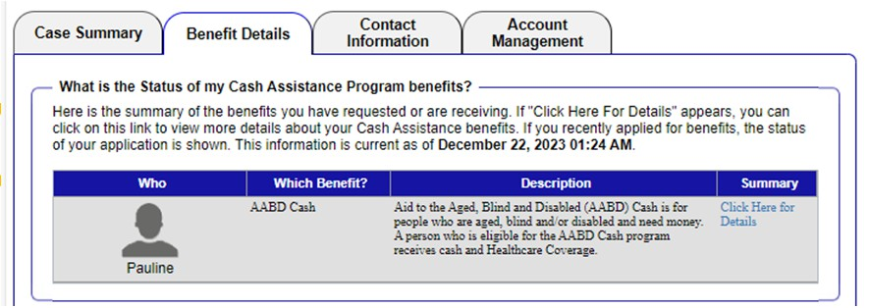
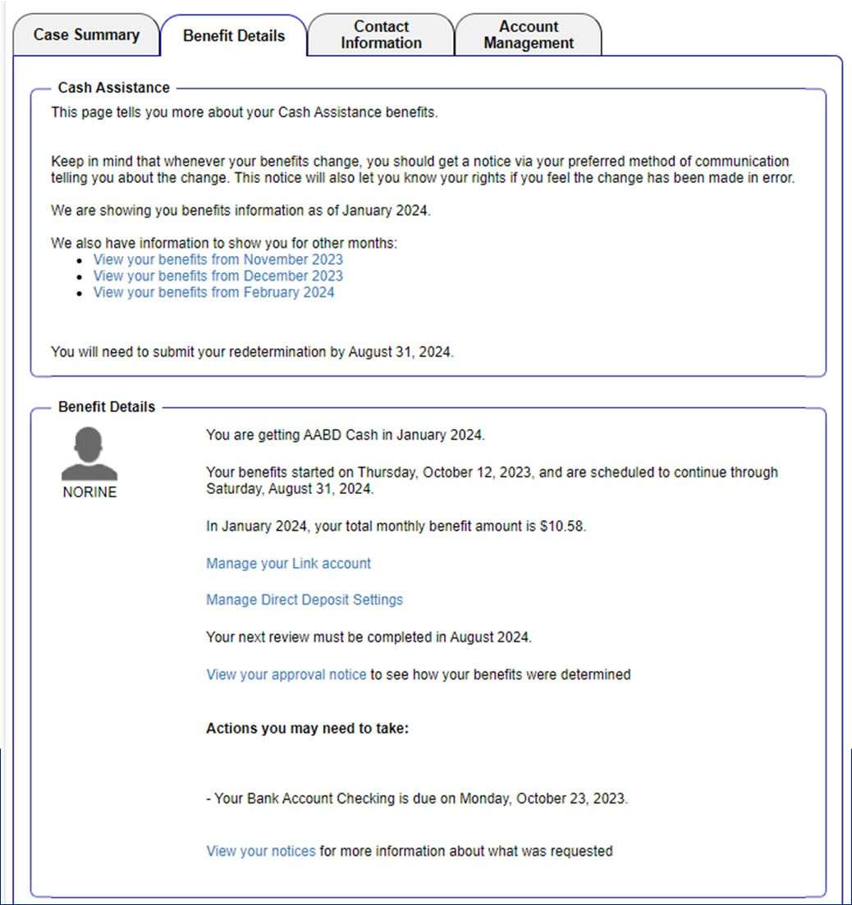
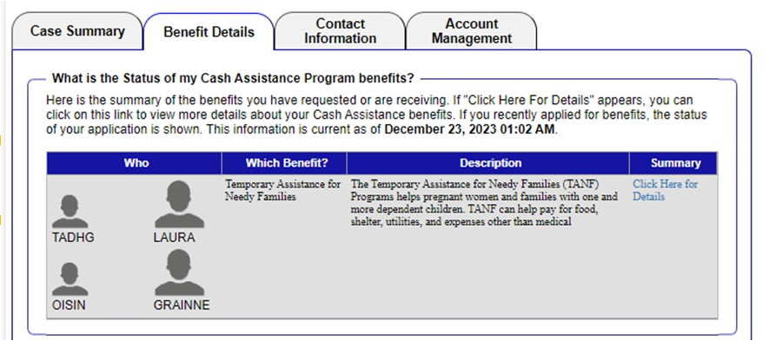
Where can I find information about my current benefits?
Benefit Details page can provide helpful information but can also be misleading if you’re not sure what to watch out for.
Cash Assistance
AABD
Other benefit months
Start date and approval period
TANF
Current amount
Notes:
[Sources]
2025_06 SHPA ABE and MMC.pdf

Slide 25
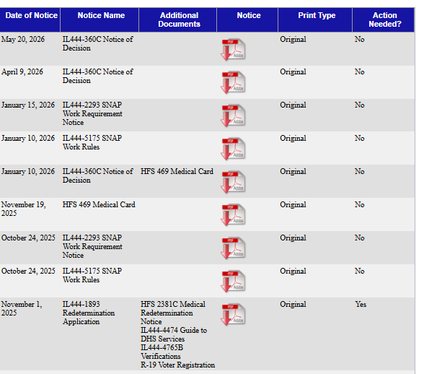
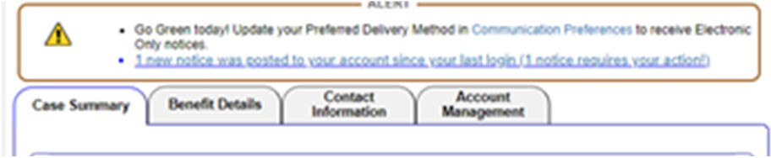
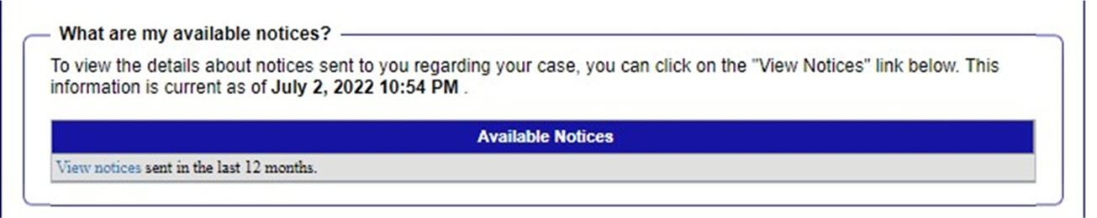
Where can I find information about my current benefits?
Remember: Information in Benefits Details has no legal weight. The notices are what matters!
Notes:
[Sources]
2025_06 SHPA ABE and MMC.pdf

Slide 26
Where can I find information about my current benefits?
Remember: Information in Benefits Details has no legal weight. The notices are what matters!
Click on pdf icon to download the notice.
Notices about benefits
Work rules notices
Medicaid card (note that RIN is usually on the last page of notices)
Date of upload NOT Date of Notice!!!
Redetermination
Notes:
[Sources]
2025_06 SHPA ABE and MMC.pdf

Slide 27
Manage My Case
Account Options
Taking Action
Getting Information
Where do I find action options
Change address or contact information with DHS
Redetermination
Report a Change
Submit Documents
Apply for a New Benefit
File an Appeal
What do I do in these scenarios
My SNAP stopped suddenly and I don’t know why. How can I get them reinstated?
I thought my redetermination was due now.
I filed an application for AABD cash 3 months ago but still haven’t gotten a response. What can I do?
I requested an exemption from the SNAP Work Requirements. How can I tell if it was approved?

Slide 28

How can I change my address or phone number using ABE?
Here, you can see what address, phone, and email address are associated with your DHS case. Recipients who are homeless may choose to list the FCRC address as their mailing address here.
You can also access a form to update your information.
If you change your address and you already receive SNAP or AABD Cash, you will also need to submit updated proof of shelter verification. If you have a SNAP Work Requirements exemption, this may also trigger DHS to re-evaluate whether you qualify for that exemption.

Slide 29
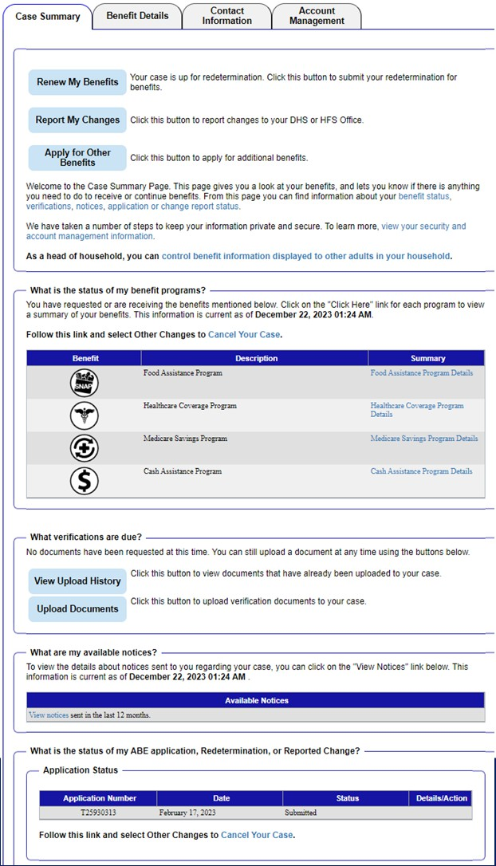
How do I file a redetermination or change report?
Redetermination
Report changes related to benefits you are already receiving. For example:
Change of address/rent amount
Change of income
Add or remove people from your household
Report pregnancy (medical only)
It’s helpful to know what changes you are and are not required to report. In some situations, not reporting changes put you at risk of incurring an overpayment. You are not required to report all changes.

Slide 30
How do I apply for other benefits?
Apply for benefits you are not currently receiving. If this button is not available, you can also submit a new application for benefits.

Slide 31
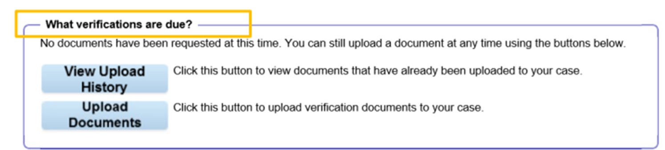
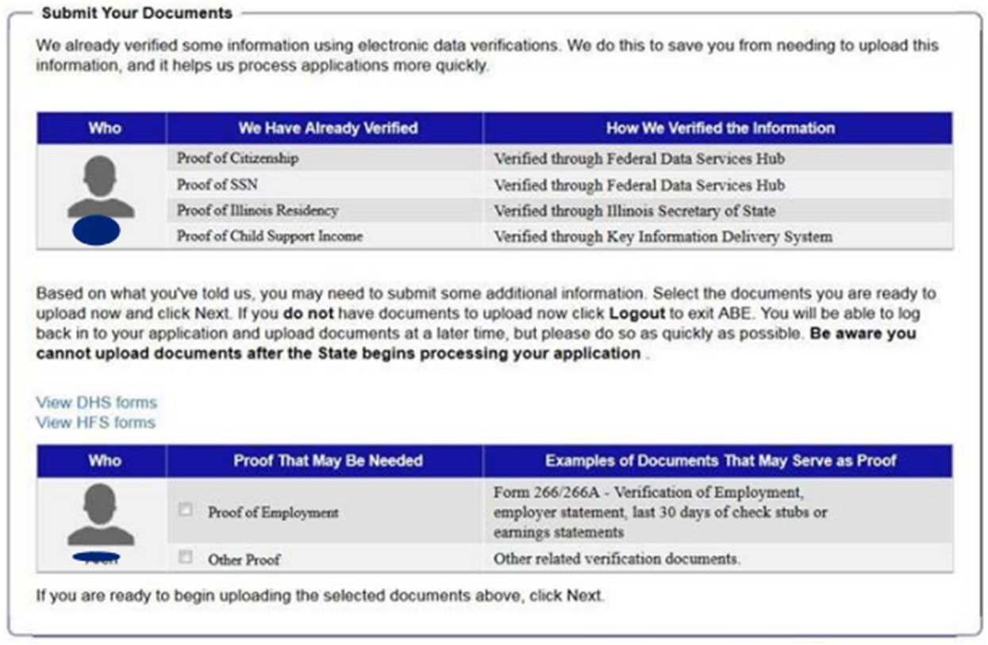
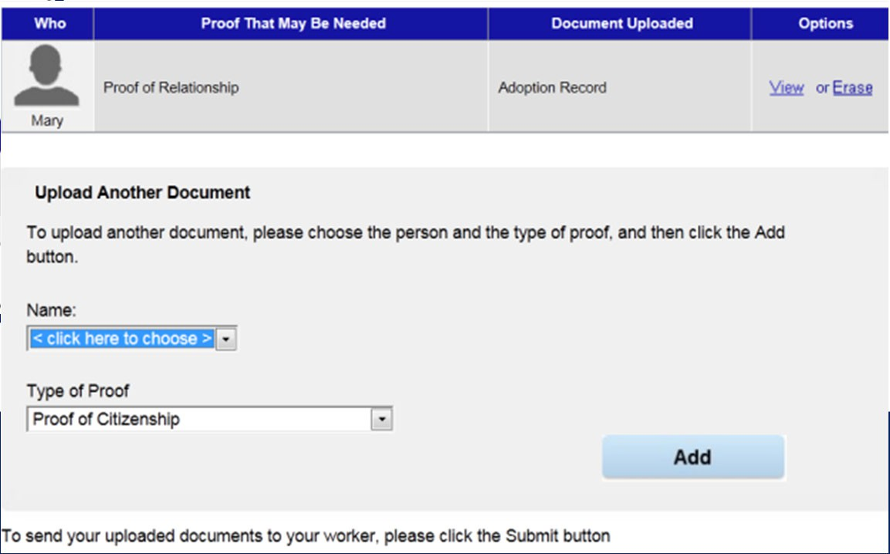
How do I upload documents?
Be sure to click the [Add] button and the [submit] button

Slide 32
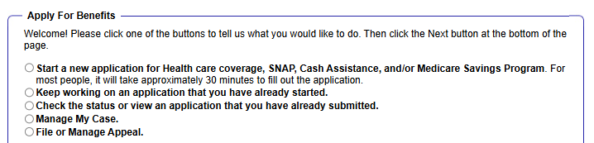
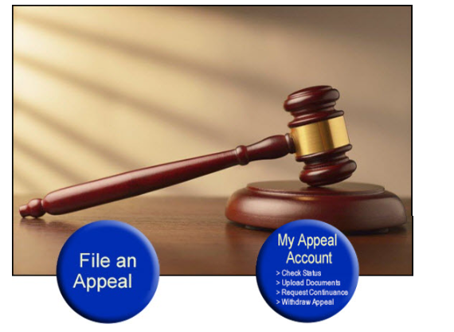
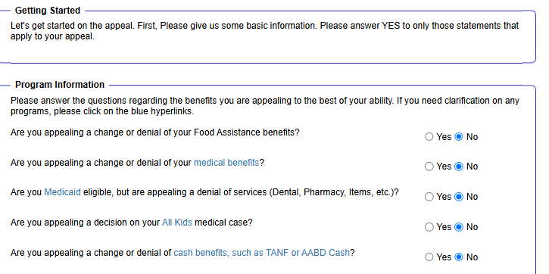
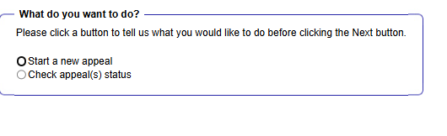
How do I file an appeal?
Do the best you can on the questions related to the appeal. The most important thing is that you submit the application on time, signed and dated. It is easy to clarify or amend the reasons for the appeal later, though it is particularly helpful if you include the correct Case # (there’s a pulldown to choose from) and the date of the notice you are appealing.

Slide 33
SCENARIOS
General problem-solving framework
Problem
What happened?
What can you do:
Appeal
Apply again
Submit documents
Contact DHS
Determine steps to take outside DHS
Notes:
[Sources]
2025_06 SHPA ABE and MMC.pdf

Slide 34
My SNAP stopped suddenly and I don’t know why. How can I get them reinstated?
Before you know how to get SNAP back, you have to figure out why SNAP stopped by looking at the NOTICES.
Notes:
[Sources]
2025_06 SHPA ABE and MMC.pdf

Slide 35
My SNAP stopped suddenly and I don’t know why. How can I get them reinstated? (Page 1 of 2)
Missed Redetermination
Check MMC in the notices section. If a redetermination was missed (you didn’t complete or DHS didn’t process), then the redetermination form will be there (Slide 27). For SNAP, there will be no other termination notice.
File later redetermination form or a new application for benefits
If you did complete the redetermination, consider filing an appeal.
Benefits Stopped because of work requirements
If you were and continue to meet an exemption*: File a new application with exemption request. Also consider appealing termination (you did not need to previously request exemption.)
If you were and continue to meet the work requirement: File a new application with proof that you met work requirement for 30 day. Also consider appealing ermination (you did not need to previous report you were meeting the work requirement.)
If you were exempt or were meeting the work requirements, but are not now: You might still appeal the termination. Note that the appeal deadline is 90 days after the date on the notice.
If you were and are not exempt or meeting, visit https://www.dhs.state.il.us/page.aspx?item=177800 to find ways to meet the requirement.
Notes:
[Sources]
2025_06 SHPA ABE and MMC.pdf

Slide 36
My SNAP stopped suddenly and I don’t know why. How can I get them reinstated? (Page 2 of 3)
Benefits stopped for another reason
Check EBT/Link account for deposits and suspicious withdrawals
If you discover SNAP was stolen (not stopped), cancel card immediately and report theft to DHS so they can investigate. Unfortunately, most skimmed SNAP and cash cannot be replaced.
EBT/LINK Issues
File a new application
You can also consider appealing the termination if (1) The decision was wrong, (2) The termination was based on a missed interview, or (3) The termination was based on not turning in verification documents. Note that the appeal deadline is 90 days after the date on the notice.
Notes:
[Sources]
2025_06 SHPA ABE and MMC.pdf

Slide 37
I thought my redetermination was due now.
Review notices to see if DHS sent you a redetermination application. If so, complete it and upload it to MMC.
Look for “Renew My Benefits” button on the Case Summary Page. If so, click on it to complete the redetermination.
Notes:
[Sources]
2025_06 SHPA ABE and MMC.pdf

Slide 38
I thought my redetermination was due now.
Look at “Benefits Details” for your SNAP or Cash benefits. If certification period is ending but there’s no redetermination in MMC, file a new application.
Make sure you look at the “Information Current as of…” Information to ensure you have the most up to date information. If information is out of date, you can (1) estimate determination date based on certification period listed on notices. OR (2) Reach out to DHS.
Notes:
[Sources]
2025_06 SHPA ABE and MMC.pdf

Slide 39
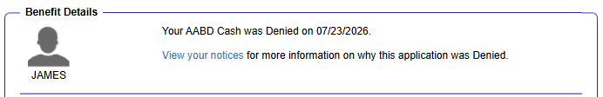
I filed an application for AABD cash 3 months ago but still haven’t gotten a response. What can I do?
Look at the Benefits Details section to quickly see if Benefits were awarded. If it says that benefits were denied or if there is no information, look at the notices.
Review notices. Also check the “Information Current as of…” Information to ensure you have the most up to date information.
If there is a decision, file a new application. If the decision was wrong or if you were denied because of a missed interview or missing verifications, also consider filing an appeal.
If DHS says it made a decision but did not send you a notice, you have a right to appeal. There is no deadline for filing the appeal.
If there is no decision, (1) submit any documents DHS requested, even if you are past the deadline, and (2) contact DHS to request an interview if you are applying for SNAP or Cash and haven’t done one yet. Consider filing an “Inaction” appeal if the processing times have passed or if DHS insists it already denied your claim but has not given you a written notice:
  30 days for SNAP (5 if expedited)
  45 days for Cash
  45-90 days for Medical
Notes:
[Sources]
2025_06 SHPA ABE and MMC.pdf

Slide 40
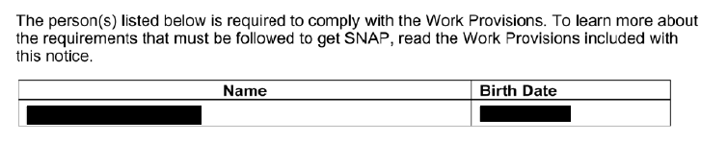
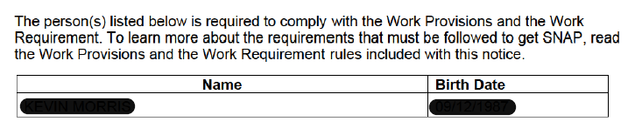
I requested an exemption from the SNAP Work Requirements. How can I tell if it was approved?
This is tricky! DHS will not send notices specifically stating whether an exemption was approved. But there is some information in Manage My Case that can help.
  Look in notices for a “Work Rules” notice. But, it is not yet clear whether not having a notice means you have an exemption.
  Have you received SNAP for more than 3 months after your request?
Notes:
[Sources]
2025_06 SHPA ABE and MMC.pdf

Slide 41
Questions?
Gwynne Mashon
gmashon@legalaidchicago.org

