Slide 1
Illinois Dept of human services
Benefits for immigrants
07.2026

Slide 2
A few other things Before we get started
Ask questions at any time!
Today’s focus is on immigration requirements.
  To receive benefits, households must also meet other financial and nonfinancial requirements.
  This training assumes participants have at least some basic knowledge of IDHS food, medical, and cash assistance programs.
Information included in this training includes the most up-to-date information I have. Many situations are fluid. I will do my best to note place of uncertainty as we proceed through the training.
I do not have expertise in immigration law.

Slide 3
Agenda
Preliminary Issues
Public Charge
Data Security
Eligibility by status
RRP Cash
HBIA/HBIS
AATV Medical
VTTC Food and Cash
VAWA Medical and Cash
Emergency Medical
Mixed Status Families
Deeper dive into programs specifically for non-citizens
Medicaid, SNAP and TANF
Recent and upcoming changes
State-funded programs

Slide 4

Public charge
Situation is Fluid
Public charge is an immigration rule that can prevent certain immigrants from obtaining Legal Permanent Residency Status.
Under U.S. immigration law, a public charge is an individual who is likely to become primarily dependent on the government for subsidence.
Section 212(a)(4) of the INA, 8 U.S.C. 1182(a)(4), provides that any alien who applies for a visa, admission, or adjustment of status is inadmissible if he or she is likely at any time to become a public charge.
The public charge ground of inadmissibility, therefore, applies to aliens applying for a visa to come to the United States temporarily or permanently, for admission at or between ports of entry, and for adjustment of status to that of a lawful permanent resident. No one factor serves as the sole criterion for making a public charge inadmissibility determination.

Slide 5
Current state of Public charge
Situation is Fluid
For those residing in the US, Public Charge only matters for those apply for Legal Permanent Residency.
Receiving public benefits for other household members does not count
  Parent receiving child-only TANF for their children is not considered for Public Charge
Public Charge rules do not apply to recipients of humanitarian relief (U Visa, T Visa, Asylum, VAWA, etc.)
Limits on what kinds of public benefits might be considered:
SSI
TANF
Medicaid long-term care
If someone is concerned about public charge, they should consult an immigration attorney.

Slide 6
Public charge: changes expected 9/18/26
Situation is Fluid
NOT Changing
WHEN public charge matters: Only when adjusting to Legal Permanent Resident status (for people already residing in the United States)
What IMMIGRANT CATEGORIES are exempt: This includes Refugees, asylees, Temporary Protected Status(TPS) applications, T-Visa, U-Visa, and VAWA Most of those not exempt are seeking status via family or employment
What would change:
WHAT benefits are considered: Immigration officers should consider “any and all public benefits funded by the government for which eligibility is determined by assessing whether the alien’s means are below a specified level.” For example. But not limited to: Medicaid, including CHIP or Moms and Babies SNAP, WIC, School Lunch Housing programs Tax credits Childcare, early education, child development programs Basic income programs
WHOSE benefits are considered: Includes benefits the individual receives for themselves, AND any benefits received by someone they are legally obligated to support.
If someone is concerned about public charge, they should consult an immigration attorney.
https://www.federalregister.gov/documents/2026/07/20/2026-14539/public-charge-ground-of-inadmissibility
https://pifcoalition.org/toolkits/public-charge-regulation/
https://docs.google.com/document/d/1LZw7fnOOAwViORiLv-K18t3ZaYKPjFko3JEwSVdgUv8/edit?tab=t.0

Slide 7
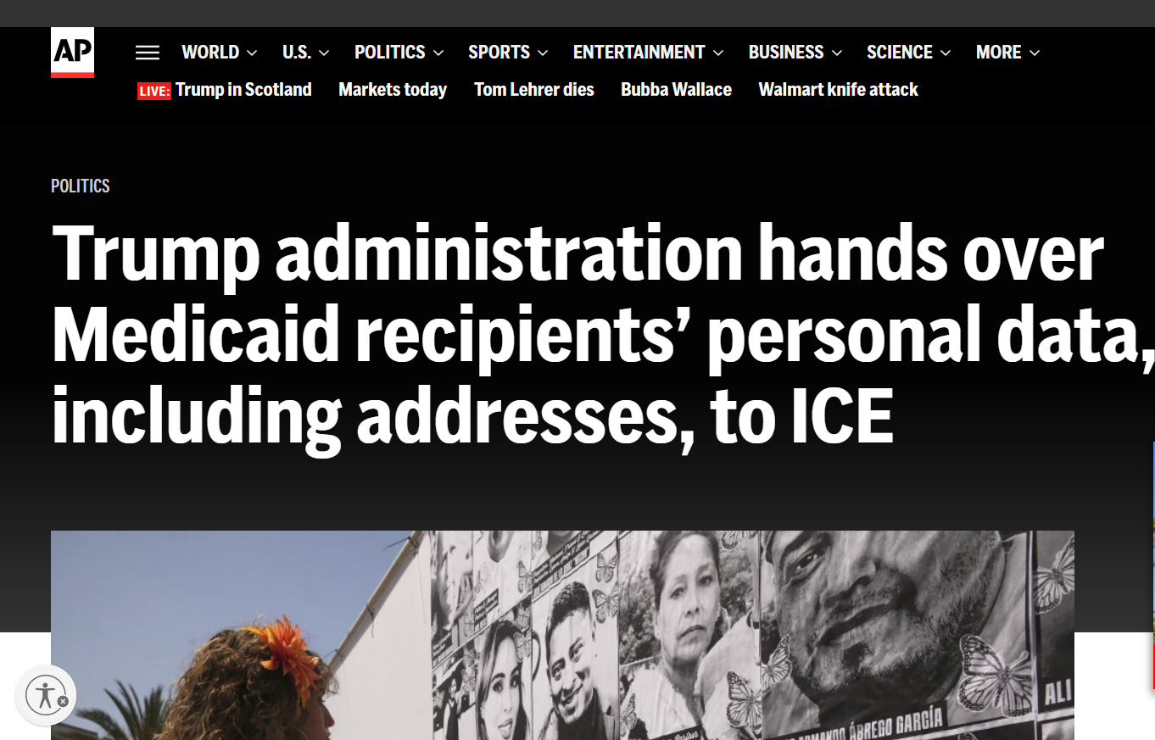
Data security: Medicaid
Illinois has joined a coalition of other states in lawsuit challenging this data sharing: State of California v. US Department of Health and Hospital, 3:25-cv-05536 in Us District Court for the Northern District of California.
Kinds of information we believe was shared:
Names
Birthdates
Addresses
Immigration status
Claims and benefits history (including types of services received)
As of 8/12/25, judge agreed to preliminary injunction stopping current and future data sharing until either (1) the full case could be heard or (2) administrative rulemaking process properly implemented.
https://apnews.com/article/immigration-medicaid-trump-ice-ab9c2267ce596089410387bfcb40eeb7

Slide 8
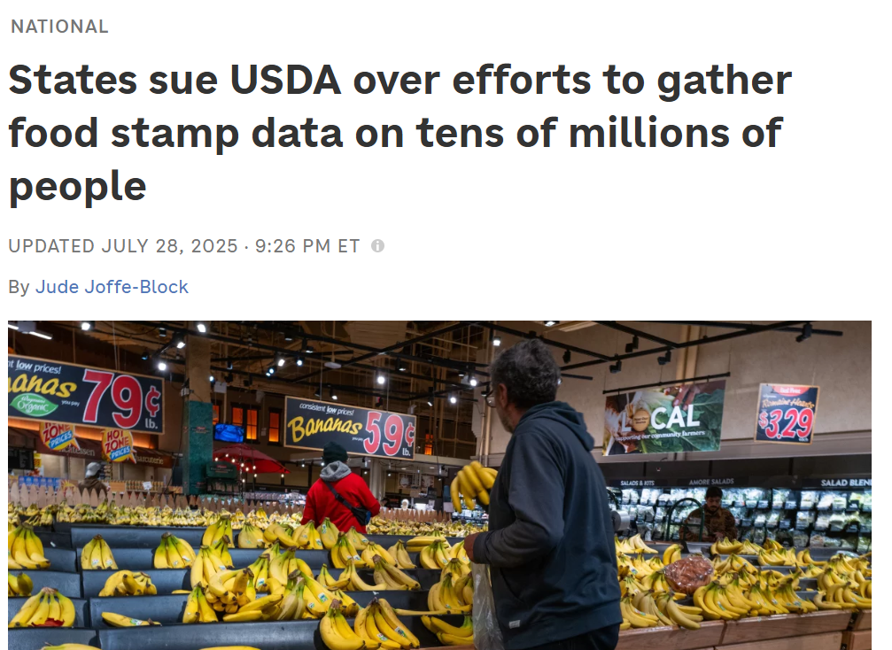
Data security: SNAP
USDA originally gave states and EBT vendors until July 30th to produce data on anyone who even applied for SNAP since 1/1/20. They asked for data such as:
Names
Addresses
Social Security numbers
Citizenship status
Benefits received
IL has joined 21 other states in a suit challenging this demand in the US District Court for the Northern District of CA, Case No. 3:25-cv-06310.
Temporary restraining order signed 9/18/25 for plaintiff states (except NE). Hearing on preliminary injunction was 10/8/25.
https://www.npr.org/2025/07/28/nx-s1-5482842/snap-usda-privacy-lawsuit

Slide 9
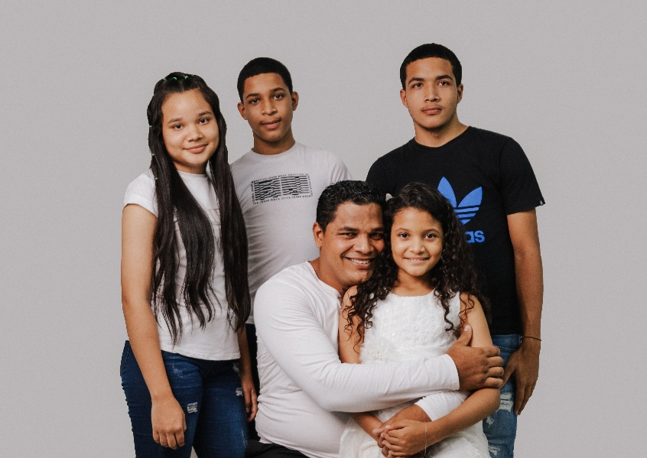
Data security: tanf
US Administration of Children and Families is proposing a rule that would allow the agency to send state TANF data to the Department of Homeland Security.
The kinds of data that could be shared is extensive
Data shared would not be limited to mixed-status families
View Proposed Rule: https://www.regulations.gov/docket/ACF-2026-0727/document
The proposed rule is open for public comment until August 11, 2026

Slide 10
So, who is eligible?
First, we will look at what has changed for SNAP and what is soon changing for Medicaid
Second, we will give an overview of who is eligible for what programs
Third, we will dive deeper into programs specifically for non-citizens

Slide 11

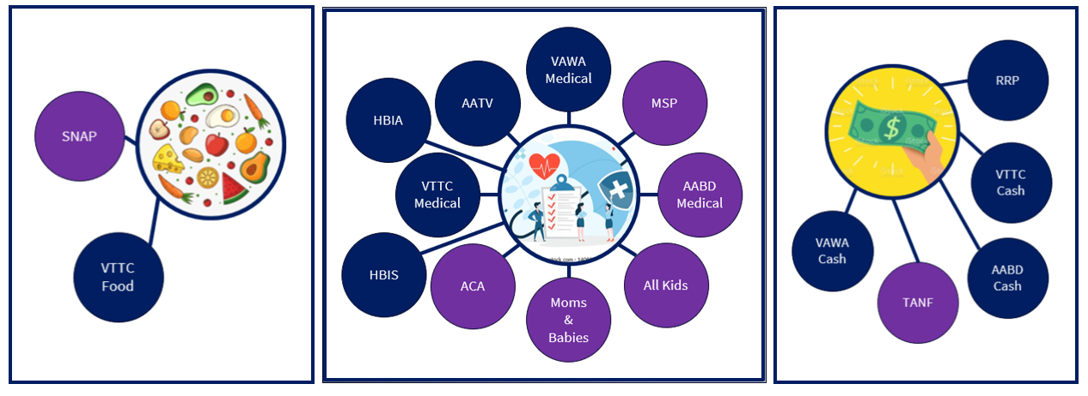
A few other things Before we get started
Food Assistance
Issued on LINK card; only for purchasing food (usually only unprepared food)
Medical Assistance
All but MSP: pays for doctor’s visits, hospital stays, prescription drugs
Cash Assistance
Issued on LINK card or direct deposit; can be used for nearly any purpose
Why this matters:
HR1 is a FEDERAL rule change so it can only impact programs that are federally funded
Note before we proceed:
We could not include all immigrant categories in this presentation. If a category is not listed, we recommend reviewing rules (or email Gwynne) with questions.

Slide 12
Non-citizens Eligible for SNAP as of 4/1
5-year bar exception based on Categories:
Under age 18;
Blind or disabled;
U.S. Veterans, or active-duty member, or their dependents;
Credited with 40 qualifying quarters, see PM/WAG 03-01-03-f;
Non-citizens who were age 65 on 08/22/1996 or prior, and legally residing in the United States.
5-year bar exceptions based on prior immigration status:
Refugee;
Asylee;
Deportation was withheld under section 243(h) or 241(b)(3) of the Immigration and Nationality Act (INA);
Victim of trafficking, or the minor child, spouse, parent, or sibling of the trafficking victim identified by the federal Office of Refugee Resettlement (ORR);
Iraqi or Afghan immigrants with special immigrant status under Section 101(a) (27) of the INA;
Afghan immigrants granted Humanitarian Parole between 07/31/2021 and 09/30/2023; or
Ukrainian immigrants granted Humanitarian Parole between 02/24/2022 and 09/30/2024.
Certain American Indians born in Canada, see PM 03-01-03-b;
Amerasians from Vietnam, and their close family members, admitted through the Orderly Departure Program beginning on 03/20/1988;
Hmong or Highland Laotian Tribe Members;
Cuban-Haitian Entrants admitted on or after 04/21/1980;
People who reside lawfully in the United States under COFA;
Lawful Permanent Residents (LPRs) who have lived in the U.S. for at least 5 years as an LPR, with these exceptions:
Sources: P.L. 119-21 (H.R.1); 8 U.S.C. 1612(a), 1613; 7 C.F.R. 273.4
IDHS PM 03-01-02: https://www.dhs.state.il.us/page.aspx?item=13098
Policy Memo 3/31/26, Changes to SNAP Eligibility for Certain Non-Citizens: https://www.dhs.state.il.us/page.aspx?item=175231

Slide 13
Non-citizens Eligible for Medicaid starting 10/1
5-year bar exception based on Categories:
Under age 18;
Blind or disabled;
U.S. Veterans, or active-duty member, or their dependents;
Credited with 40 qualifying quarters, see PM/WAG 03-01-03-f;
Non-citizens who were age 65 on 08/22/1996 or prior, and legally residing in the United States.
5-year bar exceptions based on prior immigration status:
Refugee;
Asylee;
Deportation was withheld under section 243(h) or 241(b)(3) of the Immigration and Nationality Act (INA);
Victim of trafficking, or the minor child, spouse, parent, or sibling of the trafficking victim identified by the federal Office of Refugee Resettlement (ORR);
Iraqi or Afghan immigrants with special immigrant status under Section 101(a) (27) of the INA;
Afghan immigrants granted Humanitarian Parole between 07/31/2021 and 09/30/2023; or
Ukrainian immigrants granted Humanitarian Parole between 02/24/2022 and 09/30/2024.
Certain American Indians born in Canada, see PM 03-01-03-b;
Amerasians from Vietnam, and their close family members, admitted through the Orderly Departure Program beginning on 03/20/1988;
Hmong or Highland Laotian Tribe Members;
Cuban-Haitian Entrants admitted on or after 04/21/1980;
People who reside lawfully in the United States under COFA;
Children under 19*;
Pregnant Individuals*;
Lawful Permanent Residents (LPRs) who have lived in the U.S. for at least 5 years as an LPR, with these exceptions:
* Technically, HR1 also eliminated immigrant eligibility for these categories too; but since IL uses a special federal waiver to provide medical to all children and pregnant people, eligibility for these programs
Is effectively unchanged from the point of view of those receiving benefits.
Sources: P.L. 119-21 sec. 71109; Soc. Sec. Act sec. 1903(v)(5), 42 U.S.C. 1396b(v); 8 U.S.C. 1613
CMS SHO #26-001 (4/8/26): https://www.medicaid.gov/federal-policy-guidance/downloads/sho26001.pdf
IDHS Action Memo 7/14/26, H.R.1 Noncitizen Medicaid Changes: https://www.dhs.state.il.us/page.aspx?item=179441

Slide 14
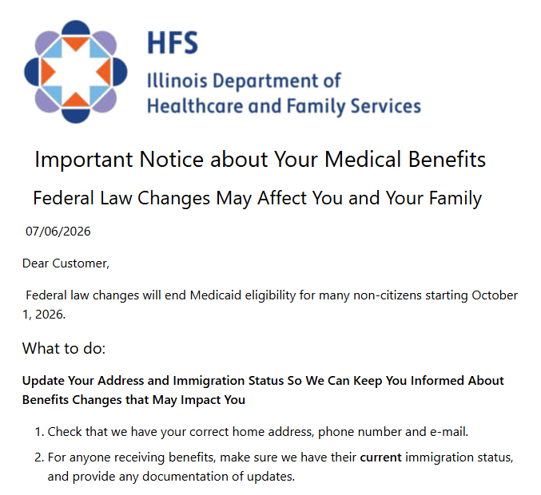
Non-citizens Eligible for Medicaid starting 10/1
What you can do:
If status has changed, update DHS.
Make sure DHS/HFS has the most up to date contact information
If you believe your Medicaid will stop in October:
  Discuss with your current health providers:
    Move up treatment
    Refill prescriptions
    Alternative payment accepted
  Explore alternative providers
Sources: P.L. 119-21 sec. 71109; 42 U.S.C. 1396b(v); CMS SHO #26-001: https://www.medicaid.gov/federal-policy-guidance/downloads/sho26001.pdf
IDHS Action Memo 7/14/26, H.R.1 Noncitizen Medicaid Changes: https://www.dhs.state.il.us/page.aspx?item=179441
HFS Immigrant Eligibility for Medicaid FAQ: https://hfs.illinois.gov/medicalclients/healthbenefitsforimmigrants/immigrantelformedfaq.html

Slide 15
Potential eligibility for Federal Programs:
SNAP, TANF, Medicaid (Current)
*Must meet all other financial and non-financial program requirements
US Citizens
SNAP
Legal Permanent Residents (“LPR”) who have met 5 year waiting period or meets exception
VAWA recipients who have met 5 year waiting period (from date on prima facie letter)
Other Children under 19 & Pregnant/Post Partum Women (up to 12 months)
Emergency Medical only
None
None
Medicaid
SNAP
TANF
TANF
Medicaid
None
TANF
Refugees and Asylees, T-Visa holders
Medicaid
Medicaid
SNAP
TANF
Cuban/Haitian Entrant
Medicaid
None
TANF
Medicaid
None
None
None of these, then most likely

Slide 16
Potential eligibility for Federal Programs:
SNAP, TANF, Medicaid (starting 10/1/26)
*Must meet all other financial and non-financial program requirements
US Citizens
SNAP
Other Children under 19 & Pregnant/Post Partum Women
(up to 12 months)
Legal Permanent Residents (“LPR”) who have met 5 year waiting period or meets exception
VAWA recipients who have met 5 year waiting period (from date on prima facie letter)
None of these, then most likely
Emergency Medical only
None
None
Medicaid
SNAP
TANF
TANF
None
None
TANF
Medicaid
None
None
Medicaid
Medicaid
SNAP
TANF
Cuban/Haitian Entrant
Refugees and Asylees, T-Visa holders
None
None
TANF

Slide 17

Potential eligibility for state Programs: aatv, vttc, rrp, vawa (major categories)
*Must meet all other financial and non-financial program requirements
NOTE:
If eligible for a federally-funded program, will get that benefit.
Refugees
VTTC (only if they have derivative family members)
T-Visa Holders (note that LPR here is eligible for federal)
VAWA (has prima facie letter)
U-Visa Applicants, Holders, LPR pursuant to U-Visa
None of these (including Refugees and other losing federal SNAP eligibility)
HBIS or Emergency Medical only
None
None
VAWA State Medical
None
VAWA State Cash
VTTC (only if they have derivative family members)
AATV
VTTC
VTTC
None
VTTC
TANF
AATV
Those ineligible for SSI only because of the 7-year limit might be eligible for AABD Cash.
None
VTTC (only if they have derivative family members)
TANF, RRP
Asylum Applicants
T-Visa Applicants
AATV
VTTC
VTTC
Asylees (note that LPR here is eligible for federal without 5 year wait)
None
None
RRP

Slide 18
Refugee resettlement program (RRP)
Who?
Refugees who do not meet the requirements for SSI, TANF, or AABD Cash
Refugee, Asylee, and Conditional Entrant
Certain other immigrants. See PM 03-01-02-d.
Requirements:
Similar to TANF except no requirement for a related dependent minor child
Work registration, with some exceptions
Limited to 4 months …
After date asylum was granted, or
After trafficking victim identified by ORR
After date of entry into the U.S. for all others
Benefit Amount:
Aligns with TANF
Does not qualify for non-financial TANF services
As of 6/11/2025, benefits limited to 4 months after the date of entry to the US (refugees) or 4 total months (asylees) or 4 months since identified by ORR (Trafficking victims)
PM 06-01-00

Slide 19
HBIA/HBIS
Health Benefit Coverage for Immigrant Seniors
Aged 65+ that do not otherwise qualify for Medicaid because of immigration status and are not Legal Permanent Residents
Modeled after AABD Medicaid
Household definition
Income limits: Under 100% FPL
Asset limits: Under $17,500
Spenddown is available – for now.
Does not cover Long-term care
Health Benefits Coverage for Immigrant Adults
Aged 42-64 that do not otherwise qualify for Medicaid because of immigration status
Modeled after ACA Medicaid
Household definition
Income limits
Enrollment paused since 11/6/2023
HBIA Closure: https://www.dhs.state.il.us/page.aspx?item=172250
HBIS Pause: https://www.dhs.state.il.us/page.aspx?item=151860

Slide 20
Medical Benefits for Asylum Applicants and Torture Victims (AATV)
Who?
Receiving services through a federally funded torture center
Has applied for T Visa, U Visa, or Asylum (including applications in appeals)
U-Visa Holder
Starting 10/1/26, T-Visa holders and asylees
Derivative family members on T-Visa, U-Visa, or Asylum application
Other non-financial requirements
IL Resident
Does not qualify for federally-funded medical programs
Pregnant/Post-partum
Children under 19
PM 06-21

Slide 21
Medical Benefits for Asylum Applicants and Torture Victims (AATV)
Financial Requirements
Countable income under 100% FPL (AABD Medical rules)
Time Limits
Continuous during T-Visa, U-Visa, or asylum application and appeals
Non-exempt resources under the AABD Resource rules
Not eligible for Spenddown, Long Term Care, or Department of Aging Services
U-Visa eligibility continues until they are eligible for federal benefits
Others limited to 24 months
PM 06-21
Manual Release 06.01.2026: https://www.dhs.state.il.us/page.aspx?item=177117

Slide 22
Non-Citizen Victims of Trafficking, Torture, or Other Serious Crimes (VTTC)
U-Visa: Waiting for a decision on a U-Visa application, U-Visa holders, LPR for obtained status via U-Visa
Asylum: Waiting for a decision on Asylum application
T-Visa: Waiting for decision on T-Visa application
  Includes family members listed as derivatives on immigration application:
    Parents, Children and siblings under 18
    Spouses can’t get VTTC benefits unless the marriage happened before the main VTTC applicant came to the U.S.
7.2.25 Memo: https://www.dhs.state.il.us/page.aspx?item=173308
7.2.26 Memo: https://www.dhs.state.il.us/page.aspx?item=179520

Slide 23
VTTC FOOD
Only approved so long as funding is available.
Financial Factors | Non-Financial Factors
Aligns with SNAP | Aligned with SNAP; SSN requirement is waived Asylum applicants and asylees only must have derivative family member of immigration application
Benefit unit includes all individuals who buy and prepare food together
Benefit amount based on all income received and certain expenses, especially rent and childcare
Current Max Benefits
Household Size | Max Benefit | Gross Countable income limit (No “qualifying member”; most VTTC households) | Gross Countable income limit (with “qualifying member”)
1 | $298 | $2152 | $2608
2 | $546 | $2909 | $3525
4 | $994 | $3665 | $4441
Policy Memo 2/21/18, Cash and Food Assistance for Non-Citizen VTTC: https://www.dhs.state.il.us/page.aspx?item=102017
Policy Memo 10/8/24, VTTC Eligibility Changes (P.A. 103-0588): https://www.dhs.state.il.us/page.aspx?item=165057
Policy Memo 7/2/25: https://www.dhs.state.il.us/page.aspx?item=173308

Slide 24
VTTC FOOD
Only approved so long as funding is available.
Financial Factors | Non-Financial Factors
Aligns with SNAP | Aligned with SNAP; SSN requirement is waived Asylum applicants only must have derivative family member of immigration application
Work Requirements
  VTTC Food recipients must comply with SNAP Work Requirements unless “physical or psychological trauma related to or arising from the trafficking, torture, or other serious crimes impedes his or her ability to comply.”
  SNAP Work “Provisions” have been consistently enforced over the last year.
  Time-Limited SNAP “Requirements” went into effect in Illinois February 1, 2026.
  If someone thinks they are exempt, they should make sure DHS knows now through the same process IDHS is using for SNAP work requirement exemptions.
VTTC: https://www.dhs.state.il.us/page.aspx?item=102017 | https://www.dhs.state.il.us/page.aspx?item=165057
SNAP Work Rules (PM 03-15-00, PM 03-16-00) - MR #26.03 (2/4/26): https://www.dhs.state.il.us/page.aspx?item=174187
Policy Memo 10/16/25, End of Waiver for Time-Limited SNAP Benefits: https://www.dhs.state.il.us/page.aspx?item=175082

Slide 25
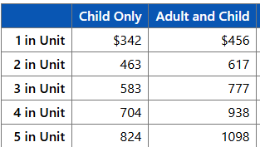
VTTC cash
Only approved so long as funding is available.
Financial Factors | Non-Financial Factors
Aligns with TANF | Aligned with TANF or RRP, respectively; SSN requirement is waived; child support cooperation requirement is waived Asylum applicants only must have derivative family member of immigration application (T-Visa holders and asylees are generally ineligible for VTTC Cash because they remain eligible for TANF.)
For VTTC (TANF), must have a dependent minor child.
If ineligible for VTTC (TANF), might be eligible for VTTC (RRP) (max 4 months.)
Each adult must sign the application.
All nonexempt adults under 60 years old must register for work with a refugee job placement agency, or other job service. Exemptions:
  Child in case
  Medical condition prevents from working
  Needed for care of another person in home due to their medical condition
  Provides child are to child under 1
  Employed > 30 hours/week
Benefit amount based on all income received
Current Max Benefits
VTTC Eligibility Changes 10/8/24: https://www.dhs.state.il.us/page.aspx?item=165057
PM 06-01-00 RRP (Cash): https://www.dhs.state.il.us/page.aspx?item=13721

Slide 26
VAWA CASH/Medical
Who?
Individual who has filed a formal petition for relief under VAWA and the petition is in pending or approved status as verified in SAVE, who does not yet meet immigration requirements for federally-funded benefits
Requirements:
Aligns with TANF and ACA or AABD Medicaid rules (Depending on age/disability)
Limitations:
Eligibility ends if VAWA petition is denied or person becomes eligible for federally-funded benefits
4/25/25 Memo: https://www.dhs.state.il.us/page.aspx?item=171026

Slide 27
Emergency medical
Requirements
Children under 19 qualify are ineligible
Pregnant women are ineligible
IL resident.
Those coming to Illinois for purpose of receiving medical care
What it covers
Placing individual’s health in serious jeopardy
Serious impairments to bodily functions
Serious dysfunction of any organ or part
Requires emergency medical services
Doctor must verify emergency in writing
Only medical services required to stabilize the emergency; so there are no longer acute symptoms
Income/asset limits
The following non-immigrant visa classes do not qualify: B (temporary visitor), C (alien in transit), D (crew member of vessels), TWOV (transit without visa)
Does not meet citizenship/immigration requirements for other Illinois medical assistance programs
Emergency medical services required as a result of a medical condition with acute symptoms that are severe enough that, without immediate medical attention, a physician could reasonably expect the condition to result in:
Sources: 8 U.S.C. 1611(b)(1)(A); 42 U.S.C. 1396b(v)(2)-(3)
PM 06-05-01: https://www.dhs.state.il.us/page.aspx?item=13826 | PM 06-05-02: https://www.dhs.state.il.us/page.aspx?item=13828
PM 06-05-03: https://www.dhs.state.il.us/page.aspx?item=13830 | IDHS Emergency Medical Coverage for Noncitizens: https://www.dhs.state.il.us/page.aspx?item=19608

Slide 28
Mixed status
Adults and Children can receive all joint federal-state or state-only funded benefits they are eligible for, even if other people they live with are ineligible
Benefit Unit
Remember that every benefit has its own rules for how to determine who is in the benefit unit. Sometimes, the definition of who is in the benefit unit is different for different family members.
If someone does not meet the immigration requirement, then they are not counted in the benefit unit size for determining eligibility or benefit amounts.
SNAP Benefit Unit:
Generally, Spouses and minor children who live together + anyone who lives with and buys and prepares food with them
TANF Benefit Unit:
Generally: Minor child and relative caretaker + spouses and minor children who live with them
Medical Benefit Unit (if over 65 or receiving Medicare):
Generally: Spouses and minor children who live with them
Medical Benefit Unit (others):
Generally: Based on tax filing units
PM 03-01-00: https://www.dhs.state.il.us/page.aspx?item=13092 | PM 03-01-02: https://www.dhs.state.il.us/page.aspx?item=13098
IDHS Noncitizen Eligibility Changes (SNAP): https://www.dhs.state.il.us/page.aspx?item=177780

Slide 29

Mixed status
Adults and Children can receive all joint federal-state or state-only funded benefits they are eligible for, even if other people they live with are ineligible
If ineligible parent or spouse who lives in the household has income, prorate across the family to determine how much of the income is countable income
If a family member living in the home is not a parent or spouse to someone in the benefit unit, their income usually should not be counted.
Income
Parent #1 LPR <5 years, $2100/month gross earned income
Parent # 2 US Citizen, no income
Countable gross income = ($2100/3 family members * 2 eligible members) = $1400/month earned income
Prorated share budgeting for ineligible non-citizens: 7 C.F.R. 273.11(c)(3); PM 03-01-02: https://www.dhs.state.il.us/page.aspx?item=13098
IDHS Noncitizen Eligibility Changes (SNAP): https://www.dhs.state.il.us/page.aspx?item=177780

Slide 30

questions
Gwynne Kizer Mashon
gmashon@legalaidchicago.org
https://legalaidchicago.org/public-benefits-training-materials/

