Slide 1

SNAP Work Requirements:
Navigating Requirements and What to do if you can’t meet them
Gwynne Kizer Mashon
gmashon@legalaidchicago.org
Last updated 04/03/2026

Slide 2



Children & Families
Consumer
Legal Aid Chicago is a private non-profit that provides free civil legal services to people with limited income in Cook County, securing their rights to economic stability, affordable housing, personal safety, fair working conditions, and basic healthcare.
Criminal Records
Relief
Public Benefits
Long-Term Care
Immigrants & Workers’
Rights
Housing

Slide 3
Learning objectives
Updated Info on Exemptions/Exemption Requests
  Who is Exempt
  Getting exemptions
What if I’m not exempt?
  Meeting the work requirement
  Reporting Requirements
  Good Cause for Not Meeting
What happens if DHS is stopping or has stopped by benefits?
  Notices
  Options for Reinstatement

Slide 4
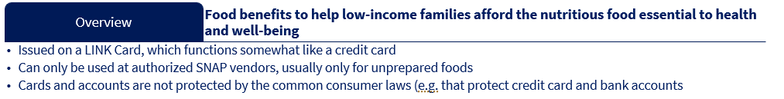
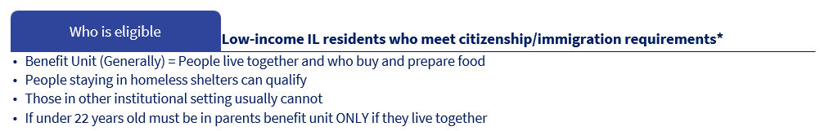
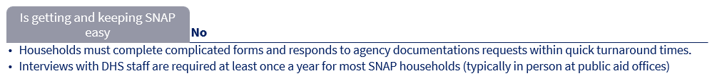
What is Snap?
* HR1 also eliminated SNAP eligibility for many legally-present immigrants.
We will not discuss those changes in today’s training.

Slide 5
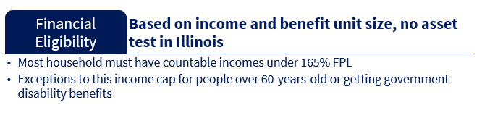
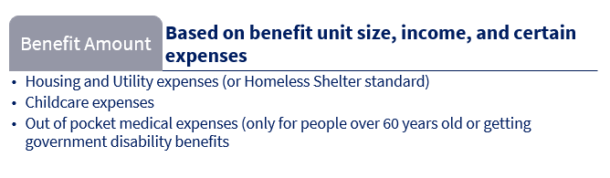
What is Snap?
“Benefit Unit” size | maximum gross countable monthly income | Maximum monthly SNAP
1 | $2,152 / $2,608 | $298
2 | $2,909 / $3,525 | $546
3 | $3,665 / $4,441 | $785
4 | $4,421 / $5,358 | $994

Slide 6
Why are work requirements happening?
HR1 made significant changes to federal rules SNAP and Medicaid, reducing federal investment in the programs. This forced the Illinois Department of Human Services to change its rules. It is expected that many Illinois residents will lose benefits. But we can help mitigate the harm to the people we serve.
General Timeline of SNAP/Medicaid Eligibility Changes in Illinois
2025
2026
2027
4/1: SNAP Noncitizen Eligibility Changes Begin
1/1: Medicaid Work Requirements Begin (might be extended) for adults (only if under 65 and not disabled); Reduced Retro Coverage (1-2 months); 6-Month Redeterminations; New address verification requirements
HR 1 passed by US Congress, signed by Trump
10/1: Medicaid Noncitizen Eligibility Changes Begin
IDHS implements 6-month redetermination and new shelter costs reqs
2/1: SNAP Time Limited Work Requirements begin, with terminations & denials starting 5/1
HR 1 requires states to use less federal and more state funding (mostly the taxes we pay), to support programs, with funding contingent on “error rates” for SNAP. As a result, we expect on-going changes to both these and the state look-alike programs.

Slide 7

Time-Limited SNAP/Work Requirements
This is a limit on how much SNAP an individual can receive.
Also referred to as:
“Time Limited Work Requirements” or
“Able-Bodied Without Dependents”
or “ABAWD”
Under federal SNAP rules, “able-bodied adults without dependents*” (ABAWDs) are limited to only 3 months of SNAP in a 36-month period unless they engage in “work activity” for at least 80 hours per month.
“Work Activity” includes:
Work (paid or unpaid), or
Volunteering/Community Service;
Comply with official IDHS SNAP Employment and Training activities, or
Any combination of the above
* Term is somewhat misleading. Prior to HR 1, SNAP families with minor children were exempt from the work requirements. HR 1 eliminated this exemption for many families.

Slide 8
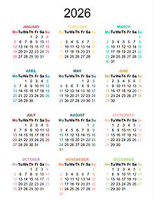
Time-Limited SNAP/Work Requirements
Current 3-year period: February – December 2026
Next 3-year period: January 2027 – December 2029
For any month that someone receives SNAP, they will get a “strike” only if:
They received SNAP for the full month and
2. All of the following are true:
They are not exempt from the SNAP Work Requirement, and
They did not meet the SNAP Work Requirement, and
They did not have Good Cause for not meeting the SNAP Work Requirement.
SNAP stops when someone accumulates 3 strikes.
It does not matter if strikes are consecutive.
DHS will only know if someone is exempt, meeting, or has good cause if the person receiving SNAP tells them.

Slide 9

Want to keep getting SNAP?
If you haven’t already, before the end of April you should:
Automatically exempt?
You shouldn’t need to do anything
Possibly Exempt?
Request exemption (self- attestation accepted)
Meet and report
Find activities
Get proof
Report
Keep an eye out for notices stopping SNAP. If you get one, you’ll need to act quickly to keep your benefits.

Slide 10
exemptions
If you are “exempt”, that means SNAP Work requirements do not apply to you.
Many SNAP recipients who could be exempt still need to act!
Protects on-going benefits
Reduces reporting requirements
Reduces change of errors

Slide 11
exemptions
“Auto-exempt” = Exemptions DHS probably already knows:
Under 18 years old, or
over 65 years old, or
Living in a SNAP household with a child under 14 years old, or
Receiving SSI or SSD benefits, or
Subject to (and compliant with) TANF work requirements, or
Receiving unemployment benefits.
Age
Other Benefits

Slide 12

exemptions
People in these categories need to tell DHS that they fit into these categories.
Exemptions IDHS only knows about if you have told them:
Alaskan Native, American Indian, American Urban Indian, or California Indian
Main caretaker of an incapacitated or disabled person
Main caretaker for someone under 6 who lives outside the home
Enrolled in a drug or alcohol treatment program (not AA or NA)
Applied for unemployment benefits
Pregnant

Slide 13
exemptions
People in these categories need to tell DHS that they fit into these categories.
Exemptions IDHS only knows about if you have told them:
Unfit for work
Enrolled in a school or training program at least half time
Working and earning at least $935/month (gross)
Mental/Physical/Cognitive Conditions do not need be so severe they meet SSA’s definition of “disability”
Includes temporary conditions
Could include need to engage in Domestic Violence or Homeless Services because of conditions
Generally, people enrolled in college at least half time are not eligible for SNAP. There are exceptions to this general role – e.g. engaged in work study, taking care of a small child, meeting a separate work requirement. See PM 03-04-03.
Note that this is an exemption!
If an individual has more than $935/month gross income reported to DHS, they do not have to engage in work activity 80 hours per month to keep SNAP benefits.

Slide 14
exemptions
People in these categories need to tell DHS that they fit into these categories.
Exemptions IDHS only knows about if you have told them:
Chronically homeless
Homeless
Lacks a fixed and regular nighttime residence or if their main nighttime residence is:
a supervised shelter that provides temporary accommodations; or
a halfway house or similar facility that provides temporary residence for persons intended to be institutionalized; or
a place not normally recognized as a place to sleep (a hallway, bus station, library, car, etc.); or
a temporary stay in the residence of another person. Persons are considered homeless for no more than 90 days when they are residing temporarily in the home of another person.
Chronically Homeless
To be considered chronically homeless, an individual must:
“Homeless” for the last 6 months or more than once in the last 12 months; and
have a diagnosable substance use disorder, serious mental illness, developmental disability, post traumatic stress disorder, cognitive impairments resulting from a brain injury, or chronic physical illness or disability.
“Homelessness, even if it does not meet the definition of chronically homeless, is also an indicator that an individual may be facing physical or mental barriers to work.”
- DHS Policy Memo 2/4/26

Slide 15
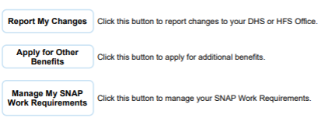

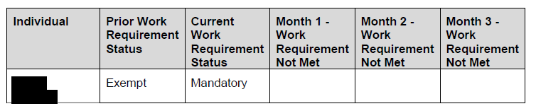

exemptions
Check online on Manage My Case.
Button will only appear if someone in household
is not exempt. Click to see who.
Ask at local IDHS Office
How can I tell if I am exempt?
Look for this notice sent in January or,
if application or redetermination was recent,
after that application.
Call DHS Hotline: 1-800-843-6154

Slide 16

exemptions
Check online on Manage My Case. *
Click “Manage My SNAP Work Requirements”
Ask at local IDHS Office
(Family Community Resource Center - Finder)
How do I request an exemption?
Submit Self-Attestation or other Proof
to DHS *
Call DHS Help Line at 1-800-843-6154
Mon-Fri 8:30 am - 5:00 pm
* More details on the next slides

Slide 17
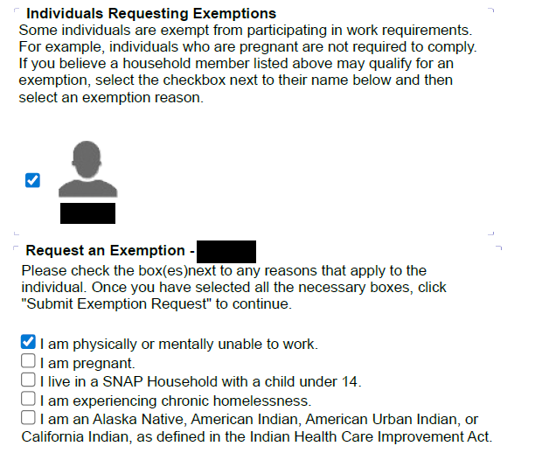

exemptions
Check online on Manage My Case.
Click “Manage My SNAP Work Requirements”
You will get an option to download a pdf of your request. We strongly suggest you print and save a copy.

Slide 18
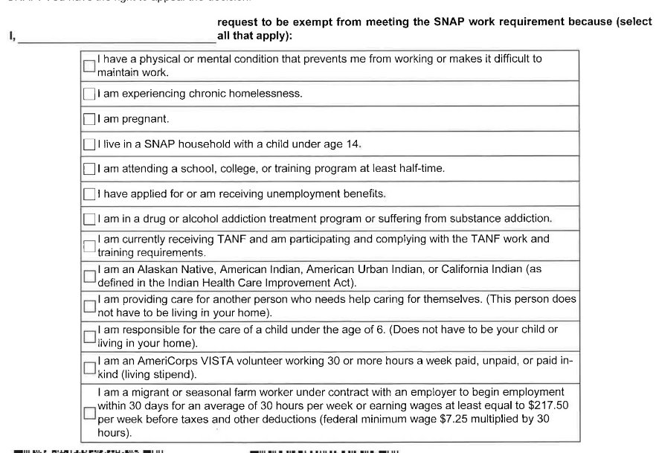
Self-Attestation Form
exemptions
Submit Self-Attestation or other Proof to DHS
Complete what is asked.
Do not write extra information or explanations on the form.
Submit to DHS
Upload to MMC
Fax to DHS
Submit in Person
Self-Attestation Form: https://www.dhs.state.il.us/onenetlibrary/12/documents/Forms/442341-202508_IES5REV6_RE.pdf

Slide 19
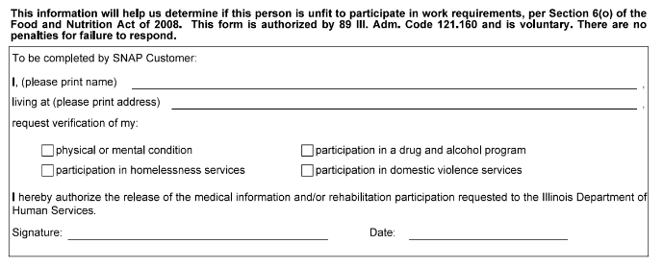
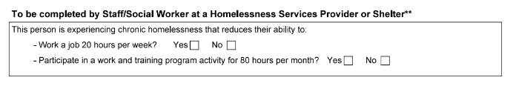
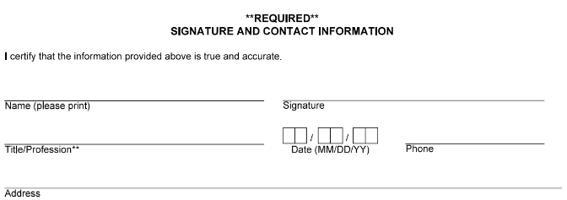
Third-Party Form
exemptions
Submit Self-Attestation or other Proof to DHS
Complete what is asked.
Do not write extra information or explanations on the form.
Submit to DHS
Upload to MMC
Fax to DHS
Submit in Person
Other Evidence
Letters from providers, Letters from family members or others, Medical Records, School Records, Unemployment records, etc.
Third-Party Form: https://www.dhs.state.il.us/onenetlibrary/12/documents/Forms/442340-202508-IES_REV9_RE.pdf

Slide 20
exemptions
How do I prove I qualify for the exemption?
Probably not. But they should tell you if they need additional verifications.
When Does DHS re-evaluate exemptions?
At application,
Redetermination, and
Any time it needs to re-evaluate eligibility (e.g. if you report an income or shelter cost change)
If I have an exemptions (e.g. earning over $935), do I have to tell DHS if I stop qualifying for that exemption?
No. They will re-evaluate at times described here (e.g. if you ask DHS to increase your monthly benefits.)
Will DHS let me know if my exemption request is approved or denied?
DHS should not ask for verification unless there is a “direct contradiction” between your request and other information you provided or information DHS finds through data sharing
If verifications are requested, those requests do not appear in Manage My Case.
FAQs

Slide 21
Meeting work requirement
If you are NOT “exempt”, that means SNAP Work requirements do apply to you.

Slide 22
Meeting work requirement
Work
Volunteer
Training
Those not Exempt are limited to only 3 months of SNAP in a 36-month period unless they engage in “work activity” for at least 80 hours per month.

Slide 23
Meeting work requirement
Includes paid and unpaid work.
Proving compliance:
  Anything that shows the number of hours your worked, for example:
    pay check stubs,
    Self-employment records
    letter from employer, etc.
  NOT
    Bank statements
    Paychecks that do not show hours of work (unless they show you earned over $935 in a month.)
Work
Volunteer
Training

Slide 24
Meeting work requirement
Tips:
We generally recommend submitting a Change Report with proof of work/income.
Keep copies!
Work
Volunteer
Training

Slide 25
Meeting work requirement
Any Volunteer Opportunity
IDHS is developing systems to make it easier for people to find and track activity with volunteer activities
https://www.dhs.state.il.us/page.aspx?item=177800
Proving compliance:
  Anything that shows the number of hours you volunteered: e.g. letter from volunteer organization
  Optional Volunteer Hours form: https://www.dhs.state.il.us/onenetlibrary/12/documents/Forms/442610-202406_IES4-STA_RE.pdf
Tips:
Keep copies!
Work
Volunteer
Training

Slide 26
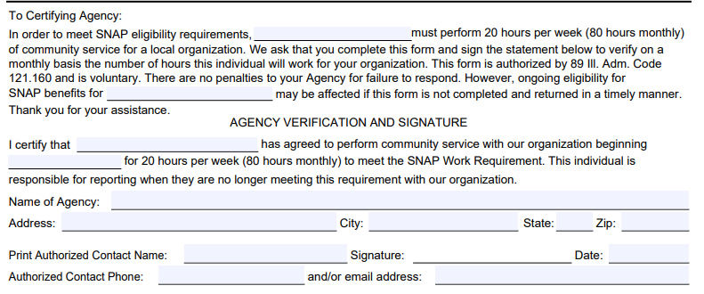
Meeting work requirement
Work
Volunteer
Training

Slide 27
Meeting work requirement
Those subject to the Work Requirement must engage in Work Activity an average of 80 hours/month:
Work
Volunteer
Training
Includes Education and Training.
Training must be through an IDHS approved “Qualified Work Program”
  https://www.dhs.state.il.us/page.aspx?item=177800
    NEW! https://jobreadyil.com/ - online training
  Ask local IDHS office for in-person options
  Education:
    Adult Education programs
    Trade schools
    Continuing education
    Traditional College (with additional requirements)
  Proving compliance:
    Check with E&T Provider; Involvement might be reported directly to IDHS

Slide 28
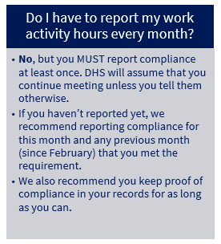
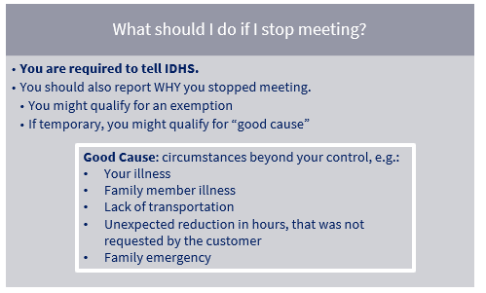
MEETING THE WORK REQUIREMENT
FAQs
Good Cause: circumstances beyond your control, e.g.:
Your illness
Family member illness
Lack of transportation
Unexpected reduction in hours, that was not requested by the customer
Family emergency

Slide 29
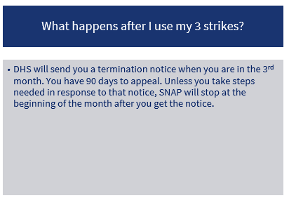
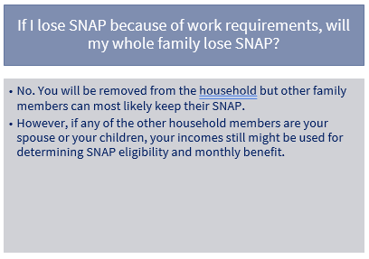
MEETING THE WORK REQUIREMENT
FAQs

Slide 30
What to do if snap stops
There are steps you can take to get the food assistance you need again!

Slide 31
Want to get SNAP Back?
If DHS sends a letter saying your SNAP will stop, or stops your SNAP:
- There IS something you can do
- To protect your SNAP, you might need to act quickly
- There are several ways to get your SNAP back – whether or not it’s already stopped

Slide 32
When snap stops
File Exemption Request
File new application (or program add)
Appeal the termination
You can take one step or all of these steps at the same time.
What steps are best for you will depend on your situation. Next slides includes some things to consider.

Slide 33

I didn’t realize I needed to ask for an exemption and now my SNAP stopped!
You can file a new application and request exemption now.
When snap stops
File Exemption Request
File new application (or program add)
Appeal the termination
Includes situations beyond the person’s control including:
  Illness, or illness of family member
  Household emergency
Those who meet an exemption, can request the exemption at any time.
What about strikes I already have?
Ones you have might stay in place until the 3-year period resets.
Can remove for previous months with “good cause”
If someone’s benefits have already stopped, they also might need to file a new application.

Slide 34
I’m not exempt and now I can never get SNAP again.
No! You should apply again but you might need to wait or take some steps first.
When snap stops
File Exemption Request
File new application (or program add)
Appeal the termination
Anyone who loses SNAP because work requirements can reapply in January 2027, when all strikes reset to ZERO.
You don’t have to wait if you can show you’ve met the work activity requirement for 30 days prior to your new application.
Those reinstated under these rules will get three new “strikes” they can use and keep their SNAP. However, they have to use these strikes in consecutive months.

Slide 35
When snap stops
Was the termination incorrect?
SNAP recipients have a constitutionally protected right to appeal improper terminations. Appeal deadline is 90 days after the notice of decision; earlier deadline if you want continuing benefits.
Examples of situations where administrative appeals might help:
File Exemption Request
File new application (or program add)
Appeal the termination
Meeting
Exempt
No exemption request submitted, but there was good cause for not submitting it
Strikes given for months when work activity requirements was met
regardless of whether that was reported
Exemption submitted before termination but was either never processed or denied; or
When generally recommend people file new applications at the same time they file appeals, if they want benefits moving forward. You might also be eligible for continuing benefits if you file an appeal in time.

Slide 36
Want to keep getting SNAP?
If you haven’t already, before the end of April you should:
Automatically exempt?
You shouldn’t need to do anything
Possibly Exempt?
Request exemption (self- attestation accepted)
Meet and report
Find activities
Get proof
Report
Keep an eye out for notices stopping SNAP. If you get one, you’ll need to act quickly to keep your benefits.

Slide 37
Children & Families
Consumer
Questions?
Gwynne Kizer Mashon
gmashon@legalaidchicago.org
https://legalaidchicago.org/public-benefits-training-materials/
Criminal Records
Relief
Public Benefits
Long-Term Care
Immigrants & Workers’
Rights
Housing

