Slide 1

SNAP: Nuts & Bolts of Navigating SNAP Work Requirements
Gwynne Kizer Mashon
Last updated 01/12/2026

Slide 2








Children & Families
Consumer
Legal Aid Chicago is a private non-profit that provides free civil legal services to people with limited income in Cook County, securing their rights to economic stability, affordable housing, personal safety, fair working conditions, and basic healthcare.
Criminal Records
Relief
Public Benefits
Long-Term Care
Immigrants & Workers’
Rights
Housing

Slide 3


Learning objectives
SNAP Work Requirements
What is required
Exemptions – who is exempted, what do SNAP recipients need to do
What happens if I’m not exempt and don’t meet the requirements?
Immigration Restrictions
Shelter Costs
Verification Requirements and impact of not submitting
Standard Homeless Shelter Deduction
Federal legislation also made changes to the Medicaid program and to Marketplace Insurance. We will not cover those today.
Implementation dates for all provisions are different the soonest changed to Medicaid eligibility is scheduled to go into effect in October 2026.
The situation is still fluid.

Slide 4

Time-Limited SNAP/Work Requirements
General Work Provisions
This is an ELIGIBILITY factor. Failure to comply means the individual is not eligible for any SNAP.
THESE HAVE NOT CHANGED.
Applies to individuals ages 16–59 who are able to work.
Requirements include:
Registering for work (by receiving notice from DHS),
Participating in SNAP Employment and Training (E&T) or workfare if assigned by your state SNAP agency,
Taking a suitable job if offered, and
Not voluntarily quitting a job or reducing your work hours below 30 a week without a good reason.

Slide 5

Time-Limited SNAP/Work Requirements
Work Requirements
This is a limit on how much SNAP an individual can receive.
Also referred to as:
“Time Limited Work Requirements” or
“Able-Bodied Without Dependents”
or “ABAWD”
THESE HAVE CHANGED.
Under federal SNAP rules, “able-bodied adults without dependents” (ABAWDs) are limited to only 3 months of SNAP in a 36-month period unless they meet the SNAP work requirement.
Work (paid or unpaid) an average of at least 20 hours/week, or
Volunteer to take part and comply with SNAP Employment and Training activities, or
Complete an average of 20 hours/week of Community Service, or
Any combination of the above
Illinois has had a state-wide waiver of these federal rules. The waiver will end January 31, 2026.
10/16/25 Policy Memo
*This implementation date has varied since OBBBA was signed; however, we are confident that work requirements WILL go
into effect on 1/31/26.

Slide 6
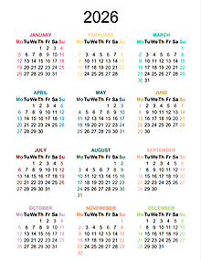


Time-Limited SNAP/Work Requirements
Time-limited SNAP rules go into effect
Work Requirements
The current 3-year period will end December 31, 2026, but will not start until February 1, 2026. (The next 3-year period will run 1/1/2027-12/31/2029.)
We expect anyone subject to, but not complying with, the work requirement will have SNAP benefits cut off at the end of April 2026.
To continue receiving benefits, each SNAP participant must:
Be exempt (and DHS must know they are exempt)
Meet the work requirement (and properly document that with DHS)
Have good cause for not meeting work requirement (and properly document that with DHS)
Will is not
exempt from work requirements.
Will tries to work 80 hrs./month but does not:
January
March
May
July
August
Will’s SNAP stops at the end of July unless he successfully proves exemption or good cause.
Unless he qualifies for reinstatement, he will not be eligible again until January 2027.
Statewide waiver in effect

Slide 7
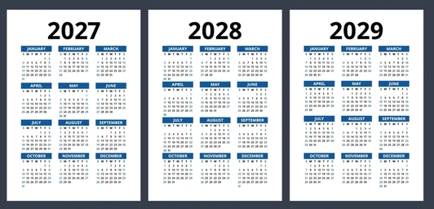
Time-Limited SNAP/Work Requirements
Work Requirements – Next three-year period
Will does not try to get an exemption or argue good cause. His SNAP eligibility ended August 2026 because of work requirement.
He can’t get new work and does not volunteer or participate in SNAP E&T.
Will reapplies in mid-January 2027 and is approved.
- New three-year period = New set of strikes
- Partial month of January doesn’t count
Work stops first week of August 2027. He does not meet the work requirement August, September or November.
SNAP stops at the end of November
Unless he qualifies for reinstatement, he will not be eligible again until January 2030.

Slide 8

Time-Limited SNAP/Work Requirements
Because of the administrative burden, we highly recommend those who fit an exemption category to get an exemption even if you are working or trying to work.
Exemption status and Compliance are determined for each person:
No exemptions – Subject to Work Requirements
Receiving Unemployment - Exempt
Enrolled in college full-time – Exempt but special rules apply
17 years old - Exempt
Over 65 - Exempt

Slide 9
Time-Limited SNAP/Work Requirements
Because of the administrative burden, we highly recommend those who fit an exemption category to get an exemption even if you are working or trying to work.
Who is exempt from the time limited SNAP/Work Requirements (Part 1 – DHS should already know)
DHS should already know, based on information it already has, that people in these categories are exempt.
They shouldn’t have to do so anything now and they should not be subject to the work requirement.
Under 18 years old, or
over 65 years old, or
Living in a SNAP household with a child under 14 years old, or
Receiving SSI or SSD benefits, or
Subject to (and compliant with) TANF work requirements, or
Receiving unemployment benefits.

Slide 10

Time-Limited SNAP/Work Requirements
Because of the administrative burden, we highly recommend those who fit an exemption category to get an exemption even if you are working or trying to work.
Unfit for work because of physical, mental, and/or medical conditions, including but not limited to people with SSI/SSDI applicants and those with appeals pending
Alaskan Native, American Indian, American Urban Indian, or California Indian
Main caretaker of an incapacitated or disabled person
Main caretaker for someone under 6 who lives outside the home
Enrolled in a school or training program at least half time (Note that those enrolled in post-secondary school are subject to special rules PM 03-04-03.)
Who is exempt from the time limited SNAP/Work Requirements
(Part 2 – You must submit something, which can be a self-attestation)
People in these categories need to tell DHS that they fit into these categories.

Slide 11
Time-Limited SNAP/Work Requirements
Because of the administrative burden, we highly recommend those who fit an exemption category to get an exemption even if you are working or trying to work.
Enrolled in a drug or alcohol treatment program (not AA or NA)
Applied for unemployment benefits
Pregnant
Chronically homeless
Working and earning at least $935/month (gross)
Who is exempt from the time limited SNAP/Work Requirements
(Part 2 – You must submit something, which can be a self-attestation)
People in these categories need to tell DHS that they fit into these categories.

Slide 12
Time-Limited SNAP/Work Requirements
Because of the administrative burden, we highly recommend those who fit an exemption category to get an exemption even if you are working or trying to work.
Who is exempt from the time limited SNAP/Work Requirements
(Part 3 – You must submit third part documentation)
Engaged in domestic violence services
Engaged in homeless services
Any of the Categories in Part 2 ONLY if DHS has reason to question the self-attestation
People in these categories need to tell DHS that they fit into these categories.

Slide 13
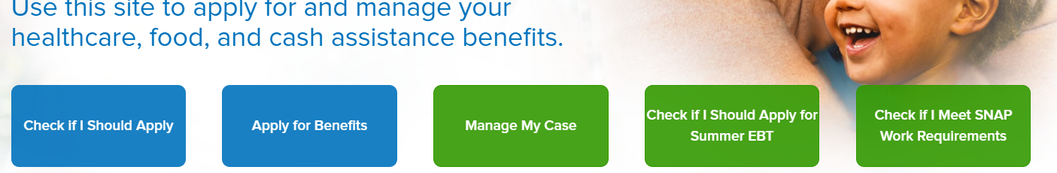
Time-Limited SNAP/Work Requirements
What can we do: (1) Screener, (2) Exemption Request on MMC or by form, (3) Unable to Work Form
https://abe.illinois.gov/access/
SNAP Recipients can use this screener to help determine if they might be subject to the work requirements. It goes through the exemption and gives next steps that DHS recommends taking.
* Note that some descriptions of exceptions do not currently align with published DHS policy
Screener

Slide 14
Time-Limited SNAP/Work Requirements
What can we do: (1) Screener, (2) Exemption Request on MMC or by form, (3) Unable to Work Form
https://abe.illinois.gov/access/
If you can access Manage My Case, you can learn more about your current status and/or submit an exemption request.
See “Using ABE and MMC – June 2025” at https://legalaidchicago.org/public-benefits-training-materials/ for tips on accessing and navigating Manage My Case.

Slide 15

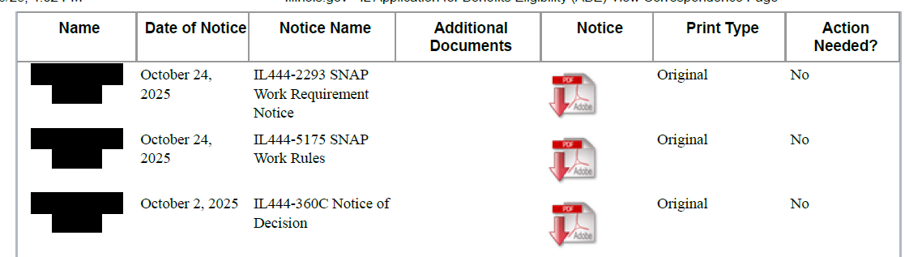
Time-Limited SNAP/Work Requirements
DHS is sending new/updated notices this month.
Review notices from DHS to determine if they think you are exempt
Click on this icon to download
a copy

Slide 16
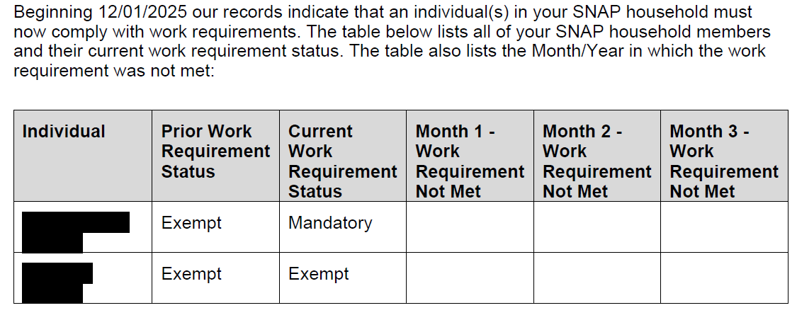
Time-Limited SNAP/Work Requirements
DHS is sending new/updated notices this month.
Review notices from DHS to determine if they think you are exempt

Slide 17
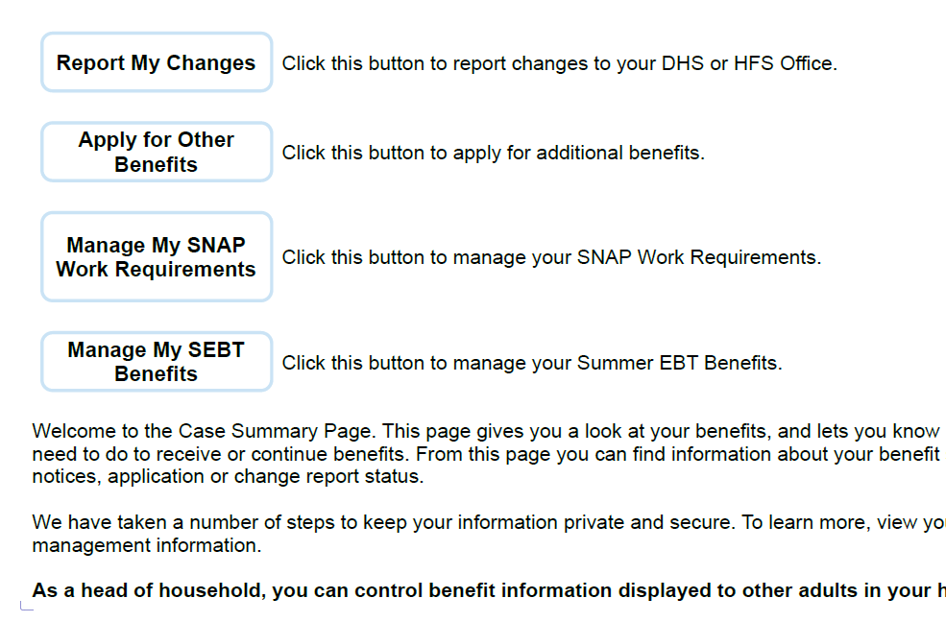
Time-Limited SNAP/Work Requirements
What can we do: (1) Screener, (2) Exemption Request on MMC or by form, (3) Unable to Work Form
Step 1
Access “Manage My SNAP Work Requirements” on the Main page within a Manage My Case Account

Slide 18
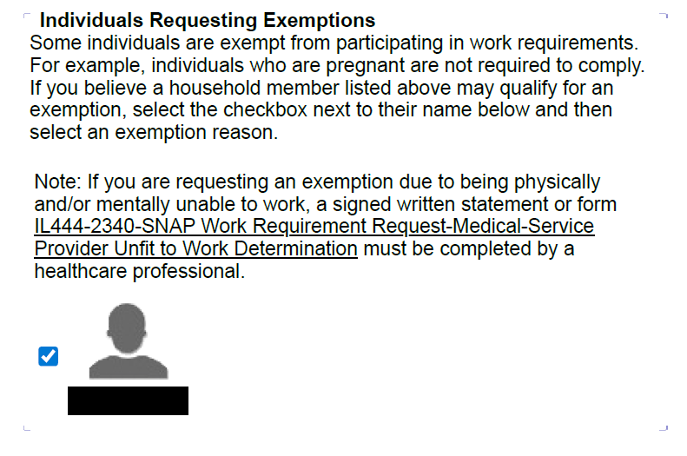
Time-Limited SNAP/Work Requirements
What can we do: (1) Screener, (2) Exemption Request on MMC or by form, (3) Unable to Work Form
Step 2
Choose whose work requirement exception you are submitting.
Note on “Note” - Not consistent with published DHS policy. “Allow the exemption and do not request verification unless the information provided by the household directly contradicts with other information provided or found through clearances.” DHS Policy Memo 10/16/25

Slide 19
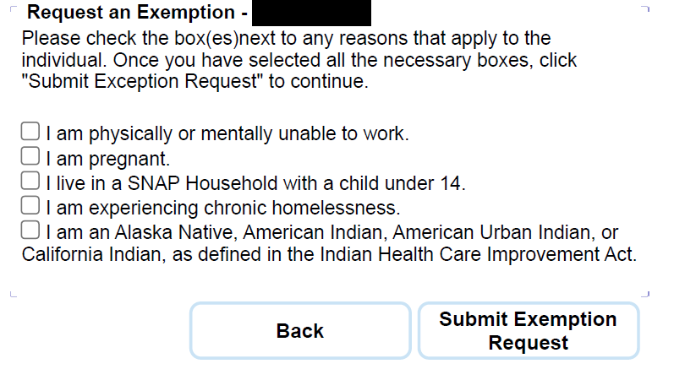
Time-Limited SNAP/Work Requirements
What can we do: (1) Screener, (2) Exemption Request on MMC or by form, (3) Unable to Work Form
Step 3
Choose reason for request and submit.
Step 4
You will get an option to download a pdf of your request. We highly suggest you print and save a copy.
Note that not all exemption categories are listed here. See DHS Policy Memo 10/16/25; and SNAP Exemption request form (following slide)

Slide 20
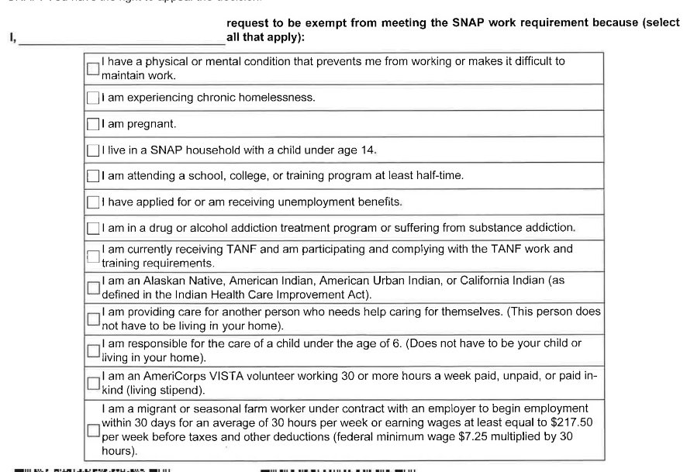
Time-Limited SNAP/Work Requirements
What can we do: (1) Screener, (2) Exemption Request on MMC or by form, (3) Unable to Work Form
If you think you qualify for an exemption, you can complete a form IL-444-2341.
Check which exemption applies to them, sign and date the form, and submit it to DHS:
Upload to MMC
Fax to DHS
Submit in Person
General Recommendation
Do not write extra information or explanations on the form
Note additional exemption categories listed here that are not on the MMC form.

Slide 21
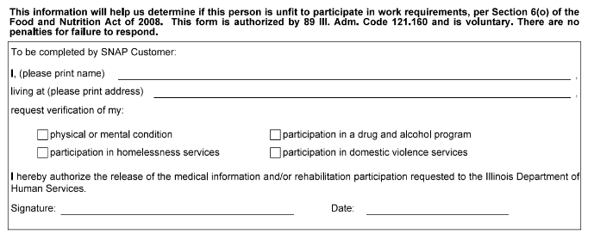
Time-Limited SNAP/Work Requirements
What can we do: (1) Screener, (2) Exemption Request on MMC or by form, (3) Unable to Work Form
If is participating in homeless services or in domestic violence services, they can complete the IL-444-2340 Form. They need to fill out this section and then have a service provider complete and sign the appropriate sections.
Then, submit it to DHS.
Upload to MMC
Fax to DHS
Submit in Person
General Recommendation
Do not write extra information or explanations on the form.
This form is NOT required for people unable to work because of physical and/or mental disability.

Slide 22
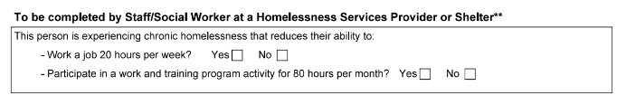
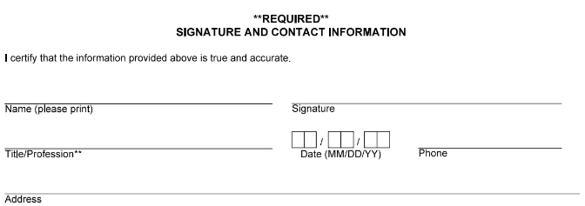
Time-Limited SNAP/Work Requirements
What can we do: (1) Screener, (2) Exemption Request on MMC or by form, (3) Unable to Work Form
If is participating in homeless services or in domestic violence services, they can complete the IL-444-2340 Form. They need to fill out this section and then have a service provider complete and sign the appropriate sections.
Then, submit it to DHS.
Upload to MMC
Fax to DHS
Submit in Person

Slide 23
Time-Limited SNAP/Work Requirements
What happens after I submit exemption request?
DHS should not request additional information unless they information is questionable
If DHS needs additional information to approve the exemption, they should contact you
DHS should apply any and all exemptions you qualify for to your case
How do I check on status? DHS said to…
Check MMC – Is “Manage My SNAP Work Requirements” option there? Those listed as option under that button are likely coded as “not exempt”.
Call DHS Help Line at 1-800-843-6154. Staff are available 8:30 am - 5:00 pm, Monday through Friday, except State holidays.
Visit local DHS Office (Family Community Resource Center - Finder)

Slide 24
Time-Limited SNAP/Work Requirements
We are awaiting guidance from DHS for how and when people must prove they are compliant.
We generally recommend you hold on to any proof in case DHS requests it or states it says you are not compliant:
Proof you earned at least $935.25 (before taxes and deductions) during the month
Proof that you engaged in work, SNAP E&T, or community service at least 20 hours/week
Fax to DHS
Submit in Person
Proof we expect DHS will accept:
Paycheck stubs (paper or access to online payroll systems)
Statements from employers or organizations
See also “Earned Income and IDHS Benefits” at https://legalaidchicago.org/public-benefits-training-materials/
What if I’m not exempt?
Meeting work requirement:
Work (paid or unpaid) an average of at least 20 hours/week, or
Volunteer to take part and comply with SNAP employment and training activities, or
Complete an average of 20 hours/week of community service, or
Any combination of the above
The situation is still fluid.

Slide 25
Time-Limited SNAP/Work Requirements
What if I am not exempt but make less than $935.25 and do not meet the work requirement?
If someone has “good cause” for not meeting the work requirement, that month should not count as a “strike.”
What is good cause?
Absence/inability to meet work requirement that is temporary
Examples:
Illness,
Illness of another household member requiring the individual’s presence,
Household emergency,
Unavailability of transportation
Other circumstances beyond your control
We are awaiting guidance on how and when to report, and what proof will be required.
What if I’m not exempt?
Meeting work requirement:
Work (paid or unpaid) an average of at least 20 hours/week, or
Volunteer to take part and comply with SNAP employment and training activities, or
Complete an average of 20 hours/week of community service, or
Any combination of the above
The situation is still fluid.

Slide 26
Time-Limited SNAP/Work Requirements
What if I lose eligibility because of work requirements?
Reinstatement
If you lose SNAP because of the SNAP Work Requirements, you can regain eligibility by:
Exemption from Work Requirements
Wait until clock resets at the end of the 3 year period (January 2027)
Showing that you have met the SNAP Work Requirements for 30 consecutive days before the date you submit a new application
DHS must issue a Notice of Decision with opportunity to appeal.
File with 10 days of notice, or before change, to request continuing benefits
Appeal must be filed within 90 days
Will my family lose benefits if I don’t meet the work requirement?
Probably not. But the case will be re-evaluated.
Household number will be reduced by 1.
Some of your income will still be counted if your spouse or children are in the SNAP Household.
Failing to Meet Work Requirement after Reinstatement
SNAP recipients can get ONE additional 3 consecutive months of SNAP (three additional strikes that must be consecutive)
The situation is still fluid.

Slide 27
Time-Limited SNAP/Work Requirements
Chapter 1
Mary is earning $2000/month. SNAP Household of 5.
SNAP Benefit = $583
Chapter 2
Mary gets sick, can’t work for four months, and loses her job. She doesn’t tell DHS and doesn’t respond to notice terminating her benefits.
SNAP Benefit = $994
Chapter 3
5 months Mary gets a new job, earning $2,000/month
SNAP Benefit = $377
Chapter 4
After working for one month, Mary reapplies for SNAP
SNAP Benefit = $583
Receiving Unemployment $787/month
– Exempt
Enrolled in college full-time – Exempt but special rules apply
No exemptions – Subject to Work Requirements
ALTERNATIVE ENDINGs where Mary requests and get exception
Chapter 2 (when Mary has no income)
SNAP Benefit = $1,183
Chapter 3 (when Mary starts working again)
SNAP Benefit = $583
17 years old - Exempt
Over 65 – Exempt;
SSA Retirement $1900/month

Slide 28
Immigrant eligibility changes
OBBBA has removed eligibility for certain lawfully-present immigrants.
Applicants were supposed to be denied starting December. HOWEVER: Illinois Attorney General Kwame Raoul joined 20 other attorneys general to file a lawsuit challenging how USDA is instructing states to implement these provisions. IDHS says, “At this time, IDHS is not implementing new federal changes to SNAP eligibility for noncitizens.” We expect IL will start implementing the new rules around April 2026.
Incomplete List of Statuses Potentially Eligible for SNAP | Former Eligibility (if receiving SNAP on 11/1, can continue through redetermination) | Current eligibility
U.S. Citizens | Yes | Yes
Legal Permanent Residents (“LPR”; aka green card holders) who have met 5 year waiting period or obtained 40 work credits | Yes | Yes
VAWA recipients who have met 5 year waiting period (from data on prima facie letter) | Yes | No
Refugees and Asylees (application approved), Trafficking survivors (T-Visa holder) | Yes | No
Cuban and Haitian entrants | Yes | Yes

Slide 29




Proving excess shelter costs
SNAP Households must prove their non-utility shelter expenses to get an excess shelter deduction. This creates an administrative burden that will reduce monthly SNAP benefits for some families.
How do I submit proof?
MMC Upload
Fax or bring to the local office
What should I do if I cannot get proof?
Tell DHS caseworker. Explain what you have already tried.
Ask them to help get the verifications pursuant to PM 02-07-02-b “If the applicant is having trouble getting third party verification, do whatever is needed to help them get it.”
What happens we cannot get proof?
In some situations, DHS can still give you credit for shelter costs if getting third party verification is impossible
In other situation, SNAP will be approved at a lower rate.
OR – if you are “homeless” you can qualify for the Homeless Shelter Standard
Application
Redetermination (if a change is reported)
Change of address
Copy of lease agreement
Copy of rent or mortgage bill
Copy of Condo Association or HOA bills
Copies of rent receipts
Letter from landlord
Property tax bill (these are available online)
Renters or property insurance agreement or bills
Screenshot or printout from venmo or zelle, processed checks, etc.
PM 11-01-02-b
WAG 25-03-02 (1) SNAP

Slide 30
Proving shelter costs
“HOMELESS”
Does not receive free shelter and utilities throughout the month, and
Lacks fixed regular nighttime residence, or
Nighttime residence is supervised temporary shelter, or
Nighttime residence is a place not normally recognized as a place to sleep, or
Nighttime residence is a temporary stay (no more than 90 days) at the residence of another person
Homeless Shelter Standard - $190
All SNAP Household members are “homeless”
Has some “shelter expense.” Verification is not required.
If verification provided, can get excess shelter instead if that’s higher.
“SHELTER EXPENSE” for homeless shelter deduction
Household costs incurred due to being homeless, including costs to secure a place to sleep, temporary shelter from weather, and accessing resources related to housing (e.g. laundry or phone)
Recently expanded list of examples in WAG 06-04-03.
PM 06-04-03

Slide 31
Questions?
Extra Resources
Legal Aid Chicago Public Benefits Training Materials: https://legalaidchicago.org/public-benefits-training-materials/
IL Commission to End Hunger “Save Our SNAP: Deep Dive Series on Pending Changes in IL”: https://us06web.zoom.us/webinar/register/8217629660597/WN_iagh1CRTR8q3Jk9hJOJbnQ#/registration
Please give us feedback and help us plan future sessions for this series:
https://forms.office.com/Pages/DesignPageV2.aspx?origin=NeoPortalPage&subpage=design&id=whoWzMUQC0KbgGazmBIwcLS5AuRIeRhJgm46kEtEIWhUQzQzMEVHNEJHWTBGV0xJQ0VJRjYxVFRBMi4u
Form closing today!

