Slide 1
TANF & TANF Crisis Assistance
Gwynne Mashon
12.2025

Slide 2








Children & Families
Consumer
Legal Aid Chicago is a private non-profit that provides free civil legal services to people with limited income in Cook County, securing their rights to economic stability, affordable housing, personal safety, fair working conditions, and basic healthcare.
Public Benefits
Criminal Records
Relief
Long-Term Care
Immigrants & Workers’
Rights
Housing

Slide 3
Take-aways
TANF...
is a cash assistance programs for low-income families with minor children
was NOT changed by OBBBA
Has complicated requirements, but many categories of people who are exempt from some of the most restrictive ones
Because of income counting rules, TANF could be a very valuable tool for increasing income for some families with higher incomes
TANF Crisis assistance can provide emergency help with small needs AND – for some families – can provide $1,250/month for up to four months
  Note: Benefits we are discussing today are only those available to USC Citizens, Legal Permanent Residents > 5 years, and other immigrants who qualifies for federally-supported benefits

Slide 4
Cash assistance for families - TANF
“Temporary Assistance for Needy Families”
Joint federal-state program
  States are giving much flexibility on how funds are spent
  However, federal rules establish many requirements for who is eligible for cash assistance
Issued on a LINK card
Can be used for nearly any purpose
Can be taken out as cash at ATMs
Legislative Intent
Allow for children to be cared for in their own homes/ home of relatives
Promote job preparation, work, and marriage for the parents
Encourage formation and maintenance of two parent households

Slide 5

Who is eligible for tanf?
Family you’re working with says they want to apply for TANF. Should they apply?
Yes!
TANF is a complicated program. There’s no cost for applying.
Do not withdraw your application until you get a Notice of Decision.

Slide 6
Who is eligible for tanf?
But ARE they eligible?
To receive TANF, you need:
Eligible child (even if they are excluded)
Caretaker Relative living with the child
Low-income*
Willing to comply with program rules:*
  Child support-cooperation
  Responsibility and Services Plan
  Work Requirement
Not over the 60-month clock*
* Many who need TANF the most are either of exempt from these rules or have special rules that apply to them – We’ll get to that in a bit.

Slide 7

Dependent child + Caretaker RELATIVE
Eligible Dependent Child | Must be IL resident Cannot be an adult in another TANF case Must be under age 18 OR age 18 and in a full-time secondary school Must live together with the Caretaker Relative Does not have to be fixed housing
Exception: | Pregnant Women with no other children

Slide 8
Dependent child + Caretaker RELATIVE
Caretaker Relative | Must be a blood-relative, step-relative, or adoptive relative of eligible child Must be primarily responsible for care of the eligible child Is presumed to be the parent, unless DCFS has removed the child from the home. Does not have to be the parent. Cannot be a child in another TANF case There is no minimum or maximum age to be designated a caretaker relative
Exceptions: | Pregnant Women with no other children
  Applicant must establish relationship using documentary evidence.
  If there is joint custody, DHS or the parents must determine who exercises the most care.
Must be “eligible”..

Slide 9
Who in “ineligible”?
A non-exhaustive list of those ineligible for TANF:
Incarcerated an entire calendar month, probation/parole violators, fugitive felons
Some people who have been convicted of public assistance fraud
Adults who have already received TANF for 60 months, unless they are exempt*
Adults who refuse to cooperate with child support enforcement, if they are required to cooperate*
Adults who refuse to sign the Responsibility and Services Plan, if they are required to sign it*
Adults who refuse to comply with TANF work requirements, if they are required to comply*
Children who do not live with a relative caretaker
Ineligible members CAN NOT be used to establish that a dependent child lives with a relative caretaker, and thus – the entire benefit unit is ineligible for benefits.
*We’ll discuss these more later.

Slide 10
Who else is included?
Required
All eligible parents and siblings who live with the dependent child
The Dependent Child (if not excluded)
If the eligible child lives with at least one eligible parent, at least one eligible parent
All eligible siblings (including adopted siblings and half siblings) who live with the dependent child
Required members
Optional member the family chooses
TANF Unit
Optional
Other adults (up to 2 total adults in a case), and children
Caretaker relative who has no children of their own in the case
Other parent of the dependent child, if they also live with the child
Spouse/civil union partner of the caretaker relative who has no children in the case
Other children living with the dependent child who has no minor siblings in the case
Excluded
SSI recipients*
Adults* receiving of SSD, Railroad, 100% VA disability, if
  Income $ > (payments with them - payments without them)
Children who do not live with the caretaker relative
Household member* who do not meet TANF citizenship/immigration requirements
*Unlike “ineligible” members, “excluded members can
be used to establish that the dependent child lives
with a relative caretaker.

Slide 11

Example 1 – Who is in the unit?
Kris and Drew are Blake and Frankie’s Parents
All USC, Blake receives SSI. The family wants TANF for Frankie.
Blake
Kris
To get TANF for Frankie, Frankie and one parent - either Kris or Drew - are required members.
The other parent is an option member.
Blake is “excluded.”
Drew
Frankie

Slide 12

Example 2 – Who is in the unit?
Kris and Drew are Blake’s parents.
Kris and Drew are Frankie’s grandparents.
All USC; Income is from grandparent’s wages: $5000/month
Blake
Kris
To get TANF for Frankie, Kris and Drew are optional members. Blake is also optional.
Frankie could qualify for a child-only case.
Drew
Frankie

Slide 13
Example 3 – Who is in the unit?
Kris and Drew are Blake and Frankie’s Parents.
Kris and Drew and do not meet TANF immigration requirements.
Blake and Frankie are USC.
Income from wages $2000/month
Blake
Kris
To get TANF for Blake or Frankie, they must both be the benefit unit.
Kris and Drew are “excluded.”
Drew
Frankie

Slide 14
Example 4 – Who is in the unit?
Kris and Drew are unmarried partners. They have custody of Blake and Frankie. Blake and Frankie are the children of Drew’s ex-spouse and not related to Drew or Frankie.
Blake
Kris
There is no TANF eligibility here because the dependent children are not living with a relative caretaker.
Drew
Frankie

Slide 15
Financial eligibility: whose income counts?
All TANF household members
Required Members
Optional members who are included in the benefit unit
Excluded Responsible Relatives
ONLY if they are legally require to provide support can be counted:
Others who are not part of the TANF unit
Income is not counted
Spouses and civil union partners. PM 09-02-01-c
Parents of children under 18 years of age (even if the children are married)
Income that is not exempt is prorated across the family
All income is countable if not exempt

Slide 16
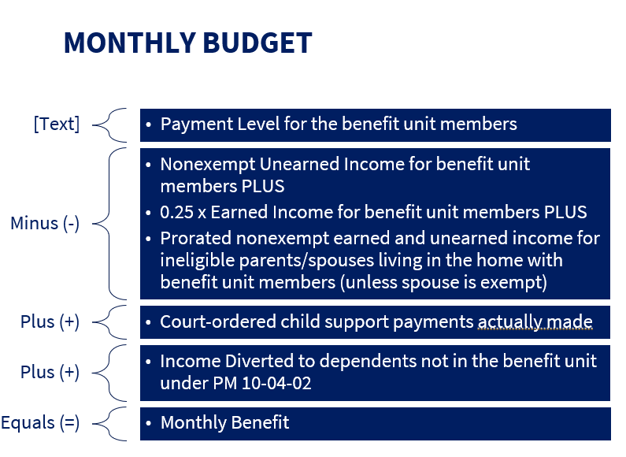
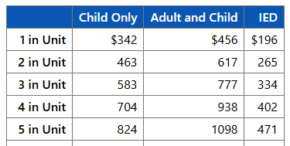
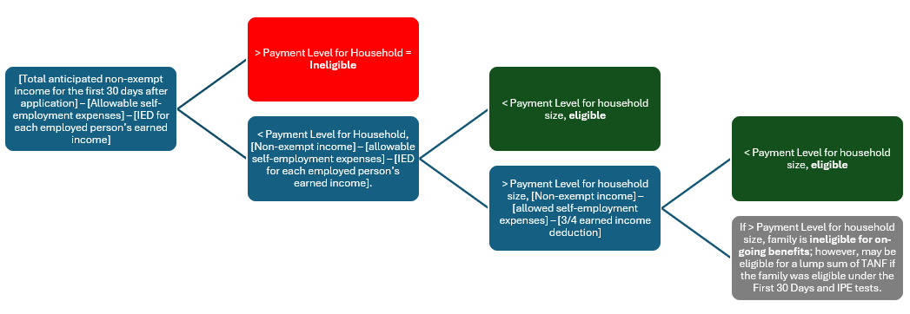
Financial eligibility is complicated!
WAG 25-03-02 (3) TANF
Rather than figuring this out yourself, we recommend checking to see if income on notices looks correct.

Slide 17
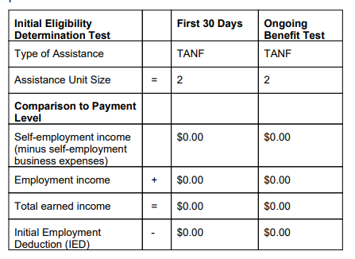
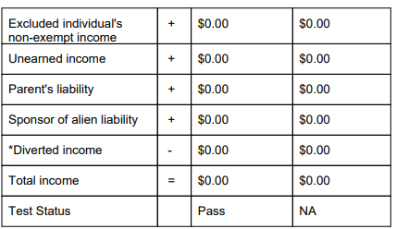
Tanf notice
Initial eligibility notices have two sections. The first test is pass/fail.
Make sure the income and assistance unit sections look correct:

Slide 18
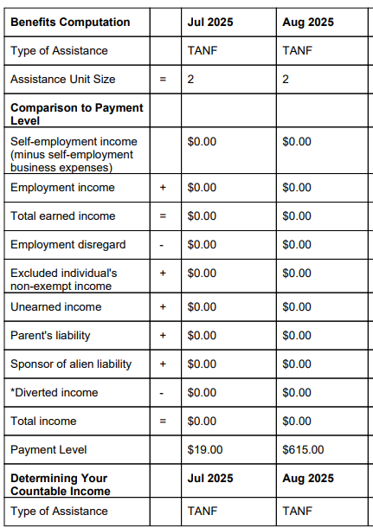
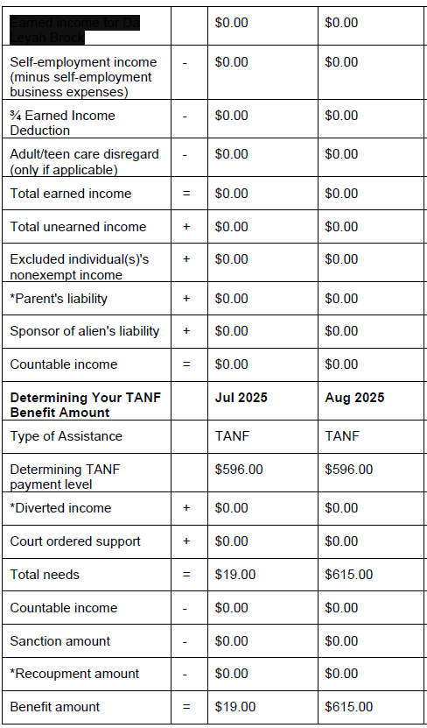
Tanf notice
More info on self-employment income in our “Making Cents” training
If initial test is “pass” or if case is for on-going benefits, there should be another budget.
Again, for most families you should just need to check:
Income
Household size

Slide 19
What is income is exempt?
Common exempt earned income
Earned income from dependent child
Earned in-kind income
College Work-Study
Common types of exempt unearned income
Earned income tax credit
SNAP, WIC, National Lunch Program
LIHEAP
SSI lump sum, except for those not in the TANF unit whose income is used to determine TANF eligibility of other
SSI, SSD, Railroad Retirement, VA 100% disability monthly payment up to the SSI level for one
Federal subsidized housing payments
Child Support
PM 08-01-01: Earned income
PM 08-01-02: Deductions from Earned income
NEW!!!
PM 08-01-04: Earmarked Income
PM 08-01-07: Unearned Income Exceptions
PM 08-01-08: Lump Sums

Slide 20
Example 1 – who’s income counts?
Kris and Drew are Blake and Frankie’s Parents
All USC, Blake receives SSI. There is no other income.
Family chooses to include only Kris and Frankie in the TANF unit because they are worried about the 60-month clock.
Blake
Kris
Blake’s SSI income does not count because he’s not in the unit.
Family has no countable income for TANF.
TANF amount is $617/month.
Drew
Frankie

Slide 21
Example 2 – who’s income counts?
Kris and Drew are Blake’s parents.
Kris and Drew are Frankie’s grandparents.
All USC; Income is from grandparent’s wages: $5000/month
Frankie in in a child-only TANF Unit
Blake
Kris
Because Kris and Drew are not in the TANF unit AND are not Frankie’s parents (not legally responsible for Frankie), their income does not count.
Frankie has no income so there is no countable income for TANF.
TANF amount is $342/month.
Drew
Frankie

Slide 22
Example 3 – who’s income counts?
Kris and Drew are Blake and Frankie’s Parents.
Kris and Drew and undocumented, Blake and Frankie are USC.
Income from wages $1000/month
Blake and Frankie are in a child-only TANF case.
Blake
Kris
Because Kris and Drew are parents to the children in the child-only case – but ineligible for TANF themselves, their income is prorated.
$1000/month ÷ 4 people = $250
$250 x 2 people in TANF unit = $500
Children are financially ineligible for TANF.
Drew
Frankie

Slide 23
Example 3 – who’s income counts?
Kris and Drew are unmarried partners. Blake and Frankie are Drew’s children from a previous relationship. Kris earns $8,000/month. Drew’s ex pays $1,000/month in child support.
Drew, Blake, and Frankie are required members. Kris is ineligible because not married to or relative caretaker to any unit members.
Blake
Kris
Kris’s income does not count because she is not in the unit and not legally responsible for any members. Child support income is exempt. There is no countable income for TANF.
TANF benefit amount is $777/month.
Drew
Frankie

Slide 24
Other tanf requirements
Responsibility and Services Plan
Work Requirements
60-Month Clock
Family Violence Exception

Slide 25
Child support cooperation
TANF applicants and recipients cannot receive TANF if they:
Refuse to cooperate with child support enforcement
Fails to cooperate with child support enforcement
  Misses a scheduled meeting with the child support worker without a valid reason;
  Misses a scheduled meeting with the child support lawyer without a valid reason;
  Misses a scheduled court appointment without a valid reason;
  do not complete the blood test scheduled by the court without a valid reason;
  refuse to sign a statement that the information given about the father of the child was true and complete to the best of their knowledge; or
  fail to cooperate in the paternity establishment without good cause.
Good Cause = “not in the best interest of the child”
Child conceived as a result of incest or rape | Possibility the child will be adopted out | Emotional harm to the client or child | Domestic or sexual violence, or fear or risk of it
birth certificates; medical records; police records. | Records showing child is up for adoption Written statement of a social service agency | Medical records showing past and present mental health status Written statement of mental health professional | More information on Family Violence slide
PM 24-02-04

Slide 26
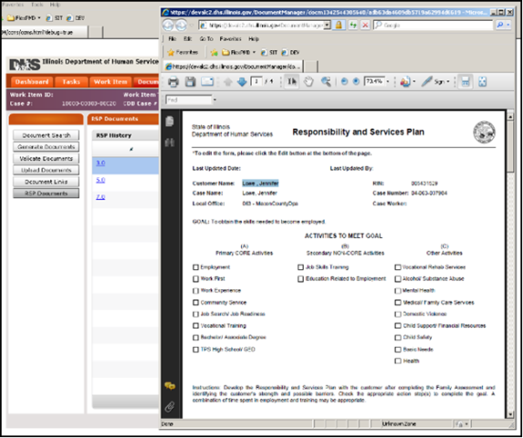
Responsibility and services plan
    RSP is “plan for achieving employment and self-sufficiency”
    Not required for
      Adults not in the TANF Unit
      Adults in child-only TANF Units
    Adults in the cases are required to complete RSP even if exempt from work activity requirements
    Plan includes:
      Education and Work goals
      Child immunizations and school attendance
      Supportive Services
        Child care
        Transportation
        Legal
        Referrals to other services to increase employability
PM 01-02-03
PM 02-09-00
PM 03-19-00

Slide 27
Non-Work Activities
Supportive activities can start as soon as the RSP is signed
Work/training plan must be based on individualized assessment of the person’s needs and abilities
Supportive Service Payments
TANF participants who are involved in approved work activities can receive supportive service payments to enable them to work or participant in an approved activity to the extent the State has resources to permit and must receive them if required to participate.
These allowances are exempt from consideration in determining the TANF grant amount.
Vocational rehab
Substance abuse
Domestic and sexual violence programs
Life skills training
Family planning/sex education
Parenting skills
Family counseling
Supportive Service Payments
Transportation
Child Care
Job Search/ Work Activity Allowance
Employment/ Job Retention Expenses
School Books and Education Fees
Eye Glasses & Dental Procedures
Supportive Service Payments
Supportive Services Available

Slide 28

Time Limits
No TANF assistance is awarded to a family that includes an adult who has received TANF as an adult for 60 months, whether or not consecutive, in any state, after 1997.
BUT…
Some months do not count and
Some people are exempt
Note: Challenging 60-month clock issues can be complicated. We recommend reaching out to your local legal aid if IDHS states you are ineligible because of the clock.

Slide 29

Time Limits
Common reasons for months that don’t run the clock
Employment equal to or greater than the state TANF work requirement (next slide)
Certain full-time post-secondary education
< 18 years old (regardless or whether receiving as a dependent child or relative caretaker)
Cares for a severely disabled child on an Medically Fragile HCBS Waiver
Primary caregiver of a child < 18 year old with physical or mental health problems, and the demands of caregiving do not allow the caregiver to retain employment to meet the state work requirement
Primary caretaker relative of spouse who has physical or mental health problems, and the demands of caregiving do not allow the caregiver to retain employment to meet the state work requirement
Months in which a person is granted a waiver due to domestic violence or sexual violence issues
PM 03-06-00

Slide 30
Work Requirement
Required work activities cannot begin until 30 day after the application date.
  Exception: If applicant lost TANF within the last 6 months because of failure to comply with work requirements without good cause, and participant is work eligible
Exceptions | Good Cause for Failure to Meet Requirements | Exempt
Child who is not a parent Parent is the caretaker of a relative child under 1 year old in the home Age 60+ Parent providing care for a disabled family member living in the home who does not attend school on a full-time basis Only children are receiving TANF and: Is not the parent of the children receiving TANF or Parent is ineligible based on immigration status or Parent receives SSI | Temporary illness Death in family Extreme weather Lack of supportive service to the extent the needed service presents a significant barrier to participation Illiteracy Non-comprehension of written and/or oral English Lack of child care Homelessness Receipt of an Eviction Notice Discontinued utilities | Family Violence Exemption
Exceptions from Work Activity does not equate to exemption from the 60-month lifetime limit. It also does not excuse the caretaker relative from developing and signing the RSP |  | Months of Family Violence Exemption do NOT count toward the 60-month limit

Slide 31

Time Limits: Exceptions
Has an application for SSI pending and probably eligible. If at the appeal stage, there must be legal or advocacy representation
Cares for a disabled adult or child:
Is the only adult in the assistance unit is the primary caregiver of a child under age 18 with physical or mental health problems, and the demands of caregiving do not allow the caregiver to retain employment to meet the state work requirement
is the primary caregiver for his or her spouse who has physical or mental health problems, and the demands of caregiving do not allow the caregiver to retain employment to meet the state work requirement
cares for a severely disabled child on an Medically Fragile HCBS Waiver
Has a medical barrier that prevents the client from obtaining or retaining employment of at least 30 hours/week
Is in an intensive service program to overcome a barrier to work that precludes the ability to obtain or retain employment at least 30 hours/week
Is in an approved education and training program that will be finished within 6 months after the end of the 60 months

Slide 32
Family violence exception: PM 03-13-02-e
Family Violence Exclusion
TANF Work and Training
60-month counter stops
Child Support Cooperation
Other requirements that would make it hard to escape violence
Acceptable Proof
Written statement by third party who knows circumstances that support exclusion
Official government/police record
Documentation from social service agency
Documentation from lawyer, clergy, medical or other professional providing support services
Other evidence, such as physical evidence
Any other credible evidence that supports the claim, including the statement of the client
NEW: “When a client claims good cause due to domestic or sexual violence and cannot give proof, they must explain why they have no proof. Help the client get proof if they ask. If no proof is obtainable, determine if good cause may be based on the anticipation of physical harm, if the claim is believable without proof. The client has the burden of establishing the validity of the claim as well as explaining why no evidence is available.
Who qualifies?
Experiencing current domestic or sexual violence or stalking, experiencing the effects of prior violence, or risk of future violence
Recovering from physical or psychological injuries
Seeking medical attention and counseling
Seeing victims services
Participating in safety planning or a safety plan
Seeking or receiving legal assistance
Avoiding dangerous situations

Slide 33
Tanf crisis assistance
TANF crisis assistance is a short-term program that is supposed to provide rapid relief to prevent homelessness or address urgent needs beyond regularly monthly TANF benefits.
- does not count as income for TANF
- does not count as income for SNAP (lump sums)
Benefit contingent on having state funding available.

Slide 34
faq
Who is eligible?
Must be eligible for TANF, but not have to be receiving it before application for crisis assistance
How do I apply?
In person at the FCRC or by submitting request in writing (should be signed and dated)
https://www.dhs.state.il.us/onenetlibrary/12/documents/Forms/IL444-2689.pdf (form has not been updated)
What do I need to prove?
Need
Circumstance
How long does it take to be approved?
If you already receive TANF, 7 days
If not already receiving TANF, DHS must determine TANF eligibility first
What does TANF Crisis Assistance provide?
It depends on the need and the circumstance
See next slides
See next slides
MR #25.41
PM 06-03-01

Slide 35
Circumstance – need - benefit
Need:
Deprived of income, food, housing, clothing, household supplies, furniture, or clothing because of domestic or sexual violence, or
Leaving domestic or sexual violence
Circumstance: Domestic or Sexual Violence
Benefits: $1,250/month for up to four months,
So long as they remain eligible for TANF
Victim is not required to leave or separate from abuser.
DHS will try to verify DV but should not require verification before approving benefits.
PM 03-13-02-e

Slide 36
Circumstance – need - benefit
Need: Homeless or Threat of Homelessness
Circumstance: Rendered homeless or threatened with homelessness by:
Benefits: $1,250/month for up to four months,
So long as they remain eligible for TANF
Fire, flood, or natural disaster; or
Eviction or order to vacate for reasons other than nonpayment of rent; or
Leaving residence due to domestic or sexual violence

Slide 37
Circumstance – need - benefit
Need: Homeless or Threat of Homelessness, or Housing Funds
Circumstance: Verified Lost or stolen cash
Benefits: Up to the amount of lost or stolen cash, not to exceed the TANF Payment level for one month

Slide 38
Circumstance – need - benefit
Need: Food
Circumstance: Only for lost food that cannot be replaced through Disaster SNAP benefits. PM 22-03-01.
Benefits: Each person in the assistance unit may receive $5 per day until:
Fire, flood, or other natural disaster
receipt date of the next regular TANF cash benefits or;
receipt of regular source of income or;
receipt of food assistance benefits not to exceed 30 days, minus the amount of available food assistance benefits available on the customers Link Account.
Lost or stolen cash
PM 03-13-02-e

Slide 39
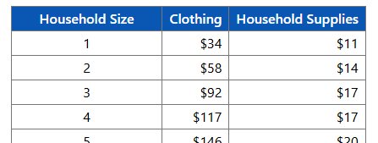
Circumstance – need - benefit
Need: Clothing
Circumstance: Need
Benefits:
Fire, Flood, or other Natural Disaster
Lost or stolen card, cannot exceed amount stolen
PM 03-13-02-e

Slide 40
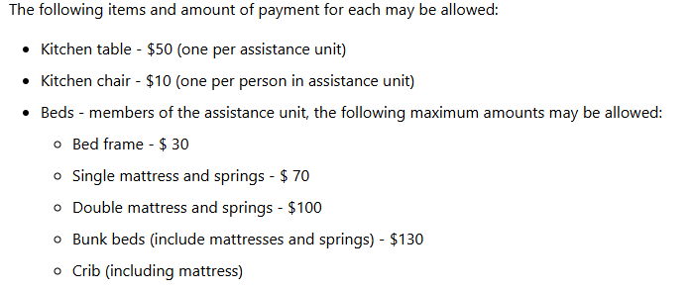
Circumstance – need - benefit
Need: Household Supplies or Furniture
Circumstance: Need
Benefits:
Fire, Flood, or other Natural Disaster
PM 03-13-02-e

Slide 41
Questions & Recommended listening
The Uncertain Hour Podcast: https://www.marketplace.org/shows/the-uncertain-hour/
Seasons 1 & 6

