Slide 1

AABD Cash
State Cash Assistance for People who are Elderly and for People with Disabilities
Gwynne kizer Mashon
November 2025

Slide 2








Children & Families
Consumer
Legal Aid Chicago is a private non-profit that provides free civil legal services to people with limited income in Cook County, securing their rights to economic stability, affordable housing, personal safety, fair working conditions, and basic healthcare.
Criminal Records
Relief
Public Benefits
Long-Term Care
Immigrants & Workers’
Rights
Housing

Slide 3
AGENDA
What is AABD Cash
Eligibility & Budgeting
Tips to maximize income and overcome barriers
Getting and Keeping benefits
Questions*
*I will try to answer questions regarding AABD Cash through the presentation. Please hold any questions related to SNAP or the Federal Shut Down until the end. I’m hoping to reserve time to discuss non-AABD Cash questions.

Slide 4
TAKE AWAYS
AABD Cash is complicated but knowing a few key things can help you maximize cash income for elderly and people with disabilities
Receiving SSA benefits and total income is less than the SSI max ($967 in 2025)? Look into (or just applying for – it’s free!) SSI and/or AABD Cash
With AABD Cash applications and redeterminations, send doctors notes if you have
If AABD Cash is denied, it’s often worth it to spend some time figuring out if that decision is correct (if the notice mostly denies TANF and you’re getting SSI, it’s wrong.)
DHS will not automatically assess your eligibility for AABD Cash – you have to apply.
And if you have changes that might increase your AABD Cash, it’s a good idea to file a change report.
When in doubt, consult with a legal aid attorney.
special dietary needs or
conditions that limit your ability to climb stairs

Slide 5

What is aabd cash?
Great question!
Most people (including some DHS staff) don’t know either.​
Program is highly under-enrolled.​
  People who qualify don’t apply
    They don’t know about or understand the program
    They abandon or withdraw applications because DHS staff or ABE tells them that the program has work requirements
    They withdraw applications because DHS staff tell them that they don’t qualify
  Applications aren’t properly processed
  Applications are erroneously denied
    Notices are complicated and often do not have enough information for people to assess whether the denial was correct
  Based on our experience, those who need the benefits the most are the likely to have benefits erroneously denied, or miscalculated

Slide 6
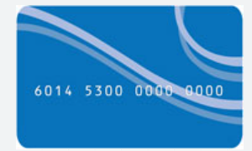
What is aabd cash?
Monthly state-funded cash benefit
Issued on a LINK card or direct deposited into a bank account*
Can be used for most purposes
No work requirements; No “clock” like in TANF
Benefits for those eligible range from $1/month – hundreds of dollars/month; average is:
How does AABD cash impact eligibility for other benefits?
Income not counted | Counts as Income | It’s Complicated
Social Security benefits – including SSI and Disability Medicaid | SNAP Medicare Savings Programs | TANF
PM 22-01-02: Upon request, the customer can choose to have all cash benefits, except child care and replacement checks, deposited directly into a checking or savings account in a bank, savings and loan or credit union

Slide 7
What is aabd cash?
AABD Cash can be particularly helpful for people receiving SSA benefits whose total income is less than the maximum SSI amount ($967 in 2025)
Overpayments
AABD Cash might help, also:
Appeal the overpayment (if SSA is wrong)
Request a Waiver (waives overpayment even if recipient was overpaid)
Overpayment repayment plan (doesn’t change overpayment but can spread payments out to reduce monthly deduction.)
Non-SSI income less than the SSI maximum + $20
AABD Cash will only help if SSI application denied because over-income, also:
Apply for SSI
If ineligible for SSI because of assets, consider financial planning to reduce countable assets
SSI reduced because someone else is paying for shelter & food
AABD Cash might help, also:
SSI recipient can start paying some money for rent – best to have a written contract to prove they are a boarder and report that expense to SSA
SSA miscalculations, mischaracterizations
AABD Cash might help, also:
Appeal SSA decisions. I recommend consulting someone with expertise in SSA rules for these situations.
SSA reduced because of child-support or other federal debt
AABD Cash might help, also:
Consult expert regarding underlying debt

Slide 8
eligibility
US Citizen or eligible immigrant
Illinois resident
Persons in certain kinds of institutional care are ineligible PM 03-10
Must be
  elderly (over 65) or
  Blind (under SSA rules) or
  Disabled (under SSA rules)

Slide 9
eligibility
Unlike other DHS programs, there is no income limit. Instead, income is compared to “allowances to determine” both program eligibility and monthly benefit.
Categorically eligible?
Asset eligible?
Financially eligible?
Maximized other income
* The financial eligibility determination process will calculate the monthly eligibility amount.

Slide 10
1. Categorical eligibility
Applicant must meet the SSA’s definition of aged, blind, or disabled
AND one of the following:
Receiving SSI
“Over-Income” for SSI
Have become ineligible for SSI when a period of eligibility based on refugee/asylee status expired. (Rules for this category are different and will not be discussed today. See PM 11-04-00.)
Be a noncitizen over 65 years old who was legally residing in the U.S. on 08/22/96, and who was denied SSI due to a finding of "not disabled," and who meets the immigration requirements for AABD medical assistance
DHS must determine if the application meets the “disabled” requirement only when SSA declined an application based on income and did not make a disability determination. This is most likely where someone is over-income for SSI but ineligible for Title II disability benefits. Under SSA rules, Disability = Unable to engage in substantial gainful employment because of medical/psychiatric conditions that will last at least 12 months or result in death.
In some situations, even people with very low amounts of Title II income are over-income for SSI.
PM 11-01-00: Categories of eligibility for AABD Cash
PM 01-02-03: Clients must apply for and receive any other financial benefits that they may qualify for.

Slide 11
Are you getting ssi?
Do you have Medicare (“red, white, and blue” card)? How old are you?
If they do AND if they are under 65 years old, then they are getting something other than SSI (but they are probably also getting SSI if total income is SSI max +20)
How much are you paid?
When does SSA pay you?
1st of the month = SSI
Any other day = Not SSI
If they get two checks, they have SSI and some other SSA benefits
SSI max ($914 in 2023): Most likely SSI
SSI max + $20 ($934 in 2023): Most likely SSI and something else
> SSI max + $20 ($934 in 2023): Something other than SSI
< SSI max ($914 in 2023): You will need to do more investigation – Likely is eligible for additional benefits!
What does your letter say?
Sometimes, the letter will state what benefit the person is getting. Examples on the following slides…

Slide 12
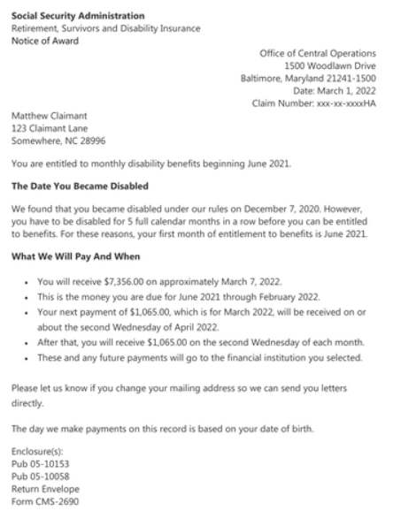
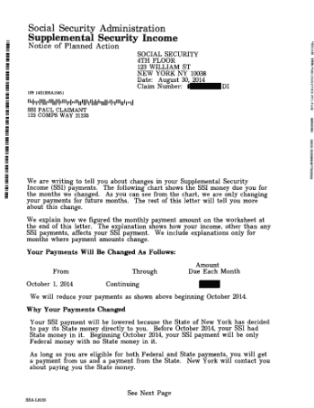


Are you getting ssi?
This is not SSI
This is SSI

Slide 13
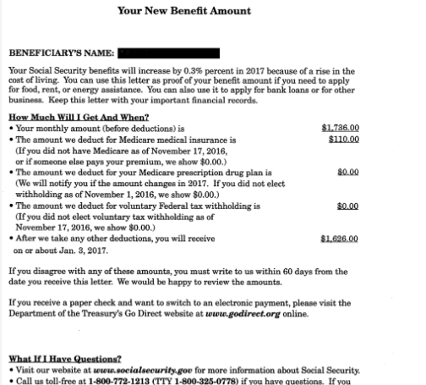
Are you getting ssi?
This is not SSI. But this person is over-income for SSI.
Medicare Part B monthly Premium Deducted
Net income client receives in their account

Slide 14
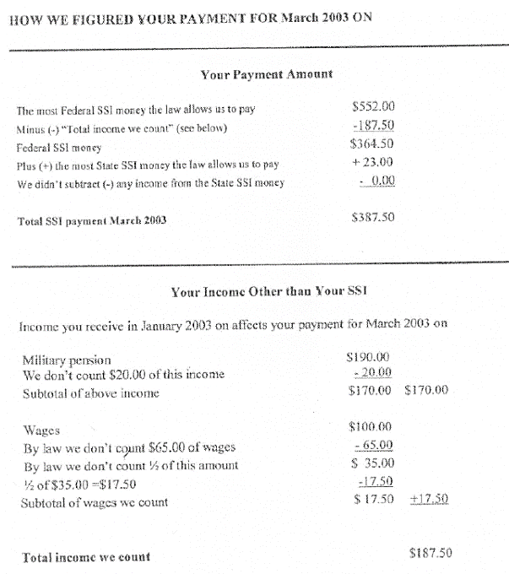
What ssa benefit is it?
This is SSI
SSI maximum (note this is from 2003)
2025 max: $967 ($1,450 couple)
2026 max: $994 ($1,491 couple)
Net SSI income
Non-SSI income SSA thinks the recipient receives

Slide 15

Is Ben Categorically eligible for AABD Cash?
Is Ben receiving or over-income (both otherwise eligible) for SSI?
Julia
61 years old
Tells you she gets $436/month in SSI
You determined that’s NOT SSI. She’s getting Social Security Disability. You also determine that her gross income is actually $600/month but $165/month is deducted for Medicare Premiums.
You help her apply for SSI. (NOTE that you do NOT need to do a SOAR application because SSA already decided Julia is disabled.)
After her application is approved,
Julia’s net income is increased to $796/month ($934/month gross)
When does SSA pay you?
“Not sure. I get paid twice.”
Do you have Medicare? How old are you?
“Yes. I’m 65 years old.”
How much are you paid?
$987/month (Note SSI Max for 2025 is $967)
What does SSA award letter say?
“I can’t find one.”
Yes - Ben is categorically eligible!
You can tell he is receiving SSI + another SSA benefit because he’s paid twice/month and gets $20 more than the SSI maximum.

Slide 16

Is Julia Categorically eligible for AABD Cash?
Is Julie receiving or over-income (both otherwise eligible) for SSI?
When does SSA pay you?
“I don’t know.”
Do you have Medicare? How old are you?
“No. I don’t think so. I’m 64 years old.”
How much are you paid?
$505/month (Note SSI Max for 2025 is $967)
What does SSA award letter say?
“Retirement, Survivors, and Disability Insurance”
You think, “Unfortunately, no. Julia needs to apply for SSI and receive a decision before you might qualify for SSI.”
But, WAIT!!!

Slide 17
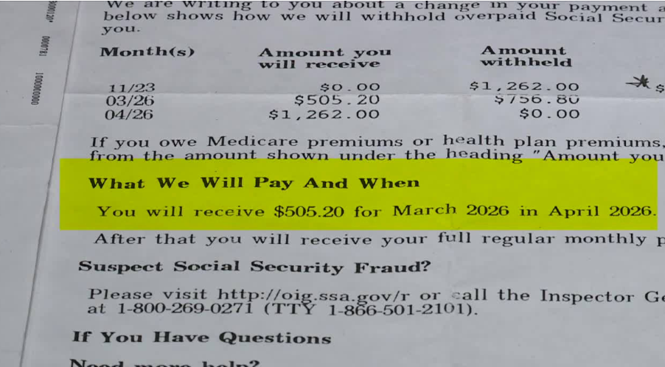
Is Julia Categorically eligible for AABD Cash?
Is Julie receiving or over-income (both otherwise eligible) for SSI?
You take another look at Julia’s SSA award letter and you notice this (let’s pretend the dates make sense):
You determine that Julie has an overpayment. Julie states she is getting benefits based on disability*.
So, she is categorically eligible!
* Remember: SSA also gives benefits to certain survivors, regardless of their own disability status. To qualify for AABD Cash, a person must be “aged, blind, or disabled.”

Slide 18
2 - Maximized other income?
4 steps to determine eligibility:
Categorically eligible?
Asset eligible?
Financially eligible?
Maximized other income
Do not forget these steps, esp. if the client is not receiving SSI.
Applicants must “avail themselves of all potential income”, so if no SSI and income is under SSI max, we they were denied SSI (e.g. SSA letter showing overpayment and/or child support deductions).*
PM 01-02-03 (exception for VA Aid and Attendance.)
*DHS Policy indicates that it will treat SSA income higher than SSA max +$20 as over-income to avoid clients from the administrative burden of applying for a program they are obviously ineligible for; but we’re not confident this is enforceable on appeal.

Slide 19
3 – asset eligible?
4 steps to determine eligibility:
Categorically eligible?
Asset eligible?
Financially eligible?
Maximized other income
Do not forget these steps, esp. if the client is not receiving SSI.
Only includes “countable” assets of the person applying and anyone living with that person who is legally responsible for taking care of that person. There are many asset exemptions.
Countable Asset limit: 1 Person: $2,000
2 People $3,000

Slide 20
4 – Financially eligible?
4 steps to determine eligibility:
Categorically eligible?
Asset eligible?
Financially eligible?
Maximized other income
Do not forget these steps, esp. if the client is not receiving SSI.
Budgeting is the method by which non-exempt income is compared to the AABD Cash Standard (“Allowances”) to determine the amount of the monthly assistance payment for the assistance unit.
If monthly assistance payment < $1, then ineligible for AABD Cash benefits.

Slide 21
4 – Financially eligible?
Fun fact
Amounts budgeted are set allowances, not actual expenses. Most allowances have not been updated since the 1980s!
Food
Clothing
Housing Supplies
Laundry
Personal Essentials
Phone
Rent/Mortgage
Utilities
NOTE:
Under state law, people who are street homeless, or not paying rent, are unlikely to qualify for AABD Cash unless:
their income is lower than the SSI maximum or
they have non-SSI income and a dependent child or spouse.
AABD Cash Standard
- Countable Income
Monthly assistance payment
Some allowances prorated for shared households

Slide 22
4 – Financially eligible?
Unearned income
+ Earned income
minus generous disregards for work-related expenses
+ Income deemed to applicant
if they live with a spouse or parent who has large enough income
- Exempt Income
e.g. income used to pay court-ordered child support, or Social Security overpayments
- Income diverted from applicant
if they live with a spouse or minor child who has little or no income
Deductions
_________________________________________
Countable Income
Budgeting is the method by which non-exempt income is compared to the AABD Cash Standard (“Allowances”) to determine the amount of the monthly assistance payment for the assistance unit.
If monthly assistance payment < $1, then ineligible for AABD Cash benefits.
AABD Cash Standard
- Countable Income
Monthly assistance payment

Slide 23
4 – Financially eligible?
Some special rules for allowances that can have a big impact:
Restaurant Meals
$102.63 food allowance ($63.95 net increase for individual in separate household without a prescribed diet)
Need to prove/submit:
Therapeutic Diet
Up to $17.82 food allowance in addition to the standard food allowance
Excess Shelter Allowance
Additional allowance on top of the standard shelter allowance equal to the difference between actual rent paid and the standard shelter allowance.
Has no facilities for preparing food OR
Is unable to cook and has no one who will prepare their meals.
No specific forms to submit
Need to prove/submit:
Doctor’s note for prescribed the diet and/or signed Request for Therapeutic Diet Allowance (Form 146)
Must submit form signed by doctor stating that the client has conditions that prevent then from navigating stairs (and proof that no suitable housing is available for $97/month, if on appeal.)
Appears as a separate allowance in the notice
Included in food allowance in the notice
Appears as a separate allowance in the notice
PM 11-01-01-a: Restaurant Meals & Therapeutic Diet Allowances
PM 11-01-02-b: Excess Shelter Allowances; Ill. Admin. Code tit. 89, § 113.308

Slide 24
4 – Financially eligible?
Some special rules for allowances that can have a big impact:
Couples both on SSI
AABD Cash can somewhat make up for the “marriage penalty in SSI.” However, married couples living together are eligible for less AABD Cash than they would if they lived separately.
Need to prove/submit:
Ineligible Spouse/Child
Non-SSI income only can be diverted to help support needs of ineligible spouse or child in the home. This results in larger AABD Cash awards.
BUT… watch out for
Non-SSI income cannot be diverted. Because of shared household rules, single parents with minor children receiving only SSI may be financially ineligible for AABD Cash.
Apply for AABD Cash for both family members to maximize cash for the household
Need to prove/submit:
Proof of relationship
Proof of income for spouse and/or child
Also, income of parent or ineligible spouse might make someone financially ineligible.
If SSA is reducing SSI amount because of income deeming, this can help make up the difference.
Appears as a separate budget in the notice
Appears as a separate allowance in the notice
PM 11-01-01-a: Restaurant Meals & Therapeutic Diet Allowances
PM 11-01-02-b: Excess Shelter Allowances; Ill. Admin. Code tit. 89, § 113.308

Slide 25
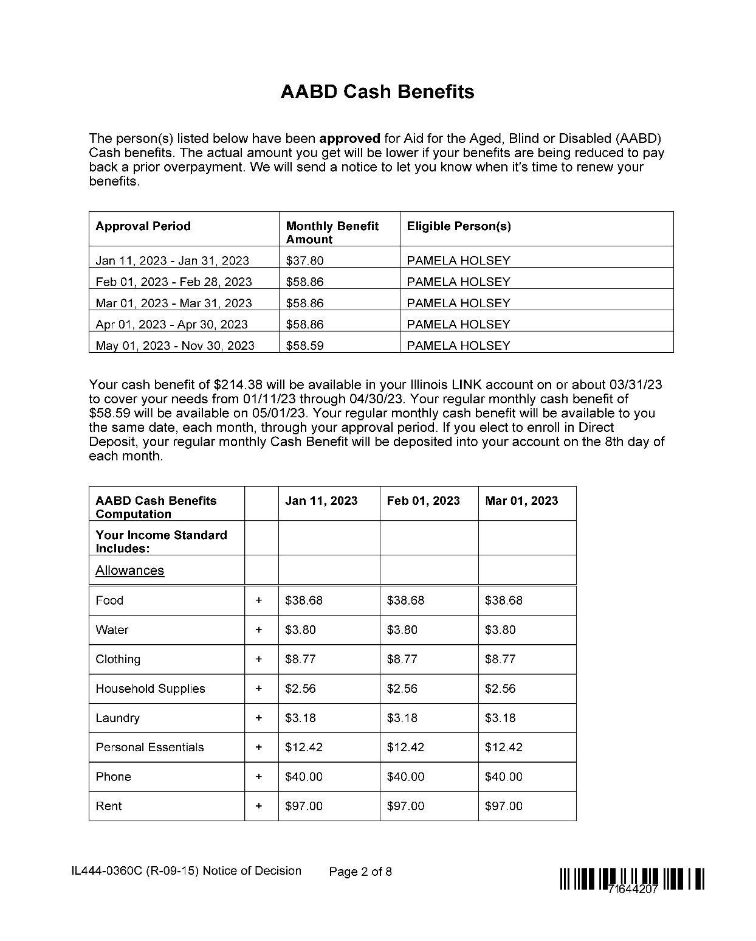

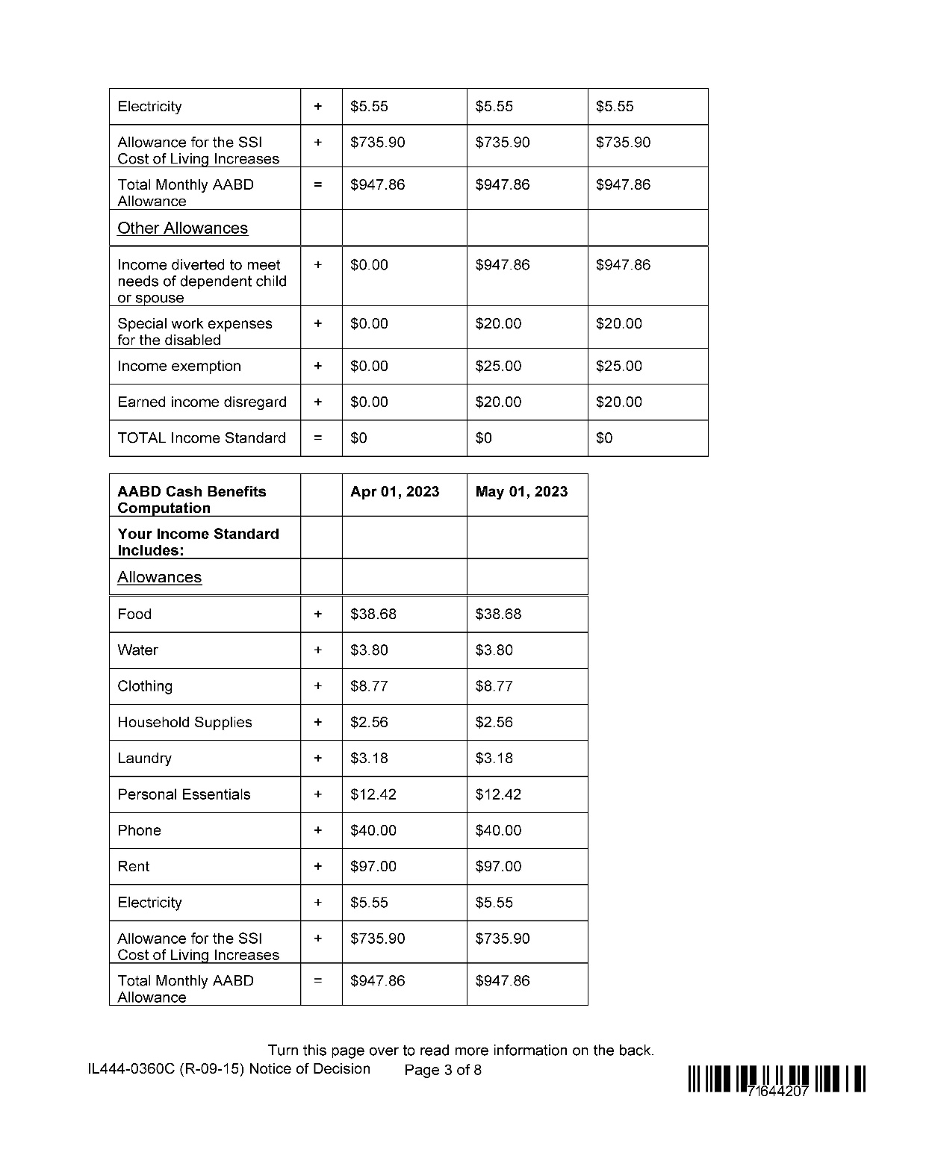
Reviewing the notice

Slide 26
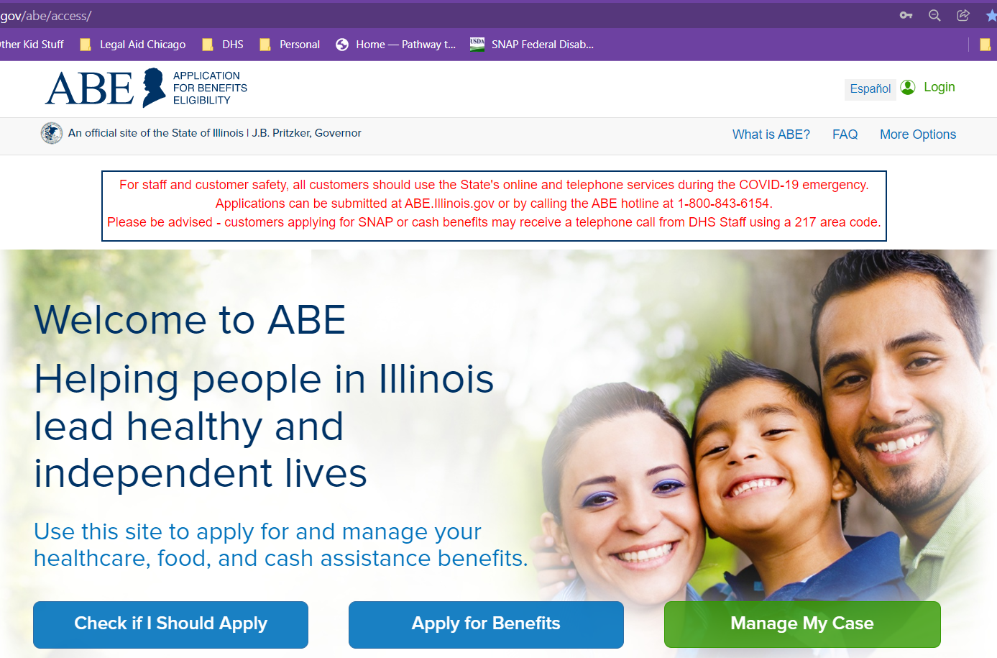
Getting and keeping benefits
DHS will not automatically enroll those who are already receiving DHS benefits. Individuals must proactively apply.
Because AABD Cash eligibility is so fact sensitive, we encourage people to considering applying often, and especially if they have a change that might make them eligible or eligible for more AABD Cash.
Apply online on ABE: https://abe.Illinois.gov
Apply at Local IDHS Office. “Family Community Resource Center” locator at: http://www.dhs.state.il.us/page.aspx?module=12
Application
Interview
Verification
Notice of Decision
Step 1
Step 2
Step 3
Step 4

Slide 27
Getting and keeping benefits
What is appealed?
Incorrect decision
No decision within the processing time (“Inaction”)
Time to File
60 days*
How to File
Through “Manage my Case” https://abe.Illinois.gov
No notice issued with 60 days after application: No deadline
phone: 1-800-435-0774 or 312-793-2618
Fax: 312-793-3387
DHS.BAH@Illinois.gov
Decisions where benefits are denied because of missing verifications or a missed interview
Applies if notices deny cash but not AABD Cash

Slide 28
TAKE AWAYS
AABD Cash is complicated but knowing a few key things can help you maximize cash income for elderly and people with disabilities
Receiving SSA benefits and total income is less than the SSI max ($967 in 2025)? Look into (or just applying for – it’s free!) SSI and/or AABD Cash
With AABD Cash applications and redeterminations, send doctors notes if you have
If AABD Cash is denied, it’s often worth it to spend some time figuring out if that decision is correct (if the notice mostly denies TANF and you’re getting SSI, it’s wrong.)
DHS will not automatically assess your eligibility for AABD Cash – you have to apply.
And if you have changes that might increase your AABD Cash, it’s a good idea to file a change report.
When in doubt, consult with a legal aid attorney.
special dietary needs or
conditions that limit your ability to climb stairs

Slide 29
Questions?
Gwynne Mashon
gmashon@legalaidchicago.org

