Slide 1
Illinois Dept of human services
Benefits for immigrants
08.12.2025

Slide 2
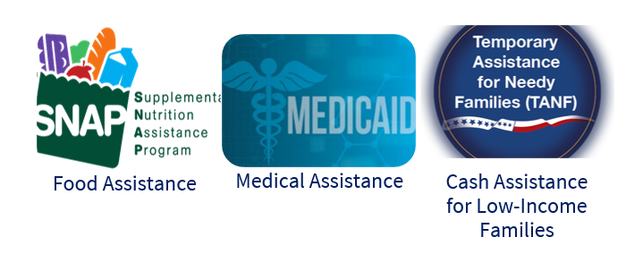
Before we get started
This training assumes participants have at least some basic knowledge of common public benefits programs:
  https://www.shpa-il.org/public-benefits-training-series/
Today’s focus is on immigration requirements.
To receive benefits, households must also meet other financial and nonfinancial requirements.
Information included in this training includes the most up-to-date information I have.
I do not have expertise in immigration law.

Slide 3
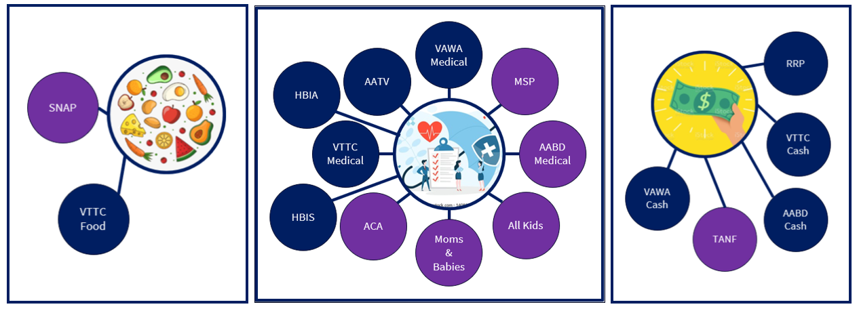

IDHS benefits

Slide 4
Preliminary issues
Public Charge
Information Sharing with Federal Agencies

Slide 5
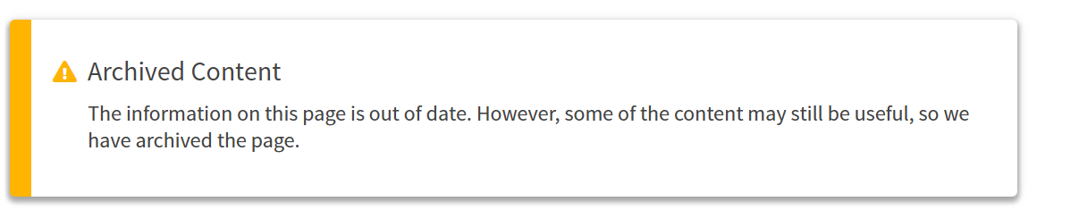
Public charge
Public charge is an immigration rule that can prevent people from becoming Legal Permanent Residents
The 2022 Final Rule, the public charge inadmissibility determination is a prospective determination based on the totality of the noncitizen’s circumstances (that is, we weigh all the information and evidence relevant to the statutory factors as applied to an applicant’s case). No one factor serves as the sole criterion for making a public charge inadmissibility determination (except for an insufficient Affidavit of Support Under Section 213A of the INA where required).”
https://www.uscis.gov/green-card/green-card-processes-and-procedures/public-charge/public-charge-resources

Slide 6
Current state of Public charge
Public Charge only applies if someone has not yet obtained Legal Permanent Residency
Receiving public benefits for other household members does not count
  Mom receiving child-only TANF for her children is not considered for Public Charge
Receiving State-funded benefits does not count
Public Charge rules do not apply to recipients of humanitarian relief (U Visa, T Visa, Asylum, VAWA, etc.)
So, as of now, what might count?
If someone is concerned about public charge, they should consult an immigration attorney.
SSI
TANF
Medicaid long-term care

Slide 7
Possible future Expansion of public charge
Rule expands definition of services that qualify as “public benefits”. However, as far as we can tell, this does not yet implicate public charge issues in immigration process.
Benefits we’re discussing today that are included in this rule include:
  Medicaid (except emergency Medicaid)
  Medicare
  Children’s Medicaid
See more:
https://www.kff.org/policy-watch/new-policy-bars-many-lawfully-present-and-undocumented-immigrants-from-a-broad-range-of-federal-health-and-social-supports/
Illinois has joined a coalition of other states in lawsuit challenging this rule. In response to this suit, HHS has agreed to delay implementation until 9/10/2025. Case 1:25-cv-00345-MSM-PAS, United States District Court for Rhode Island.

Slide 8
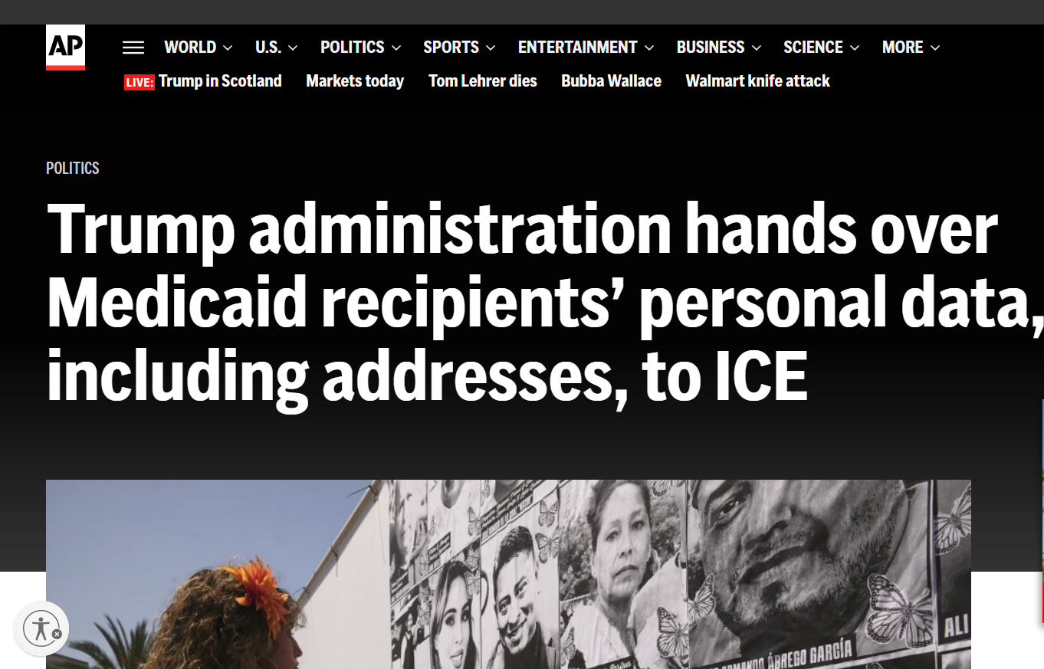
Information sharing
Illinois has joined a coalition of other states in lawsuit challenging this rule: State of California v. US Department of Health and Hospital, 3:25-cv-05536 in Us District Court for the Northern District of California.
Kinds of information we believe was shared:
Names
Birthdates
Addresses
Immigration status
Claims and benefits history (including types of services received)
As of 8/11/25, plaintiff states asked for preliminary injunction stopping current and future data sharing until the full case could be heard. It appears decision is pending.
https://apnews.com/article/immigration-medicaid-trump-ice-ab9c2267ce596089410387bfcb40eeb7

Slide 9
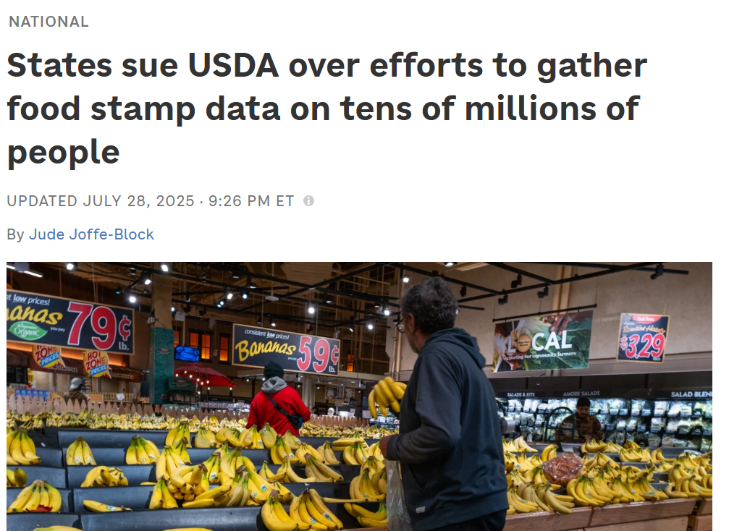
Information sharing
USDA originally gave states and EBT vendors until July 30th to produce data on anyone who even applied for SNAP since 1/1/20. They asked for data such as:
Names
Addresses
Social Security numbers
Citizenship status
Benefits received
IL has joined 21 other states in a suit challenging this demand in the US District Court for the Northern District of CA, Case No. 3:25-cv-06310.
The demand is currently paused.
https://www.npr.org/2025/07/28/nx-s1-5482842/snap-usda-privacy-lawsuit

Slide 10
H.B. 1, immigrant eligibility eff. Date (11/2025?)
Incomplete List of Statuses Potentially Eligible for Joint Federal-State Programs | Current Eligibility | Expected future eligibility – Possibly around 11/2025 | Expected future eligibility – possibly around 1/2027
*Assumes person meets all other program requirements
U.S. Citizens | SNAP, TANF, Medicaid | (no change) | (no change)
Legal Permanent Residents (“LPR”; aka green card holders) who have met 5 year waiting period or obtained 40 work credits | SNAP, TANF, Medicaid | (no change) | (no change)
VAWA recipients who have met 5 year waiting period (from data on prima facie letter) | TANF, Medicaid | (no change) | TANF only
Refugees and Asylees (application approved), Trafficking survivors (T-Visa holder) | SNAP, TANF, Medicaid | TANF, Medicaid | TANF only
Children under 19 years old & Pregnant/Post Partum Women - who are ineligible for other federal-state programs | Medicaid (All Kids, Moms & Babies) only | (no change) | (no change)
Cuban and Haitian entrants | SNAP, TANF, Medicaid | (no change) | (no change)
Individuals who are lawfully residing in the US in accordance with the Compacts of Free Association between the US and Micronesia, the Marshall Islands & Palau. | SNAP, TANF, Medicaid | (no change) | (no change)

Slide 11
State funded benefits (TODAY)
Qualifies for joint federal-state benefits
Refugees, Asylees
Asylum Applicants
T-Visa Applicants
U-Visa applicants, U-Visa Holders, LPR pursuant to U-Visa
VAWA (obtained prima facie letter)
None of these
Refugee Resettlement Cash
State-funded TANF, Medicaid
Joint Federal-State
Benefits
AATV Medical
VTTC Medical, Cash & Food
Emergency Medical

Slide 12
HBIA/HBIS
Health Benefit Coverage for Immigrant Seniors
Aged 65+ that do not otherwise qualify for Medicaid because of immigration status and are not Legal Permanent Residents
Modeled after AABD Medicaid
Household definition
Income limits: Under 100% FPL
Asset limits: Under $17,500
Spenddown is available – for now.
Does not cover Long-term care
Health Benefits Coverage for Immigrant Adults
Aged 42-64 that do not otherwise qualify for Medicaid because of immigration status
Modeled after ACA Medicaid
Household definition
Income limits
Enrollment paused since 11/6/2023

Slide 13
Refugee resettlement program
Who?
Refugees who do not meet the requirements for SSI, TANF, or AABD Cash
Refugee, Asylee, and Conditional Entrant
Certain other immigrants from Vietnam, Cuba, or Haiti
Requirements:
Similar to TANF except no requirement for a related dependent minor child
Work registration, with some exceptions
Limited to 4 months …
After date asylum was granted, or
After trafficking victim identified by ORR
After date of entry into the U.S. for all others
Benefit Amount:
Do not qualify for non-financial TANF services
Aligns with TANF; Max benefit $439/month
PM 06-01-00

Slide 14
Medical Benefits for Asylum Applicants and Torture Victims
Who?
Pending asylum application, or an appeal pending regarding asylum decision
Requirements:
Ineligible for joint federal-state medical benefits
Limitations:
Maximum 24 months of coverage unless:
Receiving federally funded torture treatment services
19 years or older
Financial eligibility aligns with AABD Medical (100% FPL income, $17,500 countable assets)
If an appeal is pending, eligibility can be expanded for up to a total of 36 months
PM 06-21

Slide 15
VTTC
Food and cash only available so long as funding is available.
Non-Citizen Victims of Trafficking, Torture, or Other Serious Crimes (“VTTC”) programs provides cash, food, and medical assistance to certain immigrants
T-Visa: Waiting for decision on T-Visa application
U-Visa: Waiting for a decision on a U-Visa application, U-Visa holders, LPR for obtained status via U-Visa
Asylum: Waiting for a decision on Asylum application
  Includes family members listed as derivatives on immigration application:
    Parents, Children and siblings under 18
    Spouses can’t get VTTC benefits unless the marriage happened before the main VTTC applicant came to the U.S.
7.2.25 Memo: https://www.dhs.state.il.us/page.aspx?item=173308

Slide 16
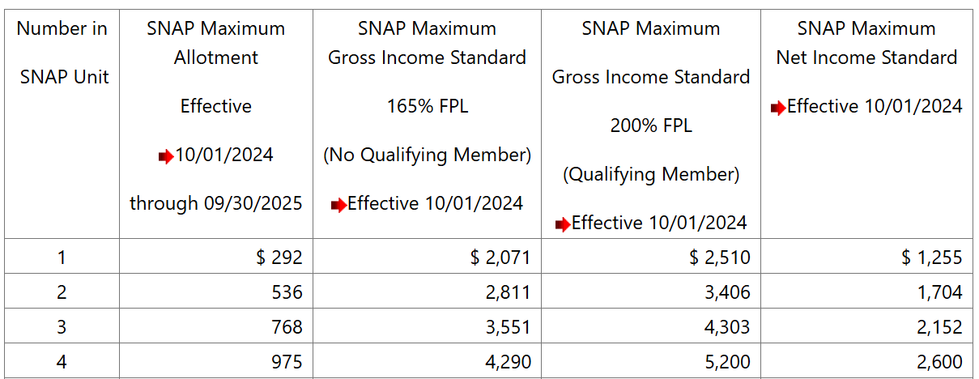
VTTC FOOD
Financial Factors | Non-Financial Factors
Aligned with SNAP | Aligned with SNAP; SSN requirement is waived
Benefit unit includes all individuals who buy and prepare food together
Benefit amount based on all income received and certain expenses, especially rent and childcare

Slide 17
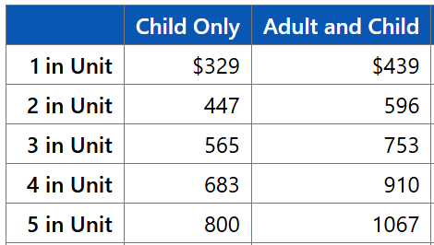
VTTC cash
Financial Factors | Non-Financial Factors
Aligns with TANF | Aligned with TANF or RRP, respectively; SSN requirement is waived; child support cooperation requirement is waived Asylum applicants only must have derivative family member of immigration application
For VTTC (TANF), must have a dependent minor child.
If ineligible for VTTC (TANF), might be eligible for VTTC (RRP) (max 4 months.)
Each adult must sign the application.
All nonexempt adults under 60 years old must register for work with a refugee job placement agency, or other job service. Exemptions:
  Child in case
  Medical condition prevents from working
  Needed for care of another person in home due to their medical condition
  Provides child are to child under 1
  Employed > 30 hours/week
Benefit amount based on all income received

Slide 18
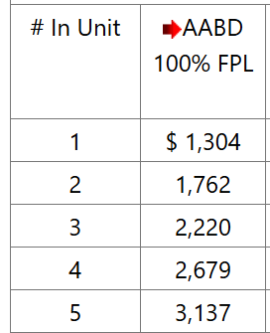
VTTC medical
Financial Factors | Non-Financial Factors
Income and resource limits aligned with AABD Medical (100% FPL Income, $17,500 asset limit) | Aligned with ACA Medical; SSN requirement is waived
Must be over 19 years old (minor children can qualify for “regular” Medicaid.
Each adult must sign the application.
Financial eligibility based on all unearned income, and all earned income by adults

Slide 19
VAWA CASH/Medical
Who?
individual who has filed a formal petition for relief under VAWA and the petition is in pending or approved status as verified in SAVE, who has not yet met the 5-year federal bar
Requirements:
Aligns with TANF and ACA or AABD Medicaid rules
Limitations:
Eligibility ends if VAWA petition is denied or person becomes eligible for federally-funded benefits
4/25/25 Memo: https://www.dhs.state.il.us/page.aspx?item=171026

Slide 20
Emergency medical
Requirements
Does not meet citizenship/immigration requirements for other Illinois medical assistance programs
Children under 19 qualify are ineligible
Pregnant women are ineligible
IL resident.
Those coming to Illinois for purpose of receiving medical care
What it covers
Emergency medical services required as a result of a medical condition with acute symptoms that are severe enough that, without immediate medical attention, a physician could reasonably expect the condition to result in:
Placing individual’s health in serious jeopardy
Serious impairments to bodily functions
Serious dysfunction of any organ or part
Requires emergency medical services
Doctor must verify emergency in writing
Only medical services required to stabilize the emergency; so there are no longer acute symptoms
Income/asset limits
The following non-immigrant visa classes do not qualify: B (temporary visitor), C (alien in transit), D (crew member of vessels), TWOV (transit without visa)

Slide 21
Mixed status
Adults and Children can receive all joint federal-state or state-only funded benefits they are eligible for, even if other people they live with are ineligible
Benefit Unit
If ineligible parent or spouse who lives in the household has income, prorate across the family to determine how much of the income is countable income
If a family member living in the home is not a parent or spouse to someone in the benefit unit, their income usually should not be counted.
Income
Remember that every benefit has its own rules for how to determine who is in the benefit unit. Sometimes, the definition of who is in the benefit unit is different for different family members.
If someone does not meet the immigration requirement, then they are not counted in the benefit unit size for determining eligibility or benefit amounts.

Slide 22

questions
If you have additional questions about new and upcoming changes to benefits for immigrants, you can reach out to Andrea Kovach from Shriver Center at andreakovach@povertylaw.org
Gwynne Kizer Mashon
gmashon@legalaidchicago.org

