Slide 1
Using ABE and MMC
June 2025

Slide 2








Children & Families
Consumer
Legal Aid Chicago is a private non-profit that provides free civil legal services to people with limited income in Cook County, securing their rights to economic stability, affordable housing, personal safety, fair working conditions, and basic healthcare.
Criminal Records
Relief
Public Benefits
Long-Term Care
Immigrants & Workers’
Rights
Housing

Slide 3
What I hope you’ll learn
How to create an online account
How to submit an application
We will not cover eligibility or details of programs today.

Slide 4
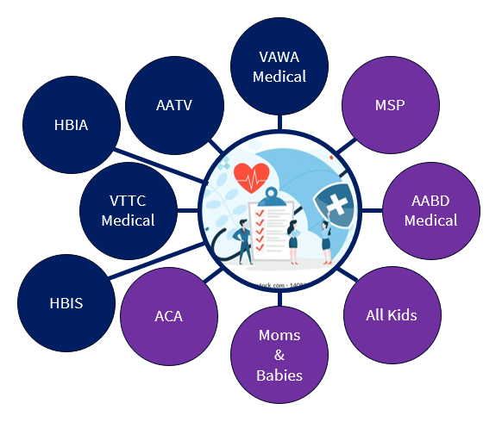
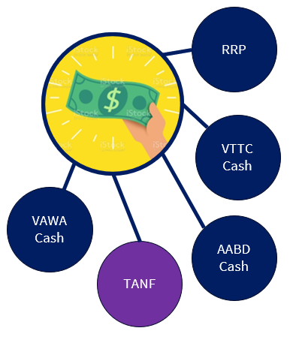
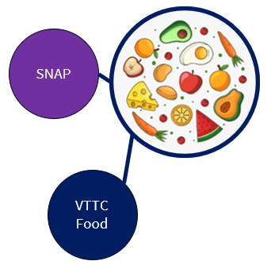
What are benefits from the
IL Department of human services?
Joint Federal-State
State only

Slide 5

Application process
Processing Time
Application
Online: Abe.Illinois.gov
Phone: 800-843-6154
In person @ FCRC
Verification/Agreement to benefits requirements
Notice of Decision
Interview (for SNAP and CASH programs)
TANF: 45 days
AABD Cash: 45 days
Medicaid: 45 days
SNAP: 30 days or 5 days if expedited
An applicant qualifies for expedited SNAP processing in a few situations, including when liquid assets are less than $100 and gross monthly income or the month of application is less than $150
*** Homelessness alone does not qualify someone for expedited benefits
No cost to apply
No punishment/fine for applying for something you don’t qualify for
No punishment for wrong answers as long as you’re not lying or misleading on purpose
Generally, recommend applicants apply for all benefits and apply for anything they are not getting at redetermination/changes.
The agency will lose things! Keep copies of everything you submit and proof of submission when possible.
Failure to complete administrative eligibility steps often results in denials.
Agency errors are not uncommon. You have a constitutional right to appeal those decisions.

Slide 6

https://abe.illinois.gov/access/
Illinois' Application for Benefits Eligibility (ABE) has three portals to support applicants with their benefits:
Apply for Benefits
ABE is the State of Illinois’ web based portal for applying for and managing health coverage, SNAP and cash benefits online, anytime.
Manage My Case (MMC)
MMC is a section on the Application for Benefits Eligibility (ABE) website that lets you check on, change, and renew your Medical, SNAP, and case benefits online, anytime.
Appeals
The ABE Appeals portal allow users to file and manage appeals via the web based portal. The Appeals portal can be accessed through MMC or directly:
https://abe.illinois.gov/abe/access/appeals

Slide 7
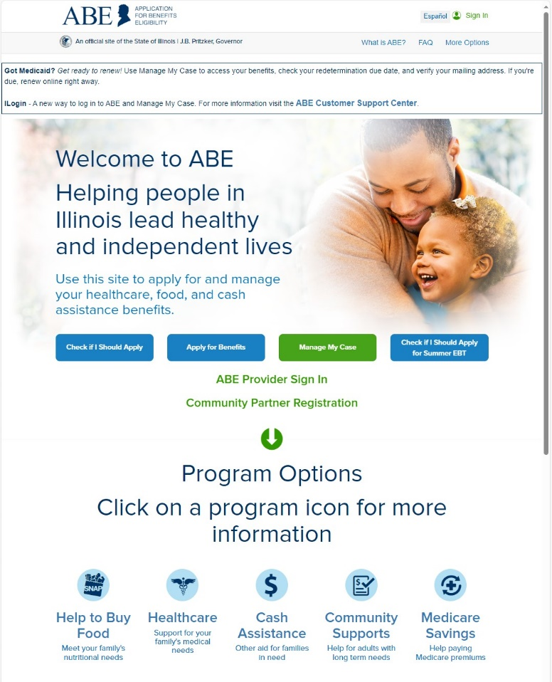
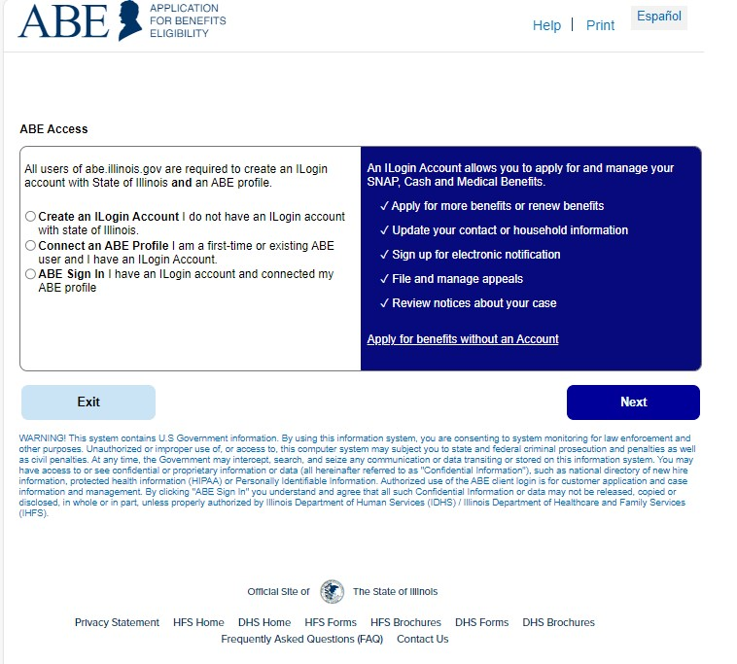
Ilogin multifactor authentication
FOUR options :

Slide 8
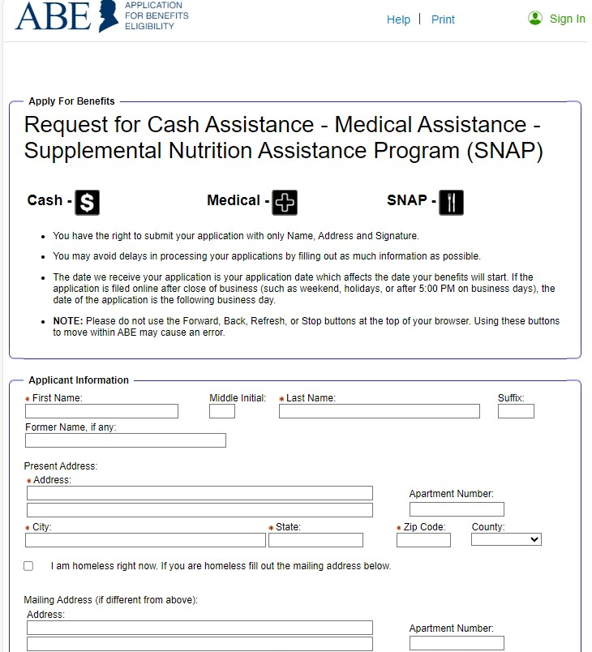
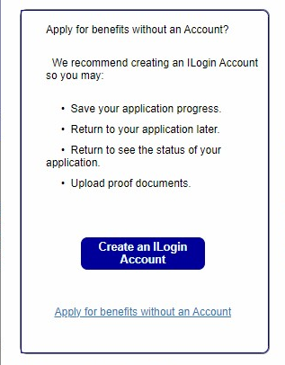
Ilogin MFA Without an Account
Step 1
Step 3
Step 2
The ONLY required fields are:
  Name
  Present Address
  Fraud Penalty Affidavit
  Electronic Attestation
As always, we recommend you print a copy of the application after you submit it and keep it for your records.

Slide 9
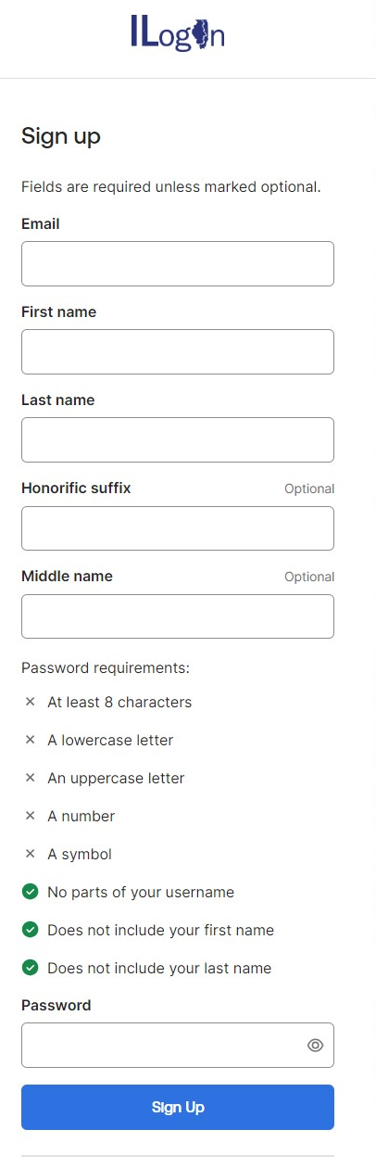
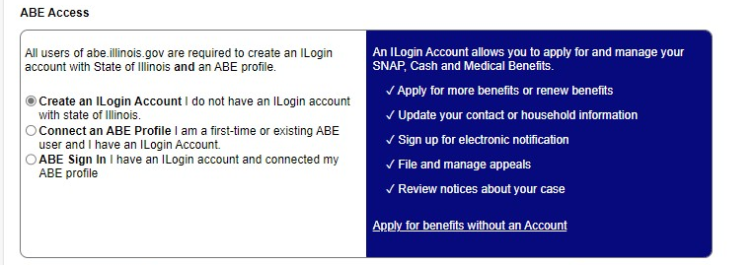
Ilogin Creating an account
“I have not set up my ILogin Account.”

Slide 10
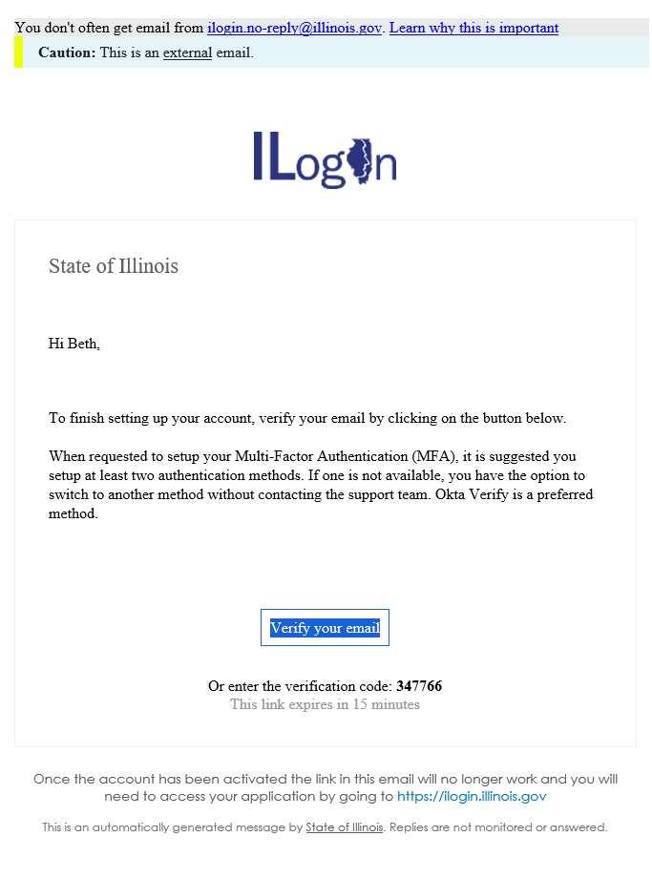
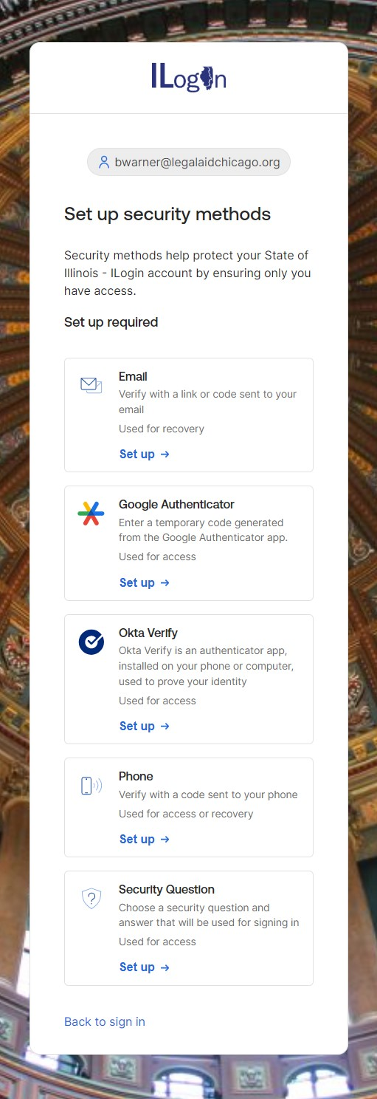
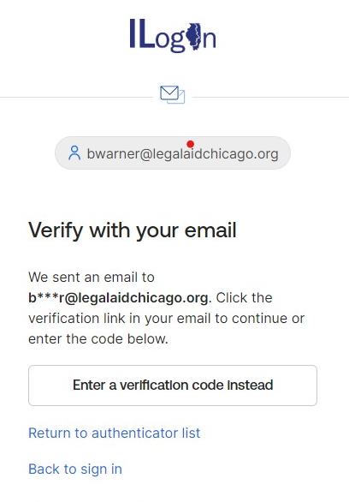
Ilogin set up
Step 1
Step 3
Step 2

Slide 11
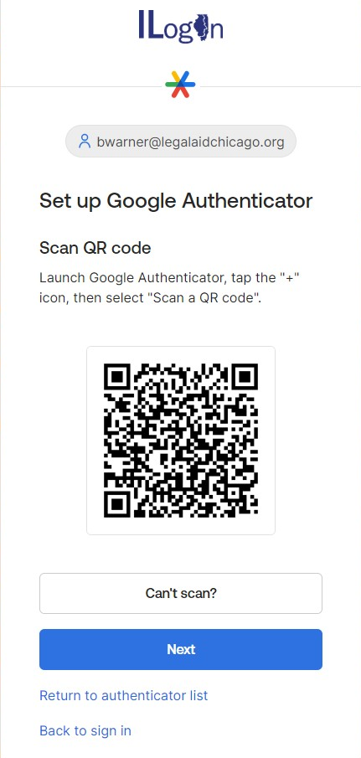
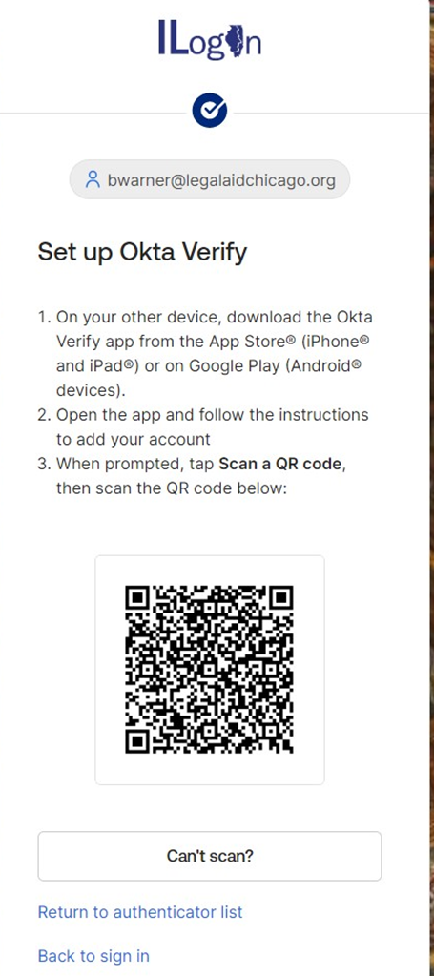
Ilogin set up
Step 4 – Option 1
Only recommended if you have consistent access to a smart phone and know how to navigate these verification apps.

Slide 12
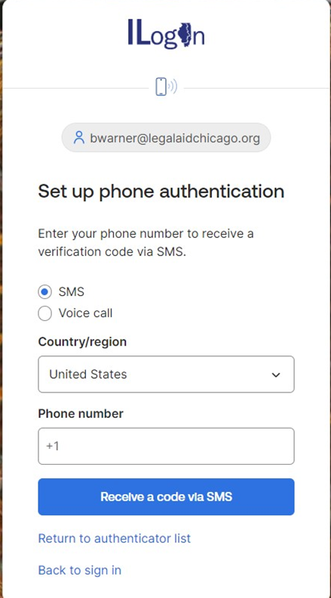
Ilogin set up
Step 4 – Option 2
Only recommended if you have consistent access to a phone (mobile or landline), and/or have the ability to move your phone number to a new phone when needed, and can navigate these fields.

Slide 13
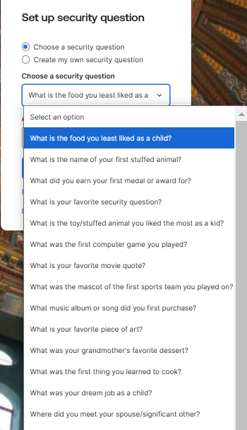
Ilogin set up
Step 4 – Option 3
This is likely the best option for someone with limited tech skills or inconsistent access to their phone and/or email.

Slide 14
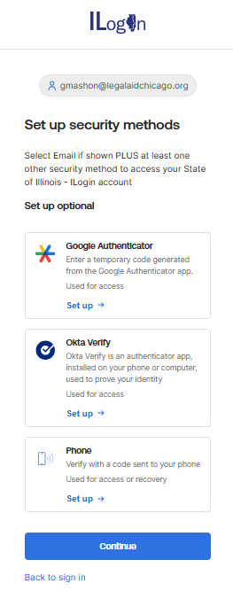
Ilogin set up
Step 5
The system will ask you to set up more security methods. If you don’t want to do that, just click “Continue”

Slide 15
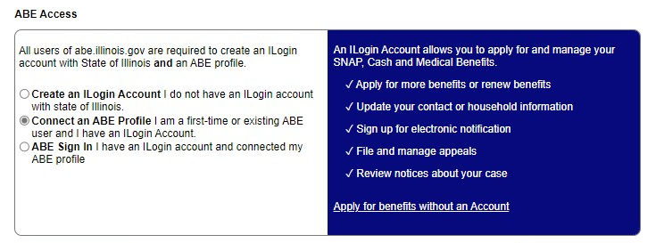

Connecting accounts
Once you’ve created you ILogin account, the system will send you back here.
Step 6
Step 7

Slide 16
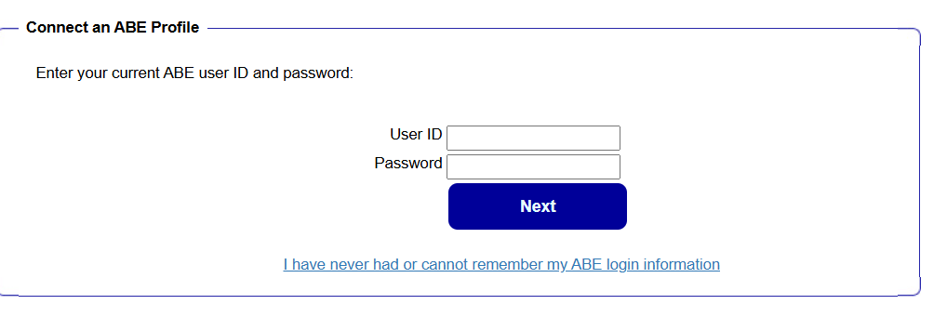
Connecting accounts
Option 1: “I already have a MMC username and password that I want to use.”
Step 8
Option 2: “I never set up an MMC username and password or I don’t remember what it is or don’t want to use it.”

Slide 17
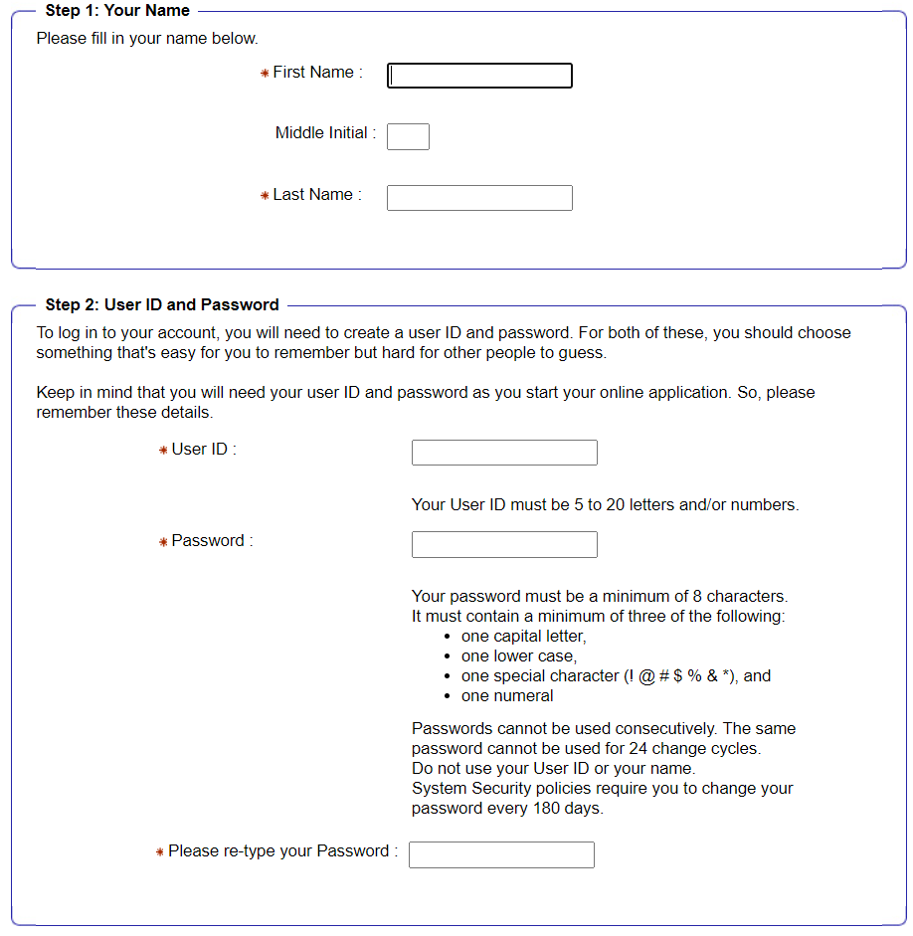
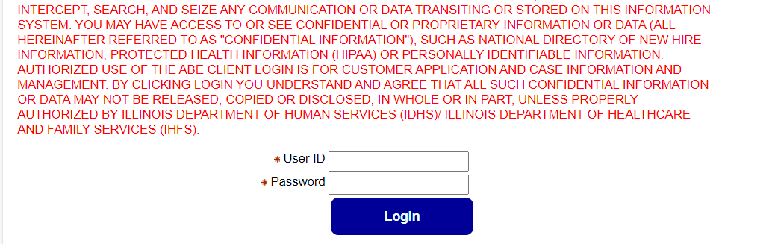
Connecting accounts
Step 9b – Create new account
Step 9a - log into existing account

Slide 18
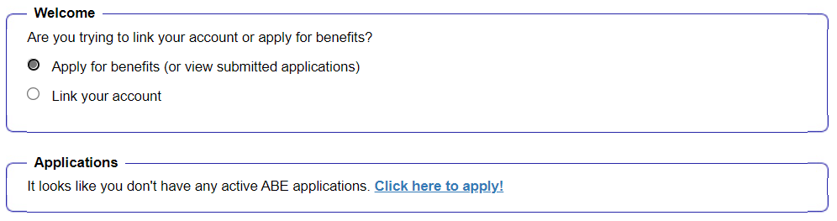
Connecting accounts
Step 10
Once logged in for the first time, you will see this screen:

Slide 19
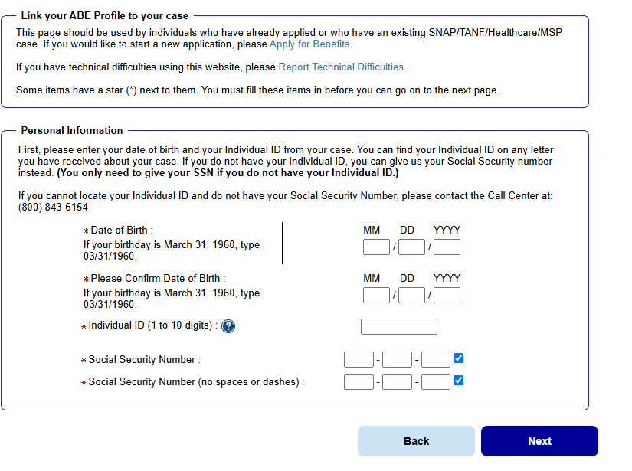
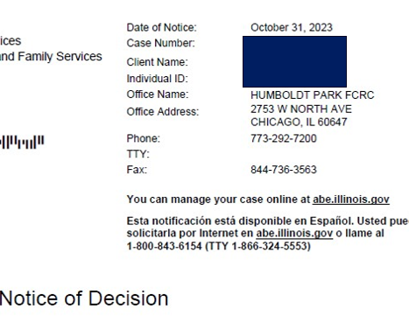
Connecting accounts
Step 11

Slide 20
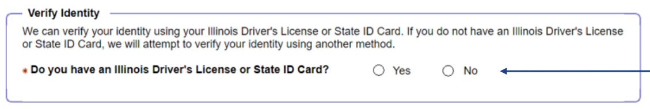
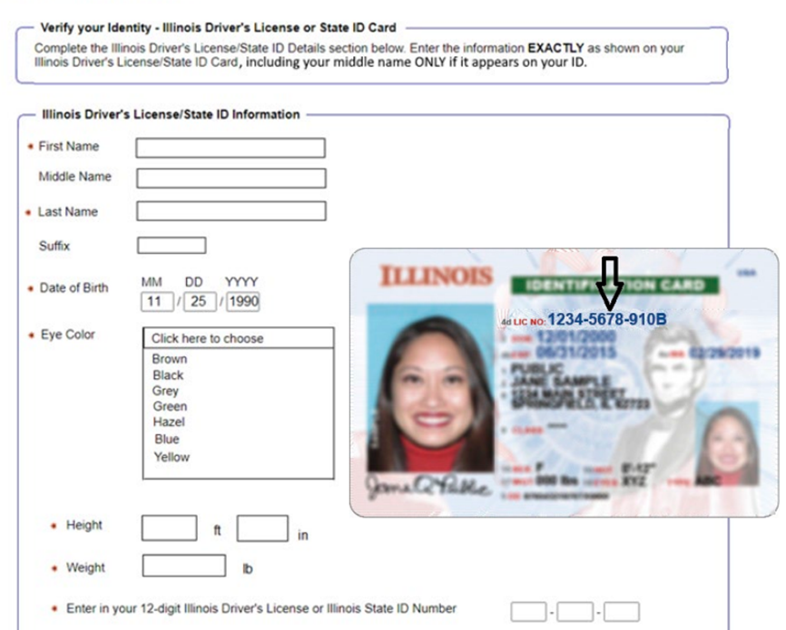
Identity proofing option 1
Step 12
They will advance to the Experian Identity Proofing process
They will advance to the Secretary of State ID Proofing process.

Slide 21
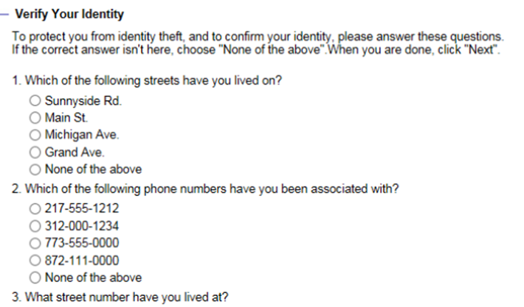
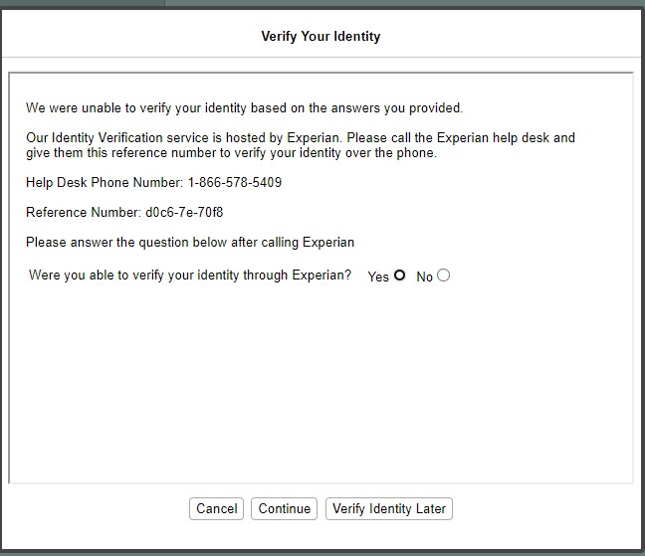
Identity proofing option 2
Step 12
Choose the best answer.
If identity is verified, the system will advance to Manage My Case.
If identity is not or cannot be verified, you go this screen.

Slide 22
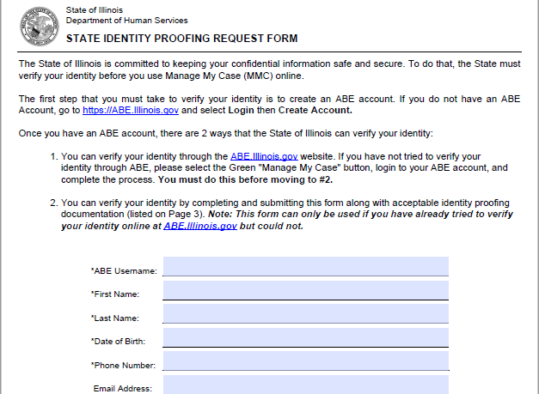
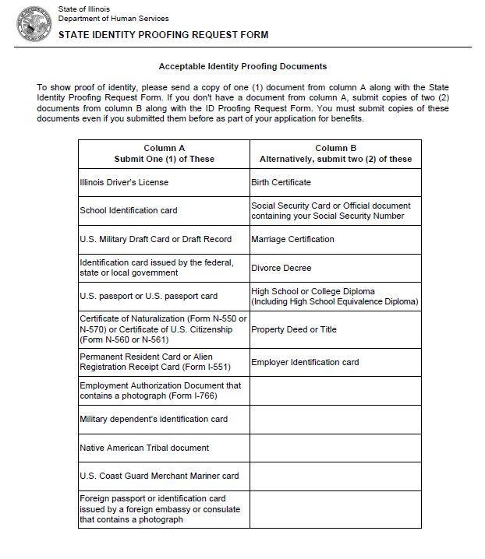
Identity proofing 3 - Manual
Step 12
1. Fill out, sign, and return the State Identity Proofing Request Form (pdf), and proof documents.
2. Proof documents listed on pg. 3 of the form:
one (1) document from Column A or
two (2) documents from Column B
3. Return the completed form and proof documents to:
Illinois Department of Human Services
Attn.: ID Proofing Unit
600 E. Ash, Building 500, 5th Fl.
Springfield, IL 62703
or
Return the form to your local FCRC
Allow 6-8 weeks to process.

Slide 23
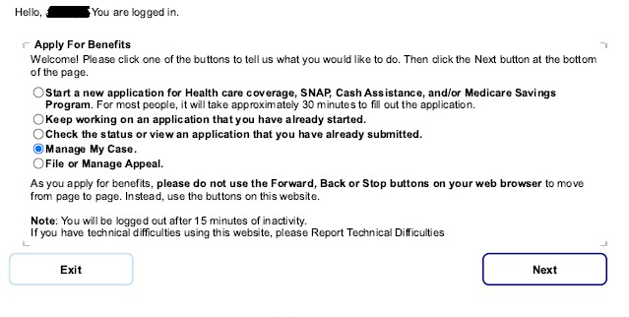
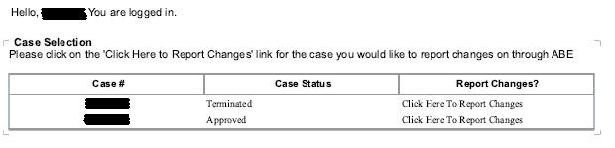
Ilogin Successful – accessing mmc
If you choose “Manage My Case”, you will get this screen. Click on “Click Here to Report Changes” to access information and copies of notices.

Slide 24
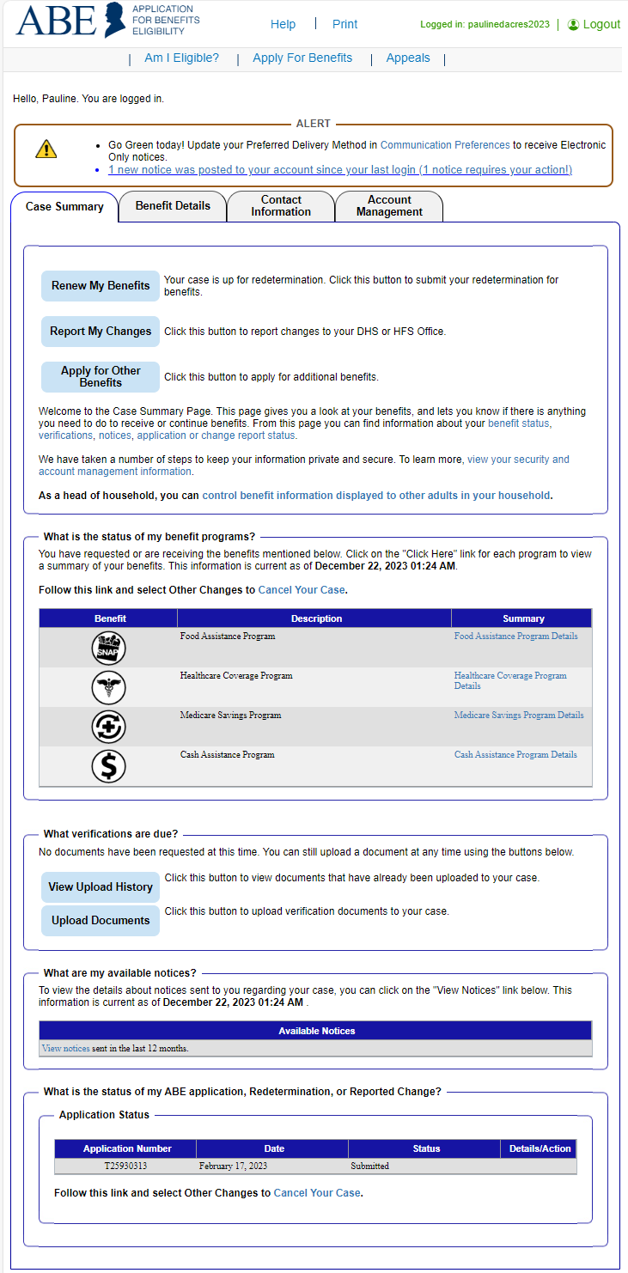
MMC – TABS Overview
The Manage My Case landing page is divided into four (4) tabs:
Apply for new benefits or report case changes
View correspondence for past 12 months.
View the status of application, redetermination, or reported case change
Reschedule an Appointment
View the type of assistance received by month
View current benefits and when they’re up for redetermination
View historical benefit information
View how to contact someone about their case
Send an email to the FCRC
Adjust access permissions for household members and third party reps
View/change communication preferences
Change a password

Slide 25
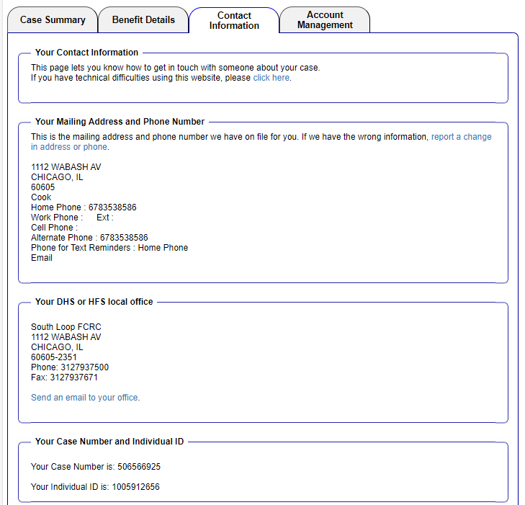
MMC – Contact information
Report change in contact information
Homeless clients using their local FCRC for a mailing address will show up matching their local office.
Case number and Individual ID
Question sent here appear in caseworkers email queue in IES
12345678
12345678

Slide 26
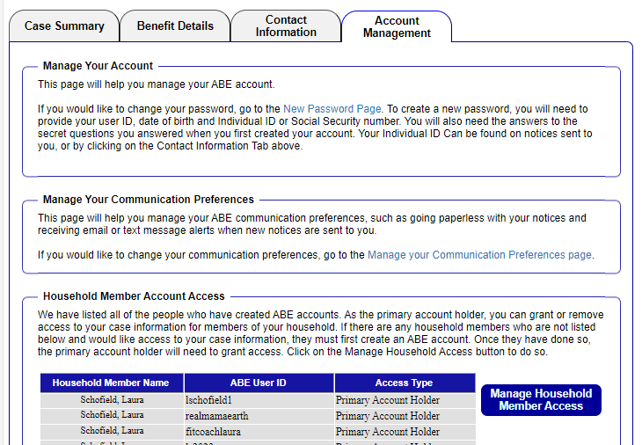
MMC – Account Management
Change password
Manage Communication Preferences (including signing up for text alerts)
Primary account holder can grant access to other adult members on the case

Slide 27
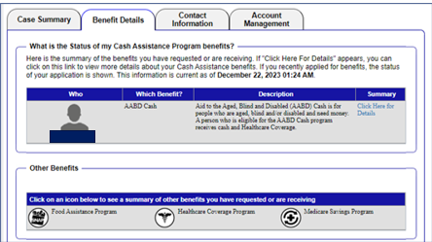
MMC – benefits details
Click here to get detailed information

Slide 28
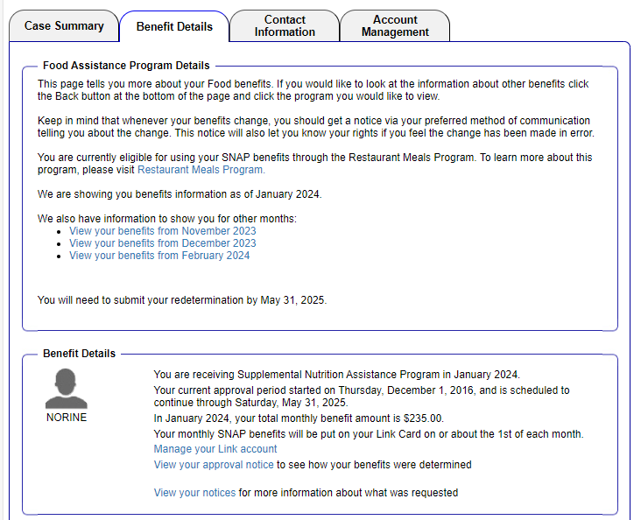
Benefits details - Food
Restaurant Meals Program
Redetermination deadline
Current approval period
Other benefit months
Benefit Amount

Slide 29
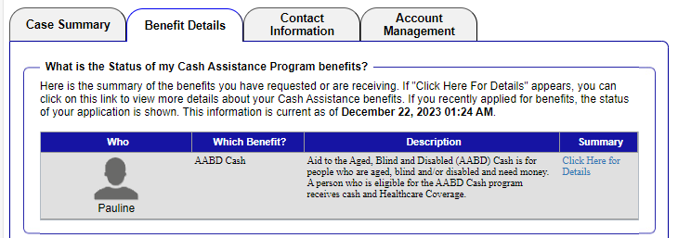
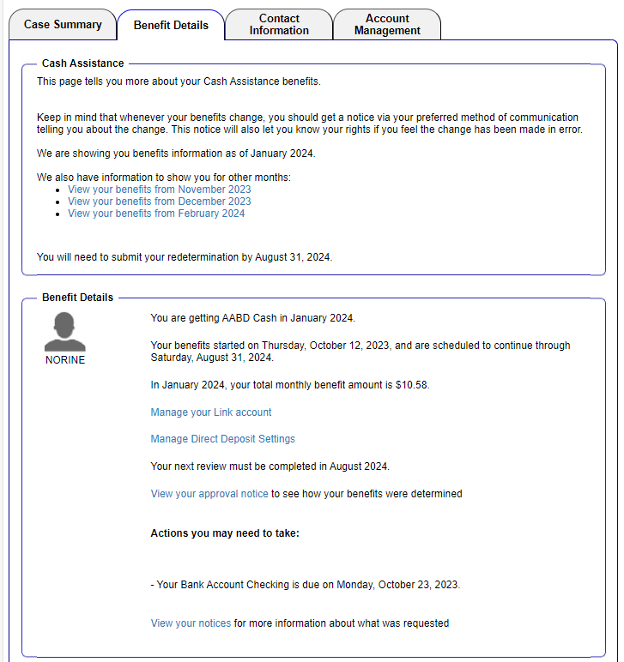
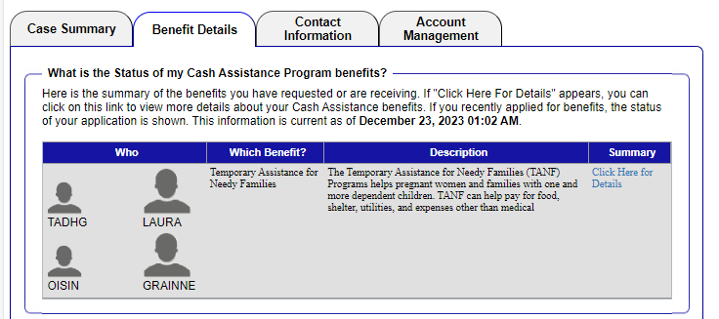
Benefits details - Cash
AABD
Other benefit months
Start date and approval period
TANF
Current amount

Slide 30
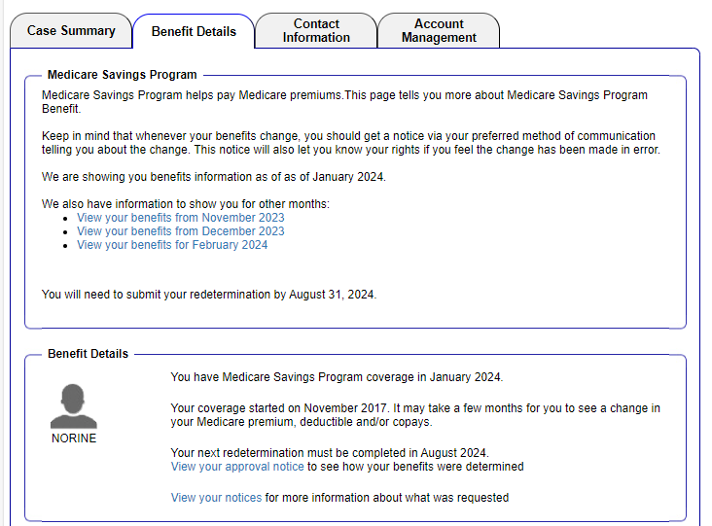
Benefits details - Medicare savings program
Other benefit months
Redetermination deadline
Start date and approval period

Slide 31
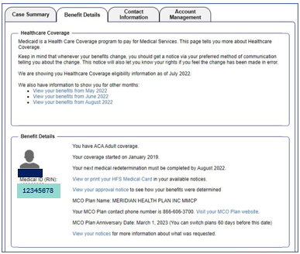
Benefits details – medical coverage
Medical Program
RIN Number
Start date and approval period
MCO (Managed Care Organization) Plan details

Slide 32
Case Summary
Renew benefits - The Renew My Benefits button will display when the customer is up for redetermination. Appears when redetermination letter is generated 60 days before end of benefit period
Make Changes
Apply for additional benefits - Apply for Other Benefits is only for requesting additional benefits on an existing case.
Goes to benefits details page
Verification Documents submitted online
Summary of Communication from DHS
Application Status

Slide 33
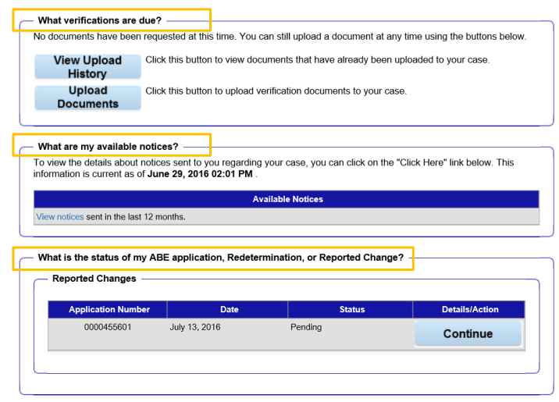
Verifications docs, notices, case status
View notices
Check the status of an application

Slide 34
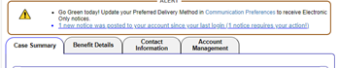
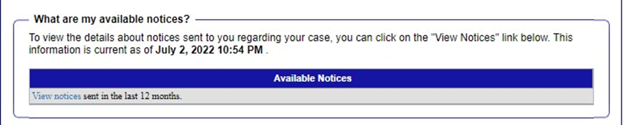
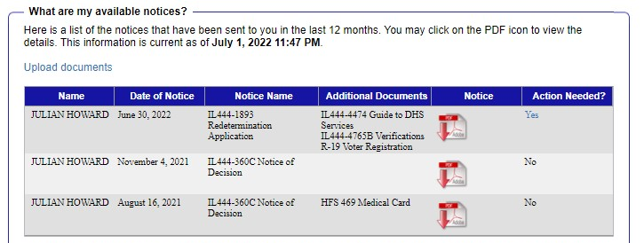
Notices
Click to view notices
Date POSTED – You must look at the notice itself to see the date of the notice, which is important for calculating appeal deadlines.
Click here to see the notice

Slide 35
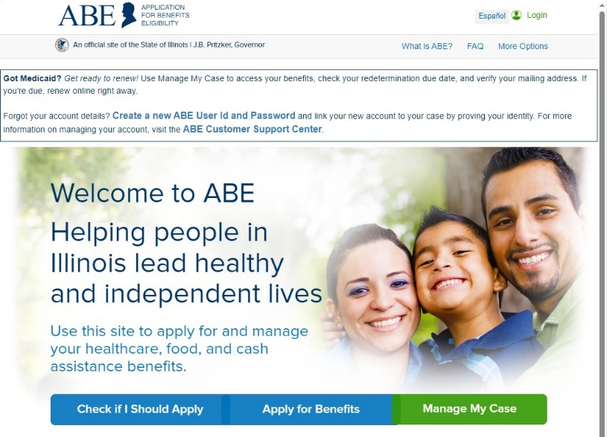
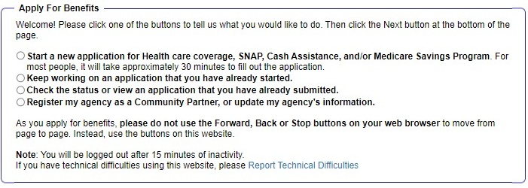
DHS programs – how to apply
  Note: Once you submit an application in ABE, you can no longer make changes to it in ABE, but you are able to view the application as it was submitted. Applicants should contact the office where the application was sent for processing to report any changes.
2

Slide 36
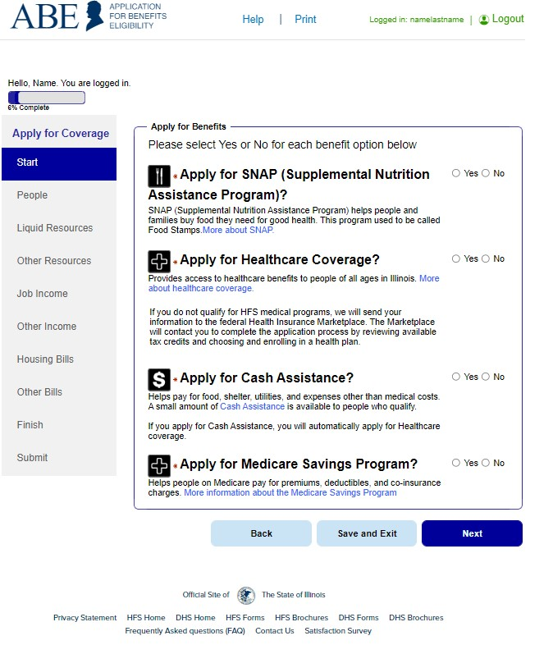
OVERVIEW OF APPLICATION
Shows the percentage of the application complete
How many people in the household, review of rights, who is filing app?
Who is in the home?
Income and Resources
Expenses
Review of answers
Submit application

Slide 37
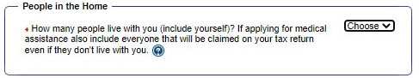
People in the home
Include everyone in the Household when applying for benefits.
Because eligibility for some medical programs are based on tax law, you also should include others who are included on your tax return if applying for medical benefits.

Slide 38
Selecting programs
Select yes for every program unless you do not want a benefit.

Slide 39

Personal information
Applicants will be asked identifying information. The red asterisks (*) indicate required information.

Slide 40


address
Check this box to indicate whether you are homeless and leave the address blank.
If you do not have a mailing address you can use the rule below to use your local FCRC.
WAG 06-04-03: Homeless Benefits
Mailing Address
Obtain approval of the LOA to use the Family Community Resource Center address for a customer with no permanent address.

Slide 41

Contact information
It is important to provide accurate contact information so that DHS can reach you.
If DHS cannot reach you to complete your interview, you made be denied benefits.
If you do not have a phone, applicants can go into their local FCRC and request their interview on the spot

Slide 42


Citizenship
If you are not a U.S Citizen: Select NO
---
If you are a documented non-citizen, select YES
If you are undocumented select NO
(selecting NO does not automatically disqualify you from receiving benefits).
---
Select document type, ex:
  Permanent Resident (I-551)
  Arrival/Departure record (I-94)
For document number – enter the full number on the documentation you have, ex: Alien number, certificate of naturalization number, etc.
Upload the document at the end of the application when it asks for documentation under the citizenship tab if you are able to – this will speed up processing your application.
If you are a U.S Citizen: Select YES

Slide 43

Other Resources
The system will ask you about various resources. Some programs have resources limits. Others require reporting resources, even if they aren’t relevant to eligibility.
Note on Life Insurance
ONLY report life insurance if it has a cash value. That means that you could “cash out” the plan while you are still alive.
- Term life insurance typically does not have cash value
- Employer provided life insurance typically does not have cash value
- Whole life insurance typically DOES have a cash value

Slide 44

Income from traditional employment
IDHS wants “Gross Pay” – the amount you are paid before taxes or other deductions (not how much you receive)
IDHS will confirm your income with IDES (Illinois Department of Employment Security), if possible.

Slide 45

Income from self- employment
Make sure you take time to think through your expenses, e.g.:
Anything you buy for work
Insurance
Transportation required for employment, which, depending on your job, could include mileage/gas, repairs, tune-ups
Taxes
Fees
Phone/Utilities
Advertising

Slide 46

Other income
Always report GROSS income.
IDHS shares data with some other government agencies and will use that data to confirm your income. This includes:
Social Security income
Illinois unemployment benefits
Some child support
IDHS does not have access to data from other sources. You must later verify this monthly income:
Veterans Administration
Railroad Benefits
Pensions
Passive income

Slide 47

interview information
Write anything else you want IDHS to know. It’s okay if you told them already. E.g. “I’m homeless.” or “I do not have a phone. I will come to the office for my interview.” and so on.
If you have a special rule you know and that you want the worker to use, you can put that here to. For example, “I am homeless and have shelter costs. Please use the Homeless Shelter Deduction in PM 06-04-03 for my SNAP.”

Slide 48

Expedited snap - PM 02-08-01
If you qualify, you will could get your benefits faster.
However, you still need to complete the whole SNAP application process later.

Slide 49
Print submitted page
When the application has been successfully submitted, an Application Summary page comes up with your Application Number.
We recommend you print and keep a copy of your application.

Slide 50


Upload documents
Be sure to click the [Add] button and the [submit] button

Slide 51
Questions?
Gwynne Mashon
gmashon@legalaidchicago.org
For technical assistance reach out to DHS
abe.questions@illinois.gov

