Slide 1
Back to Basics: An Introduction to Public Benefits
Keegan Dyer (w/ Gwynne Kizer MASHON)
04/08/2025

Slide 2
AGENDA
Administrative Agency | Topics we will discuss
Social Security Administration (SSA) | What benefits do they administer Who qualifies What do people who qualify for the benefit get How to apply
IL Department of Human Services (IDHS)
Caveat: All of these programs have a lot of complicated rules which have exceptions, exceptions to those exceptions,
and so on. Thus, we cannot cover all of the rules for any of these programs today.

Slide 3
Applying for benefits Generally
Application
Written decision
Opportunity for Appeals if the decision isn’t fully favorable
Agency confirms eligibility:
No cost to apply
No negative consequences for applying for something you don’t qualify for
No punishment for wrong answers as long as you’re not lying or misleading on purpose
The agency will lose things! Keep copies of everything you submit and proof of submission when possible.
Failure to complete administrative eligibility steps often results in denials.
Agency errors are not uncommon. You have a constitutional right to appeal those decisions.

Slide 4
Social security
Benefit Type | Eligibility | Maximum (average) monthly benefit in 2025* | How to Apply
Retirement | Is at least 62 years old and has earned enough SSA work credits | $5,108 ($1,976) | https://secure.ssa.gov/iClaim/rib or in Person
Disability | Has one or more conditions that together prevent the person from engaging in “substantial gainful employment” and has earned enough SSA work credits | $4,018 ($,1580) | https://secure.ssa.gov/iClaim/dib or 1-800-772-1213
Survivors | Certain surviving spouses and ex-spouses, parents, and children | $5,108 ($1,832) | In Person
Supplemental Security Income (SSI) | Has one ore more conditions that together prevent the person from engaging in “substantial gainful employment”, or is blind, or is over 65 years old; AND meets SSI income and asset caps | $967 | https://secure.ssa.gov/iClaim/dib
* Most do not get the maximum amount. The reasons amount might be lower then the maximum
vary by benefit type. Maximums amounts for all benefits change every year.

Slide 5
Social Security
diagnosis
symptoms
Functional limitations
Unable to engage in substantial gainful employment
Most show they cannot work any jobs, not just the jobs they’ve held in the past
Diagnosis is not enough. Conditions must result in symptoms and limitations that prevent a person from working.
Evidence used: statements by the claimant and others who know the claimant; objective evidence documented in medical and other treatment records
Strongest evidence is medical records, objective testing, and doctor’s observations
If client declines a treatment because of side effects, or fear of side effects, or the inability to pay for or access a treatment, or some other legitimate reason, that needs to be documented by the medical provider; otherwise, SSA might decline the application
Must have lasted or be expected to last for at least 12 months

Slide 6
Disability – 5-step Sequential Analysis
1. Not working at “substantial” level ($1,620 gross per month/ $2700 if blind); and
2. Have a “severe” medical impairment; and
3. “Meet a Listing” = have illness that meets specific regulatory guidelines (test results, labs, etc) considered automatically disabling
OR
4. Based on what you still can do despite your physical and mental impairments (“Residual Functional Capacity = RFC), you cannot Return to Past Relevant Work (last 15 years); and
5. Considering your RFC, your age, education, and previous work experience (if any).
You can be found disabled as you age (generally 50+) if you cannot do past physically demanding work, and you have little education and voc skills

Slide 7
Social Security
Typical Process for applying for SSI and Disability (SSD)
Complete SSI and SSD application
SSA determines if client has enough work history for SSD
DDS sends claimant a lot of documents to complete
Claimant returns documents
DDS schedules “consultative exam(s)”
DDS determines whether the claimant meets SSA disability standards
If “disabled”, SSA determines if claimant meets SSI financial requirements
SSA transfers case to DDS
Approx. 9 months!

Slide 8
Social Security
Application
Reconsideration
Administrative Hearing
Appeals Council
Federal Court
Appeals Process for applying for SSI and Disability (SSD)
Only about 30% of applications are approved on the first application so encourage your client not to feel too defeated if their application is not approved initially.
Deadline for filing appeals at each level is 65 days after the date on the notice denying benefits
Appeals add anywhere from 6 months to several years to processing time.

Slide 9
IL Department of human services
Food Assistance
Medical Assistance
Cash Assistance for Low-Income Families
Cash Assistance for Elderly and People with Disabilities
Cash Assistance for Non-Citizen Victims of Trafficking, Torture, or Other Serious Crimes
Cash Assistance Programs

Slide 10
Covers food: only can be used for unprepared foods
*** SNAP Restaurant Meals Pilot is on track to expand access to people who cannot prepare their own meals***
Benefit Amount:
Based on household size, income and certain expenses
Before comparing to the gross income standard, these costs are deducted:
Court-ordered child support someone pays
Self-Employment expenses
Other considerations for determining net income and monthly benefit:
Housing expenses
Homeless Shelter deduction for people who are homeless
Some medical expenses
Some child care expenses
SNAP “Households” live and prepare food together
Under 22 and living with parents must be in parents’ household
Under 18 and living with adults must be in adults’ household
Eligibility factors include:
Citizenship/Immigration Status
Illinois residency
Gross Income limit:
165% FPL (currently $2,071 for a single person as of 10/24)
200% FPL (currently $2,510 for a single person as of 10/24) if 60+ or disabled*
[Net income limit for 60+ or disabled = $1,255]
Asset limit:
There is no asset limit for most households in Illinois

Slide 11
Myths and facts about Snap for people who are homeless
You must have housing and a mailing address to get SNAP.
If a person does not have a mailing address, they can list the local FCRC office as their mailing address. They will need to check in the FCRC or check their case on Manage My Case frequently to ensure they don’t miss notices or deadlines.
People who live in shelters can’t get SNAP because they already get free meals.
You can get SNAP even if you live in a shelter with meals.
You need a photo ID to get SNAP
You must prove identity to get SNAP. You can use the state ID or the City Key ID. If you do not have those, you can use a work or school badge, an ID from a social service provider, a pay stub, a voter registration card, or your birth certificate.
If DHS already has an ID for you on file, you should not be required to submit identify evidence again.
Homeless youth have to provide their parent’s income when they apply for SNAP benefits
Homeless youth can apply on their own. Their parent’s income does not count.
You are required to work to apply for SNAP benefits.
SNAP requires people “register for work” (which is done through the application process), not reject a suitable job, and not voluntarily quit a job without good cause. These work requirements do not apply to all people; e.g. elderly, people with young children, people with disabilities, etc.

Slide 12
Special snap rules for people who are homeless
For DHS purposes, a person is considered “Homeless” if their main nighttime residence is ANY of the following:
A supervised shelter that provides temporary accommodations
A halfway house or similar facility that provides temporary residence for persons intended to be institutionalized
A place not normally recognized as a place to sleep (a hallway, a garage or shed, a train or train station, a library, their car, a tent, etc.)
A temporary stay in the residence of another person. Persons are considered homeless for no more than 90 days when they are residing temporarily in the home of another person.

Slide 13
Special snap rules for people who are homeless
Residency
Proof of Illinois residency is not required unless DHS has reason to believe the applicant actually lives in another state (e.g. if they are getting benefits from another state)
Homeless Shelter Standard
When calculating how much SNAP a person receives, DHS will consider housing expenses. If housing expenses are more than 50% of income, then the person might receive a higher SNAP amount.
If a person is homeless, they should qualify for the Homeless Shelter Standard if they do not have free shelter throughout the month and they do not opt for an excess shelter allowance.
To qualify, they must allege some sort of shelter cost, but they do not need to verify the expense.
Expedited Benefits Processing
Though not specifically for people who are homeless, many should qualify – e.g. if liquid assets are less than $100 and gross monthly income or the month of application is less than $150
Should be interviewed within 2 days of application and have benefits in hand within 5 days
They still must complete regular application process or benefits will be terminated

Slide 14
TANF
Usually requires a relative caretaker and a minor child (but not always)
Families who are homeless ARE eligible!
Cash benefits: Can be used to pay for most expenses; Recipients can withdraw cash funds from ATMs
Benefits Amount: Based on household size and income. Benefits are usually very low ~ 30% FPL
TANF is hard!
Limited to 60 months in (adult) lifetime: “clock”
Work Activity Requirement
BUT exemptions to both clock and work requirement for
people with disabilities
experiencing domestic violence
caring for very ill family members
Caring for child under 1 year old (stops work, not clock)
Good cause for work activity at various points during the pandemic; does not apply to the “clock”
Continuing/ returning education
Have to Cooperate with Child Support Enforcement
Exceptions for DV, sexual violence, etc.
Have to tell what you know – cannot be penalized for what you don’t know
“Pass-Through”: If receive TANF and child support, state “passes through” $100 for 1st child and $200 for 2+ children families. This means parent/recipient will get pass through amount + TANF grant. State keeps rest of support. If support > TANF, get off TANF.

Slide 15
Special TANF rules for people who are homeless
Homeless families can qualify for payments under the Crisis Assistance Program
Crisis Assistance: Provides payment for rent, food, clothing, household supplies, and essential household furnishing
Emergency Shelter: Provided crisis housing for homeless families in Cook County

Slide 16
AABD Cash
For People Age 65+ OR meets SSA’s definition of “disabled”
Usually must be receiving SSI or be over-income for SSI under SSI’s rule (note that because of the ways SSI counts income, a person might be “over-income” for SSI but actually receiving very little income)
Some immigrants who cannot get SSI for immigration status reasons (7 year limit for asylees/refugees) can get larger AABD cash grant)
Must have countable assets under the limit ($2000 individuals; $3000 married couples)
Benefit Amount:
Based on income and certain expenses; taking into consider whether the applicant is legally responsible for someone else and whether someone is legally responsible for them
The average is about $60-$70/mo, but can be several hundred dollars per month.
Cash benefits: Can be used to pay for most expenses; Recipients can withdraw cash funds at ATMs

Slide 17
Special AABD Cash rules for people who are homeless OR PRECARIOUSLY HOUSED
Restaurant Meals Allowance:
Though not specifically for people who are homeless, many people who are homeless who are categorically eligible for AABD Cash should qualify for the AABD Cash Restaurant Meals allowance. Because of the complicated way AABD Cash is evaluated, this allowance could mean that many people who are homeless who would otherwise be ineligible are eligible for cash benefits.
Excess Shelter Allowance:
This is a rent assistance payment for people who are blind or disabled. To be eligible a person just needs to show that they have disability and that the cost of housing that would accommodate the disability is greater than $97. NOTE: this benefit is not available to unhoused people, but can be a good way for disabled people to maintain housing that would otherwise be unaffordable.

Slide 18
Replacement link cards
If your card is lost or stolen, report the card missing and request a replacement as soon as you can. Keep a log of what day and time you report your card missing. You should not be responsible for charges made to your card after you report it missing. Under current policy, DHS will not replace stolen benefits.
Go to the FCRC if:
You never received a card or set up your PIN
You use the FCRC as your mailing address
You have an approved representative
You have no SSN
Your card was destroyed in a fire*
Otherwise, call 1-800-678-LINK (5465) or visit LINK.gov. You will need:
Social Security number on the LINK account
Date of birth
LINK card number or PIN
If you request five replacements within a 12 month period, DHS might investigate to determine whether there’s wrongful use of benefits, before issuing the fifth replacement.
* If food purchased with SNAP is destroyed in a fire, you can request replacement benefit to purchase new food. But the request must be made immediately.

Slide 19
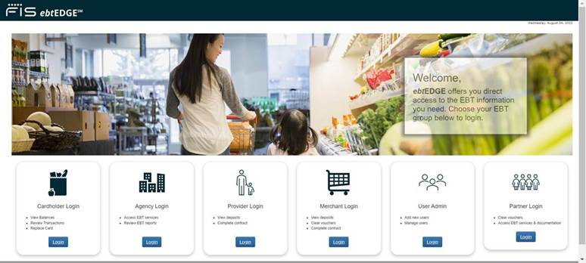
Illinois Link card fraud
Link theft seems to be more and more common.
Protect Yourself
Report Theft
Request replacement SNAP benefits (DHS currently states that it cannot reimburse other benefits for any cash benefits or state food benefits or SNAP benefits stolen after 10/20/24.)
https://www.ebtedge.com/gov/portal/PortalHome.do

Slide 20
Medicaid
Who Qualifies (non-exclusive list) | Income Limits (2023) | Asset Limit | Other
US citizens and most LPRs and some other immigrant under 65 years old IF they do not have Medicare | 138% FPL $1,677 for an individual | None
Children | 318% FPL $3,864 for an individual | none
Medicare beneficiaries; US citizens and most LPRs over 65 years old; (noncitizens 65+); Non-Citizen victims of trafficking, torture or other serious crimes; Asylum Applicants and some other immigrants | 100% FPL $1,215 for an individual | $17,500 | Can spenddown excess income/assets to become eligible for Medicaid
Pregnant Women and their babies (until baby is 12 months old) | 213% FPL $3500 for a family of 2 $5,325 for a family of 4 | None
2022 amounts

Slide 21
MedicaRe Savings Plan
Program Name | Monthly Income Limits | Resource/ Asset Limits | Program Pays | Effective Date
Qualified Medicare Beneficiary (QMB) | 100% FPL $1,305 Individual $1,763 Couple | $9,660 Individual $14,470 Couple | Part A & B Premiums, Deductibles, & Coinsurance | Premiums are paid effective the month of QMB eligibility which is (the month after the month of the QMB eligibility determination.
Specified Low- Income Medicare Beneficiary (SLIB/SLMB) | 120% FPL $1,565 Individual $2,115 Couple | $9,660 Individual $14,470 Couple | Medicare Part B Premiums | Part B premium paid for application month & may be backdated an additional 3 months.
Qualified Individual-1 (QI-1) | 135 % FPL $1,761 Individual $2,380 Couple | $9,660 Individual $14,470 Couple | Medicare Part B Premiums | Part B premium paid for application month & may be backdated an additional 3 months.
2022 amounts

Slide 22
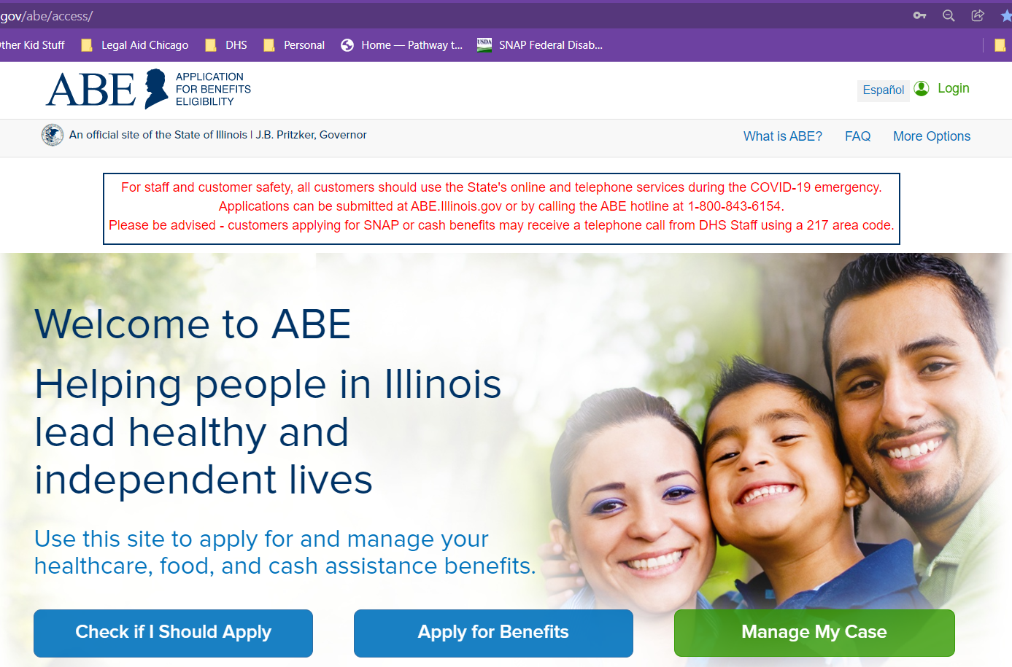
DHS programs – how to apply
Apply online on ABE: https://abe.Illinois.gov
Apply at Local IDHS Office. “Family Community Resource Center” locator at: http://www.dhs.state.il.us/page.aspx?module=12
What to bring: ID, SSNs for all household members, proof of immigration status, proof of income for last 30 days
Legal Aid Chicago PBOE referrals– more on this later
To be treated as an application, all the form needs is your name and signature. (Though practically, DHS also needs a way to contact you.)

Slide 23
DHS programs – After application
Participate in an eligibility interview (SNAP, TANF, AABD Cash)
Submit requested verification documents to DHS.
Pay check stubs or other proof of income
Proof of identity
Proof of available resources (AABD and TANF)
Other proof as needed esp. if there’s a conflict between information in the application and information on databases used by DHS
Creating and signing a Responsibility and Services Plan (TANF only)
Agreeing to cooperate with child support enforcement (some TANF and Medical)
Notices:
Open and read mail from DHS as soon as you get it. Keep copies of notices AND the envelope if you have one. DHS should send you a notice once it’s made a decision. Be sure to read the notice, esp. the short paragraphs. Also pay attention to dates.
If your application is denied because you didn’t turn in verifications or because you missed an interview, you can appeal and ask DHS to reopen your case and grant benefits back to the application date. But there’s a deadline for filing the appeal*.
If your application is denied because DHS just got it wrong, you can appeal, but there’s a deadline for that too*.
If DHS doesn’t make a decision in the required processing time, you can appeal that too.
* Not every deadline is really a deadline. If a notice is legally insufficient, we can argue that appeal deadlines should not apply. This is particularly common with AABD Cash decisions.
Benefit | Processing Time
SNAP | 5 day (expedited); 30 days other applications
Everything Else | 45 days

Slide 24
DHS programs – Tips on applying when homeless
The application:
No mailing address? Use the address of a service provider (with permission) or the FCRC nearest you
Unsure of information in the application? That’s okay! DHS must verify information. The application is not a test. You won’t get charged with fraud just for not being completely correct, or for not understanding what they’re asking for.
Don’t have rent? Still think of any shelter related expenses you can think of and put them in the application somewhere – if nowhere else, you can add it to the notes at the end of the application. For example:
Do you stay in motels sometimes?
Do you pay train fare so you can have a place to rest?
Do you stay at friend’s houses sometimes and chip in for expenses while you’re there to thank them?
In the notes at the end of your application write “I am homeless under PM 06-04.”
If possible, apply online and LINK your account. That way, your documents are saved online for you and you can check on the status of your application and see any notices there.
Submit whatever ID documents you have with your application. If you have it, also submit proof of any earned income you received in the last 30 days. But do not wait until you have these documents to file your application.
Keep a copy of your application after you submit it! Try to keep a copy somewhere that will be safe. You can consider taking a picture on your phone or saving the pdf to your device. Maybe you can even upload the picture to online storage, text the image to someone you trust, email yourself a copy, etc.

Slide 25
DHS programs – Tips on applying when homeless
Verification Checklist:
If DHS asks you to submit verifications and you don’t have them, then ask DHS for help. They should either help you get the verification or give you other ideas for other things you can use to prove whatever it is they are trying to prove.
DHS only gives 10 days from the date they mail the verification checklist to submit verifications. If you need extra time, ask DHS and they should give it to you. If you obtain verifications after the deadline, still turn them in.
Keep copies of everything. Also keep proof that you submitted information. If you can keep of log of your calls with DHS, that can also help later on if there’s problems.
Interview:
Make sure you answer your phone even if you don’t know the number. DHS might try to call you from an unknown or blocked telephone number.
If you miss an interview, call DHS to ask them to reschedule it. If they haven’t denied your application yet, they are supposed to reschedule your interview. You can also go to the FCRC and let them know that you have an interview by no phone. They should do the interview in the office.

Slide 26
Manage My Case
https://abe.Illinois.gov
Be sure to check all cases
Click here to see case details

Slide 27
Benefit Details
Verifications
Notice History

Slide 28
Benefit Details
Medicaid RIN
Note that information in this section isn’t always up to date or reliable, esp. regarding dates applications were denied or benefits terminated.

Slide 29
Date system updated
Notices for last 12 months posted.
Types of Notices include:
Notice of Decision,
Medical Cards,
Prehearing Meeting Scheduling,
Verification Checklist,
Redetermination Application
Notice of Decision
Medical Card
Click on these to download

Slide 30
Notice Date
Unfortunately, the “proposed action” does not always state what DHS is actually doing!
If you need help figuring out what’s going on, reach out to LAC-PBOE.
Proposed Action

Slide 31
Medical Expenses
Monthly SNAP Benefit Amount &
Who is included in the SNAP Household
Homeless Shelter Standard
Income Used to Calculate SNAP amount
People who are homeless can be eligible for the Homeless Shelter Standard OR the Excess Shelter Deduction, not both
Shelter Expenses

Slide 32
Restaurant Meals could be here or in its own line
Final calculations for AABD Cash often don’t make sense.

Slide 33
Appealing dhs decisions
What is appealed?
Incorrect decision
No decision within the processing time (“Inaction”)
Time to File
AABD Cash, MSP, TANF, or Medical: 60 days*
SNAP: 90 days*
How to File
Through “Manage my Case” https://abe.Illinois.gov
Inaction for any benefit: No deadline
phone: 1-800-435-0774 or 312-793-2618
Fax: 312-793-3387
DHS.BAH@Illinois.gov
Decisions where benefits are denied because of missing verifications or a missed interview!
*If the notice is legally insufficient, these deadlines arguably do not apply.

Slide 34
Referring clients to Legal Aid Chicago
Legal Aid Chicago Public Benefits Outreach and Enrollment Team can help people
determine what DHS, SSA, and Medicare benefits they might qualify for,
submit applications for DHS benefits,
Review DHS decisions to determine if they are correct, and
file and succeed in appeals related to DHS benefits.
Refer cases to Beth Warner during ride-alongs, to Chicago Public Library Cares at Harold Washington Library (on Wednesdays starting in April, or to our phone hotline (312-347-8342) or by contacting a PBOE paralegal directly.
Legal Aid Chicago also helps people with other civil legal matters including family, consumer, and eviction issues, including expungement. Call 312-341-1070 to apply for help.

