Slide 1
Making Cents of Income: Reporting Income and Expenses to Maximize IDHS Benefits
Gwynne Kizer Mashon
03.2025

Slide 2
Children & Families
Consumer
Legal Aid Chicago is a private non-profit that provides free civil legal services to people with limited income in Cook County, securing their rights to economic stability, affordable housing, personal safety, fair working conditions, and basic healthcare.
Criminal Records
Relief
Public Benefits
Long-Term Care
Immigrants & Workers’
Rights
Housing

Slide 3
Learning objectives
Understand why income matters for IDHS eligibility
Understand how IDHS treats common forms of earned income
Understand what to submit to show IDHS your income (verifications)
Agenda
What is Unearned vs Earned income
Income that changes
Verification of income
Multiple jobs
Self-employment (Lyft, Uber, Door Dash)
IDHS Budgeting tools (e.g. SNAP calculator)
PM WAG
Some of our slides include cites to the IDHS Policy Manual, which you can
find at https://www.dhs.state.il.us/page.aspx?item=13473

Slide 4
Illinois department of human services benefits & Income
Food Assistance
Medicaid & Medicare Savings Plans
Cash Assistance for Low-Income Families
Cash Assistance for Elderly and People with Disabilities
Why income (and especially earned income) matters
Eligibility for all programs is based on a number of factors including income.
Work requirements: TANF only (as of 3/7/25)
Note: SNAP recipients are currently receiving notices that look like this.
Many are confused and think they must comply with work requirements to continue
obtaining SNAP. However, these letters are related to work “provisions”,
not work “requirements”, which are waived in Illinois through 10/31/25. PM 03-25-00.
PM 08
WAG 25-03-02

Slide 5
When do I report income?
Application
Redetermination
Within 10 days of a change of income (Change report)
Mid-year report
In response to a verification checklist, which DHS might send if it suspects a change of income
We’ll go into some details here, but the most important thing you can do is… .do the best you can!
Source of income
Who is earning income
Business Expenses for Self-Employment
ADVANCED: Look up sources of income in PM (cites on following slides) to make sure you’re describing income and expenses correctly to IDHS.
What income to I report?

Slide 6
Verifying earned income, Generally
Income verification is required for all benefit programs except for persons who want only QMB or SLIB benefits.
Submit proof of income from any 30 day period that is within:
Date application is submitted through the date a decision is made
Date the redetermination is mailed through the date a decision is made
If that income does not represent backdated months or income in upcoming months, submit proof of income for those months as well
Employee Records | Employer’s Records
Pay check stubs | Employer Statements
Pay envelopes | Employer’s Wage Records
Employee’s W-2 Form | DHS Employment Verification Form
State or Federal Income Tax Return
PM 02-07-03-h
WAG 08-04-01

Slide 7
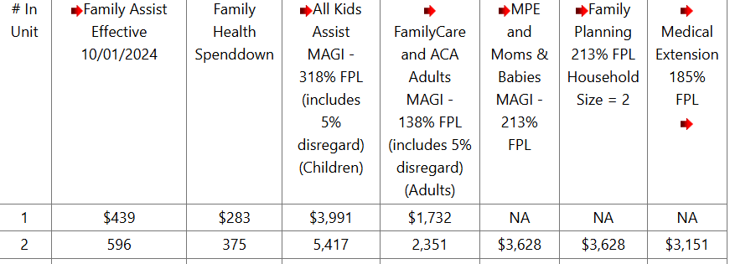
Illinois department of human services benefits & Income
IDHS uses income to determine if you meet financial eligibility for each program you apply for.
Countable Unearned Income
+ Countable Earned income
- Excluded Income
Countable Gross Income
Compare to gross income limit (Medical/SNAP) or maximum benefit (for Cash) to determine IF you’re eligible.
Used to start calculations of Net Income (SNAP), and to calculate monthly benefit (SNAP and Cash)
Gross countable income
– Deductions
Net income
PM 08
WAG 25-03-02

Slide 8
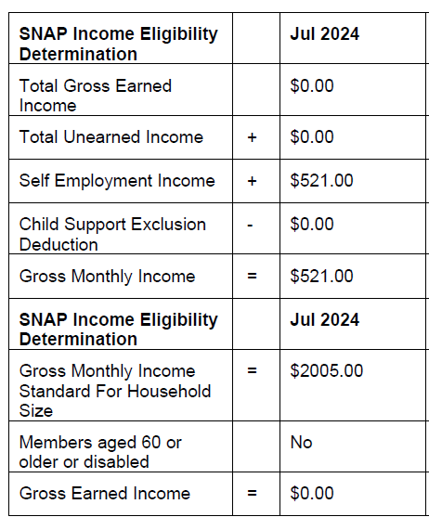
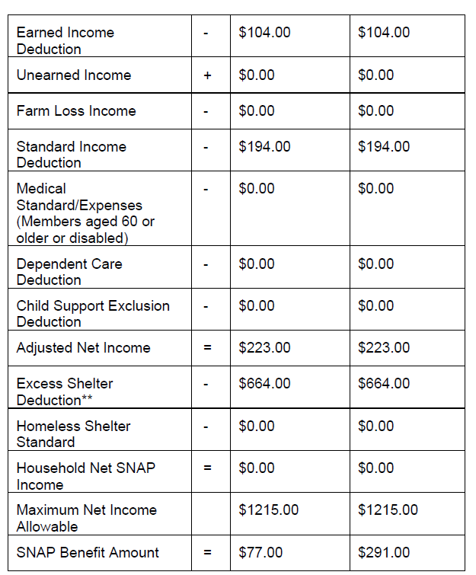
Income on notices
Income
SNAP notices should include budgets that indicate amounts of countable income DHS used in its decision.
However, we’ve sometimes noticed these budgets missing on notices in response to redeterminations or change reports, where DHS doesn’t think the change impacted benefits eligibility.

Slide 9
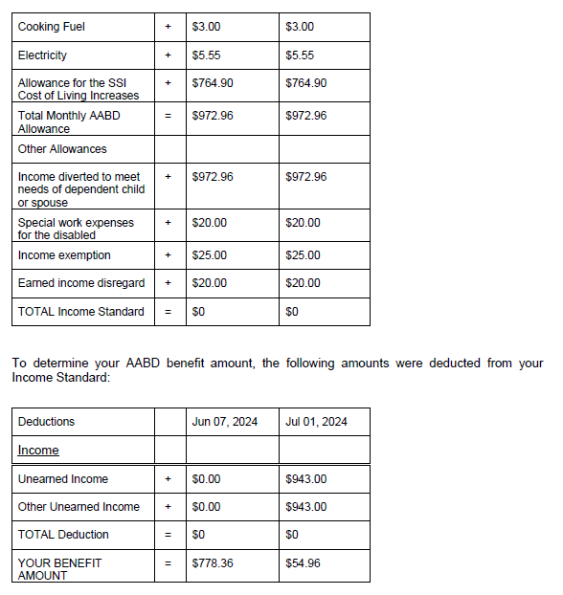
Income on notices
AABD Cash budgets sometimes list what income used in its decision.
These are the hardest notices to understand. Please let us know if you need help with one.
Earned income
Unearned income

Slide 10
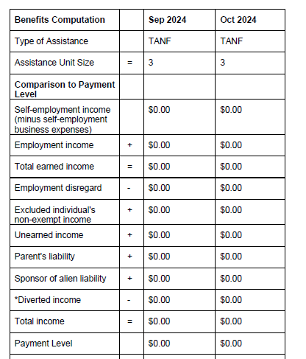
Income on notices
TANF notices should include budgets that indicate amounts of countable income DHS used in its decision.
Earned income
Unearned income

Slide 11
Income on notices
Medical notices often lack budgets, which can make it more difficult to see how DHS reached its conclusions.

Slide 12
These numbers are often different than the amount a client thinks they earned.
How did DHS get these numbers?

Slide 13
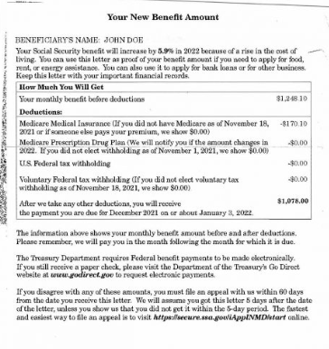
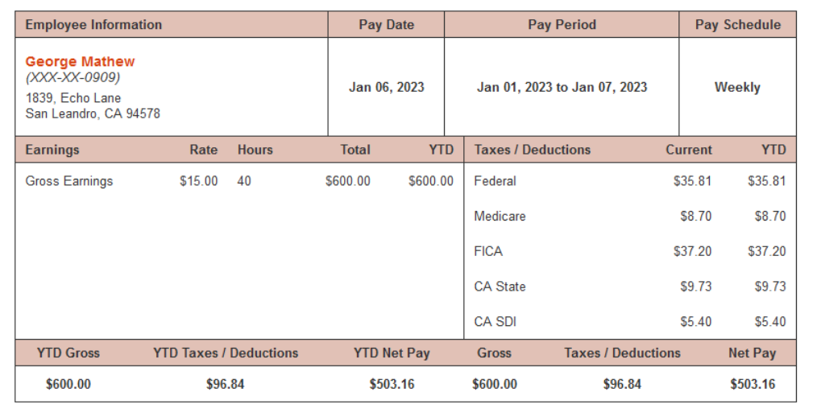
“Gross income”
What is Gross Income?
Income paid to you before deductions.
This might be different than the amount of money you receive.
Common deductions:
Garnishments
Child support and alimony paid as directed by legally binding agreement to go to a third party
Federal, state, and local taxes
FICA
Insurance (health, life, disability, etc.)
Retirement plan contributions
This person’s gross income is
$600 + $1248 = $1848
The amount of money deposited into this person’s bank each month is
$503 + $1078 = $1581
PM 08
WAG 25-03-02

Slide 14
Earned or unearned?
Earned income = wages or salary for work performed as an employee or profits from a person’s self-employment
Unearned income = income that is not earned income (e.g. Social Security, IDHS Cash benefits, pension)
How both earned and unearned income are treated vary by program. We will not get into detailed
program rules today but will look at general rules, and we will also highlight
any notable and common exceptions to rules that apply to most programs.
PM 08-01-01: TANF
PM 08-02-02: Medicaid for the Aged, Blind and Disabled
PM 08-04-00: SNAP

Slide 15
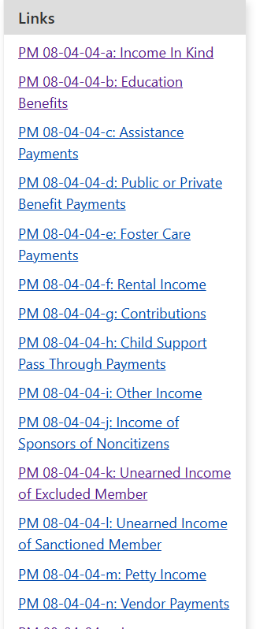
Note on Unearned income
Though not the topic of today’s training, please note:
Many categories of unearned income are exempt or excluded, or get some sort of special treatment. There is no easy way to summarize these rules. If you want to see how your unearned should be treated, you can:
Do an internet search for “unearned income PM” and the program.
Find a category that sounds like the income you have. Click on the link to see if the rule applies to you and how it applies to you.
If the unearned income you have isn’t here, it probably counts as income.
Search for “unearned income PM SNAP” brought me to https://www.dhs.state.il.us/page.aspx?item=15615

Slide 16
Special treatment of earned income
You do not need to memorize this!
Take-Away: Programs are generally designed to reward earned income over unearned income.
SNAP | TANF | AABD Cash and Medicaid + MSP | MAGI Medicaid
20% of countable earned income is deducted from the gross income when calculating net income. The net income is used to determine monthly SNAP benefits, and for eligibility determinations for some households (e.g. members who receive disability benefits and those 60+) | Those with earned income at eligibility are eligible for an “initial employment deduction”, reducing their net income. DHS then compares net income to the payment level to determine if a household is eligible. 75% of earned income is deducted before determining benefit amount and on-going TANF eligibility. | Earned income disregard: Aged/Disabled: first $20 of earned income plus 1/2 of the next $60 Blind: first $85 of earned income plus 1/2 of the amount over $85 Employment expense deduction, including: Withheld income taxes SSA tax Transportation Costs Special Tools and Uniforms Day care costs Special Work expenses for disabled persons | Pre-tax deductions for health insurance premiums, 401(k) contributions, life insurance, etc. Certain other expenses that were (or could have been) reported on IRS form 1040, including: Student loan interest Tuition and fees Alimony paid
PM 13-01-02-a: SNAP
PM 10-02: TANF
PM 08-02-03: AABD medical, AABD Cash, MSP
PM 08-03-03: MAGI Medicaid

Slide 17
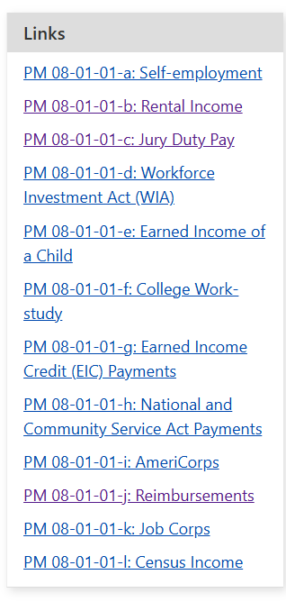
Earned income
Earned income = wages or salary for work performed as an employee or profits from a person’s self-employment
This includes:
Certain kinds of less common income get treated differently. It is hard to summarize how all types of unearned income are treated. If you want to see how your earned should be treated, you can do an internet search for “earned income PM” and the program
Wages, Tips
Self-Employment Income
Advances, Back Pay
Bonuses, Commissions
Paid time off
Overtime pay
Severance pay
Sheltered Workshop or Work Activities Center payments
Income from rental property you own and manage
Search for “earned income PM TANF” brought me to https://www.dhs.state.il.us/page.aspx?item=15191

Slide 18
special earned income rules for certain types of income
Earned income of minor | SNAP | TANF | AABD Cash and Medicaid + MSP | MAGI Medicaid
 | Exempt if: is age 17 or under; and attends elementary or secondary school; and is under the parental control of a SNAP unit member. | Exempt if receiving benefits as a dependent in the case | Not counted, but would only be relevant if the minor is receiving Medicare or if child is trying to access AABD Cash | Federal Income Tax Rules apply
SNAP: PM 08-04-01-g
TANF: PM 08-01-01-e

Slide 19
special earned income rules for certain types of income
College Work-Study | SNAP | TANF | AABD Cash and Medicaid + MSP | MAGI Medicaid
 | Treated as exempt unearned income And Can help student meet exception to college student ineligibility rules. | Exempt earned income and Can keep a month from counting against the 60-month clock | Exempt | Not exempt
SNAP: PM 03-04-03-b; PM 08-04-04-04-b
TANF: PM 08-01-01-f
AABD: PM 08-02-02-d

Slide 20
Self employment
Small business you run
Your grow fruits and vegetables and sell them
You create crafts/clothing/food and sell them
You do hair and are paid directly by clients
Child care
Ride-share and Food Delivery for apps like Uber/UberEats
You rent a room in your house and manage that property
Cash paid to you for work done where you are not an official employee
Income you receive for work you do not paid by an employer
Gross countable income from self-employment
Total amount you were paid – allowable self-employment expenses

Slide 21
Self employment expenses (not exhaustive)
 | TANF | AABD Cash and Medicaid + MSP | SNAP | MAGI Medicaid
Travel Expenses | A percentage of vehicle costs equal (including repairs, tune-ups, etc) to the percentage of mileage that the vehicle was used for business expenses |  | Same as TANF + insurance premiums | A percentage of vehicle costs equal to the percentage of mileage that the vehicle was used for business expenses
Phone costs | Costs in excess of what client would have paid for phone, but for the business needs
Utility costs | Costs in excess of what client would have paid for utilities, but for the business needs |  | Client can deduct a prorated portion of shelter expenses (utilities, rent/mortgage, insurance, taxes) | Costs in excess of what client would have paid for utilities, but for the business needs
SNAP: PM 08-04-01-b
TANF: PM 08-01-02-a; PM 08-01-01-a
AABD: PM 08-02-02-a
MAGI: PM 08-03-01-a; PM 08-03-01-b.; If self-employment expenses are greater than self-employment income, subtract loss from other income.

Slide 22
Self employment expenses (not exhaustive)
 | TANF | AABD Cash and Medicaid + MSP | SNAP | MAGI Medicaid
Other deductions specifically stated in rules | Inventory, Supplies, Raw Materials, Tools Repairs Space rental & utilities Advertising Payments to other employees/contractors Interest on loans Transportation required for employment |  | Same as TANF plus Principal and interest payments on real estate, equipment, machinery, and other durable goods Insurance premiums Taxes on income-producing property | See PM – the list of deductible expenses for MAGI is longer for MAGI than for other IDHS administered benefits
What does not count | Depreciation Losses of going out of business Entertainment Meals Personal transportation or commuting Housing/phone/utility costs they would incur even if they didn’t have self-employment |  | Same as TANF plus Net losses from previous periods Taxes Money set aside for retirement Other work-related expenses (e.g. transportation to and from work) | None specifically listed, but expenses must be: reasonable and necessary for producing self-employment income.
SNAP: PM 08-04-01-b
TANF: PM 08-01-02-a
AABD: PM 08-02-02-a
MAGI: PM 08-03-01-b.; If self-employment expenses are greater than self-employment income, subtract loss from other income.

Slide 23
Reporting self-employment
No specific form is required but DHS will send IDHS Form 2790:
https://www.dhs.state.il.us/onenetlibrary/12/documents/Forms/IL444-2790-IES.pdf
Other proof of self-employment income and expenses:
Business ledgers
Invoices
Receipts
Tax returns
Client’s statements if worker does not find information questionable and it is not reasonable for him to obtain third party evidence
List income
In the first
3 columns
List expenses
In the last 2
columns

Slide 24
How is monthly income calculated
Basic rules for consistent income
Income that varies
Changes in income
Weekly and Bi-Weekly pay: Total income for one month ÷ (number of checks) x 4.3
Semi-monthly pay:; Total income for one month ÷ 2 x 2
If change is expected, DHS uses a “best estimate” based on client’s statement, expected pay and hours, etc.
If income is less than monthly, annualize and average over the approval period to calculate monthly income
If income at application or redetermination is expected to end, use best estimate to calculate future income.
If a household is over-income for MAGI Medicaid but has projected annual income under 100% FPL, DHS must do a second determination of eligibility using projected annual income.
Special MAGI rule
Fluctuation in work hours
Increase/decrease in salary
Temporary absence from work
Job loss
Fluctuations in unearned income
Use the same calculation for income that varies:
PM 13-02-03: SNAP
PM 10-01-03-a: TANF

Slide 25
I’m confused. What income do I report?
You should report ALL income.
Regardless of whether IDHS asks, also report your expenses.
Do the best you can!
Wages, tips, bonuses
All income you receive from self-employment
All self-employment expenses, even if you’re not sure if it will count.
Be sure to say
Who in your family is getting payments,
Who the payments are from, and
What the payments are for

Slide 26
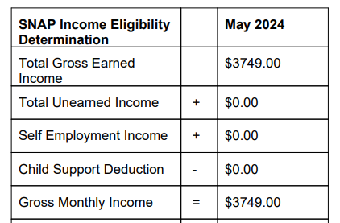
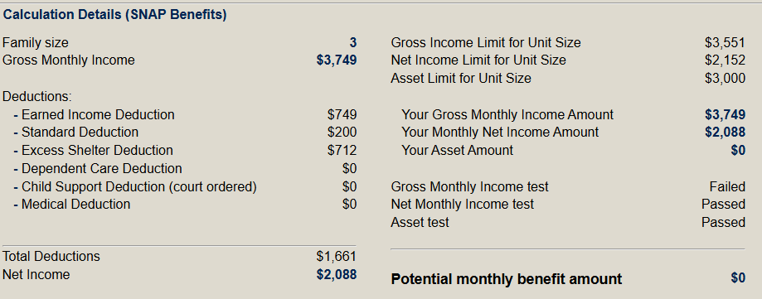
Let’s see why reporting whos and whys are important
Jan is a single mom living with her children who are 19 years old and 16 years old. They all work but are having a hard time making ends meet. They applied for SNAP but were denied. Jan entered all of the income on her application as her own income. This is what the notice looked like
You learn she pays $2000/month in rent plus all utilities.
You run the IDHS SNAP Calculator. https://fscalc.dhs.illinois.gov/FSCalc/calculateFS.do.
Jan is frustrated because she knows she isn’t making enough money to feed her family.
What can we do?

Slide 27
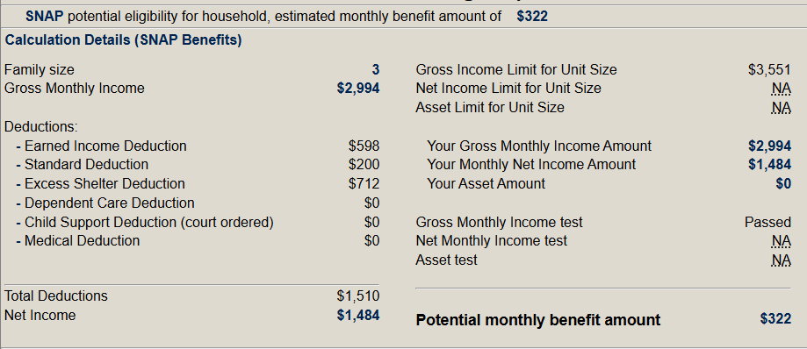
Get more information
Ask: “Who is earning income and where is it from?”
Jan – Works for UberEats
College student – Has on-campus job (you ask and she tells you this is for work-study) – earns $400/month
High school student – works on weekends at the mall – earns $400/month
You remember that under SNAP rules, work study income and income from high school students under 17 shouldn’t count. (See previous slides) You run the calculator again but only include Jan’s income.
Hooray! They should be eligible; but we’re not done.

Slide 28
Real talk about self-employment
You ask: “How much are you spending to work UberEats?”
First you ask about her phone/technology needed to do Uber Eats: You find out that Jan is paying $150/month for her phone plan. Her children pay separately for month to month phone plans. She uses her phone for work about 60% of the time.
You also ask about the car she uses. She says she almost exclusively uses it for work because she needs to save her gas for deliveries. Also, she recently needed an oil change and needed her breaks redone, which cost her about $1000.
Total income | Business Expenses
$2,994 | $2,350
Actual income for last month: $644
Paid week 1
$748.50
Gas week 1
$60
Paid week 2
$748.50
Gas week 2
$60
Paid week 3
$748.50
Gas week 3
$60
Paid week 4
$748.50
Gas week 4
$60
Uber eats fees $855
Phone $150
Car Insurance $105
Car Repairs $1000

Slide 29
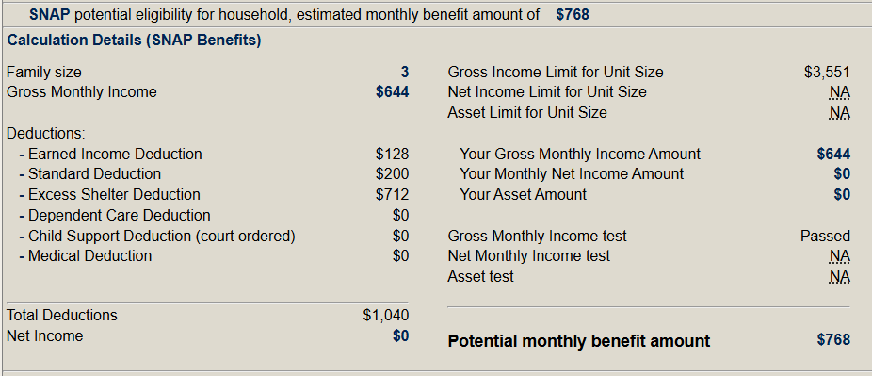
Real talk about self-employment
You run the calculator again:
But what can you do to get DHS to increase the benefits?
If the date on the Notice of Decision is less than 90 days ago, you can file an appeal. When DHS adjusts the benefits, they should increase benefits all the way back to the application.
Regardless of how old the Notice of Decision is, you can file a Change Report asking DHS to recalculate your benefits. This will only increase benefits moving forward.

Slide 30
Earned income can impact your benefits, but not always; and even if it does, the impact is less than increases in unearned income
Report income changes (both increases and decreases) within 10 calendar days of the change.
IDHS will ask you to submit verification documents to prove your income and expenses. If you don’t have something and need help getting, tell IDHS that.
Just do the best you can to report your income on applications and redeterminations; If you try, you won’t get in trouble if you’re off
If you have self-employment, spend some time to think through your self-employment expenses and report those to IDHS.
Try to keep good records of your income and expenses. You also might want to report similar expenses on your taxes.
Key Take-Aways

Slide 31
Where to get help
Legal Aid Chicago (Cook County)
Legalaidchicago.org
312-341-1070
Prairie State Legal Aid (Northern Illinois)
Pslegal.org
Land of Lincoln (Central and Southern Illinois)
Lincolnlegal.org
618-398-0574

