Slide 1
Accessing Benefits for Elderly Clients
Gwynne Kizer Mashon
02.11.24

Slide 2
Children & Families
Consumer
Legal Aid Chicago is a private non-profit that provides free civil legal services to people with limited income in Cook County, securing their rights to economic stability, affordable housing, personal safety, fair working conditions, and basic healthcare.
Criminal Records
Relief
Public Benefits
Long-Term Care
Immigrants & Workers’
Rights
Housing

Slide 3
Learning objectives
Gain or solidify knowledge of mainstream benefits seniors might qualify for, esp. those that are primarily targeted at seniors
Understand some special rules in mainstream benefits that are designed to help seniors
Understand concerns that seniors might have about public benefits programs
Agenda
Social Security Retirement
SSI
Social Security Survivors
Medicare
AABD Cash
Medicare Savings Programs
Special SNAP rules
Long-Term Care and Supportive Living

Slide 4
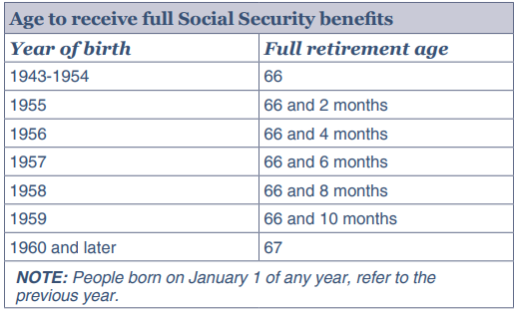
Social Security retirement
What is it?
A monthly cash benefit. The amount is based on two factors: (1) lifetime earnings and (2) age at which the recipient starts receiving the benefit.
Usually the amount increases every year with a Cost o f Living Adjustment to account for inflation.
Who qualifies:
At least 40 work credits (up to 4/year) & meets age requirement
At least 62 years old: reduced benefit
Full retirement age: full benefit
At or over age 70: full benefit + 8%
How to apply?
ssa.gov or call 800-772-1213
Processing time approx. 3 weeks – 8 months
Other:
www.ssa.gov/myaccount for estimate of monthly benefit

Slide 5
Social security disability
What is it?
A monthly cash benefit. The amount is based on earnings record.
Usually the amount increases every year with a Cost o f Living Adjustment to account for inflation.
Who qualifies:
Citizen or eligible immigrant
UNDER 65 year old AND has medical impairments that prevent from engaging in substantial gainful employment for at least 12 months, or a medical condition that will result in death
Earned at least 40 work credits, 20 of which were in the ten years before your disability began.
How to apply?
ssa.gov or call 800-772-1213
Processing time approx. 9 months
I’m 63 and am too disabled to work. Should I apply for retirement or disability?
Most likely, Disability:
larger monthly benefit
Medicare eligibility after waiting period
Other:
www.ssa.gov/myaccount for estimate of monthly benefit

Slide 6
Social Security spouse
What is it?
A monthly cash benefit. The amount is based on working spouse’s earnings record. It is as much as half of the working spouse’s retirement benefit.
Usually the amount increases every year with a Cost o f Living Adjustment to account for inflation.
Who qualifies:
Must have resided in the United States for at least 5 years
At least 62 years old or have a child in their care who is under 16 years old or has a disability and is entitled to survivors benefits on the spouse’s record
Spouse is filing for and eligible for SSA Retirement
Their own retirement benefit is less than what they would receive through this program.
How to apply?
ssa.gov or call 800-772-1213

Slide 7
Social Security survivors
What is it?
A monthly cash benefit. The amount is based on working deceased spouse’s earnings record.
Usually the amount increases every year with a Cost o f Living Adjustment to account for inflation.
Who qualifies:
Must have resided in the United States for at least 5 years
Deceased spouse earned sufficient work credits for SSA Retirement
Marriage requirement:
Married to deceased spouse at time of Death OR
you’re at least 60 years old and were married for at least 10 years OR you are caring for spouse’s child who is either under 16 years old or who is disabled and entitled to survivors benefits on working spouse’s record
If you remarried to someone else before age 60 (or before age 50 if you have a disability), you cannot get benefits on your former spouse’s work record
Age:
At least 50 years old AND disabled OR
At least 60 years old: reduced benefits OR
At least 66-67 years old: full benefits
How to apply?
Call 800-772-1213

Slide 8
Supplemental security income (SSI)
What is it?
A monthly cash benefit. The amount is based on income and other supports you receive. Maximum benefit in 2025 is $967 for an individual and $1,450 for a couple.
Usually the amount increases every year with a Cost o f Living Adjustment to account for inflation.
Who qualifies:
Citizen or eligible immigrant (complicated rules)
Is over 65 year old OR has medical impairments that prevent from engaging in substantial gainful employment for at least 12 months, or a medical condition that will result in death
Has income and assets under the income and asset limits ($2,000 individual/$3,000 couple)
How to apply?
Call 800-772-1213
Processing times vary, should be faster for people over 65 years old
I’m already getting Disability or Retirement.
Can I get SSI too?
Maybe! It depends on whether you meet the income and asset requirements for SSI.

Slide 9
That’s confusing. What do I apply for?
Do you have at least 40 work credits?
If possible, check on ssa.gov. Otherwise, if you’ve worked over 10 years full-time, you likely meet this requirement.
Yes or maybe. Are you over 67?
Definitely not. Are you married? If not, did your spouse die while you were married or were you married for at least 10 years or are you caring for your former spouse’s child who is under 16?
No. Apply for SSI
Yes. Is it possible your spouse or former spouse earned at least 40 work credits?
Yes. Apply for spousal/survivor benefits +SSI
No. Apply for SSI
Yes. Apply for Retirement and SSI
No. Do you have medical conditions that prevent you from working?
Yes. Apply for Disability and SSI. You also might want to apply for Retirement if over 62.
No. You can apply for retirement if you are over 62 + SSI if over 65. (Consider implications of early retirement)
There are situations where it might be better to apply for survivor or spousal benefits first to maximize retirement benefits.
The answer is person to your situation. I recommend you consult
with an attorney or financial planner if you are confused.
These guidelines might help.
You must show you meet eligibility requirement before SSA will approve your application.

Slide 10
Aabd cash
What is it?
A monthly cash benefit from the state of Illinois for people who are elderly or disabled. The amount is based on income and certain expenses. The average is about $60-$70/mo; but can be much more – no limit – some people get $500-$700/mo.
Do you pay mortgage/rent AND Are you blind or do you have a disability that prevent you from using stairs?
Do you live with your minor children or spouse?
Do you have earned income?
How to apply?
Manage My Case
@ local FCRC
Who qualifies:
Must be age 65 or meet SSA’s definition of “disabled”
Most recipients are receiving SSI
But can also qualify if you are over-income for SSI under SSI’s rule
If someone is getting less than the SSI maximum, they might need proof that they applied for SSI and were denied for being over-income
Can make up difference for people with SSI overpayments, child support obligations, etc.
Must maximize other income sources.
No set income limit but usually must be very low-income to qualify
Asset limits: $2,000 individual/$3,000 couple

Slide 11
Covers food: only can be used for unprepared foods
*** SNAP Restaurant Meals Pilot is on track to expand access to people who cannot prepare their own meals***
Benefit Amount:
Based on household size, income and certain expenses
Before comparing to the gross income standard, these costs are deducted:
Court-ordered child support someone pays
Self-Employment expenses
Other considerations for determining net income and monthly benefit:
Housing expenses
Homeless Shelter deduction for people who are homeless
Some medical expenses
Some child care expenses
SNAP “Households” live and prepare food together
Under 22 and living with parents must be in parents’ household
Under 18 and living with adults must be in adults’ household
Eligibility factors include:
Citizenship/Immigration Status
Illinois residency
Gross Income limit:
165% FPL (currently $2,071 for a single person as of 10/24)
200% FPL (currently $2,510 for a single person as of 10/24) if 60+ or disabled*
[Net income limit for 60+ or disabled = $1,255]
Asset limit:
There is no asset limit for most households in Illinois

Slide 12
Special snap rules for elderly
Those over 60 years old and those receiving disability benefits are “qualifying members”
Benefits for qualifying members:
SNAP Restaurant Meals
Exempt from Work Provisions
Exempt from Work Requirements*
If gross income is over gross income limit, might still qualify based on net income (after applying SNAP deductions)
Deductions for Medical expenses
Unlimited deductions for excess shelter
Deduction usually capped at $712
Deduction calculated: (Housing costs + utility allowance) – 50% countable income
Verified Qualified Expenses | Deduction
< $35 | $0
$35-$185 | $185
Over $185 | Actual medical expenses - $35
*Work requirements waived in IL through October 2025. If/when they go into effect, individuals 55+ will be exempt.

Slide 13
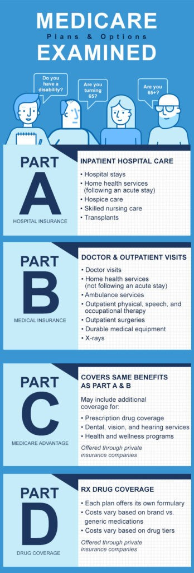
medicare
Monthly Costs (2023)
People 65 years old or older
Receiving Social Security Disability (2 year waiting period)
End-state Renal Disease
ALS (Lou Gehrig’s Disease)
Part A: up to $506; free to most
Part B: $165-560
Part C: Combined Parts A and B (and D), average in IL is regular Medicare premiums + $71
Part D: Plan Premium + $12-76
Enrollment Deadlines
Part A: ≤10%; lasts for 2x the number of years you didn’t sign up
Part B: 10% for every year you did not sign up; last as long as you have part B
Who Qualifies
3 months before - 3 months after you turn 65, unless you qualify for special enrollment
Severe penalties for missing deadlines
Penalties
Part D: One 1% for every month you didn’t sign up; lasts as long as you have Part D
https://www.medicare.org/articles/your-guide-to-understanding-medicare-parts-a-d/
Apply at https://www.ssa.gov/medicare/sign-up or call SSA
Open enrollment for general Medicare runs 1/1 – 3/31.

Slide 14
Help paying medicare costs
EXTRA HELP
Apply through the Social Security Administration
Starting in January 2024, everyone who has Extra Help will get the same benefits
Asset limits (2023): $16,600 (single); $33,240 (married)
Income limits (2023): $12,870 (single); $29,580 (married)
$0 Premium and $0 Deductible
Low out-of-pocket costs for prescription drugs
Waiver of late enrollment penalties while on Extra Help
MEDICARE SAVINGS PLANS
Apply through the Illinois Department of Human Services
Asset limits (2023): $7,080 (single); $10,620 (2 people)
Income limits:
Automatic enrollment in Extra Help
QMB: $1,215 (single); $1,639 (2 people)
Other MSP: $1,639 (single); $2,218 (2 people)
Benefits:
State pays Part B Premiums
For QMB Only: State pays Part A Premiums, assistance with Co-pays, Balance Billing Protections
State pays any late enrollment penalties associated with premiums it is paying
All except QMB: Up to three months retroactive benefits

Slide 15
Medicaid
 | Who Qualifies (non-exclusive list) | Income Limits (2023) | Asset Limit | Other
ACA | Under 65 years old with no Medicare: US citizens most LPRs and certain other immigrants | 138% FPL $1,677 for an individual | None
AABD | Medicare beneficiaries or over 65 years old: US citizens most LPRs and certain other immigrants | 100% FPL $1,215 for an individual | $17,500 | Can spenddown excess income/assets to become eligible for Medicaid

Slide 16
Long-term care and supportive living medicaid
IDHS offers a large number of programs for seniors and people with severe disabilities who have high medical needs. Some of these services are offered in nursing homes while others are “in the community.” As these programs are complicated, I will not cover them in detail today.
If you would like more training on this topic, please let us know in the post-training survey.

Slide 17
Where to get help
Legal Aid Chicago (Cook County)
Legalaidchicago.org
312-341-1070
Prairie State Legal Aid (Northern Illinois)
Pslegal.org
Land of Lincoln (Central and Southern Illinois)
Lincolnlegal.org
618-398-0574

