Slide 1
SNAP 102:
Up Your SNAP SKILLZ
Gwynne Kizer Mashon
01.14.2025

Slide 2
Children & Families
Consumer
Legal Aid Chicago is a private non-profit that provides free civil legal services to people with limited income in Cook County, securing their rights to economic stability, affordable housing, personal safety, fair working conditions, and basic healthcare.
Criminal Records
Relief
Public Benefits
Long-Term Care
Immigrants & Workers’
Rights
Housing

Slide 3
Learning objectives
Gain or solidify SNAP knowledge you need to understand basic rules of the SNAP program
Understand more complicated rules we believe are commonly overlooked, as well as those people have trouble navigating
Know when and where to ask for help
Basic
Advanced!
Agenda
What is SNAP?
What is a SNAP “Household” and Who is in it?
Who Qualifies?
Asset Limits
Income Limits
SNAP “Budgeting”
Getting SNAP
Keeping SNAP

Slide 4
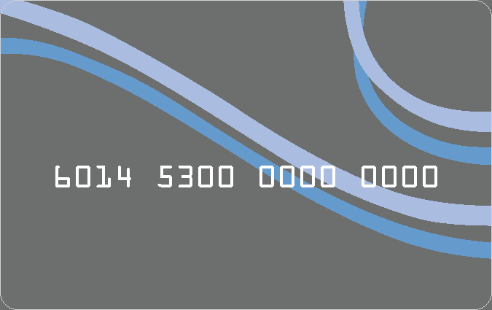
What is Snap?
The Supplemental Nutrition Assistance Program (SNAP) (formerly called “food stamps”) provides food benefits to low-income families to supplement their grocery budget so they can afford the nutritious food essential to health and well-being.
Basic
Federal law: The Farm Bill
Illinois Administrative Code Title 89
Manuals, Policy Memos, Office Operations, Guidance letters, etc.
USDA regulations and guidance
Approved waiver requests IL sends to USDA
Illinois Compiled Statutes 305 ILCS 5
If you’re interested in learning more about and getting updates on the Farm Bill, you can join mailing lists from the Food Research and Action Center (FRAC), the Center for Law and Social Policy (CLASP), and/or the Greater Chicago Food Depository.

Slide 5
what is snap?
Basic
Generally, SNAP can be
used to buy ONLY:
Unprepared foods
From qualified vendors
You cannot buy:
Beer, wine, liquor, cigarette, or tobacco products
Vitamins, medicines, or supplements
Live animals (with some exceptions for seafood)
Any non-food items
Foods that are hot at the point of sale
EXCEPT: IL SNAP Restaurant Meals Waiver

Slide 6
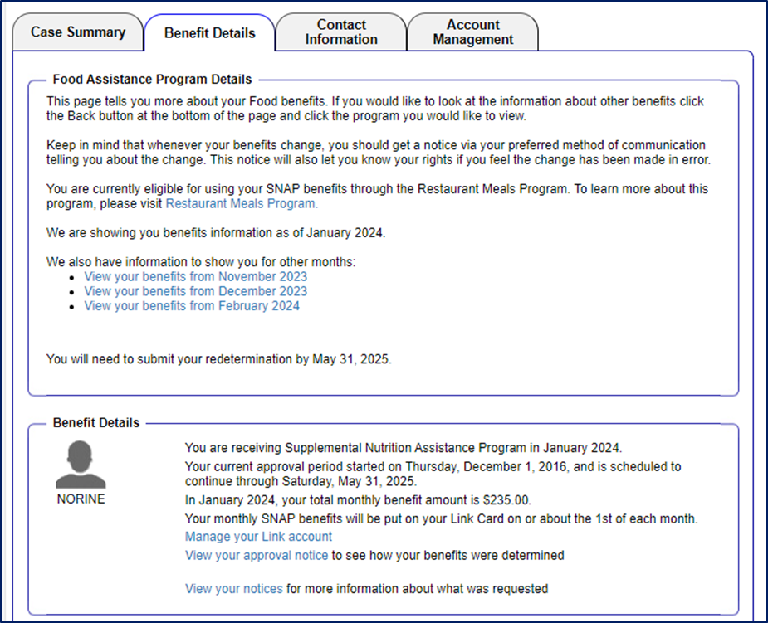
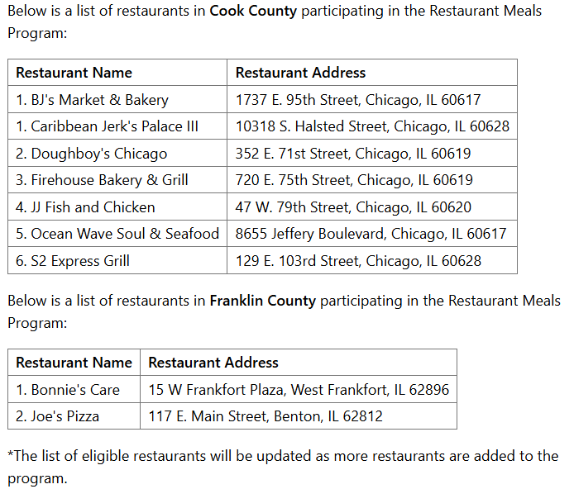
what is snap?
Basic
Some SNAP recipients can use their SNAP to buy hot meals at certain
restaurants.
Who qualifies?
- Homeless*
- Qualified Members**
- Determined permanently and totally disabled by IDHS
Do I have to apply? No, but you need to make sure that IDHS knows
you’re eligible
More info at: https://www.dhs.state.il.us/page.aspx?item=145505#:~:text=The%20Restaurant%20Meals%20Program%20(RMP,prepared%20meals%20at%20authorized%20restaurants.

Slide 7
What is a snap household and who is in it?
Basic
SNAP household it the unit of people who are receiving SNAP together, under one case number
All countable income and expenses for the SNAP household is considered together
Benefits are issued into a shared LINK account
Generally, people living together and buying and preparing food together are considered part of the same household.
They don’t need to be related
Some family members could be excluded because they’re ineligible
Some family members living in the house might be in the unit even if they don’t buy and prepare food with others
It is DHS’s job – not YOURS! – to know who should and should not be in the SNAP Household.
List everyone in the home on the application and give IDHS the information it requests so they can figure it out.
PM 04-05

Slide 8
What is a snap household and who is in it?
Advanced!
What does living separately mean:
The living quarters are considered separate even if there is a shared entrance (e.g., a hallway or stairway).
Required SNAP Household members, if living together:
Spouses (note that issues around this might arise if DV is present)
Parent and their child who is under 22 years old
Any child under 18 (except for foster children) under parental control of an adult SNAP member
Required family members are part of the SNAP Household, even if that member is ineligible. Income will be treated differently. More on that later…
The following are not part of the SNAP Household:
Unless a required member, anyone living together but does not usually buy and prepare their food together.
Roomers and boarders
Live-in attendants
Ineligible college students
PM 04-05

Slide 9
What is a snap household and who is in it?
Advanced!
College Students
Under federal law, a student enrolled more than half-time in a school of higher education (e.g. college) does not
qualify for SNAP unless they meet an exception. If ineligible, that status continues until they graduate or disenroll (including any school breaks.) They are excluded completely from the SNAP Household.
To receive SNAP, college students need to show one of the following:
Enrolled in a special program, such as English as a second language, Adult Basic Education, Literacy, GED, or community education courses.
Under 18 or over 50 years old
Physically or mentally unfit
Meets work requirements (paid work or work study)
Responsible for care of a child under 12 years old (in addition to other requirements)
Receiving TANF
enrolled as a result of participation in the Job Opportunities and Basic Skills program under Title IV of the Social Security Act or its successor program, or certain other work development programs
Participating in an on-the-job training program.
PM 03-04-03

Slide 10
Basic
Who qualifies?
US Citizens and eligible immigrants
Eligible immigrants include:
Those who secured refugee or parolee status
5 year wait for legal permanent residents and certain abused spouses and children (and parents of abused children) unless:
LPR with 40 qualifying quarters
Child under 18
Disabled/blind
US veteran or in active military
We highly recommend looking at PM 03-01-03 to determine if you or someone you work with has other immigration statuses that might qualify for SNAP.
PM 03-01-03

Slide 11
Advanced!
Who qualifies?
IL Resident –A person who leaves IL maintains IL residency so long as they intend to return when their reason for leaving is complete. There is no specific time frame.
Proof of residence is required unless a person is (1) homeless, (2) migrant farmworker, (3) new arrival to the area.
NOTE: When mail is returned to the office as undeliverable, DHS will send a request for contact and will cancel the person’s benefits if they do not respond within 10 days.
PM 03-02

Slide 12
Advanced!
Who qualifies?
Work Provisions
Requirements:
Receive SNAP Work Rules notice
Provide information re: employment status/availability to work
If receiving TANF, comply with TANF work and training rules
Do not quit a job or reduce work hours below
30 hours/week without good cause
Exempt from Requirements include (PM 03-15-02)
Under 16 or over 60 years old
Ineligible and excluded SNAP household members
Physically or mentally unable to work
Those with certain family care responsibilities
Working at least 30 hrs/wk or receiving at least $217.50/wk
PM 03-15

Slide 13
Basic
Who qualifies?
Work Requirements
Under federal SNAP rules, “able-bodied adults without dependents” (ABAWDs) are limited to only 3 months of SNAP in a 36 year period unless they meet the SNAP work requirement.
Work (paid or unpaid) an average of at least 20 hours/month, or
Volunteer to take part and comply with SNAP Employment and Training activities, or
Complete an average of 20 hours/month of Community Service, or
Any combination of the above
USDA has given Illinois a state-wide waiver of these rules. The current waiver is good through 10/31/2025.
Because these rules aren’t currently active in IL, I will not review them in detail here.
PM 03-25

Slide 14
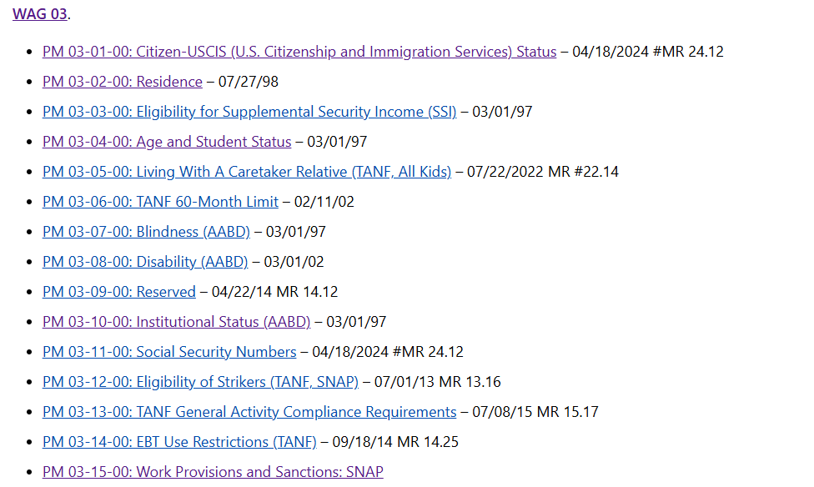
Advanced!
Who qualifies?
Other Non-Financial Requirements
PM/WAG 03

Slide 15
Putting it together
Alexis (US Citizen and half-time college student) is in the process of getting divorced from her husband, Bradley (US Citizen). They cannot afford to live on their own so they are living with her mother Connie (US Citizen) and her boyfriend Darryl (LPR for 2 years), along with her children (5 and 7 years old.) Bradley buys and prepares his own food, but the rest of the family buys and prepares food together.
Alexis wants help with a SNAP application. You can’t figure out who is supposed to be in the household.
What do you do?
How could we figure out who belongs in the SNAP Household?

Slide 16
Basic
Asset rules
SNAP Household | Asset limit
At least one qualifying member | $4,500
No qualifying member | $3,000
Lottery/gambling winnings | $4,500
Other households that are “Categorically Eligible” | N/A
However, in Illinois, the asset rules only apply in the following rare situations:
Household has lottery or gambling winning of $4,500 or more
Household is not “Categorically Eligible”
DHS gives the household a TANF funded information and referral service brochure, or
Everyone in the household is authorized to receive SSI or TANF.
Household is not “Categorically Eligible” if any member:
Is disqualified for an intentional program violation
Is sanctioned for failure to comply with Work Provision
Is a “qualified member” and gross monthly income exceeds 200% FPL for household size
Has first application after losing eligibility due to lottery or gambling winnings
Advanced!

Slide 17
Advanced!
Income limit
We recommend you report all income to DHS. It is DHS’s job to determine how to count income. But knowing the rules is useful if you’re trying to figure out if DHS got it right!
Here are a few rules we try to an eye on:
Self-Employment Income - PM 08-04-01-b
IDHS should deduct allowance business expenses from gross income before comparing it to the income standard or calculating net income.
Child Support Payments PM 13-01-07
Court-ordered child support payments paid by the SNAP Household are excluded if paid to someone outside the SNAP unit
Income from Ineligible SNAP Household member should be prorated if the member is ineligible because
Earned Income of an Excluded Member – PM 05-04-01-h; PM 08-04-04-k
Did not meet Social Security Number Policy
Are ineligible noncitizens
Have not had their citizen/BCIS verified

Slide 18
Advanced!
Income limit
Overpayment Withholdings PM 08-04-03
DHS should not consider recouped TANF or SSI benefits as income unless recoupment is result of either criminal or civil court judgment that member fraudulently obtained an overpayment.
Income In-Kind PM 08-04-04-a
Assistance other than money for e.g. meals, clothing, housing, food is exempt. For example, if someone is helping SNAP Household pay rent and it giving those payments directly to the landlord, then those payment are exempt.
Loans PM 08-04-04-o
Loans are exempt. A contract isn’t required. However, IDHS will likely request a statement signed by both parties that states the amount of the loan and states that the payment is a loan and must be repaid.
Lump Sums PM 08-04-04-q
Nonrecurring on-time only payments are exempt income. This includes but is not limited to: tax refunds, retroactive one-time payments for SSA, AABD Cash, VA, etc, insurance settlements, retroactive child support pass through payments, refunds on security deposits, etc.
Whenever you see an uncommon income sources (esp. one that makes you think “well that shouldn’t count as income!”), it’s worth looking at PM 08

Slide 19
Basic
We haven’t gone over this yet. If the Net Income Limit applies to you, revisit this page after you go through the SNAP Budgeting slides.
INCOME LIMIT
Income limits for SNAP, as of 10/01/2024: WAG 25-03-02(1)
What limit applies?
Household has a qualifying member (QM): Needs to meet EITHER the gross income or the net income limit
Households with a member disqualified because of intentional program violation or work sanction: Need to meet BOTH the gross and net income limit
Households where all members receive TANF or SSI, do not need to meet any income standard
All other households need to meet the gross income limit (No QM)
Number in SNAP Household | Gross income limit (No QM) | Gross Income limit (QM) | Net (after SNAP rules deductions) Income Limit
1 | $ 2,071 | $ 2,510 | $ 1,255
2 | 2,811 | 3,406 | 1,704
4 | 4,290 | 5,200 | 2,600
Advanced!
PM 13-01: SNAP Income Rules
PM 05-06-01: Qualifying Member Definition

Slide 20
Basic
SNAP Budgeting
Advanced!
Calculate SNAP Net Income: Nonexempt Income – SNAP Deductions = Net Income
Compare to SNAP Basis of Issuance Table to determine monthly allotment.
For, most accurate results, enter the number of non-excluded SNAP Household members
https://fscalc.dhs.illinois.gov/FSCalc/
For, most accurate results, enter only countable income, prorated income for mixed status families.
Deductions – next slides
Reliability of this calculator is highly dependent on how accurately you identify what goes into it.

Slide 21
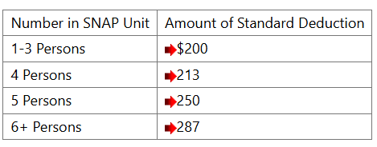
Basic
SNAP Budgeting
SNAP Deductions
SNAP standard deduction
Earned income deduction: 20% of countable earned income
Dependent care deduction: Dependent care costs may be allowed as a deduction when the care is necessary for a child under age 18 or an incapacitated person of any age.
Includes full costs actually paid for qualified dependent care + transportation costs to an from care facility, so long as costs are not reimbursed as part of dependent care payments
Service must be provided by someone outside the SNAP Household
PM 13

Slide 22
Basic
SNAP Budgeting
Who can get this deduction: Qualified Members
60 years or older or
Disabled and receiving certain other government benefits because of that disability (e.g. SSI, Social Security Disability, VA Pension)
What out of pocket expenses count?
Must not be reimbursed by insurance, etc.
Medical, dental, and prescription costs and copays
Medical equipment
Insurance premiums including Medicare premiums
Long list of eligible medical expenses at PM 13-01-05-a
How much is the deduction?
*note amounts are different for people living in group homes and supportive living facilities
SNAP Deductions
Medical Deduction
Verified Qualified Expenses | Deduction
< $35 | $0
$35-$185 | $185
Over $185 | Actual medical expenses - $35
PM 13

Slide 23
Basic
SNAP Budgeting
SNAP Deductions
Shelter deduction
Excess Shelter
Homeless Shelter
Utility Deduction
PM 13

Slide 24
Basic
SNAP Budgeting
Excess Shelter deduction
Shelter costs:
Rent or mortgage
Renters/Homeowners insurance
Property tax
Condo or HOA fees
Utilities: Only eligible for standards described here for utilities the client is responsible for paying
How much is the deduction?
For household without a “qualifying member”:
The total shelter costs + utility standards that are over 50% of the SNAP household’s adjusted net income. Maximum of $712
For household with a “qualifying member”:
The total shelter costs + utility costs that are over 50% of the SNAP household’s adjusted net income. No limit.
Utilities household is responsible for paying | SNAP Utility Standard
Air Conditioning / Heat (including electricity to operate those utilities) | $532
At least 2 utilities but not AC/Heat | $445
1 utilities that is not phone or AC/Heat | $76
Only phone | $65

Slide 25
Basic
SNAP Budgeting
Homeless Shelter deduction - $190
All SNAP Household members are “homeless”
Lacks fixed regular nighttime residence
Nighttime residence is supervised temporary shelter
Nighttime residence is a place not normally recognized as a place to sleep
Nighttime residence is a temporary stay (no more than 90 days) at the residence of another person
Not receiving free shelter throughout the month
Not receiving for the excess shelter deduction
Verification
What does DHS count as “shelter expense”?
No verification is required unless requesting excess shelter allowance
PM 06-04-03

Slide 26
Putting it together
Advanced!
Alexis receives her Notice of Decision. Here’s how I approach reviewing the notice to see if it’s correct:
Step 1: Who was approved? Look at the names to make sure the right people are included in the SNAP Household.
Step 2: I usually focus on the items that will have the biggest impact on eligibility/monthly benefit amount. For MOST households, these are:
Did DHS use the correct Household Standard?
Do the incomes listed on the notice seem consistent with what you know about the household’s income?
Does the shelter deduction/homeless shelter deduction look correct?
Step 3: What is the certification period? (esp. if the household is eligible for expedited processing)
Step 4: Other deductions and issues specific to the SNAP Household

Slide 27
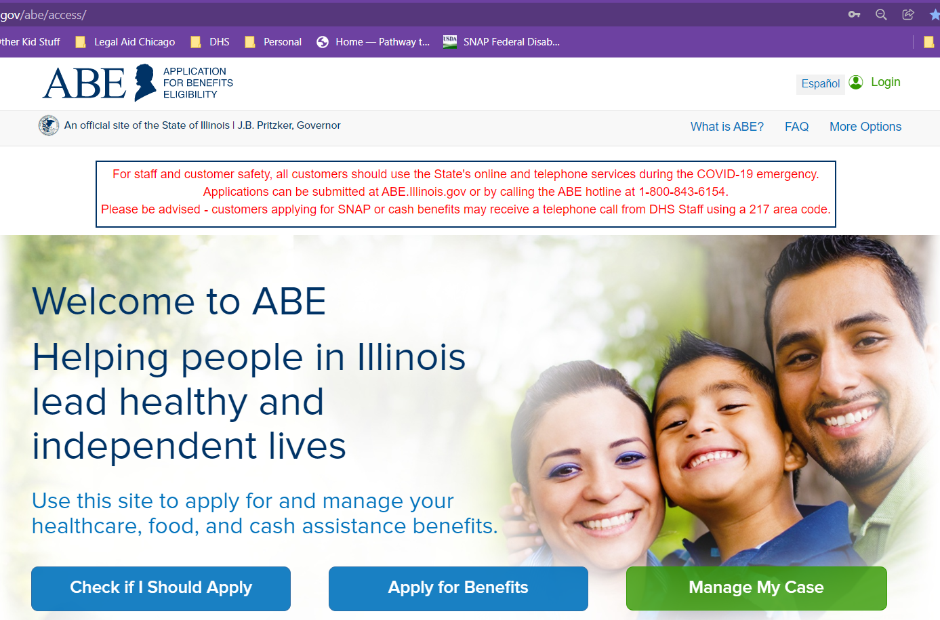
Basic
Getting snap
Apply online on ABE: https://abe.Illinois.gov
Apply at Local IDHS Office. “Family Community Resource Center” locator at: http://www.dhs.state.il.us/page.aspx?module=12
What to bring: ID, SSNs for all household members, proof of immigration status, proof of income for last 30 days
Legal Aid Chicago PBOE referrals– more on this later
Under federal law, to be treated as an application, all the form needs is your name and signature. (Though practically, DHS also needs a way to contact you.)

Slide 28
Basic
Getting snap
Application
Eligibility Verification
Notice of Decision
Interview
SNAP: 30 days or 5 days if expedited*
No cost to apply
No negative consequences for applying for something you don’t qualify for
No punishment for wrong answers as long as you’re not lying or misleading on purpose
The agency will lose things!
*An applicant qualifies for expedited processing in a few situations, including when liquid assets are less than $100 and gross monthly income or the month of application is less than $150. We encourage these applicants to request same-day interviews.

Slide 29
Basic
Keeping snap
SNAP benefits usually are “certified” for 12 or 24 months.
Tips to help you keep benefits you qualify for during your certification period and beyond
Report changes within 10 days:
Income*
Housing, include housing cost changes
Add or remove SNAP Household members
If you have a good calendar/reminder system, put the end of your SNAP (and cash) certification periods on your calendar. Put a reminder 1 month before so you know your redetermination is coming.
Sign up for text alerts on Manage My Case
Always open and read mail you get from IDHS as soon as you can
Respond to ALL verification check lists, even if you are already receiving benefits
Submit redeterminations applications before the deadlines.
Keep copies of everything you submit and proof you submitted it.

Slide 30
Basic
Keeping snap
Where to find Notices and Deadlines
Notices to the client
Manage My Case in ABE https://abe.illinois.gov/
Notice of Decision
Appointment Notice
Redetermination
Click on image to download a pdf of the notice

Slide 31
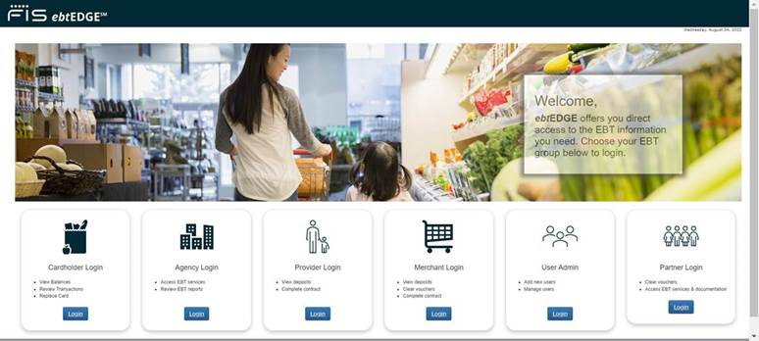
Basic
Keeping snap
Illinois Link card fraud
LINK theft seems to be more and more common.
Protect Yourself
Report Theft
Request replacement SNAP benefits (DHS currently states that it cannot reimburse other benefits.) At this time, thefts after 12/20/24 will not be reimbursed, but we highly recommend you still report them.
https://www.dhs.state.il.us/page.aspx?item=35280
https://www.ebtedge.com/gov/portal/PortalHome.do
Why should you report if they’re not going to reimburse you?
Helps your Congress People understand the prevalence of this problem, so they can address it
Helps IDHS find and take down skimming machines
Helps from protect you avoid erroneous allegation of an intentional program violation and potential overpayment and sanctions later.

Slide 32
Advanced!
Keeping snap
Overpayments
Type | Definition | Effect
Agency Error | Agency mistakes: e.g. not acting on change report, miscalculating benefits | For active cases, the monthly recoupment amount is the greater of $10 or 10% of the SNAP unit's monthly benefit.
Inadvertent Household Error | Member unintentionally gave incorrect information or failed to timely give information to DHS
Intentional Program Violation | Member intentionally lies, misleads, or withholds information; Violate policy on legal use of SNAP | Hearing is scheduled without need to file appeal. It is important to participate. The burden of proof on DHS in these cases is high. So, we recommend getting legal assistance with these cases because they are complicated. In addition to paying back the overpayment, sanctioned members are banned from SNAP from 12 month – permanently. Monthly recoupment for active cases is limited to the greater of $20 or 20% of the monthly benefit the SNAP unit would receive if the person having the IPV was included.

Slide 33
Basic
Keeping snap
What is appealed?
Incorrect decision
No decision within the processing time (“Inaction”)
Time to File
SNAP: 90 days*
How to File
Through “Manage my Case” https://abe.Illinois.gov
Inaction for an application, redetermination, or change report: No deadline
phone: 1-800-435-0774 or 312-793-2618
Fax: 312-793-3387
DHS.BAH@Illinois.gov
Decisions where benefits are denied because of missing verifications or a missed interview!
Termination or decreasing benefits without notice
*If the notice is legally insufficient, these deadlines arguably do not apply.

Slide 34
Where to get help
Legal Aid Chicago (Cook County)
Legalaidchicago.org
312-341-1070
Prairie State Legal Aid (Northern Illinois)
Pslegal.org
Land of Lincoln (Central and Southern Illinois)
Lincolnlegal.org
618-398-0574

