Slide 1
Veterans Benefits 101
Laura Chapman
Staff attorney, public benefits practice group, veterans’ rights project
lchapman@legalaidchicago.org
April 2024

Slide 2
Children & Families
Consumer
Legal Aid Chicago is a private non-profit that provides free civil legal services to people with limited income* in Cook County, securing their rights to economic stability, affordable housing, personal safety, fair working conditions, and basic healthcare.
Criminal Records
Relief
Public Benefits
Long-Term Care
* No financial eligibility requirements for seniors or victims of domestic or sexual violence; higher income limits for certain populations or legal issues, including veterans, people living with HIV, and others.
Immigrants & Workers’
Rights
Housing

Slide 3
WHAT WE’LL LEARN
Benefits available through the VA for veterans and former service members with disabilities as well as their family members
How to tell what type of VA benefit your client is receiving
How to determine if there are other VA benefits your client may be eligible for but isn’t receiving
How to apply for and access various VA benefits
How receiving VA benefits interacts with Social Security disability benefits

Slide 4
VA Pension
What is it?
The VA’s Pension program is a monthly financial benefit for wartime veterans who are low-income, have little assets, and are totally disabled and/or over age 65
The program is straightforward to qualify for and easy to apply for, and applications can be completed online.

Slide 5
VA Pension Eligibility
Minimum active-duty service requirement, including at least 1 day during a wartime period
Active duty prior to September 8, 1980: service of at least 90 days on active duty with at least 1 day during wartime period
Active duty as an enlisted service member after September 7, 1980: 24 months or full period for which called to active duty with at least 1 day during wartime period
Disabled
Age 65 or older
Totally and permanently disabled
A patient in a nursing home receiving skilled nursing care
Receiving SSI or SSDI
Low-income
Maximum VA Pension rate for a household of a single veteran is $1379, and is reduced by any other income or benefits (except SSI, which is replaced by VA Pension)
Higher maximum Pension rates for veterans who have dependents, are housebound, or who require Aid & Attendance to perform activities of daily living

Slide 6
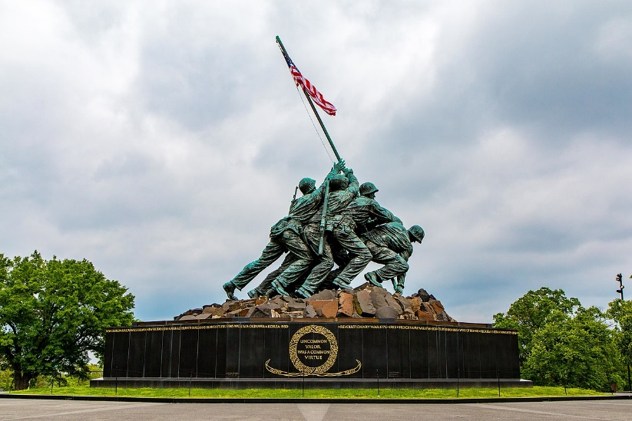
What is “wartime service”?
Wartime periods:
World War I (April 6, 1917 – November 11, 1918)
World War II (December 7, 1941 – December 31, 1946)
Korean conflict (June 27, 1950 – January 31, 1955)
Vietnam era (February 28, 1961 – May 7, 1975 for Veterans who served in the Republic of Vietnam; otherwise August 5, 1964 – May 7, 1975)
Gulf War (August 2, 1990 – present)

Slide 7
“Wartime service” for va pension
A common misconception regarding this term is that a veteran or former service member must have served in combat or have been deployed outside of the United States in order to be eligible for a VA Pension
This is not true. “Wartime service” concerns only the time period during which a veteran or former servicemember served, not whether they served overseas or in combat.

Slide 8
EXAMPLE: STEPHEN
Stephen is a 59 year old veteran who served active duty in the United States Navy from September 1988 to September 1990. He was never deployed or in combat during his service.
Stephen lives by himself and doesn’t need assistance with activities of daily living.
He receives the maximum SSI benefit of $943 per month for a mental health condition and has no other income.
Is Stephen eligible for VA Pension?

Slide 9
EXAMPLE: STEPHEN
Active duty service requirement:
Stephen served 24 months (Sept. 1988 – 1990)
Stephen served at least 1 day during a wartime period: the Gulf War wartime period commenced on August 2, 1990
Disability
Stephen is considered to be disabled by the Social Security Administration and receives SSI, so he categorically qualifies as disabled for purposes of VA Pension
Income (some math here…but it’s relatively simple)
Stephen’s only income is $943 per month with no other significant assets
The VA’s maximum pension rate for a single veteran is $16,551
$943 x 12 = $11,316 is Stephen’s total annual income from SSI benefits
$16,551 (VA MAPR) - $11,316 (Stephen’s annual income) = $5,235
$5,235 / 12 months = $436.25
Stephen is eligible for $436.25 per month in VA Pension benefits!

Slide 10
VA Pension Rates**
Status | Maximum Pension Rate, Per Month
Veteran with no dependents | $1375
Veteran with 1 dependent spouse or child | $1806
Veteran qualifying for Housebound benefits, with no dependents | $1685
Veteran qualifying for Housebound benefits, with 1 dependent spouse or child | $2112
Veteran qualifying for Aid & Attendance, with no dependents | $2300
Veteran qualifying for Aid & Attendance, with 1 dependent spouse or child | $2727
**These numbers are up to date for 2024 and reflect the VA’s December 1, 2023 cost-of-living increase.

Slide 11
HOW TO APPLY FOR VA PENSION
Ways to apply:
Online using the VA’s website here
Using the VA Form 21P-527EZ (form available here online)
Upload it online to the VA using AccessVA
Mail the form to the VA Pension Management Center
Drop off the form at a VA Regional Office in person
Illinois’ va regional office is located in Chicago, near the jesse brown va medical center at 2122 w taylor street, Chicago, il 60612
Work with a Veterans Service Organization or Veterans Service Officer

Slide 12
WHAT do you need to apply for va pension?
Social security number
Information about:
Marital history (if a Veteran is married, their spouse’s marital history also)
Military history (if a Veteran has their DD-214, make a copy and keep it to submit)
Work history
Information about your dependents if you hve them
Financial information:
Household’s gross monthly income and value of household assets
Unreimbursed medical expenses

Slide 13
VA Service-connected disability COMPENSATION
What is it?
Monthly benefit for veterans or former servicemembers who have a current medical condition that was caused by something that happened during military service or worsened by military service.
Physical and mental health conditions can qualify a veteran or former servicemember for the benefits.

Slide 14
VA Service-Connected Disability Benefits Eligibility
Current diagnosis of a medical condition
In-Service incurrence or aggravation of a disease or injury
Nexus between the current symptoms and the in-service event

Slide 15
EXAMPLE: Leah
Leah is a 34 year old veteran who served active duty in the United States Air Force from January 2010 to October 2013.
While serving, Leah was diagnosed and treated with for an anxiety disorder. Leah received medication and counseling for the condition during service.
Leah works part-time at a grocery store and makes about $500 a month. Leah still experiences some symptoms of the anxiety disorder, but no longer takes medication.
Is Leah eligible for VA Service-Connected Disability Benefits?

Slide 16
EXAMPLE: Leah
Leah’s current doctor agrees she still has an anxiety disorder
Current diagnosis of a medical condition
Leah was initially diagnosed with the condition during her service in the Air Force
In-Service incurrence or aggravation of a disease or injury
Leah is experiencing the same condition she did during service
Nexus between the current symptoms and the in-service event
Leah likely qualifies for VA Service-Connected Disability Benefits.
Leah’s income from her part-time work does not affect her ability to receive VA Service-Connected benefits or the amount she will receive.

Slide 17
HOW TO APPLY FOR VA Service-connected disability benefits
Applying for VA SCX disability benefits initially is relatively straightforward.
Filing online:
Online filing is available here and easy to access
Filing by mail, in person, or fax
Filing with assistance from a Veterans Service Officer or Veterans Service Organization

Slide 18
HOW TO APPLY FOR VA Service-connected disability benefits
What do you need to file an application?
If available, medical records related to the condition the claim is for.
Information about the Veteran or former servicemembers:
Military service
Medical conditions being claimed, including when they began to experience them
Social security number

Slide 19
How can i tell what form of va benefit someone is receiving?
VA Pension vs. VA Service-Connected Disability Compensation
VA Pension does not have a “rating” level, but VA SCX benefits do.
If a veteran or former servicemember knows that they have been awarded a percentage rating (anywhere from 10 to 100 percent), it is likely they are receiving VA SCX compensation rather than VA Pension
How much are they paid?
Common payment amounts for veterans who receive VA SCX benefits are:
50 percent disability ratings - $1075* for a veteran living alone
10 percent disability rating - $171* for a veteran living alone
Call the VA with the veteran or former servicemember to check!
If the veteran doesn’t know or have any paperwork regarding the benefits, call the VA Benefits hotline at 1-800-827-1000. The hotline operates Monday through Friday, 7 am to 8 pm Central Time. Call with the veteran and have their Social Security number ready for the operator.
*Amounts up to date for 2024 Service-Connected Disability Ratings pay schedule, effective December 31, 2023

Slide 20
Interactions between social security benefits and va benefits
VA service-connected benefits are not dependent upon income, so veterans and former servicemembers can receive both VA service-connected disability benefits and SSDI at the same time
VA Pension benefits are means-tested and dependent upon income, so receiving SSDI, SSI, or Social Security Retirement benefits will affect someone’s ability to receive them and can reduce or wipe out their eligibility for them

Slide 21
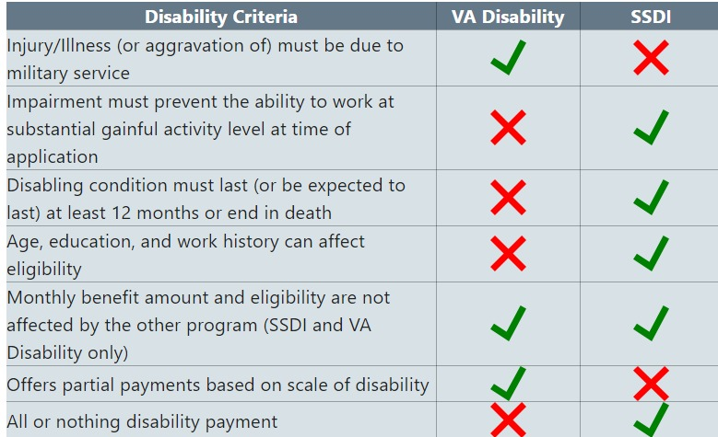
Differences between the va’s definition of “disabled” and social security’s definition of “disabled”
Chart produced by the Social Security Administration, available online here:
https://www.ssa.gov/people/veterans/index.html#1

Slide 22
VA healthcare
What is it?
VA healthcare coverage, if a veteran or former servicemember is eligible for it, covers preventative care, inpatient hospital services, mental health services, assisted living and home health care, prescription drugs, and urgent and emergency care
Dental care: some services available, but not available to all who qualify for VA Healthcare
Vision care: Routine eye exams and preventative tests. Possible coverage for eyeglasses and rehabilitative services for the blind or those with low-vision

Slide 23
VA healthcare – PRIORITY GROUPS
The VA issues VA healthcare coverage in accordance with a ranked system called “priority groups”
Depending upon a person’s level of service-connected disability rating, a higher priority group may be assigned
Priority groups also correspond to specific conflicts, assignments, medals and awards, income, and other factors
Can a priority group change?
If your income changes or your service-connected disability gets worse, your priority group assignment can change.

Slide 24
VA healthcare - ELIGIBILITY
Eligibility
Enlisted after September 7, 1980 or entered active duty after October 16, 1981
Must have served a continuous 24 months of service or the full period for which you were called to active duty
Enlisted prior to September 7, 1980
No requirement of 24 months of continuous service or full period called to duty
Served in certain locations and time periods during the Vietnam War era
Exposed to toxins or other hazards while serving – in the United States and elsewhere

Slide 25
VA Healthcare – how to apply
Apply online here
Apply by phone by calling the VA at 1-877-222-8387, Monday through Friday, 7 am to 7 pm Central Time
Apply by mail
Use VA Form 10-10EZ, available here
Apply in person at a VA medical center or clinic
Bring a completed VA Form 10-10EZ to a VA facility

Slide 26
Educational and vocational training benefits
GI Bill benefits
Post 9/11 GI Bill Benefits
Montgomery GI Bill Benefits
Veteran Readiness and Employment
Education and career counseling (Chapter 36)

Slide 27
VA Education and vocational benefits – how to apply
Apply online here
Get help applying by mail by calling 1-888-442-4551, Monday through Friday 7 am to 6 pm Central time to request an application and information on which regional claims processing office to send it to
Apply in person at a VA regional office

Slide 28
Burial and memorial benefits
Pre-need eligibility for burial in VA cemetery
Veterans and former servicemembers can apply before death to find out if they’re eligible for burial in a VA cemetery and choose a cemetery
Veterans burial allowance
Surviving spouses, children, and parents of veterans and former servicemembers may be eligible for reimbursement of costs for burial and funeral costs, internment allowance, transportation for transporting Veterans’ remains to final resting place
Memorial items
Headstones, markers, burial flags, memorial certificate signed by current President

Slide 29
What is a military discharge?
When a military member is discharged from service, they are assigned a status that is attached to that discharge.
The most common type of discharge is an “honorable” discharge, but there are other levels of discharge status.
Where is the discharge status? It can be found on a veteran or former servicemembers’ DD-214, the discharge document given at the time of discharge.

Slide 30
Benefit availability for veterans with discharges that aren’t honorable
Honorable
General
Other than Honorable
Bad Conduct (SCM)
Bad Conduct (GCM)
Dishonorable
Eligible for VA benefits, though only veterans with an honorable discharge at eligible for GI Bill benefits
Wobbler. Presumed ineligible for VA benefits unless the veteran can show why the VA should not consider his/her service not dishonorable. Not eligible for other benefits like the GI Bill
Ineligible for most benefits, though eligible for healthcare for treatment of conditions determined to be service-connected

Slide 31
Benefits for family members of veterans
Financial assistance, healthcare, training, and respite care for family members who are caregivers of Veterans or former servicemembers
VA Program Comprehensive Assistance for Family Caregivers (PCAFC)
Monthly stipend, healthcare benefits, training, and respite care for family members who perform caretaking services for veterans who have VA disability ratings of 70 percent (or a combined rating of 70 percent) or more
VA Program of General Caregiver Support Services (PGCSS)
Peer support, skills training, coaching, phone support, online programs, and referrals for caregivers of veterans who are enrolled in VA healthcare

Slide 32
MORE Benefits for family members of veterans
Healthcare for family members of veterans or former servicemembers
TRICARE - healthcare plans for “retired” service members and their families administered by the Department of Defense
CHAMPVA – healthcare plans for family members of veterans who died from or live with “permanently and totally” disabling service-connected disabilities

Slide 33
MORE Benefits for family members of veterans
Education
Survivors’ and Dependents’ Education Assistance (DEA), sometimes referred to as Chapter 35
Fry Scholarship
Transfer of GI Bill benefits
Post 9/11 gi bill
Montgomery gi bill (pre-9/11 benefit)
Personalized Career Planning and Guidance (Chapter 36)

