Slide 1
Beyond Medicaid: Understanding Medicare and Marketplace Health Insurance
Hugh F. “Trey” Daly III
tdaly@legalaidchicago.org
11.2024

Slide 2
Children & Families
Consumer
Legal Aid Chicago is a private non-profit that provides free civil legal services to people with limited income* in Cook County, securing their rights to economic stability, affordable housing, personal safety, fair working conditions, and basic healthcare.
Criminal Records
Relief
Public Benefits
Long-Term Care
* No financial eligibility requirements for seniors or victims of domestic or sexual violence; higher income limits for certain populations or legal issues, including veterans, people living with HIV, and others.
Immigrants & Workers’
Rights
Housing

Slide 3
agenda
How is Medicare structured?
Who is eligible for Medicare?
How do Medicare and Medicaid interact?
How is the Health Insurance Marketplace structured?
Who Can Purchase Health Insurance from the Marketplace?
What are Marketplace Cost and Options?

Slide 4
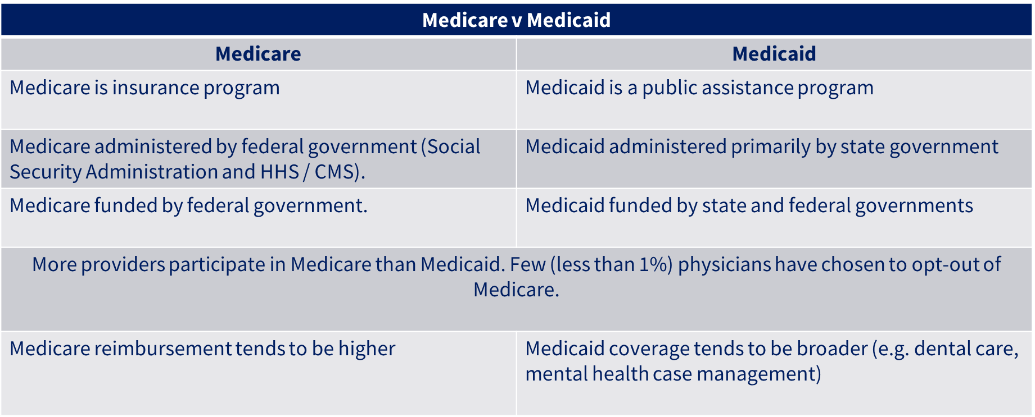
Medicare basics

Slide 5
Medicare Structure
Part A: inpatient hospital stays, skilled nursing facility (SNF) stays, some home health visits, and hospice care
Part B: physician visits, outpatient services, preventive services, and some home health visits.
Part C: Medicare Advantage - private health plans (health maintenance organization (HMO) or preferred provider organization (PPO)) with all Medicare-covered Part A and Part B benefits and typically also Part D benefits

Slide 6
Medicare Structure
Part D: outpatient prescription drugs through private plans that contract with Medicare, including stand-alone prescription drug plans (PDPs) and Medicare Advantage plans with prescription drug coverage (MA-PDs).
Medicare-Medicaid Alignment Initiative: allows eligible beneficiaries to receive their Medicare Parts A and B, Medicare Part D, and Medicaid benefits from a single Medicare-Medicaid Plan, also known as a MMAI plan. (e.g. Aetna, BCBS, Humana, Meridian, Molina)

Slide 7
More People Are Choosing Medicare Advantage

Slide 8
More Money is Going to Medicare Advantage

Slide 9
Medicare Open Enrollment Period October 15-December 7.
Join, drop, or switch to another Medicare Advantage Plan (or add or drop drug coverage).
Switch from Original Medicare to a Medicare Advantage Plan or from a Medicare Advantage Plan to Original Medicare.
Join, drop, or switch to another Medicare drug plan if you’re in Original Medicare

Slide 10
Who Can Get Medicare Part A
Generally, eligible for Part A if:
65 or older and meet the citizenship and residency requirements.
Get disability benefits because of ALS (Amyotrophic Lateral Sclerosis, aka Lou Gehrig’s disease).
Get disability benefits from Social Security or the Railroad Retirement Board for at least 25 months.
Have ESRD and meet certain requirements.
How much does Part A coverage cost?
Usually $0 - if you or your spouse paid Medicare taxes for at least 10 years while working. If not eligible for free Part A, you can buy-in if :
65 or older and have (or are enrolling in) Part B and meet the citizenship and residency requirements.
Under 65, disabled, and free Part A coverage ended because of return to work. (If under 65 and disabled, Part A can continue for free up to 8 ½ years after you return to work.)

Slide 11
Who Can Get Medicare Part B
Generally, eligible for Part B if
Entitled to hospital insurance; or
Meet the following requirements:
Age 65.
Resident of the United States.
Citizen of the United States, or alien lawfully admitted for permanent residence who has resided continuously in the United States during the 5 years preceding the month in which applies for enrollment.

Slide 12
Conditional Part A
72,948 65+ yo Illinois residents could buy-into Part A
Part A Buy-In v. Group Payer States
Part A Buy-In States agree to pay the Part A premium of people eligible for Premium Part A and the enrollment process happens automatically. Group Payer States require interested people to initiate the process. See SSA POMS HI 00801.140
GROUP PAYER STATES
Alabama | Kansas | New Mexico
Arizona | Kentucky | South Carolina
California | Missouri | Utah
Colorado | Nebraska | Virginia
Illinois | New Jersey

Slide 13
Why Medicaid recipients want medicare

Slide 15
Medicare pays more than medicaid
Medicaid-to-Medicare Fee Index (2019)
 | All Services | Primary Care | Obstetric Care | Other Services
California | 0.73 | 0.76 | 0.61 | 0.73
Texas | 0.65 | 0.58 | 0.72 | 0.80
Florida | 0.58 | 0.49 | 0.79 | 0.66
New York | 0.57 | 0.43 | 0.75 | 0.71
Pennsylvania | 0.68 | 0.46 | 1.11 | 0.67
Illinois | 0.59 | 0.44 | 0.87 | 0.78
Ohio | 0.62 | 0.57 | 0.66 | 0.72
Georgia | 0.83 | 0.71 | 0.96 | 0.97
North Carolina | 0.78 | 0.78 | 0.68 | 0.92
Michigan | 0.69 | 0.62 | 0.91 | 0.57
USA | 0.72 | 0.67 | 0.80 | 0.78

Slide 16
Medicare: a Racial Justice Tool
Medicare enrollment associated with reductions in racial and ethnic disparities in insurance coverage, access to care, and self-reported health across the US. Expanding eligibility for Medicare may be a viable means to reduce racial and ethnic disparities and advance health equity by closing gaps in insurance coverage.
Journal of the American Medical Association, July 26, 2021

Slide 17
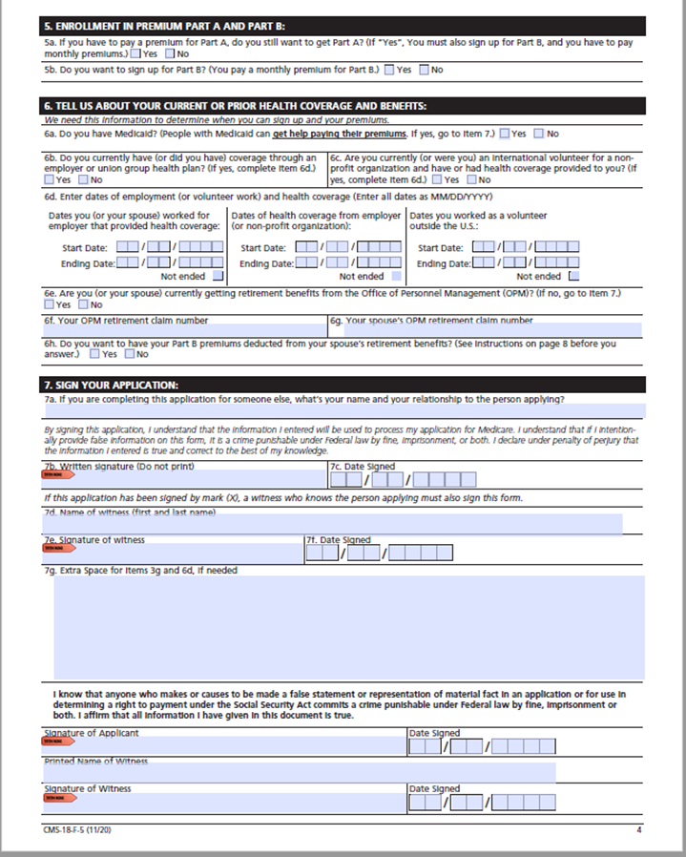
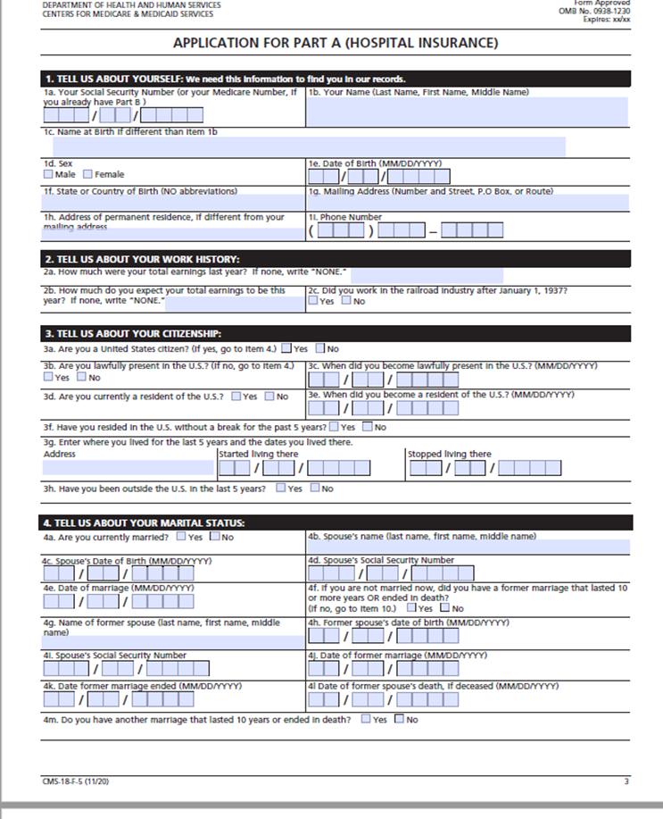
Conditional Part A

Slide 18
Conditional Part A – Magic Words
“I wish to enroll in Part A (hospital insurance). I understand that:
I’m not eligible for Premium-Free Part A. By enrolling, I’m buying Part A coverage.
I must also have Part B (medical insurance).
I must pay monthly premiums for Part A and Part B coverage.
I only want Part A coverage if my State approves my application for the Qualified Medicare Beneficiary (QMB) program. I do not want Part A coverage to begin before my State starts paying my monthly premiums. I understand that if I lose my QMB status, I must pay the monthly premiums to keep my Part A coverage.”

Slide 19
Medicare Is Not Cheap: $6663 / year

Slide 20
Medicare is Not Cheap
MEDICARE COSTS 2024
Part A | Monthly Premium | $0 (40 Qrtrs) $278 (30-39 Qrtrs) $505
 | Inpatient Hospital Deductible | $1,632
 | Inpatient Hospital Co-Payment | Days 61 – 90 = $408; Days 91 – 150 = $816
 | SNF Co-Payment | Days 21 – 100 = $204
Part B | Monthly Premium | $174.70 – higher for higher income
 | Deductible | $240
 | Co-Insurance | 20%
Part D | Monthly Premium | $34.70 national base premium ($55.50 national average)
 | Deductible | Up to $545
 | Co-Insurance | Up to 25% per prescription up to $1,165 in Initial Coverage Period
 | Donut Hole | Up to 25% per prescription(when out of pockets exceed $5,030 - $8,000)

Slide 21
MEDICARE COSTS 2025
Part A | Monthly Premium | $0 (40 Qrtrs) $285 (30-39 Qrtrs) $518
 | Inpatient Hospital Deductible | $1,676
 | Inpatient Hospital Co-Payment | Days 61 – 90 = $419; Days 91 – 150 = $838
 | SNF Co-Payment | Days 21 – 100 = $209.50
Part B | Monthly Premium | $185 – higher for higher income
 | Deductible | $257
 | Co-Insurance | 20%
Part D | Monthly Premium | $36.78 national base premium ($46.50 national average)
 | Deductible | Up to $590
 | Co-Insurance | Up to 25% per prescription up to $2,000 in Initial Coverage Period
 | Donut Hole | DONUT HOLE ENDS: $2000 cap on out of pocket expenses

Slide 22
Part D Low income subsidy – extra help
Income Limit: 150% FPL $15,060 / yr ($1,255 / mos)
Resource Limit: $16,100 ($32,130 if married) – not all resources count
Benefit: $0 premium; $0 deductible
How Enrolled: Medicaid / SSI recipients auto-enrolled; others apply at SSA or DHS

Slide 23
What are Medicare Savings Programs (MSPs)?
MSPs are Medicaid-administered programs ​
MSPs help cover Medicare premiums and cost-sharing for those with Medicare who have limited incomes and resources and don’t qualify for full Medicaid​
MSPs “buy” those who are eligible into Medicare​

Slide 24
Different Types of MSPs
Qualified Medicare Beneficiary (QMB)​
Pays Part A premium (if applicable) and Part B premium; also pays Part A & B deductibles, copayments and/or coinsurance​
Specified Low-Income Beneficiary (SLMB)​
Pays only the Part B premium​
Qualified Individual (QI)​
Pays only the Part B Premium ​
A block grant, meaning if states exceed their allotment no more people can get QI​​

Slide 25
Qualified Disabled Working Individual
QDWI is for people under age 65 who lost premium-free Part A because they’ve gone back to work after getting SSDI long enough to have received Medicare​
QDWI pays Part A premiums for those who qualify : ​

Slide 26
Benefits of MSPs
Any Part B penalty premium is waived for people who qualify for QMB, SLMB, and QI​
No estate recovery​
States are not allowed to ask for repayment of the costs they covered under the MSP from the estates of deceased MSP recipients ​
Those eligible for MSPs automatically get the Part D Low Income Subsidy/Extra Help​
They are “deemed eligible” -- meaning they automatically get Extra Help with their prescription costs​

Slide 27
How MSPs Work: Behind the Scenes
CMS & States: Centers for Medicare & Medicaid Services (CMS) and state Medicaid agencies work together to provide this help​
CMS (federal government) oversees the program​
Provides matching funds for QMB and SLMB​
Provides 100% of costs for QI (block grant)​
State Medicaid agencies administer the MSPs​
Determine eligibility​
Pay Medicare Part B premium (on behalf of QMBs, SLMBs and QIs)​
Pay Medicare copayments, coinsurance, and deductibles to health care providers (on behalf of QMBs)​
Pay Part A premium for those who owe it (on behalf of QMBs and QDWIs)​

Slide 28
MSP’s Relationship with Extra Help/LIS
People enrolled in an MSP automatically qualify for the Low-Income Subsidy (LIS)/Extra Help (“deemed eligible”) ​
Means your clients get the help they may need with prescription drug costs and automatically!​
If they don’t join a Part D plan on their own - “facilitated” into a plan by CMS​
Facilitated enrollment occurs two months after being “deemed” eligible for LIS​
This gives them time to select a Part D plan that best meets their needs​
However, enrollment is done randomly into a plan within the LIS premium amount without regard to beneficiary’s medication requirements. If medications are not on the formulary, the beneficiary owes the full amount of the drug cost vs. the LIS discounted amount.​

Slide 29
MSP’s Relationship with Extra Help (cont.)
What about those with LIS who do NOT automatically qualify for MSPs? ​
When they apply for LIS (unless they decline), Social Security sends their LIS application info to their state Medicaid agency ​
That triggers the MSP application process​
State Medicaid agencies then have 45 days to determine MSP eligibility​
Applicants may be asked for further information / documentation​

Slide 30
Health insurance marketplace
Created by the Affordable Care Act (Obamacare)
Offers affordable, private insurance to people for whom affordable insurance is not available through an employer
Over 20 million people have purchased coverage and most (93%) qualify for premium tax credit assistance through health insurance marketplaces.
The premium tax credit assistance was enhanced with the passage of the American Rescue Plan Act (ARPA) in 2021 and extended by The Inflation Reduction Act (IRA) through 2025.
During 2024, 368,251 Illinois residents enrolled in a plan through the marketplace. Enrollment in the state has increased by 42% since 2020.

Slide 31
Health insurance marketplace: what
Private Health Insurance
All Marketplace plans cover:
10 essential health benefits
Free preventive health services at no cost to you when delivered by a doctor or provider in your plan's network
Coverage for pre-existing conditions

Slide 32
Health insurance marketplace: what
All plans offered in the Marketplace cover these 10 essential health benefits:
Ambulatory patient services (outpatient care you get without being admitted to a hospital)
Emergency services
Hospitalization (like surgery and overnight stays)
Pregnancy, maternity, and newborn care (both before and after birth)
Mental health and substance use disorder services, including behavioral health treatment (this includes counseling and psychotherapy)
Prescription drugs
Rehabilitative and habilitative services and devices (services and devices to help people with injuries, disabilities, or chronic conditions gain or recover mental and physical skills)
Laboratory services
Preventive and wellness services and chronic disease management
Pediatric services, including oral and vision care (but adult dental and vision coverage aren’t essential health benefits)

Slide 33
Health insurance marketplace: what
Additional benefits
Plans must also include the following benefits:
Birth control coverage
Breastfeeding coverage
Plans may offer additional benefits, including:
Dental coverage
Vision coverage
Medical management programs (for specific needs like weight management, back pain, and diabetes)

Slide 34
Health insurance marketplace: who
Live in the United States (U.S).
U.S. citizen or national, or be lawfully present non-citizen in the U.S.
Not incarcerated.
Not enrolled in Medicare coverage.

Slide 35
Health insurance marketplace: when
Open Enrollment is November 1-January 15
Enroll by December 15 for coverage that starts January 1
Enroll by January 15 for coverage that starts February 1
Outside the yearly Open Enrollment, only if you:
Have a life change or income that qualifies for a Special Enrollment Period.
Qualify for Medicaid or the Children's Health Insurance Program (CHIP). You can enroll any time of year and coverage can start immediately.

Slide 36
Health insurance marketplace: how much
Most people qualify for savings
Depending on expected annual household income, may qualify for:
Lower costs for Marketplace plan, like the premium tax credit that lowers your monthly plan premium, and for extra savings on out-of-pocket costs like deductibles, copayments, and coinsurance.
Coverage through Medicaid or CHIP. Your children may qualify for CHIP, even if you don't qualify for Medicaid.

Slide 37
Health insurance marketplace: how much
KFF Health Insurance Premium Calculator - https://www.healthcare.gov/lower-costs/qualifying-for-lower-costs/

Slide 38
KFF – SAMPLE #1
35 year old single man
no dependents
earning $33,696 (Chicago minimum wage)
no coverage available from job
non-smoking

Slide 39
KFF – SAMPLE #2
40 year old single woman
2 dependent children, age 14, 10
earning $40,000
no coverage available from job
smokes

Slide 40
Shopping - Preview plans
https://www.healthcare.gov/see-plans/#/

Slide 41
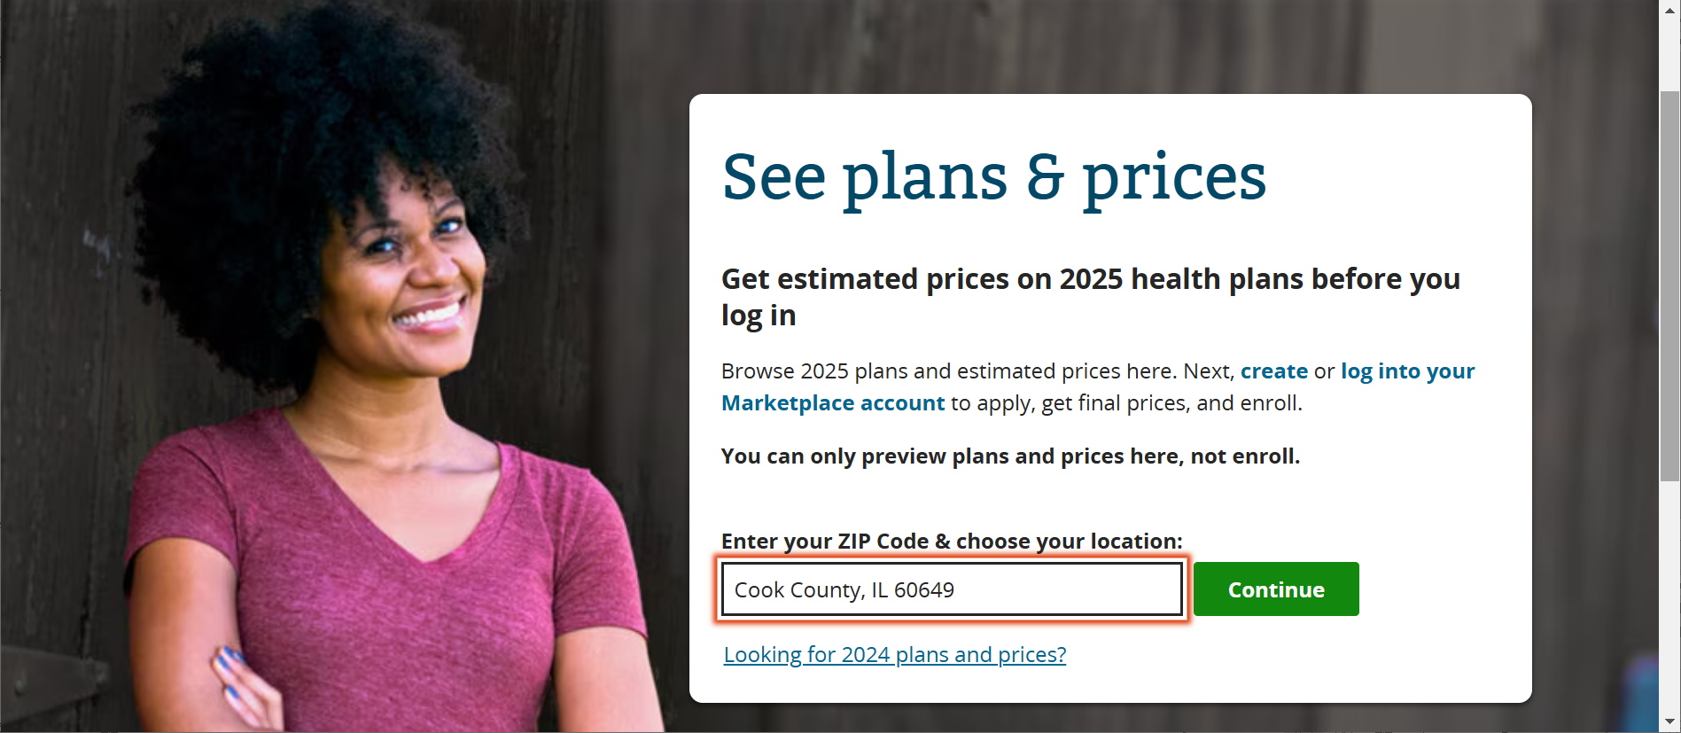

Slide 45
What’s next:
October | November | December
IDHS Appeals Part 2 What do I do after I file an appeal? Preparing for and representing yourself in others in hearings What happens at a hearing? Post-hearing | Healthcare options beyond Medicaid: Marketplace Health Insurance & Medicare | “Ask an Attorney” We will be answering your questions regarding your client’s IDHS and SSA benefits, what changes we’re expecting, how to get more help when you need it, etc. *NOTE: We cannot provide legal advice in this or any other training.

Slide 46
questions
Trey Daly
tdaly@legalaidchicago.org

