Slide 1
Appealing Illinois department of human services (IDHS) decisions part I
Gwynne Kizer Mashon
gmashon@legalaidchicago.org
09.2024

Slide 2








Children & Families
Consumer
Legal Aid Chicago is a private non-profit that provides free civil legal services to people with limited income* in Cook County, securing their rights to economic stability, affordable housing, personal safety, fair working conditions, and basic healthcare.
Criminal Records
Relief
Public Benefits
Long-Term Care
* No financial eligibility requirements for seniors or victims of domestic or sexual violence; higher income limits for certain populations or legal issues, including veterans, people living with HIV, and others.
Immigrants & Workers’
Rights
Housing

Slide 3
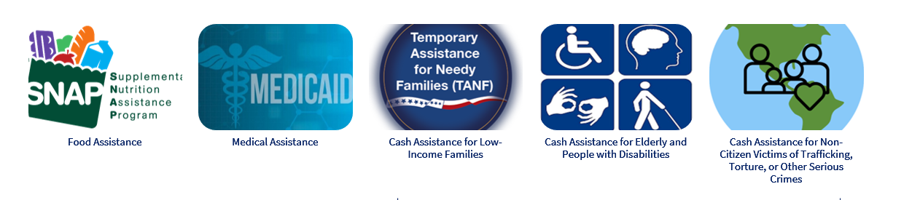
IL Department of human services
AGENDA
What is an appeal?
What can you appeal and when?
How do you file an appeal?
What else can you do and when?
Note 1
In this training series, I am not teaching you exactly how attorneys approach and address these issues. I hope this is more useful to you!
Note 2
Do not withdraw an appeal until you have evidence in writing! Practice telling them “no”.

Slide 4

What is an appeal?
Goldberg v. Kelly, 397 USC 254 (1970)
Welfare benefits are a form of property, so are subject to Procedural Due Process (5th and 14th amendments to US Constitution)
Interest of a recipient in obtaining benefits needed to procure the necessities of life outweighs administrative efficiency
Pre-termination procedures are required before terminating benefits
  Notice
  Hearing with an impartial decision-maker
  Right to cross-examine witnesses
  Discovery (getting information)
  Decision on the record
  Right to have an attorney (but not a free or court-appointment one)
This is your constitutional right!

Slide 5
What is an appeal?
“Filing an appeal” is really asking for an impartial decision-maker (the administrative law judge (“ALJ”)) to step in to:
  Assert your due process RIGHTS
  Ensure IDHS follows federal and state laws
  Fix a mistake that IDHS made so you can get the benefits you’re entitled to receive
  There is no charge for appealing –
  even if you don’t win!
In reality, you can often resolve problems without ever talking to the ALJ.
(We’ll talk about that more next month.)

Slide 6
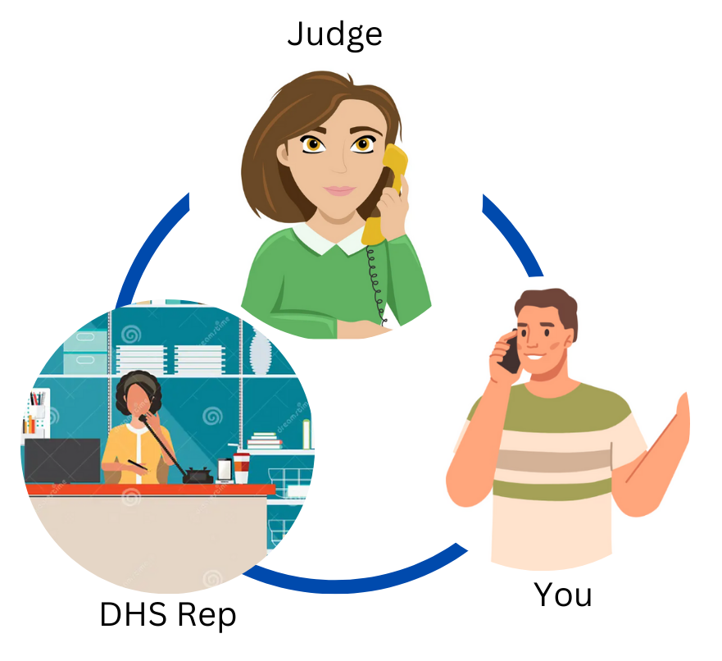

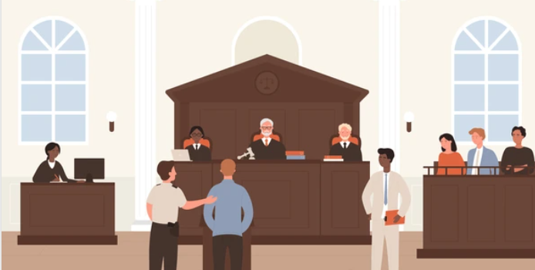
What is an appeal hearing?

Slide 7
What can I appeal
IDHS reduces or stops benefits without sufficient notice to the recipient in writing
IDHS fails to timely act or an application
Actions
Inactions
IDHS issues a Notice of Decision that has the wrong decision
IDHS incorrectly finds someone ineligible or eligible for less than they should have
Decisions
Determinations
Report to a Report Form
IDHS incorrectly finds someone ineligible or eligible for less than they should because of a change
IDHS applies a policy that does not comply with state or federal law. ***
Any issue of policy that a person disagrees with
PM 01-07-01
*** We will not discuss this kind of appeal.

Slide 8
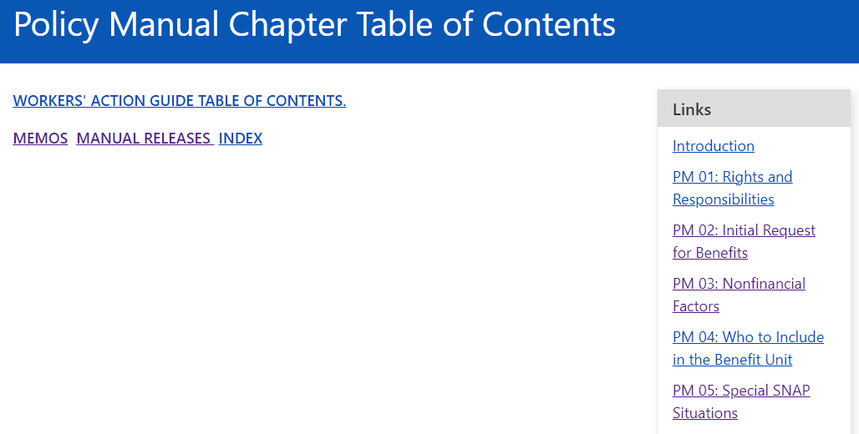
Quick aside: the policy manual
https://www.dhs.state.il.us/page.aspx?item=13473
Google: “Illinois DHS PM”

Slide 9
When can I appeal?
Calculating Dates
Day 1 =
Date on notice
Date benefits will be reduced or canceled
If date on medical notice is June 1, 2024, appeal deadline is July 31, 2024.
Date Appeal Filed
Mailed: postmark
Otherwise:
Date received prior to 5pm.
If after 5pm, next business day.
60 days
Decision related to cash or medical
90 days
Decision related to food
No deadline!
IDHS fails to send a required notice
IDHS fails to timely
IDHS fails to notify the client that a request was denied
PM 01-07-03

Slide 10
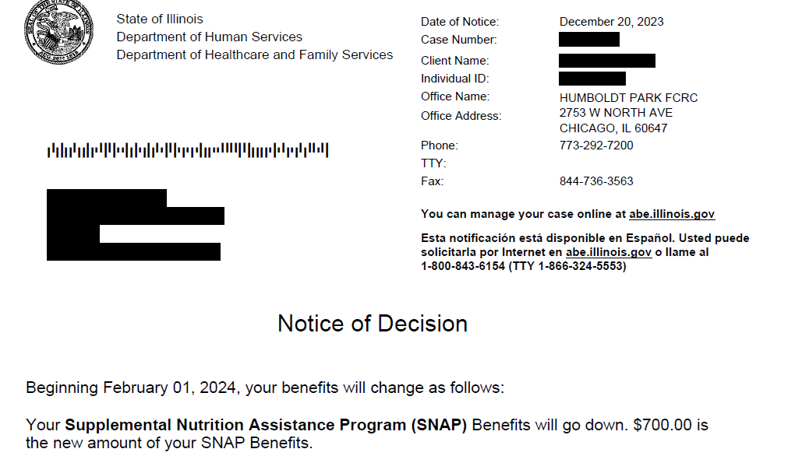
When should I appeal termination or reduction?
Continuing Benefits
MUST file appeal by the later of:
  10 calendar days after the date on the notice, or
  The date of change
No continuing benefits for missed SNAP redetermination
Risk of overpayment for SNAP and Cash
Date of Notice: 12/20/2023 + 10 days = 12/30/24
Date of change = 2/1/24
Appeal must be filed before 2/1/24 to request continuing benefits.
PM 01-07-04

Slide 11
No deadline to appeal
Program | Longest Deadline
Medical for someone who is over 65 or who has Medicare | 60 days
AABD Cash | 60 days
Medical for others | 45 days
TANF | 45 days
SNAP (regular processing) | 30 days
SNAP (expedited processing) | 30 days
No legally sufficient notice of decision (or no notice at all) issued in response to an application (or program add) within processing deadlines
IDHS saying it made a decision is not enough!
Includes cases where DHS fails to consider all months of eligibility it should (e.g. 3 months of retroactive Medicaid or MSP)
Exception: Termination at end of SNAP Certification period
PM 17-01-01

Slide 12
No deadline to appeal
Incomplete list of information IDHS is required to include in notices
Written notice was sent but didn’t have legally required elements:
Practice Tip: Do not file appeal for inaction until you have all of the documents you think IDHS will need to approve your application
  Things requested in a Verification Checklist
  Proof of 30 days of earned income
Clear statement of approval, denial, or action taken
Amount of benefit
Date change or approval is effective
Clear statement of the reason for the action
Reference to specific policy that supports the action
Names of individuals whose benefits are starting, ending, or changing
Budgets for cash and food assistance
Type of medical assistance they are eligible for/ineligible for
If medical is denied for financial reasons, calculations supporting that decision
PM 01-06-00

Slide 13
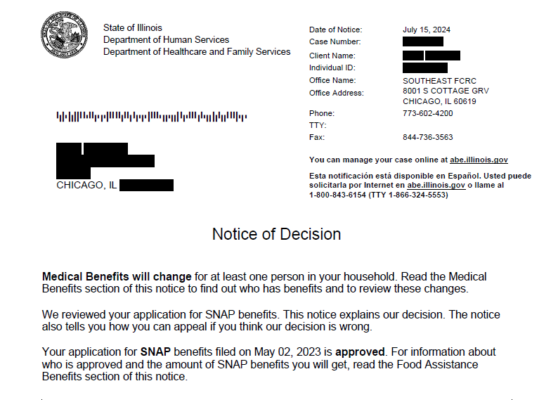
EXAMPLE 1
No date of change
No statement of change
Clear statement of approval??

Slide 14
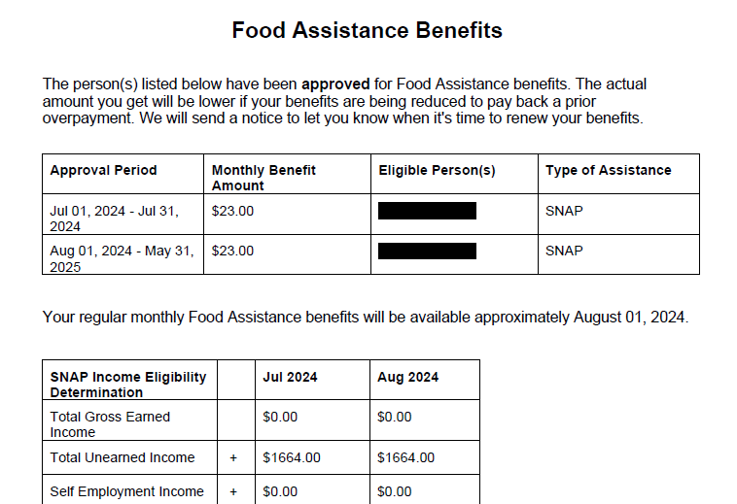
Practice Tip
Make sure beginning date is correct. If not, you might have an inaction for those dates.
EXAMPLE 1
Practice Tip
Make sure that all people on the application are included. If they are not, there should be a reason stated later in the notice. If not, you might have an inaction for those members.
Names of people impacted
Dates of eligibility
Budget

Slide 15
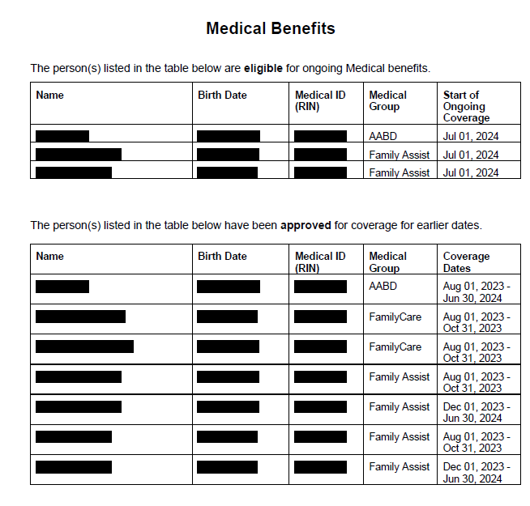
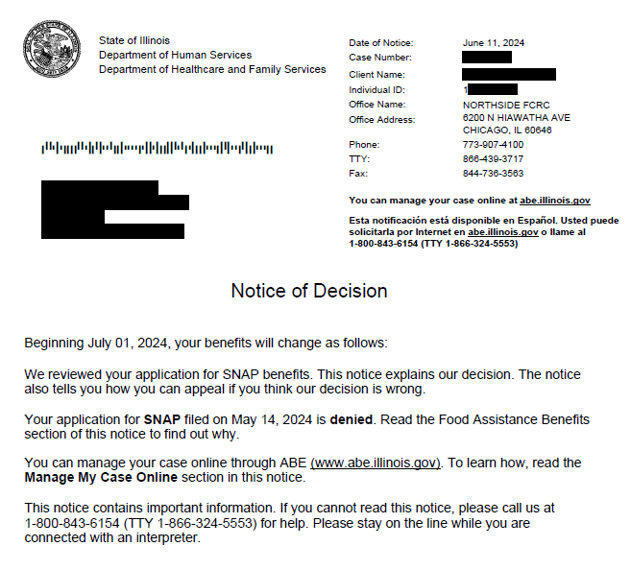
EXAMPLE 2
Page 1
Page 2

Slide 16
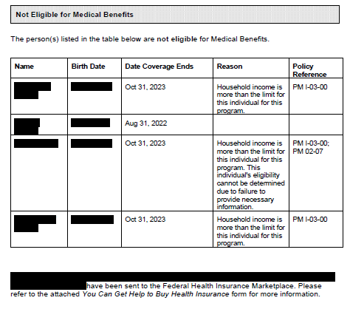
EXAMPLE 2
ANALYSIS
It appears that IDHS found the entire household ineligible for SNAP and found at least four members ineligible for Medical benefits.
No reason for SNAP denial
No reference to PM for SNAP denial
No reason for medical denial for one member
No explanation for why other members were denied based on income – It doesn’t even state WHICH Medicaid program they were considered for
Arguably, if IDHS doesn’t cure the problems with this notice by issuing a new one, then these denials can be appealed at ANY TIME.
Practice Tip
If possible, file appeal by the deadline anyway. That way you don’t have to worry about arguing whether there’s a deadline.
Page 3

Slide 17
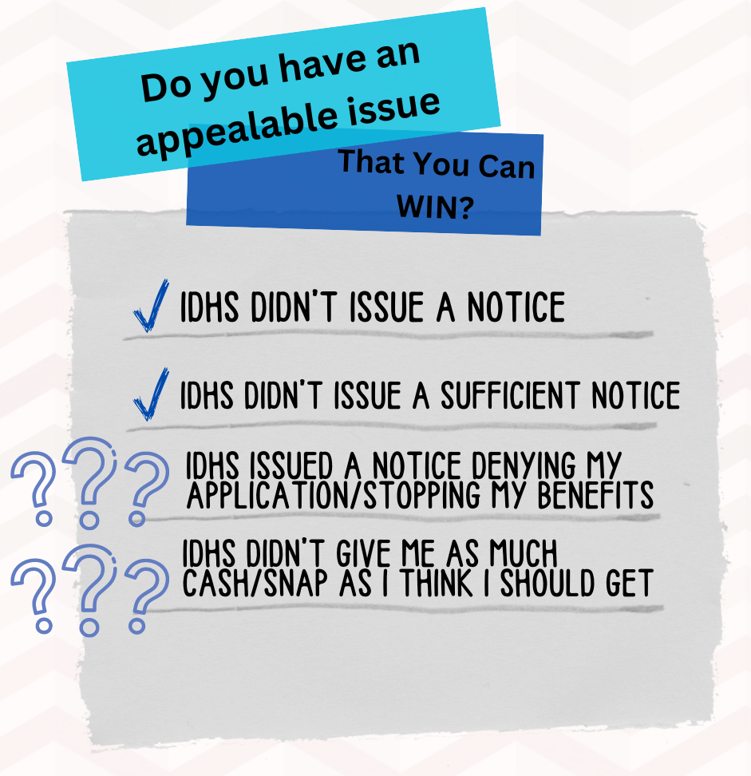
Do I have an appealable issue? YES!
To win an appeal based on a decision, you will have to show one of the following:
IDHS didn’t properly apply the law
IDHS didn’t get the facts right
IDHS made some combination of getting the facts and law wrong
Practice Tip: Winning an Appeal does not guarantee you benefits.

Slide 18
Quick decisions checklist:
This checklist will not identify all appealable issues or all mistakes IDHS might have made. But it will find many of the kinds of problems you can usually resolve without an attorney:
Benefits denied or terminated because of a missed interview
Benefits denied or terminated because of missed verifications
Failure to include correct household members in the eligibility unit
Incorrect Income used
Incorrect Expenses used
Failed to consider correct Medical, Food or Cash category
Benefits denied because of failure to submit redetermination where one was submitted on time

Slide 19
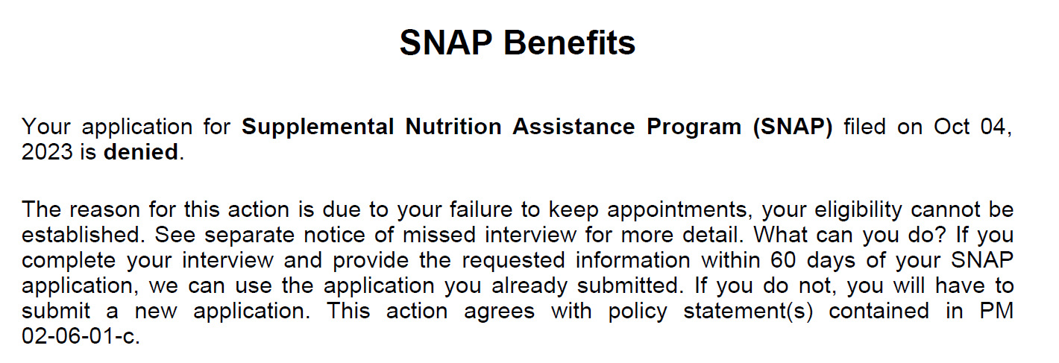
Missed interview
PM 01-07-08: If notice denies/terminates benefits based on a missed application, and the notice is timely appealed, then IDHS must reschedule the interview. If the client appears for the interview and provides all required information, IDHS will reopen the application back to the original date and provide benefits as if all benefits were available at the time of the original decision.
PM 01-07-08

Slide 20
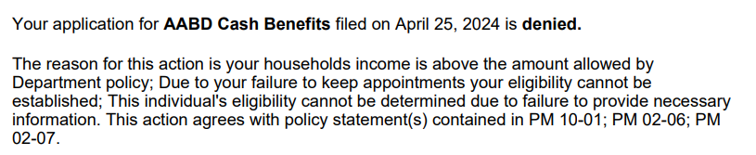
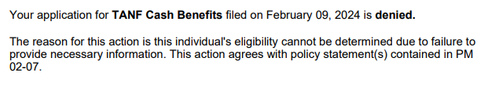
Missed VERIFICATIONS
PM 01-07-08: If notice denies/terminates benefits based on a missed verifications and appeal is timely filed, IDHS must accept any information or verifications presented during the appeal process, treat that information and those verifications as if they were available at the time of the original decision, and reverse or modify their decision.
PM 01-07-08

Slide 21
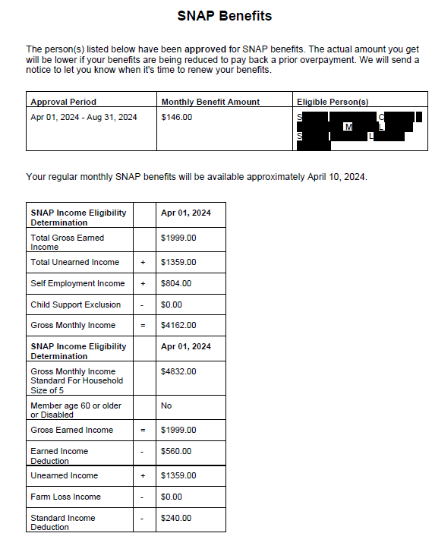
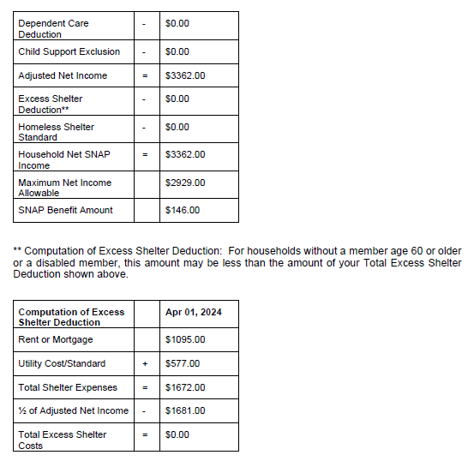
Snap notices
Did they list everyone in my family?
If I’m homeless with income and have any shelter expense (possibly including phone), do I have an excess shelter deduction or homeless shelter deduction of $179 or more?
Is my income correctly listed?
Gross income
Self-Employment show income after business expenses
Is my monthly rent correct?
Is the utility standard correct?
Numbers until 10/2024
AC/Heat or LIHEAP >$21: $577
2+ other utilities: $386
1, not phone: $62
1, Phone only: $75

Slide 22
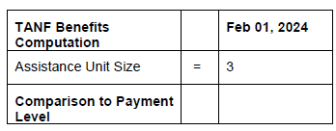
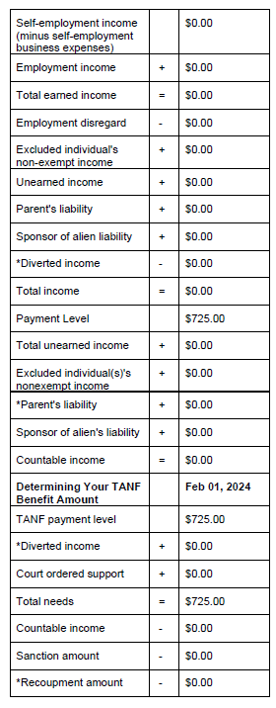
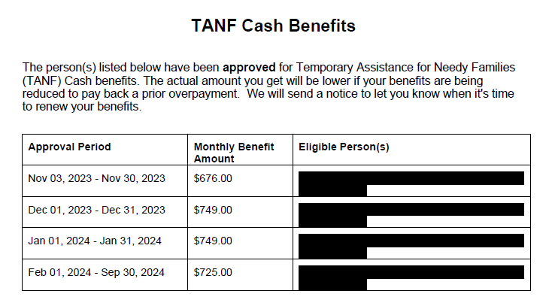

TANF notices
Is income correctly listed?
Gross Income
Self-Employment Expenses Deducted
Are all household members listed?

Slide 23
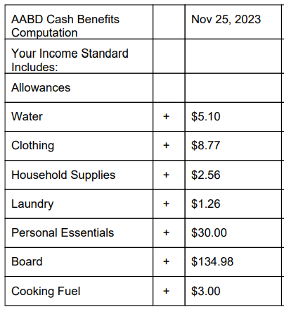
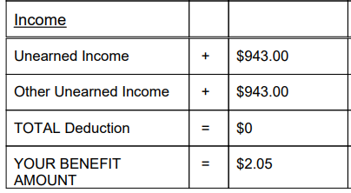
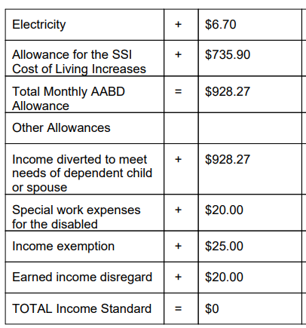
AABD Cash notices
AABD Cash budgets are the most complicated and are the most likely to not make sense.
The amounts do not correlate to actual expenses.
Please see our AABD Cash training for more information or ask an expert for help.

Slide 24
Common Wrong categories
Person on SSA benefits applies for cash assistance
Denied TANF because no minor children in the family
Asylum applicant who is pregnant with income at 150% FPL applies for medical
Denied VTTC Medical because over income
T-Visa Holder with income 120% FPL applies for medical assistance
Denied VTTC Medical because over-income
Child on SSI applies for cash assistance
Denied TANF because ineligible while receiving SSI
U-Visa Holder applies for food assistance
Denied SNAP because doesn’t meet the immigration requirements

Slide 25
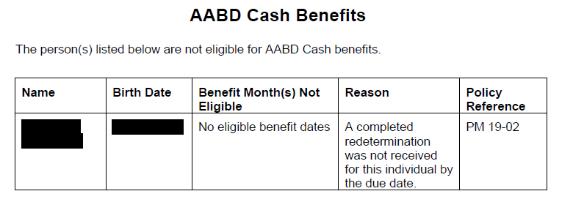
Missed redetermination
Unlike verifications, you cannot file an appeal to get IDHS to recognize a redetermination filed after the deadline. However, if you have proof it was filed timely, you can successfully appeal the termination.

Slide 26



How to appeal
Method | How?
Orally | Go to FCRC and tell them you want to appeal. Get proof that you did this in writing, or at least, write down: your appeal number, the FCRC rep’s name, where you met them, and day/time you met them. Call 1-800-435-0774. Write down: your appeal number, the name of the BAH rep you talked to, and the day/time you talked to them.
In writing | Form IL444-0103. Mail (with proof), fax, or drop off at the FCRC. Get proof that you did this in writing, or at least, write down: your appeal number, the FCRC rep’s name, where you met them, and day/time you met them.
On line | Through the Appeals Portal in Manage My Case
PM 01-07-02

Slide 27
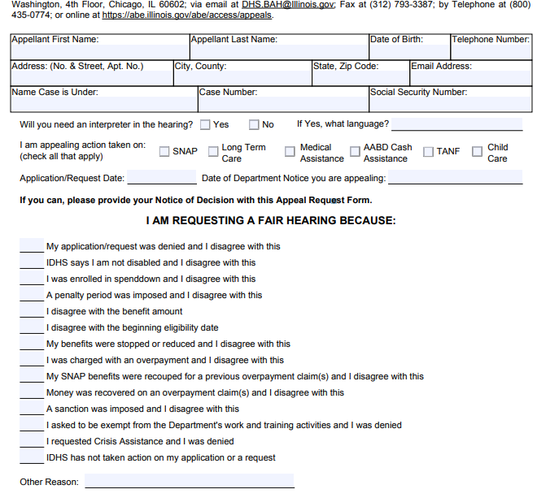
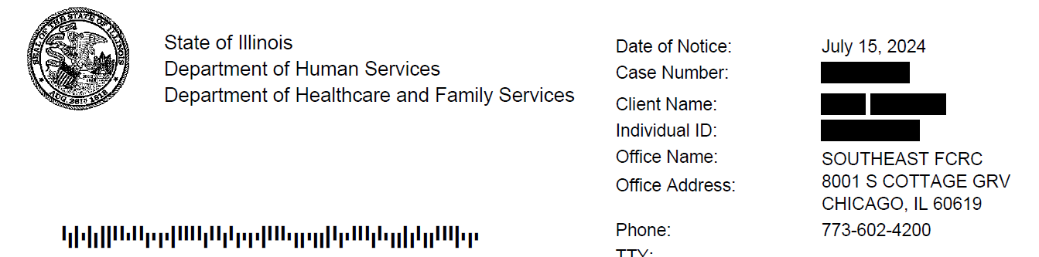
How to appeal: in writing
If you have a notice from IDHS, you can find your case number here.
Include enough information that they can tell whose case you’re talking about.
Do your best. If none of the choices makes sense,
write your answer in. IDHS should not reject your
appeal or deny your case based on this information.

Slide 28
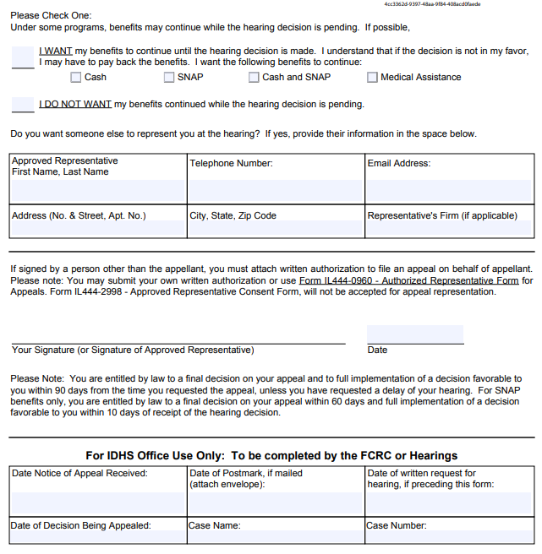
How to appeal: in writing
Request continuing benefits relevant and if filed before the latter of:
Date of change
10 days after the date of the notice reducing or stopping benefits
This is the person who they will contact for the hearing.
They will still contact the recipient directly to discuss the
case. We’ll discuss this more next month.
If someone other then the recipient signs, they must be
authorized to do that by law or be the authorized rep on the case.

Slide 29
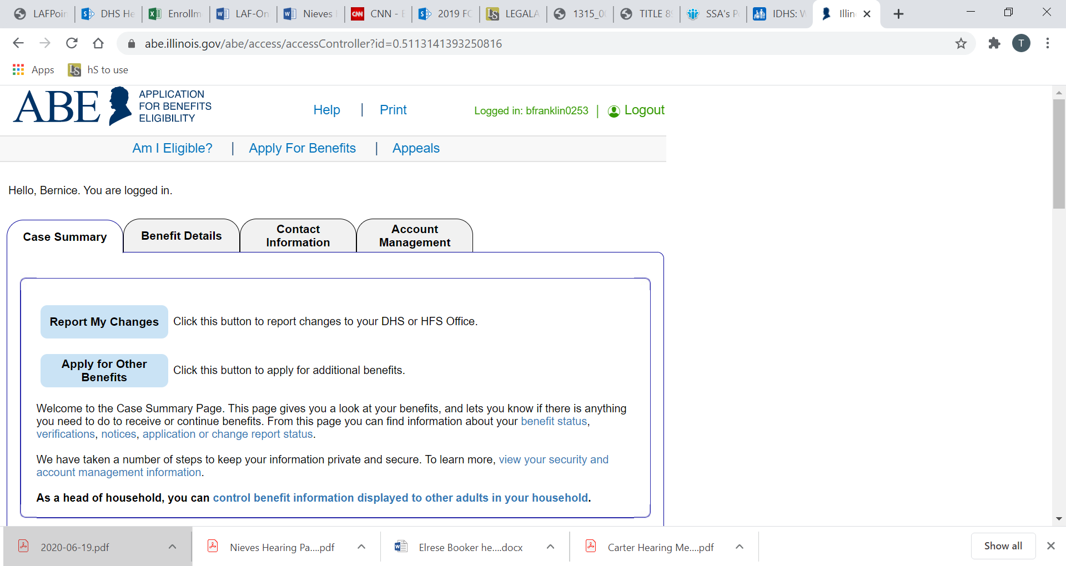
How to appeal: Online
For more information on accessing Manage My Case, please see our previous training. We plan to do an updated training in 2025.
Step 1

Slide 30
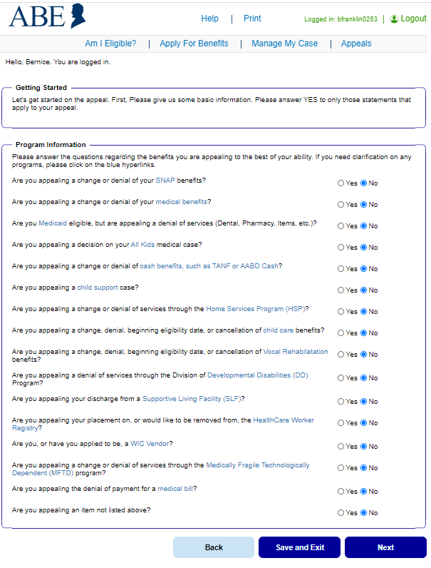
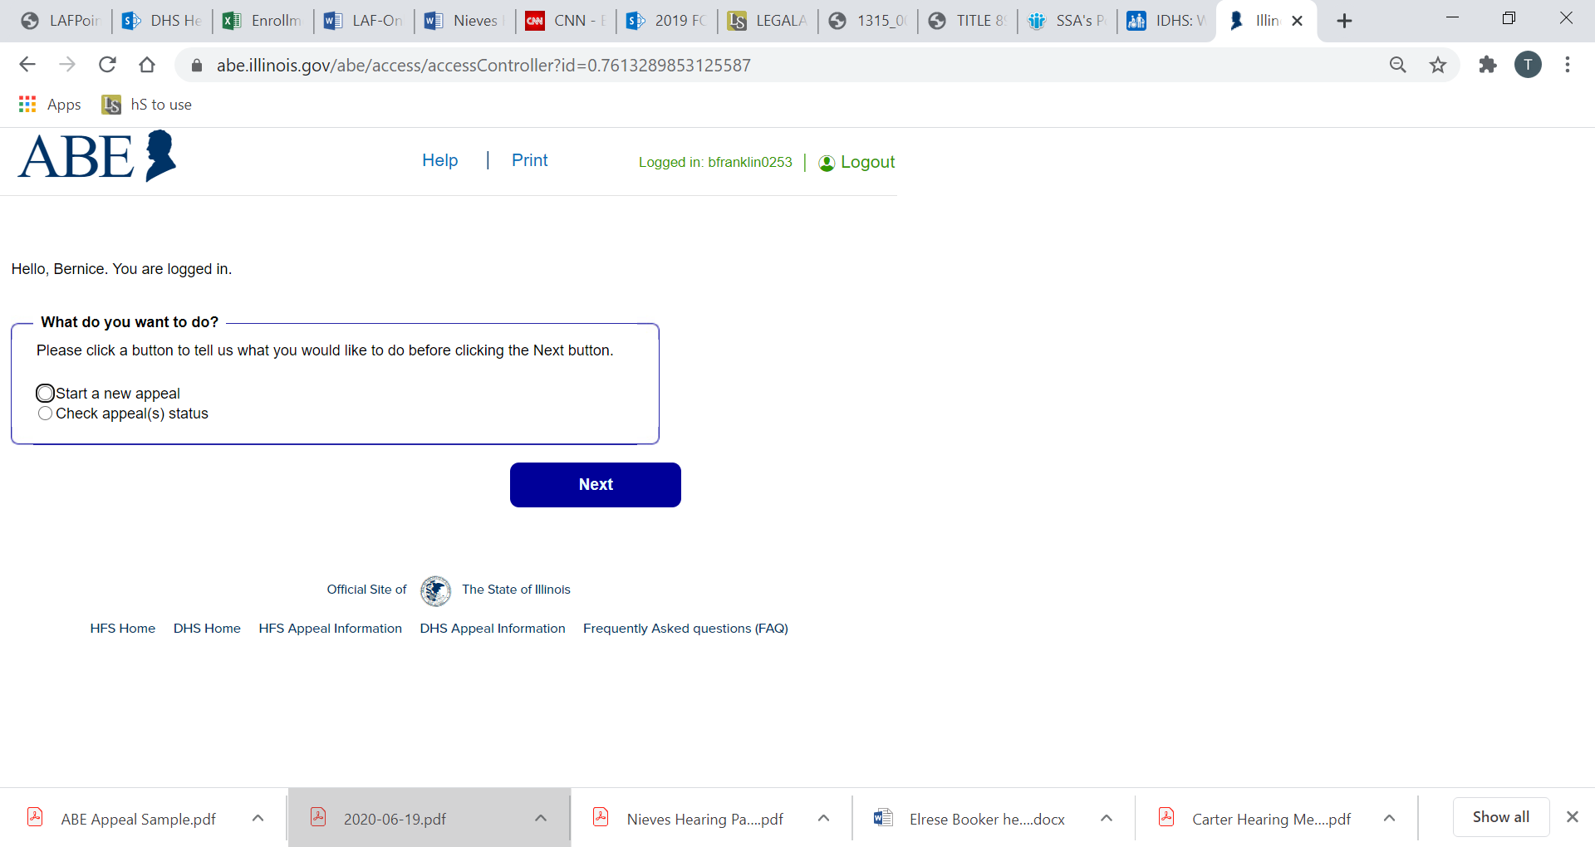
How to appeal: Online
Step 2
Indicate why you are appealing the best you can. This is not a test. Sometimes the reason for your appeal isn’t listed. Pick the option that is closest. You can explain and even change (“amend”) your reason for filing later.
Step 3

Slide 31
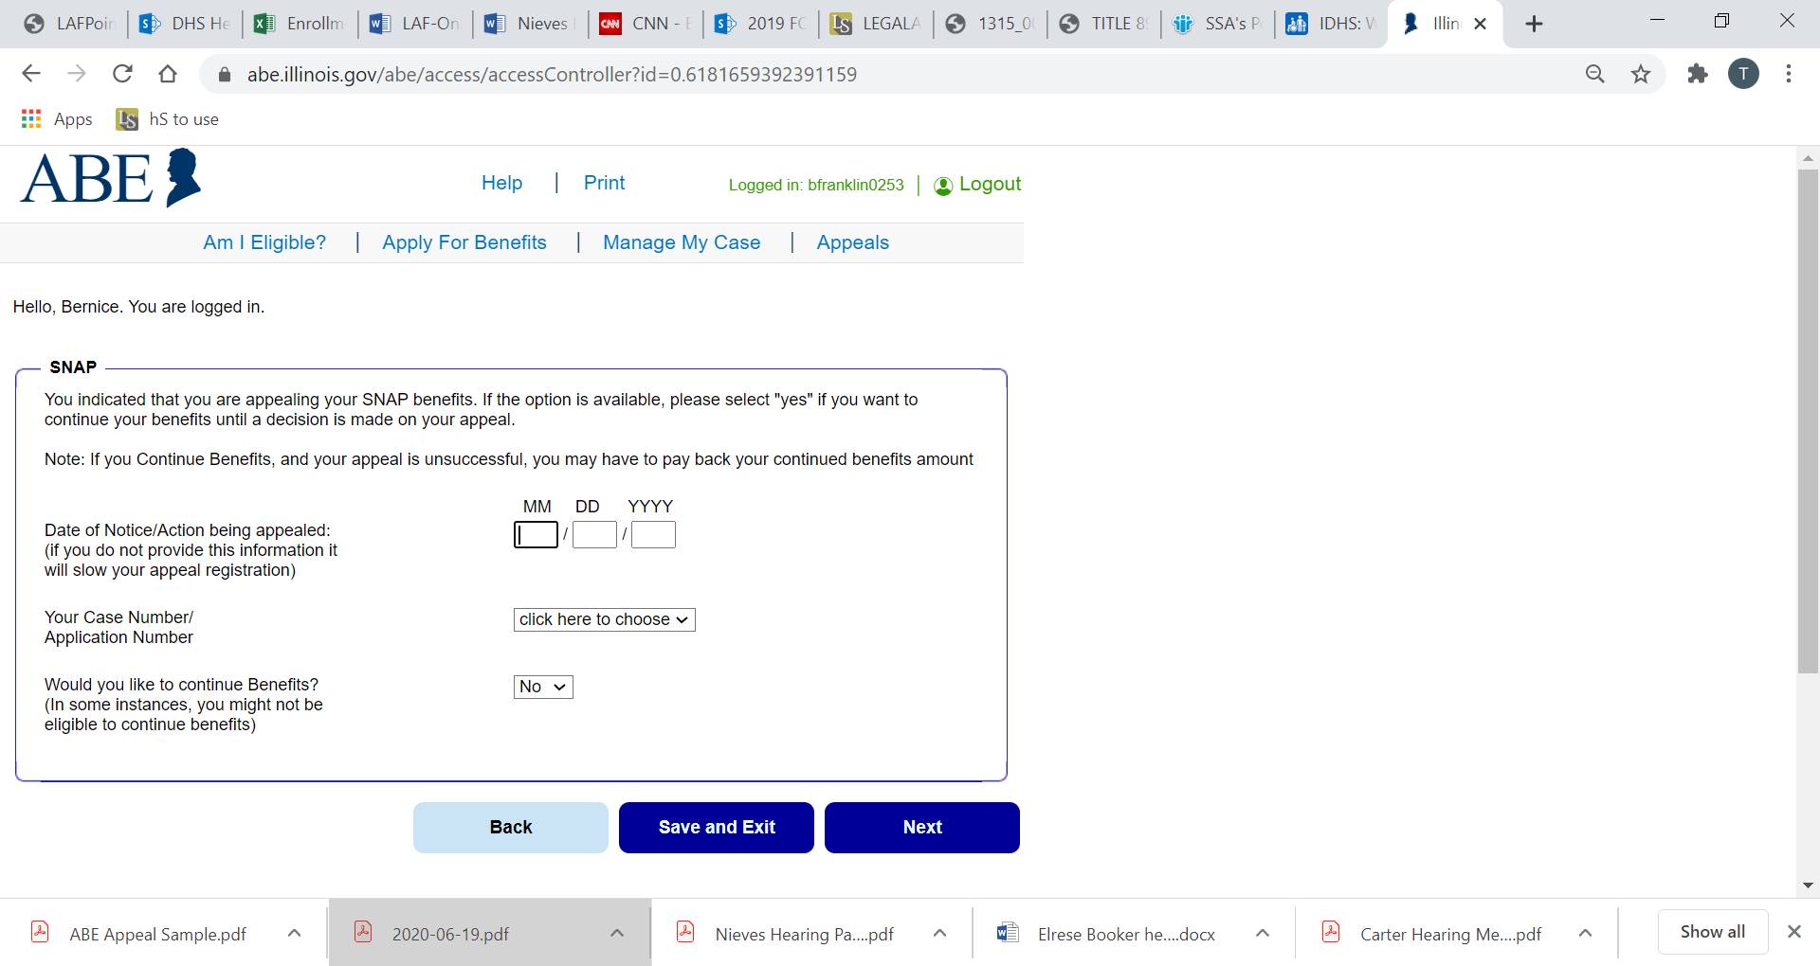
How to appeal: Online
Include the date on the notice, if you have it. For inactions, we usually put the date of the application
This is one of the few place in the appeal where entering incorrect information might cause confusion later in the appeal process.
Step 4
For terminations and reductions: Change this to “yes” if you want to receive continuing benefits during the appeal.

Slide 32
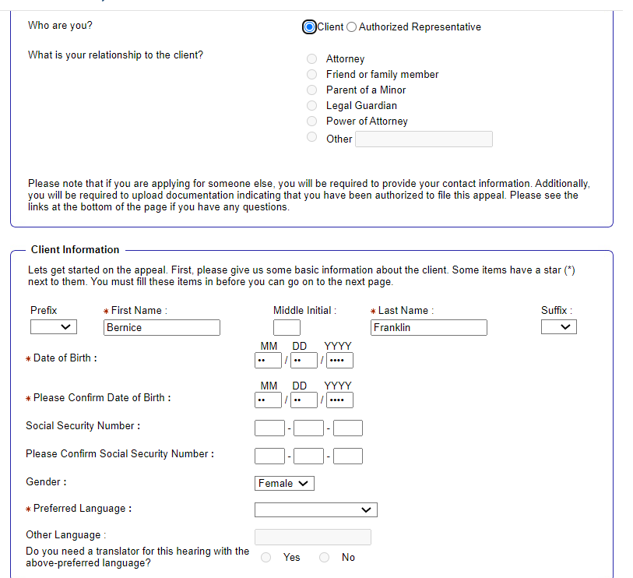
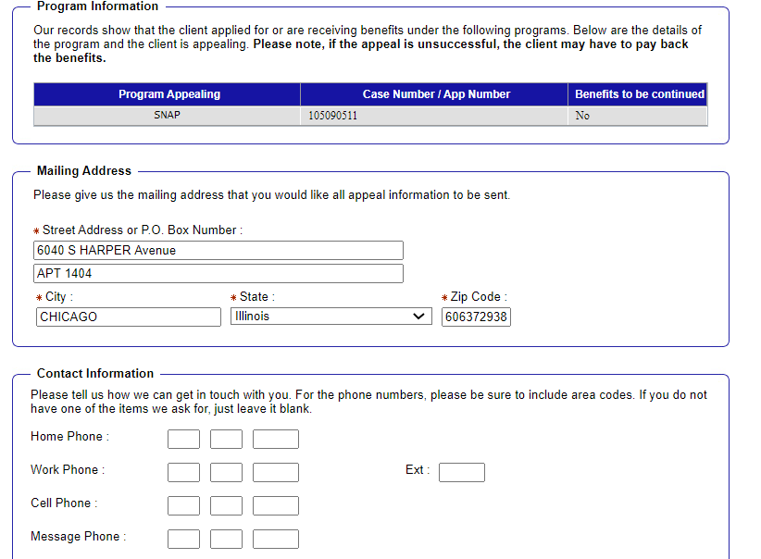
How to appeal: Online
If the “authorized representative”, then you must also submit a signed authorized representative form.
Updating your address here will NOT update your address in your case. This section only ensures that appeal-related information is sent to the proper address.
Step 6
Step 5

Slide 33
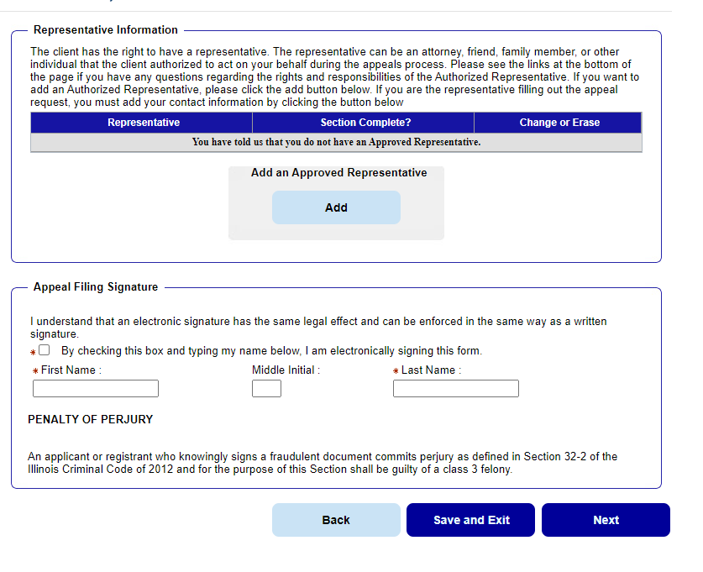
How to appeal: Online
Upload authorized rep for here. If you do not have one yet, you can also upload it later.
Signature line must match the client’s name as written in the system.
Step 6

Slide 34
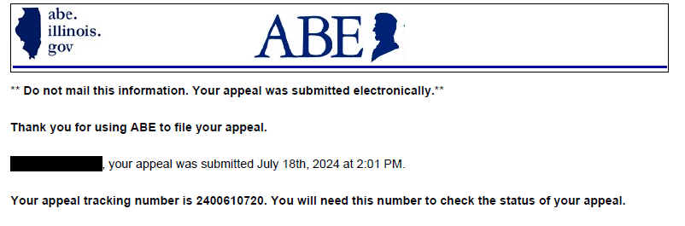
How to appeal: online
On the following screen you will get a Confirmation Number and you can download a pdf copy of the appeal itself.
We recommend you write down the confirmation number AND keep a copy of the appeal itself.

Slide 35
Alternative resolution
Appeal
Application
Change report to adjust benefits moving forward.
New medical or MSP (SLIB/QI-1) application with request for retroactive benefits
New application to get benefits slowing moving forward
Use your contacts at DHS
  FCRCs
  IDHS Policy Staff
Cash (30 day delay after application)
Appeal
Application
SNAP and QMB
Appeal
Application
Medicaid, SLIB, and QI1 (3 months retroactive coverage)

Slide 36
Other common issues you might want to bring to an expert
“No eligible member”
TANF – failure to pass through all of child support received
Overpayments
AABD Cash budgeting
VAWA eligibility for cash and medical benefits
SNAP or AABD Cash denied after a nursing home stay
60 month clock TANF cases
Benefits stopped or terminated for any reasons not discussed here!
It can take time to find a competent attorney.
Make sure you don’t miss appeal deadlines!

Slide 37
What’s next:
October | November | December
IDHS Appeals Part 2 What do I do after I file an appeal? Preparing for and representing yourself in others in hearings What happens at a hearing? Post-hearing | Healthcare options beyond Medicaid: Marketplace Health Insurance & Medicare | “Ask an Attorney” We will be answering your questions regarding your client’s IDHS and SSA benefits, what changes we’re expecting, how to get more help when you need it, etc. *NOTE: We cannot provide legal advice in this or any other training.

Slide 38

questions
Gwynne Kizer Mashon
gmashon@legalaidchicago.org

