Slide 1
IDHS benefits for Children and Families
Gwynne Mashon
07.09.2024

Slide 2








Children & Families
Consumer
Legal Aid Chicago is a private non-profit that provides free civil legal services to people with limited income in Cook County, securing their rights to economic stability, affordable housing, personal safety, fair working conditions, and basic healthcare.
Public Benefits
Criminal Records
Relief
Long-Term Care
Immigrants & Workers’
Rights
Housing
Notes:
Introduce ourselves here – very quickly – if introductions aren’t made for us

Slide 3
agenda
Overview of non-cash benefits available to children and families
Detailed discussion of TANF
  What is it?
  Who qualifies?
  How much do families receive?
  Note: Benefits we are discussing today are only those available to USC Citizens, Legal Permanent Residents > 5 years, and other immigrants who qualifies for federally-supported benefits

Slide 4
Overview of benefits for children and families
SNAP Food Assistance
Number of people who live together & buy and prepare food together | Max Gross Income - No “Qualifying Member” | Max Gross Income - “Qualifying Member” | Max Monthly SNAP benefit
2 | $2,712 | $3,286 | $535
4 | $4,125 | $4,998 | $973
Medicaid (for those under 65 and not on Medicare)
Number of people who live together and file taxes together | Children | Moms – Pregnant through 12 mo postpardum | Other adults
2 | $5,417 | $3.628 | $2,351
4 | $8,268 | $5,538 | $3,588

Slide 5
Cash assistance for families - TANF
“Temporary Assistance for Needy Families”
Joint federal-state program
  States are giving much flexibility on how funds are spent
  However, federal rules establish many requirements for who is eligible for cash assistance
Issued on a LINK card
Can be used for nearly any purpose
Can be taken out as cash at ATMs
Legislative Intent
Allow for children to be cared for in their own homes/ home of relatives
Promote job preparation, work, and marriage for the parents
Encourage formation and maintenance of two parent households

Slide 6
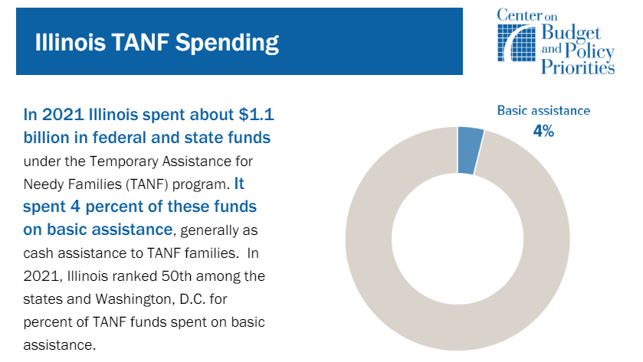
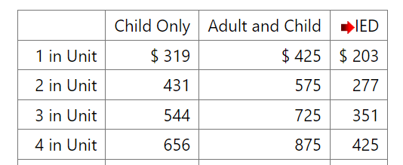
Illinois TANF grants are now 35% FPL.
https://www.dhs.state.il.us/page.aspx?item=138862

Slide 7
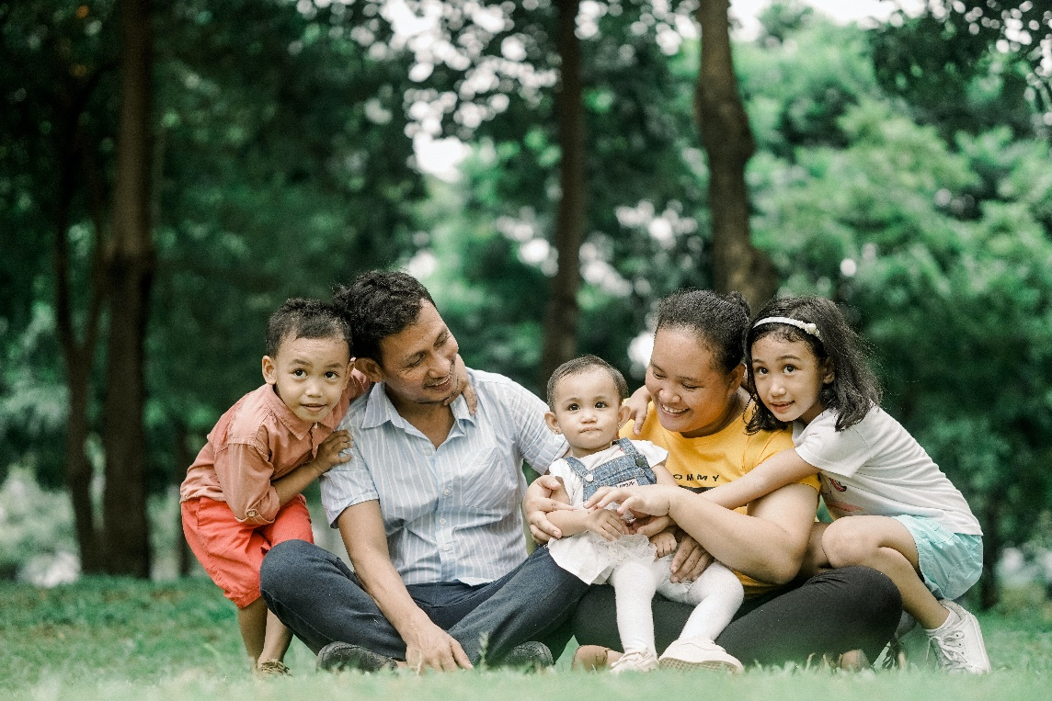
families
Illinois TANF requires:
At least one eligible* dependent child and one caretaker relative (with some exceptions)
Illinois residency
US Citizenship (with exceptions)
SSN (with exceptions)
Must cooperate with the application process
Must help develop and sign an Responsibility and Services Plan (RSP) (except for child-only cases)
Must agree to cooperate with Child Support Enforcement with exceptions for when is it not in the best interest of the parent or the child. PM 24-02-04.
Financially eligible

Slide 8
families
Illinois TANF requires:
At least one eligible* dependent child and one caretaker relative (with some exceptions)
A non-exhaustive list of those excluded from TANF:
SSI recipients
Some recipients of SSA Title II benefits, Railroad, or 100% VA Disability
Ineligible noncitizens
Excluded member can be used to establish that a dependent child lives with a relative caretaker, but are ineligible for benefits.

Slide 9
families
Illinois TANF requires:
At least one eligible* dependent child and one caretaker relative (with some exceptions)
A non-exhaustive list of those ineligible for TANF:
Incarcerated an entire calendar month, probation/parole violators, fugitive felons
Some people who have been convicted of public assistance fraud
Some adults who have already received TANF for 60 months (We’ll discuss this later)
Children who do not live with a relative caretaker
Ineligible members can NOT be used to establish that a dependent child lives with a relative caretaker, and are ineligible for benefits.

Slide 10

Requires Dependent child + Caretaker RELATIVE
Eligible Dependent Child | Cannot be an adult in another TANF case Must be under age 18 OR age 18 and in a full-time secondary school Must live together with the Caretaker Relative Does not have to be fixed housing
Caretaker Relative | Must be a blood-relative, step-relative or adoptive relative Must be primarily responsible for care of the dependent child Presumed to be the parent, unless DCFS has removed the child from the home Cannot be a child in another TANF case There is no minimum or maximum age to be designated a caretaker relative
Exceptions: | Children receiving SSI Pregnant Women with no other children Parent receiving SSI
  Applicant must establish relationship using documentary evidence.
  If there is joint custody, DHS or the parents must determine who exercises the most care.

Slide 11

Household members
Parent and child both USC with no income
Blake = Dependent Child
Kris = Relative Caretaker
Grandparent and child both USC with no income
Blake = Dependent Child
Kris = Relative Caretaker
Benefit Unit Size = 2
Benefit Unit Size = 1 or 2
Parent and child; Parent has no status; no income
Kris = Relative Caretaker, but ineligible for benefits
Benefit Unit Size = 1, child only
Blake = Dependent Child
Parent and child; Both USC; Blake is SSI
Parent and child; Both USC; Kris is SSI
Blake = Dependent Child
Kris = Relative Caretaker, but ineligible for benefits
Benefit Unit Size = 1, child only
Blake = Dependent Child
Kris = Relative Caretaker, but ineligible for benefits
Benefit Unit Size = 1, adult only
Unrelated adult and child; Both USC with no income
No TANF Benefit Unit
Blake
Kris

Slide 12
Who else is included?
Required
All eligible parents and siblings who live with the dependent child
The Dependent Child (if eligible)
If the dependent child lives with at least one parent, at least one parent
Siblings (including adopted siblings and half siblings) who live with the dependent child who are eligible
Required members
Optional member the family chooses
TANF Household
Optional
Other adults (up to 2 total adults in a case), and children
Caretaker relative who has no children of their own in the case
Spouse/civil union partner of the caretaker relative who has no children in the case
Other children living with the dependent child who has no minor siblings in the case
Excluded
SSI recipients
Adults receiving of SSD, Railroad, 100% VA disability, if
  Income $ > (payments with them - payments without them)
Children who do not live with the caretaker relative
Ineligible household members : Certain noncitizens, Over 60 month time limit

Slide 13
Frequently seen families at LAC
Kris and Drew are Blake and Frankie’s Parents
All USC, No income
Blake
Kris
To get TANF for Blake or Frankie, all family members are required members.
Drew
Frankie

Slide 14

Frequently seen families at LAC
Kris and Drew are Blake’s parents.
Kris and Drew are Frankie’s grandparents.
All USC; Income is from grandparent’s wages: $5000/month
Blake
Kris
To get TANF for Blake, Kris and Drew are required members, Frankie is optional.
To get TANF for Frankie, Kris and Drew are optional members. If they are in the case, Blake is also optional.
Frankie could qualify for a child-only case.
Drew
Frankie

Slide 15
Frequently seen families at LAC
Kris and Drew are Blake and Frankie’s Parents.
Kris and Drew and undocumented, Blake and Frankie are USC.
Income from wages $2000/month
Blake
Kris
To get TANF for Blake or Frankie, they must both be the benefit unit. Kris and Drew are ineligible.
As we’ll see later, their income will still be considered.
Drew
Frankie

Slide 16
families
Illinois TANF requires:
At least one eligible* dependent child and one caretaker relative (with some exceptions)
Illinois residency
US Citizenship (with exceptions)
SSN (with exceptions)
Must cooperate with the application process
Must help develop and sign an Responsibility and Services Plan (RSP) (except for child-only cases)
Must agree to cooperate with Child Support Enforcement with exceptions for when is it not in the best interest of the parent or the child. PM 24-02-04.
Financially eligible

Slide 17
Child support cooperation
TANF applicants and recipients cannot receive TANF if they:
Refuse to cooperate with child support enforcement
Fails to cooperate with child support enforcement
  Misses a scheduled meeting with the child support worker without a valid reason;
  Misses a scheduled meeting with the child support lawyer without a valid reason;
  Misses a scheduled court appointment without a valid reason;
  do not complete the blood test scheduled by the court without a valid reason;
  refuse to sign a statement that the information given about the father of the child was true and complete to the best of their knowledge; or
  fail to cooperate in the paternity establishment without good cause.
Good Cause = “not in the best interest of the child”
Child conceived as a result of incest or rape | Possibility the child will be adopted out | Emotional harm to the client or child | Domestic or sexual violence, or fear or risk of it
birth certificates; medical records; police records. | Records showing child is up for adoption Written statement of a social service agency | Medical records showing past and present mental health status Written statement of mental health professional | More information on Family Violence slide

Slide 18
families
Illinois TANF requires:
At least one eligible* dependent child and one caretaker relative (with some exceptions)
Illinois residency
US Citizenship (with exceptions)
SSN (with exceptions)
Must cooperate with the application process
Must help develop and sign an Responsibility and Services Plan (RSP) (except for child-only cases)
Must agree to cooperate with Child Support Enforcement with exceptions for when is it not in the best interest of the parent or the child. PM 24-02-04.
Financially eligible

Slide 19
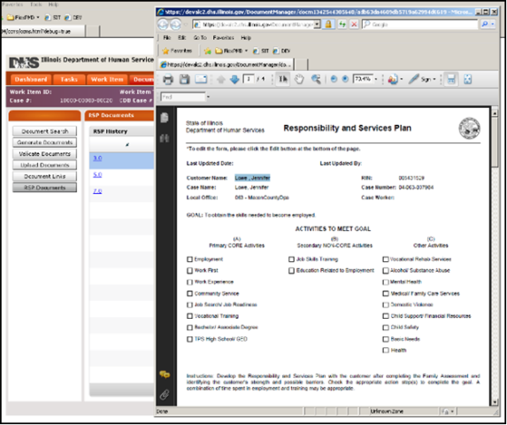
Responsibility and services plan
    RSP is “plan for achieving employment and self-sufficiency”
    Not required for individuals not in the TANF request
    Not required for child-only cases
    Adults in the cases are required to complete RSP even if exempt from work activity requirements
    Plan includes:
      Education and Work goals
      Child immunizations and school attendance
      Supportive Services
        Child care
        Transportation
        Legal
        Referrals to other services to increase employability
PM 01-02-03
PM 02-09-00
PM 03-19-00

Slide 20
Work Requirement
Exceptions | Good Cause for Failure to Meet Requirements | Exempt
Child who is not a parent Parent is the caretaker of a relative child under 1 year old in the home Age 60+ Parent providing care for a disabled family member living in the home who does not attend school on a full-time basis Only children are receiving TANF and: Is not the parent of the children receiving TANF or Parent is ineligible based on immigration status or Parent receives SSI | Temporary illness Death in family Extreme weather Lack of supportive service to the extent the needed service presents a significant barrier to participation Illiteracy Non-comprehension of written and/or oral English Lack of child care Homelessness Receipt of an Eviction Notice Discontinued utilities | Family Violence Exemption
Exceptions from Work Activity does not equate to exemption from the 60-month lifetime limit. It also does not excuse the caretaker relative from developing and signing the RSP |  | Months of Family Violence Exemption do NOT count toward the 60-month limit

Slide 21
Work Requirements
Required work activities cannot begin until 30 day after the application date
  Exception: If applicant lost TANF within the last 6 months because of failure to comply with work requirements without good cause, and participant is work eligible
Supportive activities can start as soon as the RSP is signed
Work/training plan must be based on individualized assessment of the person’s needs and abilities
Supportive Service Payments
TANF participants who are involved in approved work activities can receive supportive service payments to enable them to work or participant in an approved activity to the extent the State has resources to permit and must receive them if required to participate.
These allowances are exempt from consideration in determining the TANF grant amount.
Vocational rehab
Substance abuse
Domestic and sexual violence programs
Life skills training
Family planning/sex education
Parenting skills
Family counseling
Supportive Service Payments
Transportation
Child Care
Job Search/ Work Activity Allowance
Employment/ Job Retention Expenses
School Books and Education Fees
Eye Glasses & Dental Procedures
Supportive Service Payments
Supportive Services Available

Slide 22
families
Illinois TANF requires:
At least one eligible* dependent child and one caretaker relative (with some exceptions)
Illinois residency
US Citizenship (with exceptions)
SSN (with exceptions)
Must cooperate with the application process
Must help develop and sign an Responsibility and Services Plan (RSP) (except for child-only cases)
Must agree to cooperate with Child Support Enforcement with exceptions for when is it not in the best interest of the parent or the child. PM 24-02-04.
Financially eligible

Slide 23
Whose income counts?
Non-parent relative caretaker income isn’t included
All TANF household members unless exempt
Required Members
Optional members who are included in the benefit unit
Excluded Responsible Relatives
ONLY if they are legally require to provide support can be counted:
Other excluded member are not part of the TANF household
Income is not counted
Spouses and civil union partners. PM 09-02-01-c
Parents of children under 18 years of age (even if the children are married)
Income is prorated across the family
All income is countable if not exempt

Slide 24
What is income is exempt?
Common exempt earned income
Earned income from dependent child
Earned in-kind income
College Work-Study
Common types of exempt unearned income
Earned income tax credit
SNAP, WIC, National Lunch Program
LIHEAP
SSI lump sum, except for those not in the TANF unit whose income is used to determine TANF eligibility of other
SSI, SSD, Railroad Retirement, VA 100% disability monthly payment up to the SSI level for one
Federal subsidized housing payments
Child Support
PM 08-01-01: Earned income
PM 08-01-02: Deductions from Earned income
NEW!!!
PM 08-01-04: Earmarked Income
PM 08-01-07: Unearned Income Exceptions
PM 08-01-08: Lump Sums

Slide 25

INITIAL Financial Eligibility
Note this is my recommended order, which differs slightly from the policy manual, but it gets you where you need to go.
[Total anticipated non-exempt income for the first 30 days after application] – [Allowable self-employment expenses] – [IED for each employed person’s earned income]
> Payment Level for Household = Ineligible
< Payment Level for Household, [Non-exempt income] – [allowable self-employment expenses] – [IED for each employed person’s earned income].
< Payment Level for household size, eligible
> Payment Level for household size, [Non-exempt income] – [allowed self-employment expenses] – [3/4 earned income deduction]
< Payment Level for household size, eligible
If > Payment Level for household size, family is ineligible for on-going benefits; however, may be eligible for a lump sum of TANF if the family was eligible under the First 30 Days and IPE tests.
Blake
Kris
$300 wages in first 30 days
monthly: $500 wages + $400 child support
Benefit Unit = 2
IED = $277
Max. Payment Level = $575
$300 - $277 = $123
$123<$575
$500 - $277 = $223
$223<$575
Eligible!

Slide 26
MONTHLY BUDGET
Payment Level for the benefit unit members
Minus (-)
Nonexempt Unearned Income for benefit unit members PLUS
0.25 x Earned Income for benefit unit members PLUS
Prorated nonexempt earned and unearned income for ineligible parents/spouses living in the home with benefit unit members (unless spouse is exempt)
Plus (+)
Court-ordered child support payments actually made
Income Diverted to dependents not in the benefit unit under PM 10-04-02
Plus (+)
Equals (=)
Monthly Benefit
https://www.dhs.state.il.us/page.aspx?item=138862
$300 wages in first 30 days
monthly: $500 wages + $400 child support
Benefit Unit = 2
IED = $277
Max. Payment Level = $575
Blake
Kris
$575 – (0.25*$500) = $450

Slide 27

Time Limits
No TANF assistance is awarded to a family that includes an adult who has received TANF as an adult for 60 months, whether or not consecutive, in any state, after 1997.
BUT…
Some months do not count and
Some people are exempt
Note: Challenging 60 month clock issues can be complicated. We recommend reaching out to your local legal aid if IDHS states you are ineligible because of the clock.

Slide 28

Time Limits
Common reasons for months that don’t run the clock
Employment equal to or greater than the state TANF work requirement
Certain full-time post-secondary education
< 18 years old (regardless or whether receiving as a dependent child or relative caretaker)
Cares for a severely disabled child on an Medically Fragile HCBS Waiver
Primary caregiver of a child < 18 year old with physical or mental health problems, and the demands of caregiving do not allow the caregiver to retain employment to meet the state work requirement
Primary caretaker relative of spouse who has physical or mental health problems, and the demands of caregiving do not allow the caregiver to retain employment to meet the state work requirement
Months in which a person is granted a waiver due to domestic violence or sexual violence issues
PM 03-06-00

Slide 29

Time Limits: Exceptions
Has an application for SSI pending and probably eligible. If at the appeal stage, there must be legal or advocacy representation
Cares for a disabled adult or child:
Is the only adult in the assistance unit is the primary caregiver of a child under age 18 with physical or mental health problems, and the demands of caregiving do not allow the caregiver to retain employment to meet the state work requirement
is the primary caregiver for his or her spouse who has physical or mental health problems, and the demands of caregiving do not allow the caregiver to retain employment to meet the state work requirement
cares for a severely disabled child on an Medically Fragile HCBS Waiver
Has a medical barrier that prevents the client from obtaining or retaining employment of at least 30 hours/week
Is in an intensive service program to overcome a barrier to work that precludes the ability to obtain or retain employment at least 30 hours/week
Is in an approved education and training program that will be finished within 6 months after the end of the 60 months

Slide 30
families
Illinois TANF requires:
At least one eligible* dependent child and one caretaker relative (with some exceptions)
Illinois residency
US Citizenship (with exceptions)
SSN (with exceptions)
Must cooperate with the application process
Must help develop and sign an Responsibility and Services Plan (RSP) (except for child-only cases)
Must agree to cooperate with Child Support Enforcement with exceptions for when is it not in the best interest of the parent or the child. PM 24-02-04.
Financially eligible

Slide 31
Family violence exception: PM 03-13-02-e
Family Violence Exclusion
TANF Work and Training
60-month counter stops
Child Support Cooperation
Other requirements that would make it hard to escape violence
Who qualifies?
Experiencing current domestic or sexual violence or stalking, experiencing the effects of prior violence, or risk of future violence
Recovering from physical or psychological injuries
Seeking medical attention and counseling
Seeing victims services
Participating in safety planning or a safety plan
Seeking or receiving legal assistance
Avoiding dangerous situations
Acceptable Proof
Written statement by third party who knows circumstances that support exclusion
Official government/police record
Documentation from social service agency
Documentation from lawyer, clergy, medical or other professional providing support services
Other evidence, such as physical evidence
Any other credible evidence that supports the claim, including the statement of the client

Slide 32
Questions & Recommended listening
The Uncertain Hour Podcast: https://www.marketplace.org/shows/the-uncertain-hour/
Seasons 1 & 6

