Slide 1
Solving Problems Overcoming Common Administrative Barriers To Access Benefits From The Department Of Human Services
Gwynne Kizer Mashon
Beth Warner
Special Thanks to Andrew Watkins for help preparing this presentation

Slide 2








Children & Families
Consumer
Legal Aid Chicago is a private non-profit that provides free civil legal services to people with limited income in Cook County, securing their rights to economic stability, affordable housing, personal safety, fair working conditions, and basic healthcare.
Public Benefits
Criminal Records
Relief
Long-Term Care
Immigrants & Workers’
Rights
Housing

Slide 3
Have you applied for, obtained, or used state medical, cash, or food assistance benefits before (for yourself or an immediate family member)?
Have you ever helped a client or someone else apply for, obtain, or use IDHS benefits before?

Slide 4
overview
We hope that you will leave this session understanding:
- What is an administrative burden? - What barriers creates them? | - What are administrative burdens that frequently keep Illinois residents who are homeless and/or who have severe disabilities from accessing and keeping all of the DHS benefits they qualify for? | - How can you help yourself and/or your clients navigate and overcome the barriers that create these burdens? | - How have Illinois and other states reduced burdens? What else could they do?

Slide 5
Administrative Burdens
What are they
Who is impacted by them
IDHS/IDHFS Benefits
AGENDA
What are they
Procedural requirements to get and keep benefits
Administrative Burdens in Getting and Keeping IL Benefits
What barriers create administrative burdens
How do we help clients navigate those barriers
What are IL and other states doing to reduce burdens

Slide 6
Administrative burdens
The costs (financial and non-financial) associated with applying for, receiving, participating in, and keeping government benefits and services. These burdens prevent those who are eligible from accessing or getting the benefits of programs they qualify for.
Learning Costs
Psychological Costs
Compliance Costs
Redemption Costs
Learning Costs derive from the complexity of these systems and a lack of public education and awareness about the program’s existence, eligibility, benefits, and rules; as well has how to best navigate the entire process.

Slide 7
Administrative burdens
The costs (financial and non-financial) associated with applying for, receiving, participating in, and keeping government benefits and services. These burdens prevent those who are eligible from accessing or getting the benefits of programs they qualify for.
Learning Costs
Psychological Costs
Compliance Costs
Redemption Costs
Psychological Costs are the health impacts of the stress, stigma, and lack of autonomy that come with navigating these programs’ administrative processes.

Slide 8
Administrative burdens
The costs (financial and non-financial) associated with applying for, receiving, participating in, and keeping government benefits and services. These burdens prevent those who are eligible from accessing or getting the benefits of programs they qualify for.
Learning Costs
Psychological Costs
Compliance Costs
Redemption Costs
Compliance Costs (“Time Tax”) are the time, energy, and money spent completing administrative requirements.

Slide 9
Administrative burdens
The costs (financial and non-financial) associated with applying for, receiving, participating in, and keeping government benefits and services. These burdens prevent those who are eligible from accessing or getting the benefits of programs they qualify for.
Learning Costs
Psychological Costs
Compliance Costs
Redemption Costs
Redemption Costs are the time, effort, money and other resources needed to use public benefits or services where participants must navigate third-party agents or vendors.

Slide 10
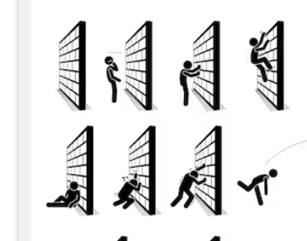
Structural & Procedural barriers
Federal Statutes
State Administration
State Statutes
State Regulations & Policies
Federal Regulations & Policies
DHS Staff
DHS Office Procedures
Agency publicizes and communications information about benefits, rights and procedural requirements
Application process
Notices (Verification Checklists, Notices of Approvals, Denials, and Changes)
Eligibility Determination Process (including Interviews and Verifications)
Steps Recipients Must Take to Use Benefits
Steps Recipients Must Take to Keep Benefits

Slide 11
Major Il public assistance programs
Food Assistance
Medical Assistance
Medicare Savings Program
Cash Assistance for Low-Income Families
Cash Assistance for Elderly and People with Disabilities
Note: Some benefits we discuss today are administered by IDHFS; but for simplicity and because many benefits are processed through IDHS, we will refer to IDHS and IDHFS collectively as “IDHS”

Slide 12
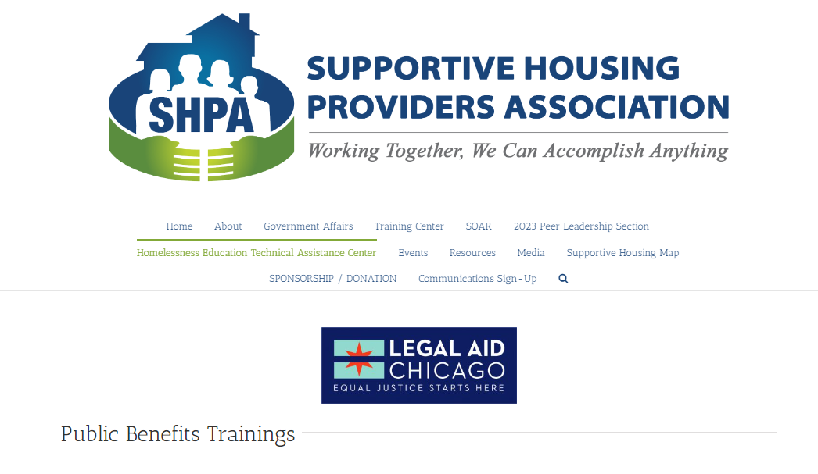
https://www.shpa-il.org/public-benefits-training-series/

Slide 13
Application process
Application
Interview
for SNAP and CASH programs
Verification
Notice of Decision
Step 1
Step 2
Step 3
Step 4
Filed:
Online
Telephone
In-Person
Fax
Must understand:
How to file
What to apply for
Who can apply
Notice of Interview (sometimes)
Participate in Interview Appointment:
Phone
In-Person
Verification Checklist
Understand list
Understand what documents satisfy list
Get documents
Submit documents
10 days!
Receive Notice of Decision
Understand notice
Determine if decision is correct
Know what to do if it is correct
Know what to do if it’s not correct

Slide 14
Post-application process
Using Cash/Food Benefits
Using Medical Benefits
Keeping Benefits
Step 5
Step 6
Step 7
Obtain LINK card
Get replacement card when needed
Use card for valid purchases
Protect benefits from theft
Choose an MCO
Navigate MCO
Finding doctors
Filling prescriptions
Contesting denials
Timely report changes
Understand what needs to be reported and how to report it
Mid-Point Reports and Redeterminations
Know then these are due
Similar to the application process
Compliance with Work and Training Requirements

Slide 15
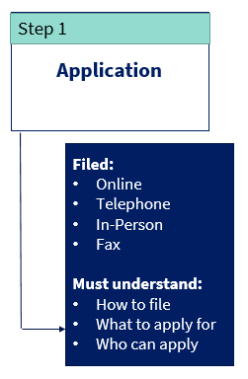

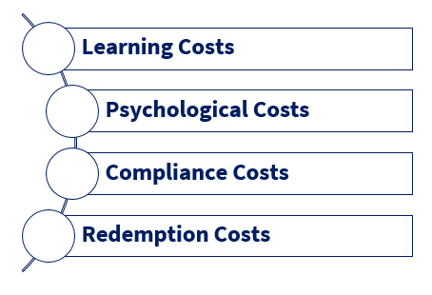
Based on your experience, what administrative burdens do you think our clients might have navigating this process?
Eligible for:
Medicare Savings Plan
Medicaid
SNAP
AABD Cash (maybe)
Patricia
75 years old
Only income is $970/mo. in SSA Retirement (minus Medicare copays)
No internet, Doesn’t use a computer
Doctor told her not to drive
Lives in an apartment in rural Washington Co.
Cannot afford rent ($800/mo.) + other expenses
Will soon be evicted

Slide 16
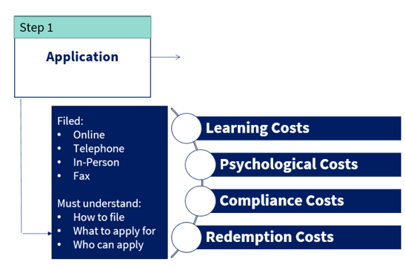
Clients don’t apply for benefits they need because they don’t think they qualify for them and don’t know when then can apply for them
Don’t know how to find publicly-available information
Don’t understand the information available
Publicly available information might not include vital exceptions and special rules
Don’t know that they might be eligible for additional benefits after their situation changes

Slide 17

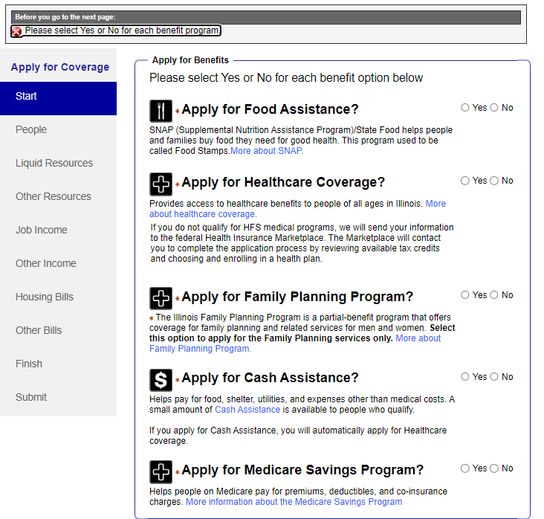
Clients don’t apply for benefits they need because they don’t think they qualify for them and don’t know when then can apply for them
What does
Single application/Single agency
ABE and Manage My Case
Triage on ABE
Prerelease Applications allow incarcerated individuals nearing their release date to apply for benefits so they begin receiving benefits immediately upon release
Helps community organizations engage in outreach and education
305 ILCS 5/11-4 requires IDHS to evaluate an applicant for public assistance for all programs unless the applicant expressly declines in writing.
However…
Notes:
Illinois Law says applicants should be evaluated for all benefits unless declined:
Train and enforce policy with staff processing applications
Re: 305 ILCS 5/11-4: However, online application force people to say yes or no and in our experience people will click No to programs they don’t recognize and ones they think they don’t qualify for . Additionally, many receive application assistance from providers who do not or who cannot help the individual apply for all benefits. DHS may not have a duty to evaluate these applications for all benefits. And many of these applicants do not realize that they have not applied for benefits they qualify for.

Slide 18
Clients don’t apply for benefits they need because they don’t think they qualify for them and don’t know when then can apply for them
What YOU can do:
Educate Yourself
SHPA trainings
Educate your clients and Connect them to Help when Needed
Encourage clients to apply for any and all benefits they might want
In City of Chicago, Legal Aid Chicago (312) 341-1070
Other experts in your area
There’s no punishment for applying for something they’re not eligible for
Help them understand WHO can apply for benefits for family members (IDHS PM 02-04-03)
Learn about benefits available so you can help your clients maximize benefits and learn about when you might want to ask for additional help
IDHS and IDHFS website and trainings
Other resources:
Food Depositories
Other local and national organizations
Legal aids
SNAP and Medicaid Assisters
FQHCs
There’s no financial cost for applying

Slide 19
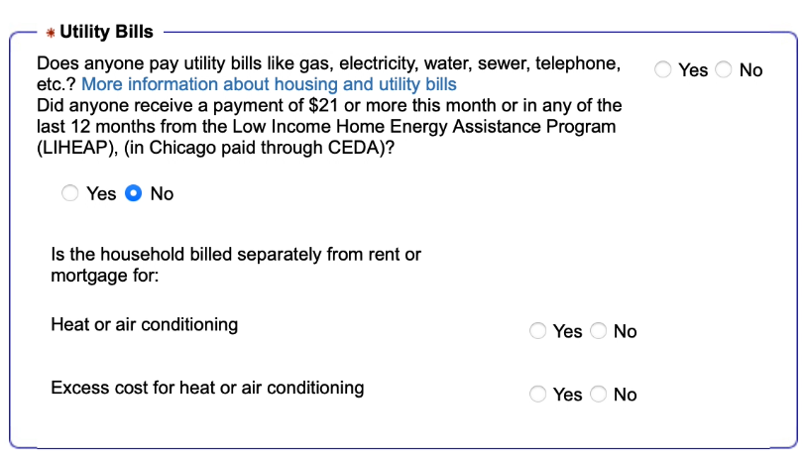
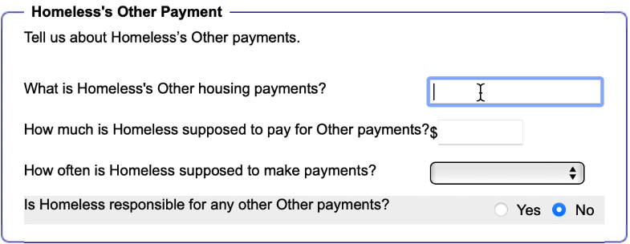
Online application is difficult or confusing for some applicants – especially those who are elderly, those with disabilities, and those with low-literacy.

Slide 20
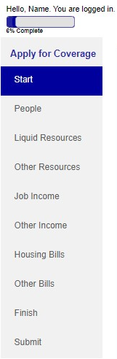
Online application is difficult or confusing for some applicants – especially those who are elderly, those with disabilities, and those with low-literacy.
How many people in the household, review of rights, who is filing app?
What can be done?
2/14/24 USDA Guidance: “The online application must include the name, address, and signature fields on one of its initial screens, and questions other than name, address, and signature must be optional. One option to meet this requirement is by including a “submit now” button immediately following the name, address, and signature fields.”
Who is in the home?
Assists, income recourses
Expenses
Review of answers
Sign & Submit application
Notes:
https://www.fns.usda.gov/snap/online-application-policy-clarification

Slide 21
Online application is difficult or confusing for some applicants – especially those who are elderly, those with disabilities, and those with low-literacy.
What YOU can do:
Help Client Apply
Direct Clients to Other Services
Allay Their Fears
In City of Chicago, Legal Aid Chicago (312) 341-1070
Other experts in your area
Help Clients Complete application on MMC so you can help them understand the questions
SNAP and Medicaid Assisters
FQHCs
Explain that client won’t be punished for getting questions wrong as long as they’re not lying or hiding information on purpose
Encourage them to use the notes section if applying online

Slide 22
Denied or not considered for special provisions because applicant did not provide certain evidence, but was never asked in the application or interview.
Homeless Status
Applicant is asked if they are “homeless” but never provided the definitions IDHS uses
AABD Cash budgeting
Complicated financial eligibility, which requires information about: cost of basic phone plan from phone provider, details about medical conditions impacting ability to climb stairs
Domestic Violence
Family Violence exceptions allow survivors to opt out of certain requirements for Medical and Cash benefits; This results in applicants choosing between benefits they need and safety.

Slide 23
Denied or not considered for special provisions because applicant did not provide certain evidence, but was never asked in the application or interview.
What YOU can do:
Educate Yourself and Your Clients
Help/Encourage Client to be Proactive
Appeal Incorrect Decisions
List relevant PM in the notes of the application
If you serve a certain population, learn about some of the special rules that might have a big impact on eligibility for that population
If DHS failed to consider eligibility for specific provisions - esp. if you asked DHS to do it or submitted relevant evidence – then you likely can successfully appeal that decision.
Elderly or People with Disabilities: AABD
College Students: SNAP Rules and Medicaid Households
Domestic Violence Survivors: Family Violence Exceptions
Submit evidence you think DHS might need, even if DHS doesn’t request it
Ask for help if needed

Slide 24

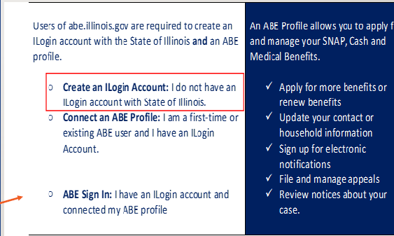
Upcoming Problem: Multifactor Verification for Applications
Starting around 07/24, Manage My Case will require an email address
Who will be affected?
People using MMC to:
Apply for benefits using ABE
Check on the status of their benefits
Submit Rede, Midpoint reports, or other documents

Slide 25
Upcoming Problem: Multifactor Verification for Applications
What YOU can do:
Help Clients Set Up Email Accounts
Educate Clients on Other ways to Submit Applications
Educate Clients on Other ways to manage benefits
In-Person
Ensure clients know how to access their accounts so they can use them for multi-factor verification
Checking EBT Card Balance
Check with your agency regarding potential ethical or legal concerns with accessing or helping clients to access their email accounts
IDHS Help Line
Assisters
Checking RIN Status
Submitting documents:
In-Person
Phone
Fax
Email

Slide 26
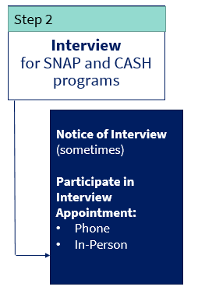

Based on your experience, what administrative burdens do you think imaginary people would have navigating this process?
Eligible for:
$291/mo in SNAP
Medicaid
Joe
Recently lost job and was evicted from apartment
Now homeless – stays in an encampment in Chicago
Backpack recently stolen – had his phone and ID
No regular place for mail
Has never had IDHS benefits before
Speaks only Spanish

Slide 27
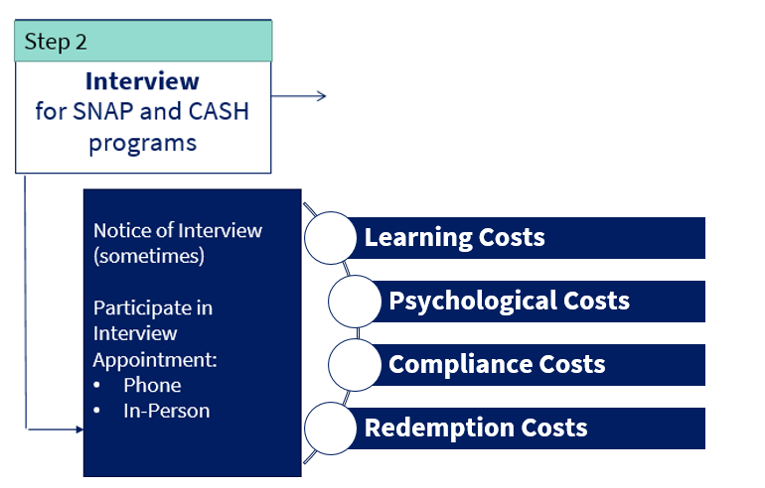
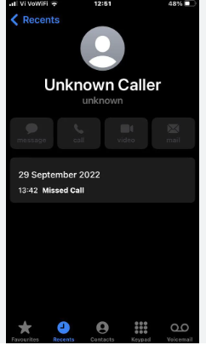
Clients miss their interview and Cash/SNAP benefits are denied.
“The interview allows states to understand a household’s circumstances more fully, to screen for special and/or complex circumstances that might not be captured via the application, and to explain the household’s rights and responsibilities.” FNS Memo 3/26/24
Missed Phone Calls
Unable to answer phone
Confusing Notices
Interview notices often arrive after scheduled interviews
Calls from unknown or blocked numbers

Slide 28
Clients miss their interview and Cash/SNAP benefits are denied.
Permits phone interviews. PM 02-06-01-b.
Lack of child care
Health
Transportation
Work or education conflicts
Fear of danger from domestic or sexual violence
Rescheduling missed interviews. PM 02-06-01-c.
Appealing denials based on missed interviews under PM 01-07-08
What Does:

Slide 29
Clients miss their interview and Cash/SNAP benefits are denied.
What YOU can do:
Educate Your Client
Request On-Demand Interview
Help if They Miss the Interview
DHS Help Line (SNAP only)
Calls might call from a blocked or unknown number
As for DHS to reschedule
Use Manage My Case to check for interview notices
Sign up for text alerts
At local FCRC
Appeal Denials
Potential Systemic Solutions: Adopt of policy permitting on-demand interviews for all SNAP applicants
  At least 14 states – including Florida, Texas, and Kentucky – have adopted policies that allow applicants to complete their interview by phone at their convenience

Slide 30
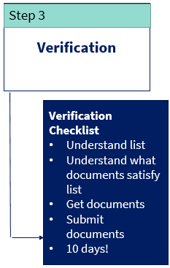
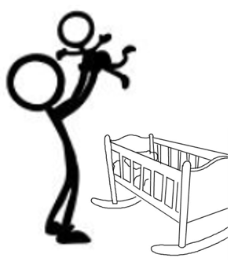
Based on your experience, what administrative burdens do you think imaginary people would have navigating this process?
Eligible for:
TANF
SNAP
Medicaid
Samantha
Mom of 9 month old
Recently escaped physically violent relationship with baby’s father
Residing in rapid rehousing unit
Receives about $600/month cash cleaning houses

Slide 31
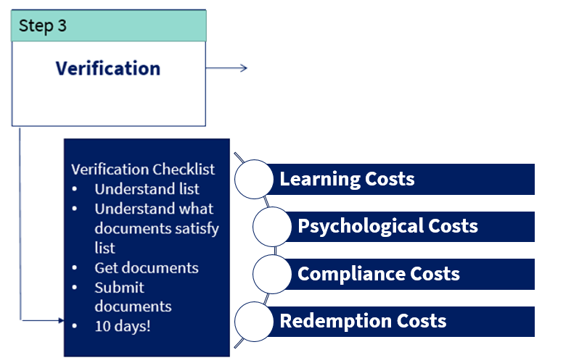
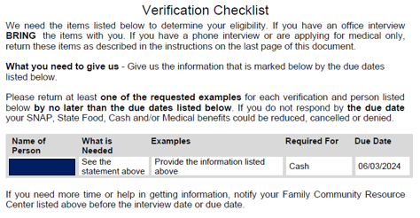
Clients do not timely submit verifications and benefits are denied.

Slide 32
Clients do not timely submit verifications and benefits are denied.
DHS policy states that DHS workers should help clients obtain verification documents. See e.g. IDHS PM 02-07; IDHS PM 02-07-02-b “If the applicant is having trouble getting third party verification, do whatever is needed to help them get it.”
Before denying a case for missed verifications, IDHS staff should (WAG 02-07-03)
Review old case files
Use electronic sources to verify information BEFORE asking the client for it
Accept other forms of verification if the information is consistent and the verification requested is unavailable
Escalate cases where client cannot obtain verifications from third parties
What Does:

Slide 33
Clients do not timely submit verifications and benefits are denied.
Appealing denials based on missed interviews under PM 01-07-08
Reopening under IDHS PM 02-07-02-d
SNAP: Application should be reopened if verification received by the 60th day after the application was filed
Medical: Application should be reopened if the verification is received by the 60th day after the Notice of Decision denying medical benefits
Cash: Application should be reopened if appeal is timely filed
What Does:

Slide 34
Clients do not timely submit verifications and benefits are denied.
What YOU can do:
Submit Early
Help Client Understand the Process – their rights and responsibilities
Help if They Are Denied because of missed verifications
Look for Verification Check Lists in Manage My Case
Submit documents late and ask DHS to reopen the application, if within reopening timeframes
Submit documents with the application, if possible:
ID
30 days of income
Assets
Proof of relationship (TANF)
Help client understand what DHS is requesting and why
Help client submit documents
Proof of submission
Retain copies of documents
Reach out to DHS if for questions/clarifications
File appeals under PM 01-07-08

Slide 35
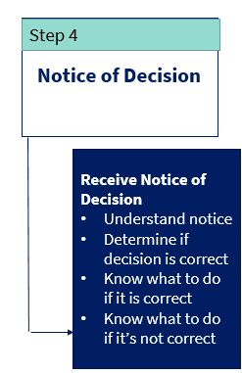
Based on your experience, what administrative burdens do you think imaginary people would have navigating this process?
Eligible for:
$291/mo in SNAP
Medicaid
Recently lost job and was evicted from apartment
Now homeless – stays in an encampment in Chicago
Backpack recently stolen – had his phone and ID
No regular place for mail
Has never had IDHS benefits before
Speaks only Spanish

Slide 36
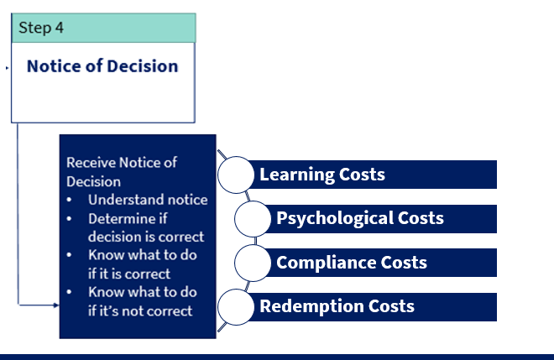
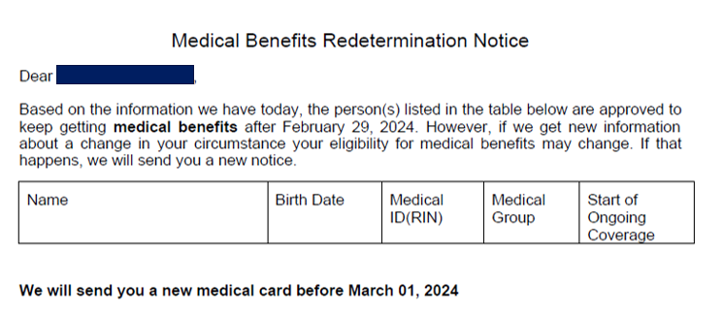
Clients doesn’t understand what benefits are approved, for who, or for what dates.

Slide 37
Clients doesn’t understand what benefits are approved, for who, or for what dates.
Inaccurate or Incomplete Introductory Paragraphs
Missing budgets
Denied for missed verifications, but notices don’t state what verifications are missing
More than one reason listed for denying application so it’s hard to tell why the benefits were actually denied
Some clients have multiple “cases”, which can make notices more confusing

Slide 38
Clients doesn’t understand what benefits are approved, for who, or for what dates.
What YOU can do:
Educate Your Client
Determine how much SNAP or TANF we think the client is eligible for:
  Use Manage My Case to check for Notice of Decision
  Help client understand the decision and any additional steps they need to take
  Help client understand appeal rights
  SNAP:
    IDHS PM 13 – SNAP Budgeting - https://www.dhs.state.il.us/page.aspx?item=16111
    IDHS SNAP Calculator: https://fscalc.dhs.illinois.gov/FSCalc/
  Medical Programs:
    https://www.dhs.state.il.us/page.aspx?item=21741
  TANF:
    Budgeting: IDHS PM 10 - https://www.dhs.state.il.us/page.aspx?item=15814
See upcoming SHPA Training

Slide 39
Clients doesn’t understand what benefits are approved, for who, or for what dates.
What YOU can do:
File inaction appeals when notices are insufficient
If notices doesn’t contain required elements in IDHS PM 01-06 and/or doesn’t include all information required by Federal and State Procedural Due Process requirements, then the notice isn’t really a “notice”
E.g. Denials of applications must include, inter alia:
Amount of benefit
All of the people who are eligible, all of the people who are denied
Clear statement of the reason for the action
Dates of approval and/or certification period
Budgets showing how DHS calculated eligibility and/or monthly benefit
Through inaction, IDHS must reopen the application and issue a new Notice of Decision properly approving or denying the application

Slide 40
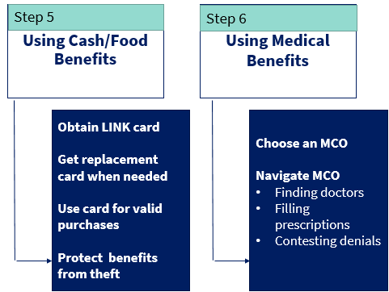
Based on your experience, what administrative burdens do you think our clients might have navigating this process?
Eligible for:
Medicare Savings Plan
Medicaid
SNAP
AABD Cash (maybe)
Patricia
75 years old
Only income is $970/mo. in SSA Retirement (minus Medicare copays)
No internet, Doesn’t use a computer
Doctor told her not to drive
Lives in an apartment in rural Washington Co.
Cannot afford rent ($800/mo.) + other expenses
Will soon be evicted

Slide 41
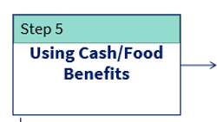
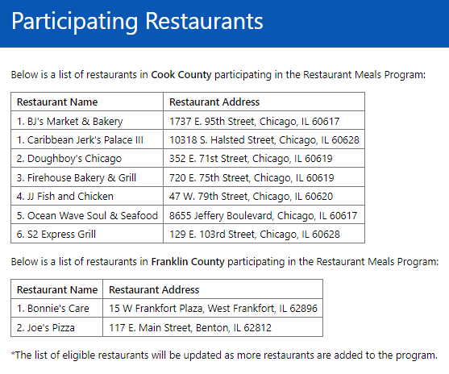
Clients do not have capacity to cook or store unprepared foods.
People who DHS has identified as homeless, elderly (>60), or disabled (government benefits), can use SNAP to buy prepared foods at participating retailers: https://www.dhs.state.il.us/page.aspx?item=146353
What Does:
IL’s SNAP Restaurant Meals is a pilot program. States with more developed programs offer:
Much larger network of restaurant providers
Food trucks
Notes:
Restaurant Meals Program | Food and Nutrition Service (usda.gov)

Slide 42
What YOU can do:
Clients do not have capacity to cook or store unprepared foods.
Protecting Cash/SNAP from Theft
EBT Card Protections
Lost or Stolen Card, or Never Received
Request new LINK card at the FCRC (PM 22-01-01-d) if
Never share card or PIN
Know process to replace skimmed SNAP
Never received card or set up PIN
Homeless and using FCRC as their address
Has an approved representative
Has no SSN
Card destroyed in disaster (not theft)
Not eligible for SNAP Restaurant Meals
Ensure DHS has properly identified client as one of the qualifying categories.
Confirm SNAP Restaurant Meals eligibility via MMC
Ensure client knows where they can use their SNAP benefits

Slide 43
Based on your experience, what administrative burdens do you think imaginary people would have navigating this process?
Keeping Benefits
Step 7
Eligible for:
$291/mo in SNAP
Medicaid
Joe
Recently lost job and was evicted from apartment
Now homeless – stays in an encampment in Chicago
Backpack recently stolen – had his phone and ID
No regular place for mail
Has never had IDHS benefits before
Speaks only Spanish
Timely report changes
Understand what needs to be reported and how to report it
Mid-Point Reports and Redeterminations
Know then these are due
Similar to the application process
Compliance with Work and Training Requirements

Slide 44
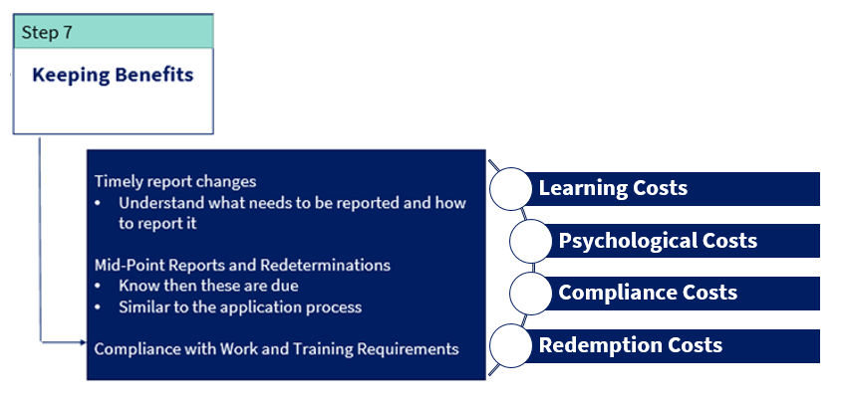
Clients lose benefits they do not timely submit redeterminations or SNAP Mid-Point Reports
Do not receive notice
Do not understand notice
All of the same problems described above!

Slide 45
Clients lose benefits they do not timely submit redeterminations or SNAP Mid-Point Reports
Ex Parte Medicaid Renewals
Re-opening SNAP cases with late verifications
12 month eligibility for postpartum mothers
SNAP Elderly and/or Disabled Simplified Redetermination Project
What Does:

Slide 46
Clients lose benefits they do not timely submit redeterminations or SNAP Mid-Point Reports
What YOU can do:
Educate Clients
Help Submit Mid-Point and Redeterminations
Same as Above
Help client check Manage My Case regularly to see notices
Clients may experience all of the obstacles we’ve already discussed above, and may need the same kinds of supports every time they have a redetermination due
Calendar certification dates for SNAP and Cash
Calendar expected redetermination date for Medical
Explain what to expect and what client is responsible for at each redetermination
Help client sign up for text alerts
Remind client to always open and read mail from IDHS
Help them complete and submit forms before deadlines
If you think there should have been a redetermination, but you never received a form, file a new application.

Slide 47
Thank you!

