Slide 1
Mastering Manage My Case
Beth warner
Paralegal, Public Benefits Outreach and Enrollment
bwarner@legalaidchicago.org
February 2024
Notes:
Run of Show/Script
GKM Welcome and Open
Recap
Pass to SHPA
Thank Yous
Housing keeping
Introduce BW
Welcome
We are excited that you are joining us for the FIFTH training in our 12 part Main Stream Benefits training series, Submitting DHS benefits applications using ABE
I'm Gwynne Mashon – Gwynne introduce yourself
Recap on previous trainings?
Thank you’s
Supportive Housing Providers Association, David Esposito
Illinois Office to Prevent and End Homelessness
Thank you to funding from the Office to Prevent and End Homelessness: TRAININGS AND POWERPOINTS for this series ARE NOW AVAILABLE!
To access our past trainings and PowerPoints:
Visit the SHPA website
Click on Homeless Education Technical Assistance Center tab
Select public benefits training series
Share! Share! Share
We will also drop the website in the Q and A section of this training and include it in our post-training email.
Housekeeping
We are recording these sessions
50 minutes presentation with 10 minutes for questions
Link to training will be sent out after training
Send copy of PowerPoint at the end
Cameras are on but participants do not have access to their microphone or a general chat
All Questions can be posted in the Q&A section on teams. You can locate the Q&A section at the top of your teams screen on the left. Any further questions can be sent to me or Beth. I will drop our emails in the Q&A section.
Introduce Beth
Beth Warner is a Paralegal in the Public Benefits Outreach and Enrollment project at Legal Aid Chicago. Beth’s work focuses on connecting our cities most vulnerable people to food, medical and cash benefits through the Department of Human Services.
They are a survivor of homelessness and human trafficking in the City of Chicago. They utilize their experience as a survivor of homelessness and human trafficking in the City of Chicago, to inform their current work assisting people who are experiencing homelessness connect to legal services.
Beth has presented at state and national conferences on the topic of Lived Experience and Legal Services.
They received their undergraduate degree in English Literature from Northwestern University.

Slide 2








Children & Families
Consumer
Legal Aid Chicago is a private non-profit that provides free civil legal services to people with limited income in Cook County, securing their rights to economic stability, affordable housing, personal safety, fair working conditions, and basic healthcare.
Criminal Records
Relief
Public Benefits
Long-Term Care
Immigrants & Workers’
Rights
Housing
Notes:
GWYNNE can you add description?

Slide 3



What I hope you’ll learn
Overview of what MMC can do
Renew current benefits
Report changes to current benefits
Applying for Additional Programs
Review
  Contact information
  Account information
  What is due?
  What is the status of my case?
Viewing Notices
Submitting required documents
Provide Key Information to unlock services and maximize DHS benefits
Notes:
Our goal is to help applicants and providers working with applicants submit applications that will help them maximize their access to the public benefits they qualify for and are entitled to receive. The purpose of this training is to provide tips and information when using Manage My Case.
Provide Key Information to unlock services and maximize DHS benefits
What does this mean?
There are lots of things that can be learned from Manage My Case:
We will discuss:
How to access key information
How to make changes to current benefits and add new benefits
We will not discuss:
Things covered in our previous trainings
Creating ID and Password
Linking Accounts
VTTC applications
Specific questions related to program eligibility
Technical questions related to the functioning of ABE

Slide 4
Illinois' Application for Benefits Eligibility (ABE) has three portals to support applicants with their benefits:
Apply for Benefits
ABE is the State of Illinois’ web based portal for applying for and managing health coverage, SNAP and cash benefits online, anytime.
Manage My Case (MMC)
MMC is a section on the Application for Benefits Eligibility (ABE) website that lets you check on, change, and renew your Medical, SNAP, and case benefits online, anytime.
Appeals
The ABE Appeals portal allow users to file and manage appeals via the web based portal. The Appeals portal can be accessed through MMC or directly:
https://abe.illinois.gov/abe/access/appeals
Notes:
Overview of ABE
ABE Born 2013/4, ABE stands for the Application for Benefits Eligibility. ABE is the State of Illinois’ web-based application portal for Medicaid, SNAP and cash benefits. Anyone can apply for Medicaid, SNAP, cash benefits and the Medicare Savings Program through ABE
We strongly encourage to apply for Medicaid, SNAP, cash assistance and the Medicare Savings Program online through ABE for the fastest service.
This overview will familiarize you with some of ABE’s features and explain how to set up your user account and submit an application.
ABE does not replace the need for caseworker interviews for SNAP and cash benefits; Applicants will be contacted within 14 days for this interview. In most cases, interviews can be completed over the phone.
ABE & the Integrated Eligibility System (IES)
The Integrated Eligibility System (IES) is the caseworker portal for eligibility determination and case management.
Once you submit an application in ABE, you can no longer make changes to it in ABE, but you are able to view the application as it was submitted. Applicants should contact the office where the application was sent for processing to report any changes.
The new application will appear in an electronic inbox where a caseworker will take it from the queue and register it.
The caseworker will schedule an interview with the customer, if necessary, and complete the data collection process. Interviews are required for SNAP and Cash Assistance.
IES includes electronic tools that interface with State and Federal data sources to verify information provided in the ABE Application. Applicants will be asked to provide required documentation for any information that cannot be verified electronically
The caseworker will then complete the determination of eligibility and the Applicant will receive a written notice of the decision in the mail.

Slide 5
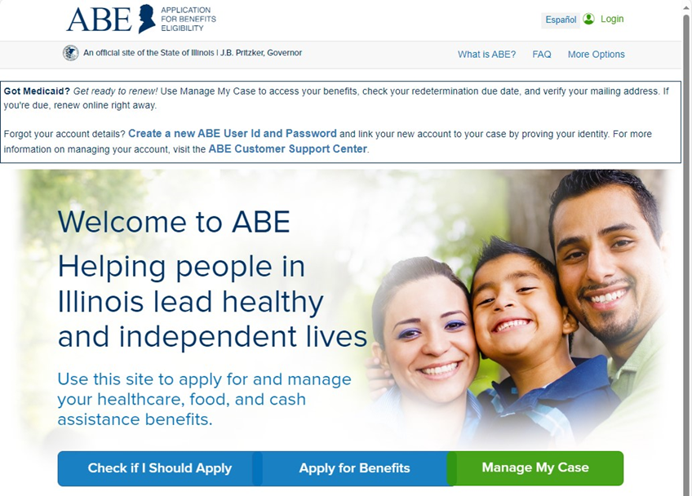
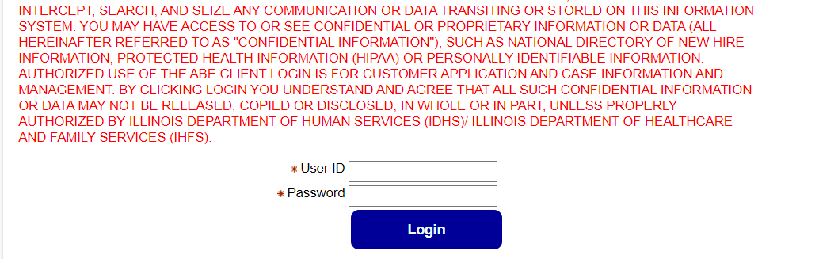
MMC getting Started
Notes:
Only the HOH can use MMC
In our previous training we covered setting up a username and password, linking accounts and completing identity proofing. In the interest of time I go right ahead and get us logged into MMC. For the purpose of this training, we are reviewing case information for someone who already has and existing case open with DHS.
Enter your User ID and Password. Click [Login]
If you enter the wrong User ID and/or password 3 times you will be locked out of your ABE account for sixty minutes. If you forget your User ID, or cannot reset your password you will need to create an all new ABE account.

Slide 6
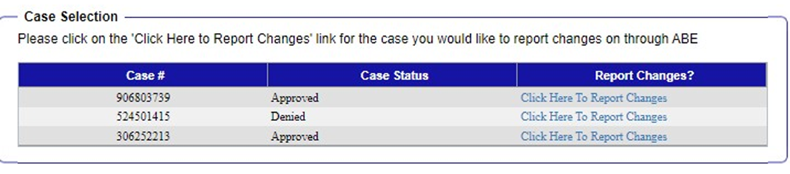
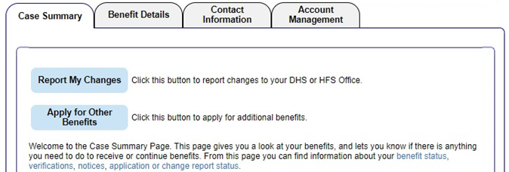
MMC – Managing my case(s)
More than one case
12345678
12345678
12345678
One case
Notes:
If you have more than one case it will look like that top screen shot
It shows
Current cases and previous cases.
Cases can be Approved, denied, terminated
By looking through previous cases, we can learn more about someone's history with DHS benefits.
Even closed cases can be useful.
For example, terminated or denied cases can provide more information on why someone's benefits have been denied and maybe even provide clues to r
If there is only one case MMC will take you right to the MMC home or “summary” page

Slide 7
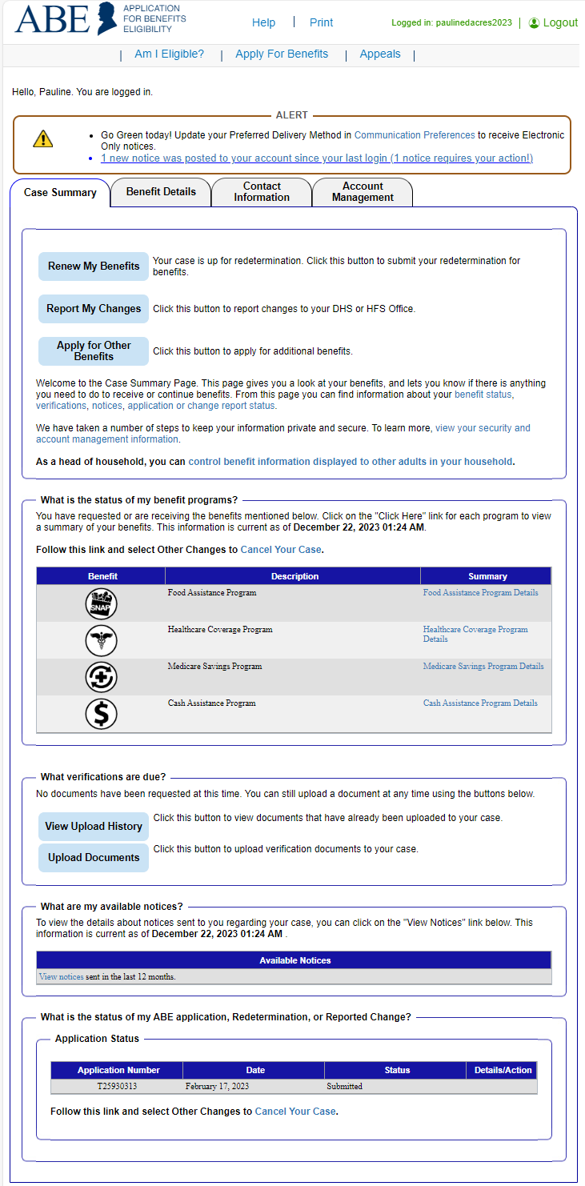
MMC – TABS Overview
The Manage My Case landing page is divided into four (4) tabs:
Case Summary TAB
Apply for new benefits or report case changes
View correspondence for past 12 months. If a notice requires action, there will be an indicator on the page.
View the status of their application, redetermination, or reported case change
Reschedule an Appointment
Benefit Details Tab
View the type of assistance received by month
View current benefits and when they’re up for redetermination
View historical benefit information
Contact Information Tab
View how to get in touch with someone about their case
Send an email to the FCRC
Account Management
Adjust access permissions for household members and third party reps
View/change communication preferences
Change a password
Notes:
The Manage My Case landing page is divided into four (4) tabs:
Case Summary TAB
Customers can:
apply for new benefits or report case changes
View correspondence for past 12 months. If a notice requires action, there will be an indicator on the page.
View the status of their application, redetermination, or reported case change
Reschedule an Appointment
Benefit Details Tab (Review top tabs, info from “What is the status of my Benefits/” is same as that displayed under benefit details)
Customers can:
View the type of assistance received by month
View current benefits and when they’re up for redetermination
View historical benefit information
Contact Information Tab
Customers can:
View how to get in touch with someone about their case
Send an email to the FCRC
Account Management
The primary account holder can:
Adjust access permissions for household members and third party reps
View/change communication preferences
Change a password

Slide 8
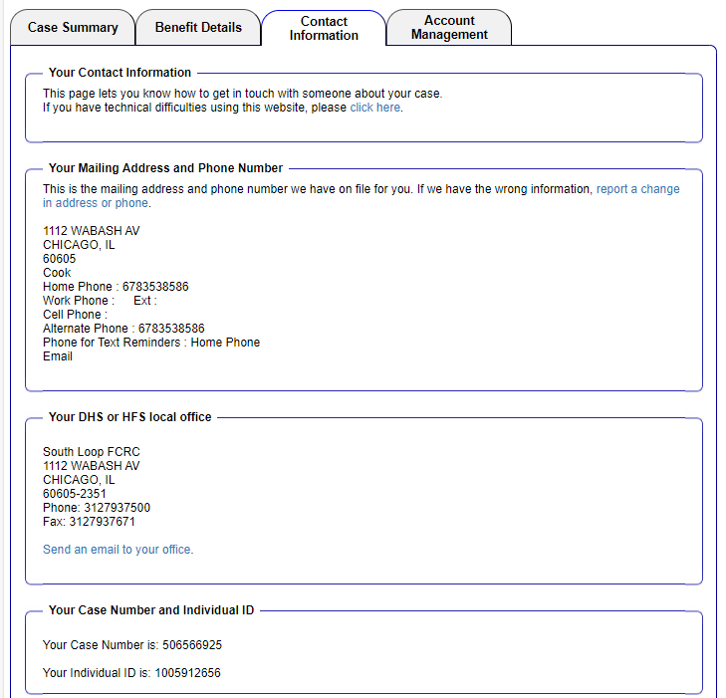
MMC – Contact information
Review address information (report any changes)
Homeless clients using their local FCRC for a mailing address will show up matching their local office.
Case number and Individual ID
Question sent here appear in caseworkers email queue in IES
12345678
12345678
Notes:
We’re doing the tab in the order that I would review them to make sure information is correct.
Example is Homeless client using their local FCRC
UPDATING CONTACT INFORMATION IS SO IMPORTANT!
Inaccurate information here can impact someone's ability to complete an application successfully,
Case number and individual ID
There are three important numbers you can find here in MMC
Individual ID: Helpful when no SSN. Individual ID that your cases area associated
RIN number: Medical ID Check status of medical benefitsAutomated Voice Recognition System (AVRS) at 1-855-828-4995 with your Recipient Identification Number (RIN). Helpful when no DOB or SSN
Case tracking Number: Application (has a T in front), change report, redetermination
Reminder of a rule we learned last training: PM 06-04-03: Homeless Benefits: Persons who are homeless may qualify for cash, medical, or SNAP benefits, if otherwise eligible. A permanent or fixed address is not required to receive benefits. Do not require proof of residence from homeless persons. WAG 06-04-03: Homeless Benefits Obtain approval of the LOA to use the Family Community Resource Center address for a customer with no permanent address.

Slide 9
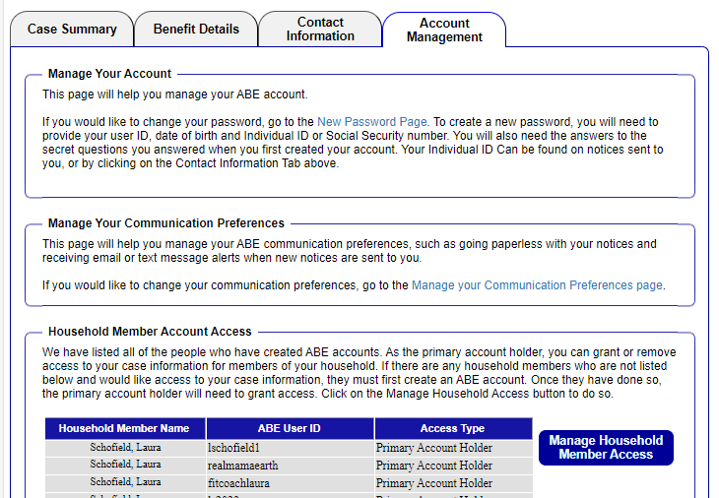
MMC – Account Management
1. Change password
2. Manage Communication Preferences (including signing up for text alerts)
3. Primary account holder can grant access to other adult members on the case
Notes:
I have previously mentioned that it is possible to have many useranmes and passowrds. Here is an example what hat looks like.
that's where folks can sign up to get text alerts of when notices are posted to the site? You might also want to say that we haven't tested it yet but we have no reason to believe it doesn't work.

Slide 10
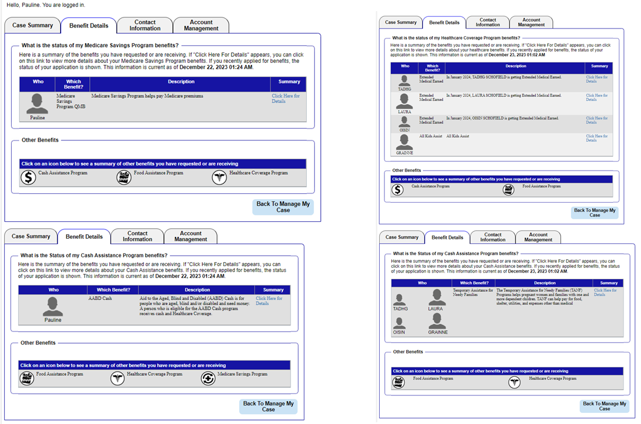
MMC – Review your benefits
Single Person
Household of more than one
Notes:
Your Benefits tab will look different depending on how many people are in your household and the benefits you qualify for
I want to premise this whole section with: Information is pretty reliable if someone has benefits. Example: If it shows that an application was denied, it doesn't actually mean that the application was denied. DHS must issue a notice of decision for a denial to be effective. Might need inaction (actually - if you want to call me in on this one, that might be easier for you. It's up to you.)
Click the hyperlink under ‘Summary’ to view details about each benefit program received. Can also get link from Case Summary tab.

Slide 11
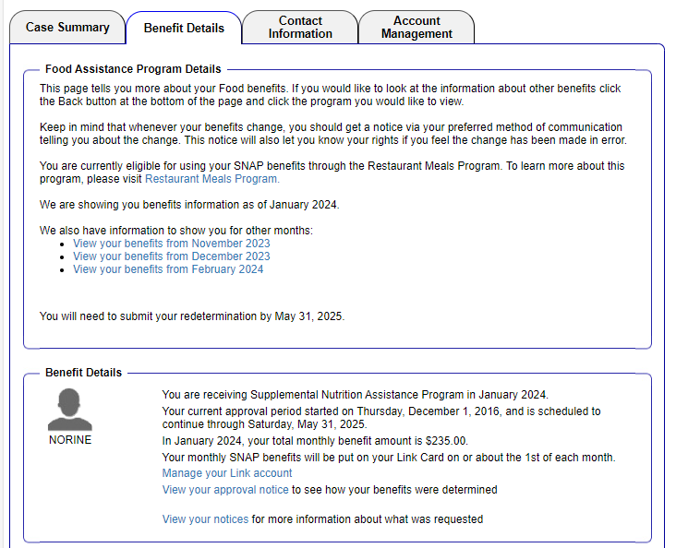
Review your benefits - Food
Restaurant Meals Program
Redetermination deadline
Current approval period
Other benefit months
Benefit Amount
Notes:
Illinois has elected to participate in the SNAP Restaurant Meals Program (RMP) starting late Spring of 2022. RMP allows specific qualifying SNAP households to utilize their SNAP Benefits to purchase hot meals at participating restaurants.
The Restaurant Meals Program (RMP) allows eligible SNAP customers to purchase prepared meals at authorized restaurants. This program is available to SNAP customers who are homeless, elderly and/or disabled.
Homeless To be considered an eligible homeless customer, the customer must lack a fixed and regular nighttime residence or be living in a shelter, halfway house, or a place not designed for sleeping. This includes a homeless individual or household who is temporarily staying in the home of another person (90 days or less).
Elderly To be eligible, the household must have only members who are age 60 or older and his or her spouse
Disabled To be eligible, the household must have only members who are designated as disabled by a government entity and his or her spouse.
Your restaurant is eligible to apply to participate in the SNAP Restaurant Meals Program if it resides in Dewitt County, Franklin County or Cook County with the following zip codes (60619, 60620, 60628 and 60617) AND meets certain criteria. Illinois will be rolling the program out to selected areas over a period of time.

Slide 12
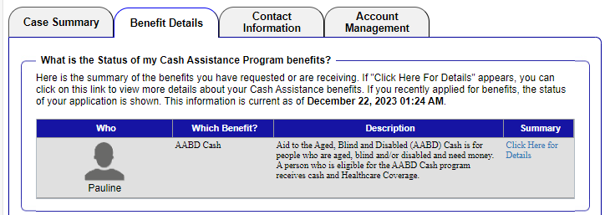
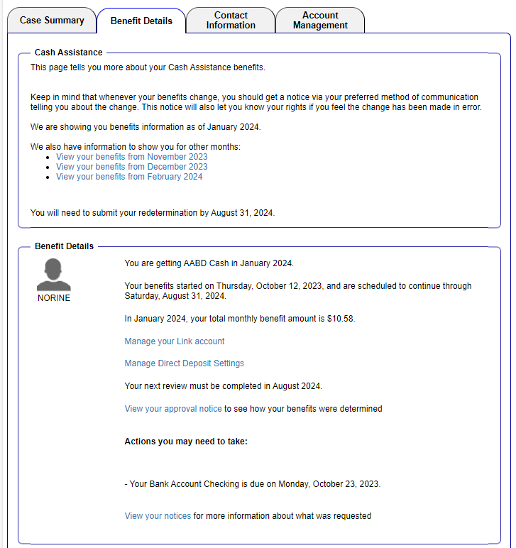
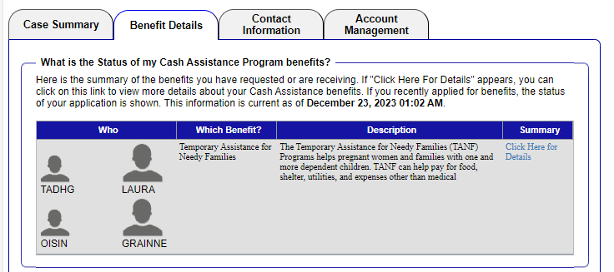
Review your benefits - Cash
AABD
Other benefit months
Start date and approval period
TANF
Current amount
Notes:
Differences between an individual receiving AABD cash A household receiving TANF
The people represent how many people are in the household

Slide 13
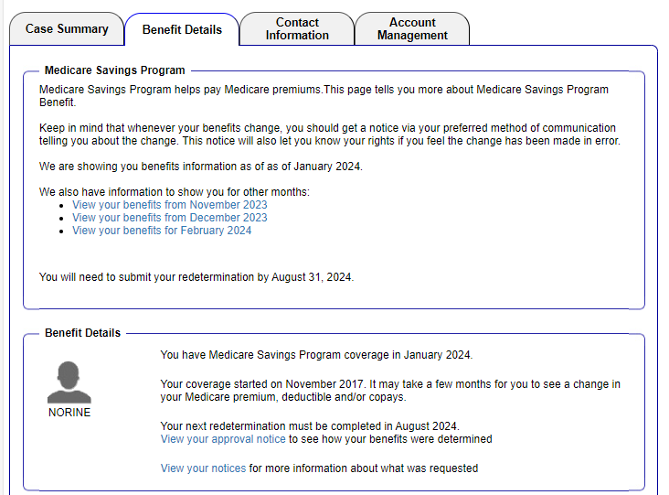
Review your benefits - Medicare savings program
Other benefit months
Redetermination deadline
Start date and approval period
Notes:
Important to note the coverage started date for MSP. If the payment hasn’t kicked in yet, you made need to contact DHS to ensure that they pay your MSP.

Slide 14
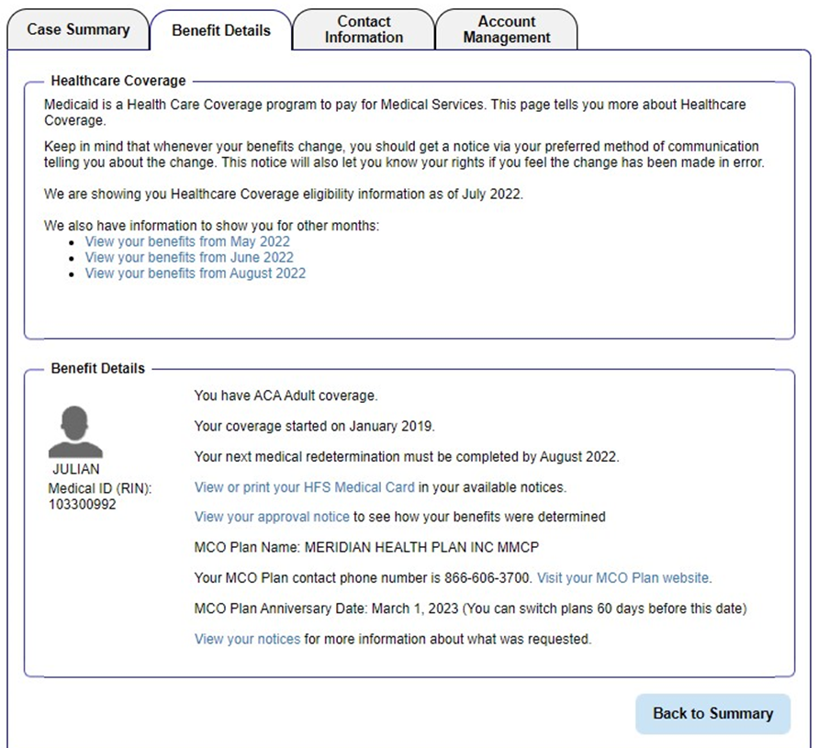
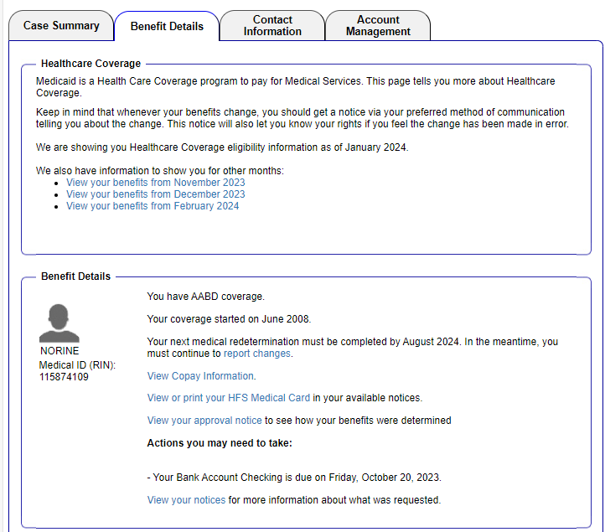
Review your benefits - health care coverage
ACA Adult
AABD Medical
Medical Program
RIN Number
Medical Program
Start date and approval period
12345678
12345678
RIN Number
Start date and approval period
ACA medical with have MCO Plan details
Notes:
Differences between medical program
RIN number: Medical ID Check status of medical benefitsAutomated Voice Recognition System (AVRS) at 1-855-828-4995 with your Recipient Identification Number (RIN). Helpful when no DOB or SSN

Slide 15
MMC is Divided into FOUR tabs
Overview
Make Changes
Summary benefit information
Summary of Verification Documents
Summary of Communication from DHS
Summary of Application Status
Notes:
Manage My Case (MMC) is a section on the Application for Benefits Eligibility (ABE) website that lets you check on, change, and renew your Medicaid, SNAP, and TANF benefits online, anytime.
Manage My Case provides information about your case and is a portal to make changes to your case.
You can Use Manage My Case to:
Check the status of an application
Renew benefits
Report changes – income, household members, expenses, or new address
Apply for additional benefits
View notices
Upload Verification documents/Review Verification documents deadlines
Review benefits
View and reschedule upcoming appointments
Here his how we are going to break this down today:
Tabs:
Contact Information
Account Information
Account Management

Slide 16
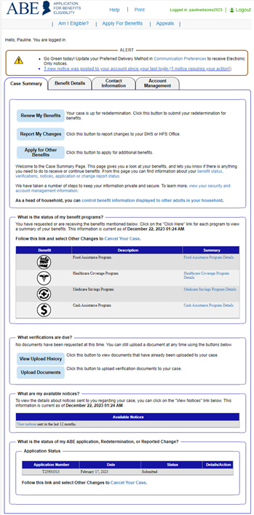
renew, report, Review or add benefits
Renew benefits - The Renew My Benefits button will display when the customer is up for redetermination. Appears when redetermination letter is generated 60 days before end of benefit period
Report changes
Apply for additional benefits - Apply for Other Benefits is only for requesting additional benefits on an existing case.
Summary Review of benefits
Customers can get their own benefit details here or from the tab at the top of the page
Notes:
Renew
Report
Review
Add benefits

Slide 17
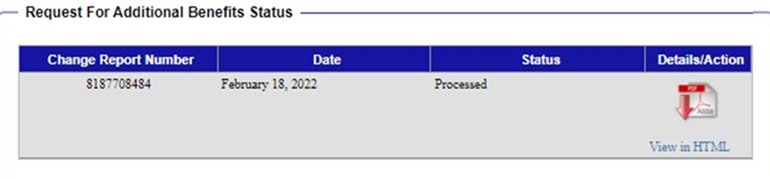
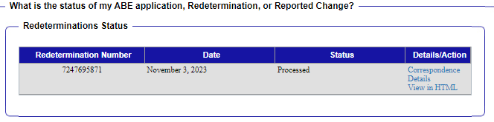
Case Summary Check Status
Copy of change report/redetermination/application
12345678
Tracking number
Status
12345678
T12345678
Notes:
You can view this status update even if you are unable to use MMC. Any customer can use MMC to check the status of their case whether they have access to manage my case or not.
The Status will show one of three stages:
1. Pending – means the application has NOT yet been submitted
2. Submitted –means the application has been submitted but not yet processed
3. Processed – means the application has been processed. Client should watch for a Notice of Decision in the mail.

Slide 18
Renew my benefits
Notes:
If it is time to renew customer benefits, a Renew My Benefits button displays on the Case Summary page. This button displays a month before the customers renewal is due.
Click thebutton. The Redetermination Overview page displays letting the customerknow which of theirbenefits is up for redetermination. Review and click Next.
Information screen: lets the customer know what information they will need to complete their renewal.
Clicking [Next] will bring up the customers renewal screens –some information will be prefilled.
If the customer needs to provide any final comments or submit other changes not reported during the redetermination, they will check the “Report any other change” in the Questions section of the page.
For certain Groups you will see a mid- oint review. If a Mid-Point Report is due for SNAP or Cash benefits, a [Mid-Point Report]button displays on the Case Summarypage.
The customer completes all questions and clicks [Next]. The Signing your Mid-Point Report page displays.
Customer Attestation: information is true and correct
Customer enters First Name and Last Name.
Customer clicks Submit ote:

Slide 19
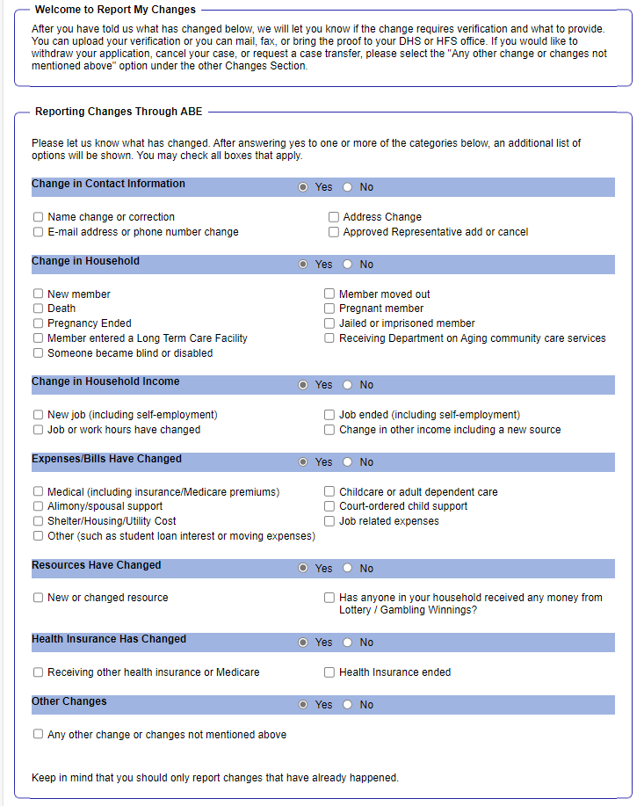
MMC – Report Changes
Every Change submitted in MMC requires an electronic signature, just like the application
Notes:
Reporting a change in the household or circumstances: circumstances:
1. Customer clicks on the Report My Changes button on the Case Summary page.
2. Customer chooses the change to be reported and clicks Next.
3. Customer completes additional questions
4. If the change requires proof, documents can be uploaded through Manage My Case.

Slide 20
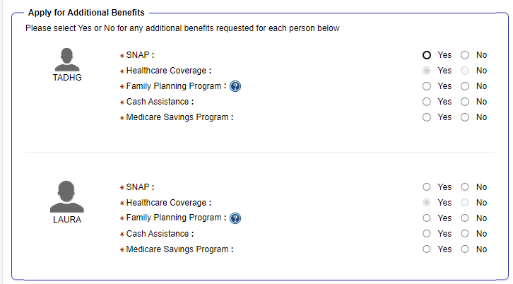
Apply for other benefits
Notes:
What do they do?

Slide 21
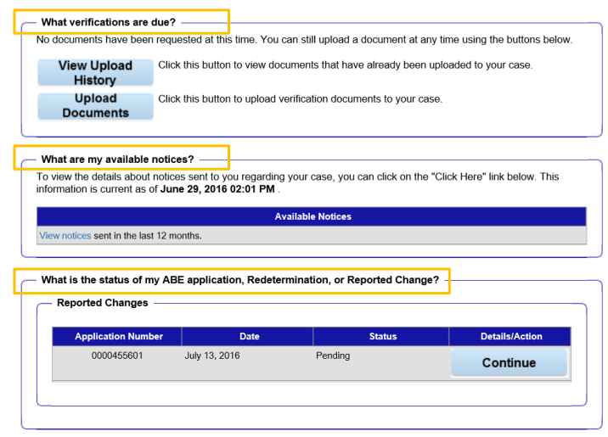
Verifications docs, notices, case status
Upload Verification documents/Review Verification documents deadlines
View notices
Check the status of an application
Notes:
Customers can view Verification Requests & Notices and see the status of their application, change report or Rede from the MMC landing page
VERIFICATION UPLOADS are important. The categories can be somewhat confusing. It is helpful to find the best match. You must make sure that you click add upload your document, hit next and next again to complete this process. You will be met with a screen that confirms you uploaded your docs and a tracking number. Keep a copy of this for your records as proof that you uploaded verification documents

Slide 22
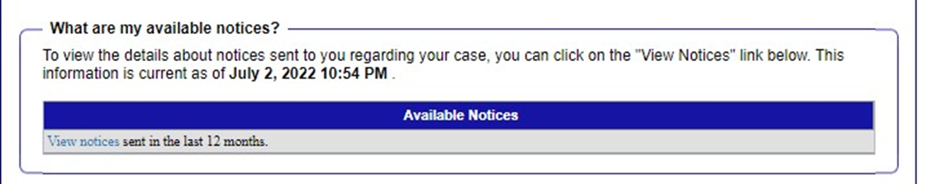
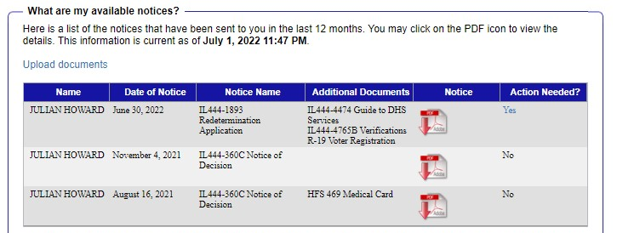
Notices
Click to view notices
Date of notice – this can sometimes be inaccurate best practice is to go by date listed on NOD
Type of notice
Copy of notice
Notes:
Check notices
Head of household will be able to view notices sent within the past 12 months.

Slide 23
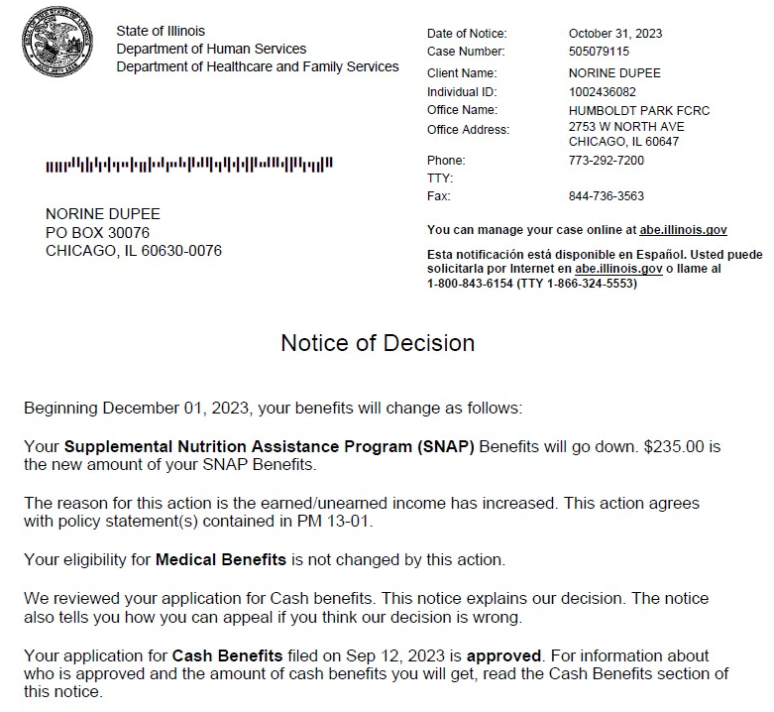
Viewing Notices
Date of notice
Individual ID
Local Office
Client Name
Client Address
Date of change
Summary of Benefit Details
Notes:
Reviewing notices allows us to learn key information about the case and unlock the next steps for those receiving DHS benefits.

Slide 24
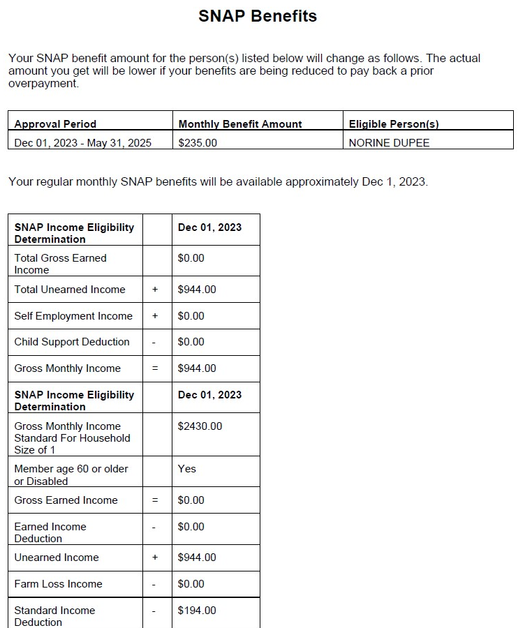
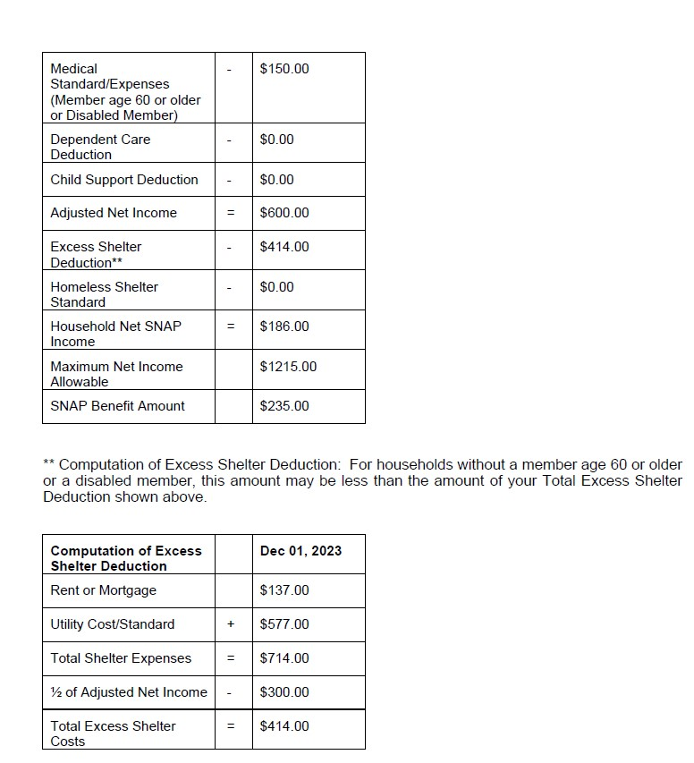
Viewing Notices
Benefit Amount
Approval Period
Notes:
Calculations

Slide 25
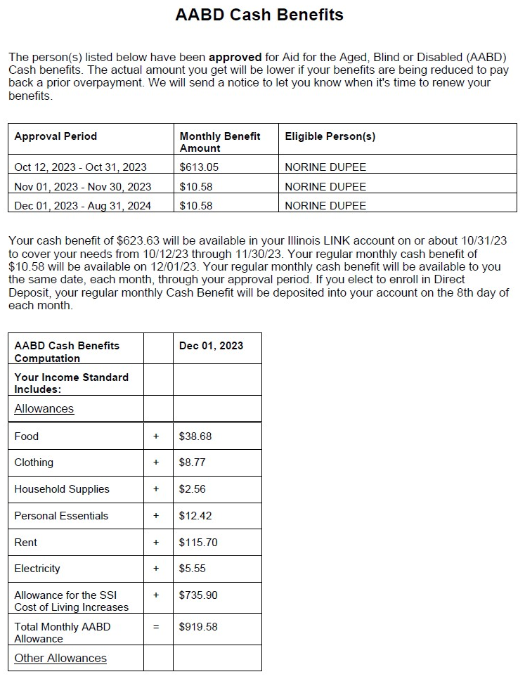
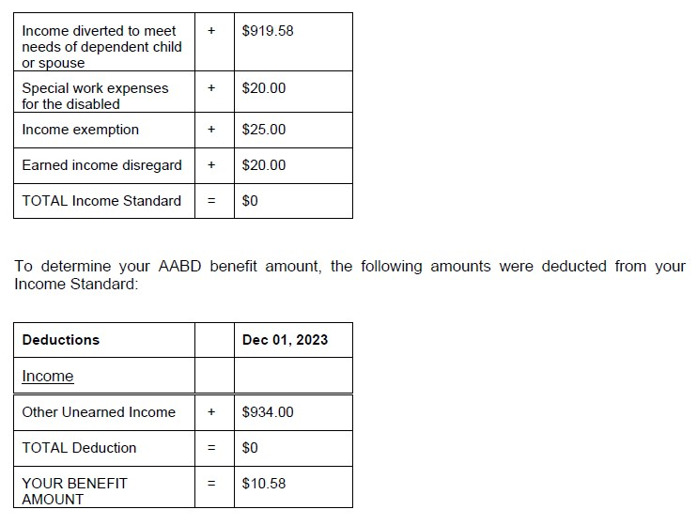
Viewing Notices
Benefit Amount
Approval Period
Deposit Details
Notes:
What do they do?

Slide 26
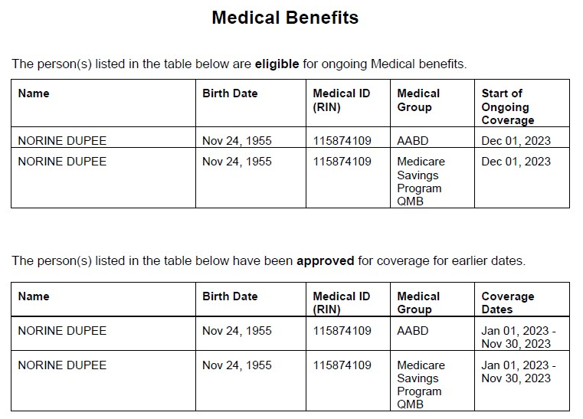
Viewing Notices
Benefit Details
123456789
RIN Number
Coverage Dates
123456789
Notes:
What do they do?

Slide 27
Questions?
Gwynne Mashon
gmashon@legalaidchicago.org
Beth Warner
bwarner@legalaidchicago.org
For technical assistance reach out to DHS
abe.questions@illinois.gov

