Slide 1
Appealing Illinois department of human services (IDHS) decisions part II
Gwynne Kizer Mashon
gmashon@legalaidchicago.org
10.2024

Slide 2

What is an appeal?
Goldberg v. Kelly, 397 USC 254 (1970)
Welfare benefits are a form of property, so are subject to Procedural Due Process (5th and 14th amendments to US Constitution)
Interest of a recipient in obtaining benefits needed to procure the necessities of life outweighs administrative efficiency
Pre-termination procedures are required before terminating benefits
  Notice
  Hearing with an impartial decision-maker
  Right to cross-examine witnesses
  Discovery (getting information)
  Decision on the record
  Right to have an attorney (but not a free or court-appointment one)
This is your constitutional right!

Slide 3
Quick recap of part i
“Filing an appeal” is really asking for an impartial decision-maker (the administrative law judge (“ALJ”)) to step in to:
Actions
Inactions
Decisions
  Assert your due process RIGHTS
  Ensure IDHS follows federal and state laws
  Fix a mistake that IDHS made so you can get the benefits you’re entitled to receive
Determinations
Report to a Report Form
Any issue of policy that a person disagrees with

Slide 4
Quick recap of part i
60 days
Decision related to cash or medical
90 days
Decision related to food
No deadline!
IDHS fails to send a required notice
IDHS fails to timely
IDHS fails to notify the client that a request was denied
We discussed:
What kinds of problems you can appeal
  Complete inaction
  “Partial Inaction”
  Decisions denying, reducing, or terminating benefits
  Decisions with budgeting errors
Deadlines for filing different kinds of appeal, including how to determine if regular deadlines apply and eligibility for continuing benefits
How to review notices to determine if they are legally sufficient and correct
How to file an appeal

Slide 5
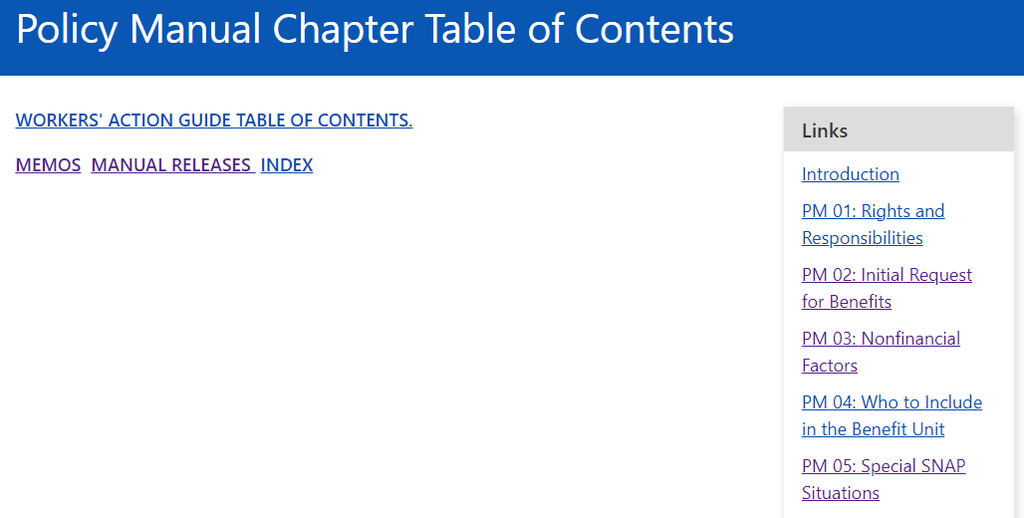
Quick recap of part I
https://www.dhs.state.il.us/page.aspx?item=13473
Google: “Illinois DHS PM”
State and federal law
State and federal regulations
PM/WAG

Slide 6

IL Department of human services
AGENDA
What do I do after I file an appeal?
Preparing for and representing yourself in others in hearings
What happens at a hearing?
Post-hearing
Note 1
In this training series, I am not teaching you exactly how attorneys approach and address these issues. I hope this is more useful to you!
Note 2
Do not withdraw an appeal until you have evidence in writing! Practice telling them “no”.

Slide 7
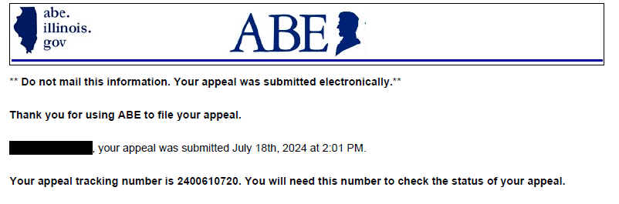
Here’s where we left off…
Whenever possible, keep a copy of the appeal you filed.
If you cannot keep a copy, make sure you at least keep a copy of the tracking number.

Slide 8
overview
Engage the FCRC
Submit all of the evidence you need to win to BAH and FCRC
Show appeal was filed on time
Show that DHS made an error or otherwise should reopen case
Prepare for Hearing
Write down your arguments and why your evidence supports them.
Prepare any witnesses that need to testify
Hearing Day
Final Administrative Decision
Pre-Hearing
Hearing
Appealing bad decisions
Enforcing good ones
Explain why you think DHS made an error or should otherwise reopen case and ask them to do it without needing a hearing
Do not withdraw until you get what you think you’re entitled to receive!

Slide 9
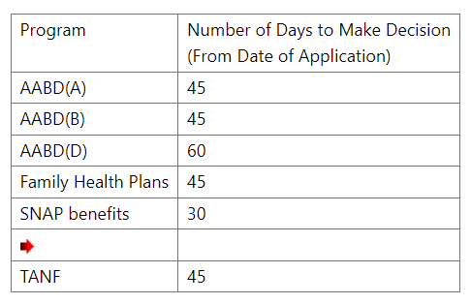

Example 1
John filed an application for SNAP and Medicaid on September 4, 2024. It’s now October 15, 2024. He direly needs both food and medical but hasn’t received any response to his application.
What can he do?
PM 17-01-01

Slide 10
inaction
Step 1
File Appeal –
No Deadline!
Over 30 days past since SNAP application filed = Inaction by the Department
PM 17-01-01
After filing the appeal, you should receive
an appeal confirmation letter in the mail.
That letter should have the same appeal number
as your Appeal Tracking number.

Slide 11
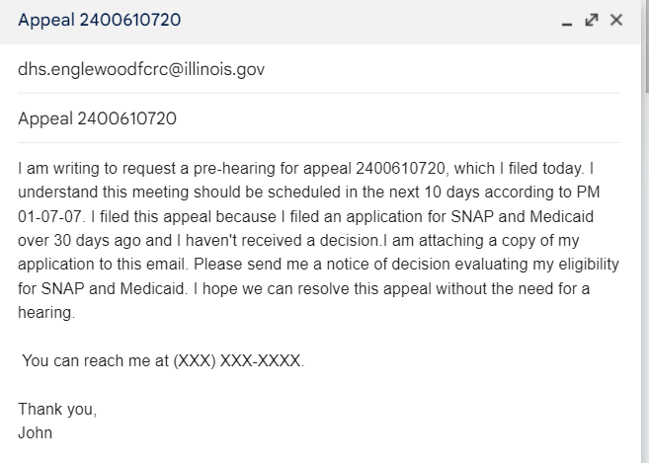
Step 2
Engage the FCRC
DHS “must” schedule a pre-appeal meeting with the client within 10 days after the appeal is received (or 2 days for expedited SNAP). PM 01-07-07.
Ask them to contact you for pre-hearing meeting.
Tell them WHY you are appealing.
Submit any proof you have.
Ask them to send you proof if they think you are wrong.
Include Authorization form for Appeals, if you are representing someone else: https://www.dhs.state.il.us/onenetlibrary/12/documents/Forms/IL444-0960.pdf

Slide 12
Step 2
Engage the FCRC
Pre-Hearing Meetings
Usually take place over the phone, but you can ask to meet at the FCRC if that’s better for you.
Take notes of what happens at the meeting
Be sure to note:
  Date and time of meeting
  Name of the FCRC representative you’re talking to
  Contact information for the FCRC representative so you can follow-up with them later
  Any next steps you need to take
  Anything the DHS rep says they will do, and by when they will do it

Slide 13


Step 2
Engage the FCRC
Common Responses | Possible Replies
“It looks like we made a mistake. We can process it this week. Do you want to withdraw the appeal?” | “No. I can withdraw the appeal after I receive the notice of decision. Do you need any additional information before you can approve my benefits?”
“We already denied your application. Do you want to withdraw your appeal?” | “No. Please send me a copy of the notice of decision your office sent when it denied my application. After I review it, I might withdraw my appeal. If your office didn’t issue a notice of decision, please let me know if you need any additional information before you can approve my benefits.”
“It looks like we denied your application for missed verifications. I have the notice here. I can send it to you. Do you want to withdraw your appeal?” | “No. Please send me a copy of the notice. Also, let me know what verifications your office things I did not send it.”
Do not withdraw until you get what you think you’re entitled to receive!

Slide 14
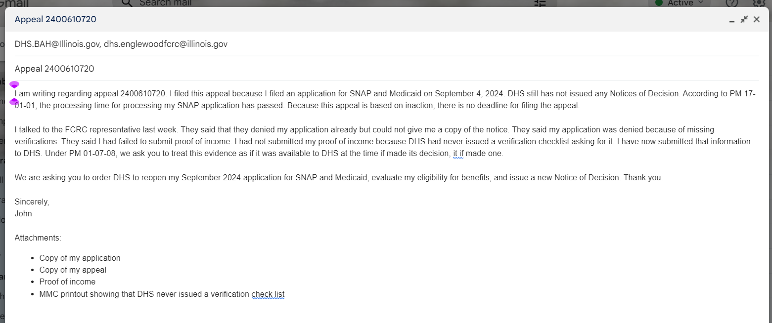
Step 2
Prepare for Hearing
Note
Communication and attachments sent to BAH are not easily viewable (if at all) by FCRC staff. If you submit verifications or change contact information with BAH, you still need to submit those to your FCRC.
Do not withdraw until you get what you think you’re entitled to receive!

Slide 15
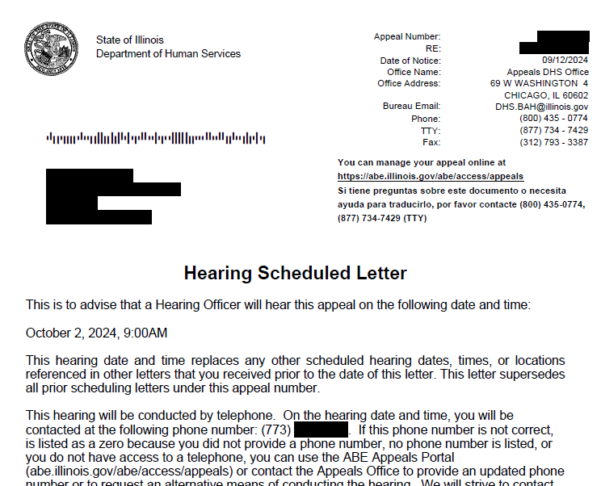
Step 2
Prepare for Hearing
Continue engaging with the FCRC as needed to resolve your appeal.
When your hearing is scheduled, you should receive a notice of the hearing date.
Do not withdraw until you get what you think you’re entitled to receive!

Slide 16

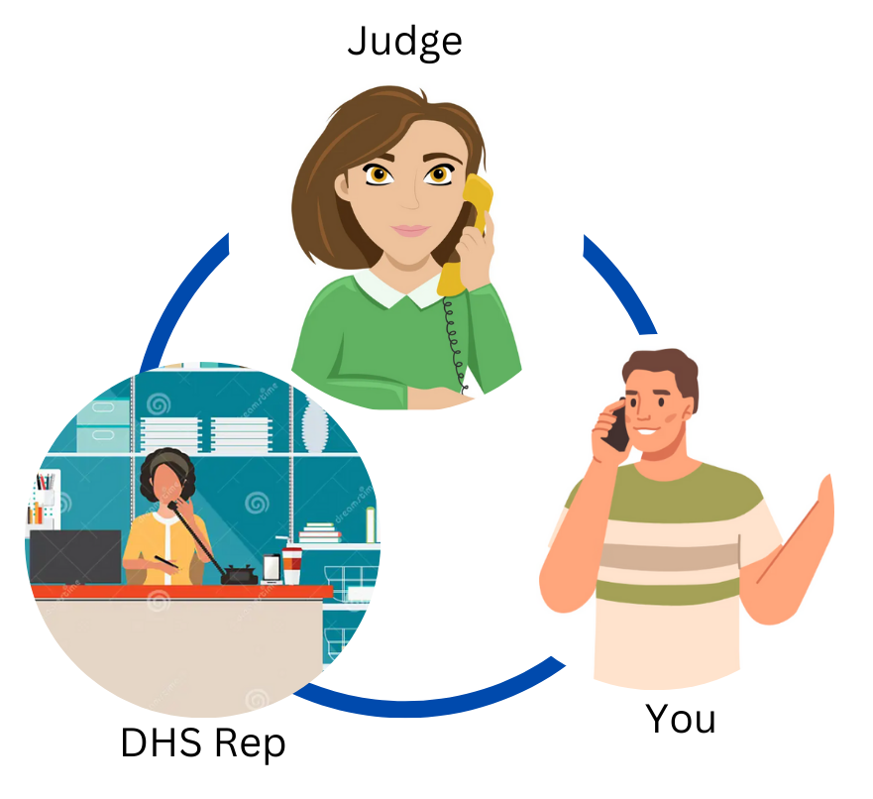
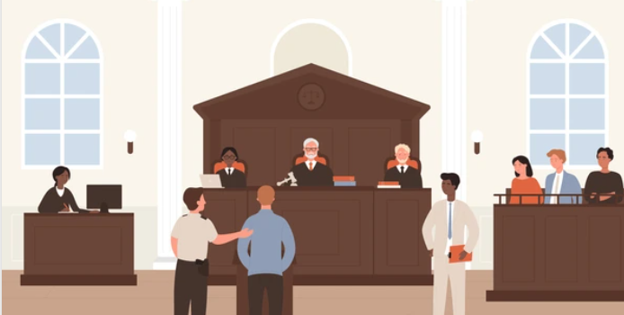
Step 3
A LOT of phone calls. The FCRC rep should call you before the hearing for a final pre-hearing conference. Conversations with the judge usually will be recorded.
If you do not get a call within 1 hour after your hearing start time, email dhs.bah.coordinator@illinois.gov to let them know you’re ready and waiting.
Hearing day
Do not withdraw until you get what you think you’re entitled to receive!

Slide 17
Step 3
Hearing day
More prehearing meetings – probably with someone who never looked at your case before
Most likely, DHS will ask if YOU want a continuance…
PM 01-07-10-c: Request for Hearing Delay
After a hearing starts, you can request it be continued at another time. You have a right to one continuance in each appeal. After that, you need “good cause.”
Do not withdraw until you get what you think you’re entitled to receive!

Slide 18

Step 3
Hearing day
INACTION
General Hearing Tips
Keep the emails you’ve sent handy. You’ve already written out your arguments there so you can just read them!
Keep a checklist of what you need to prove so you can make sure you get all of them in
Wait until it’s your turn to talk. If you feel like you need to interject, ask the judge first. Generally, direct your comments and arguments to the judge.
You have a right to cross-examine the FCRC Representative. But it is best not to argue with them.
You do not need to convince the FCRC Rep that you are right. It’s up to the judge now!
Application for SNAP
Medicaid filed 9/4/24
Appeal filed
Requested verifications
submitted
No response from DHS
Do not withdraw until you get what you think you’re entitled to receive!

Slide 19
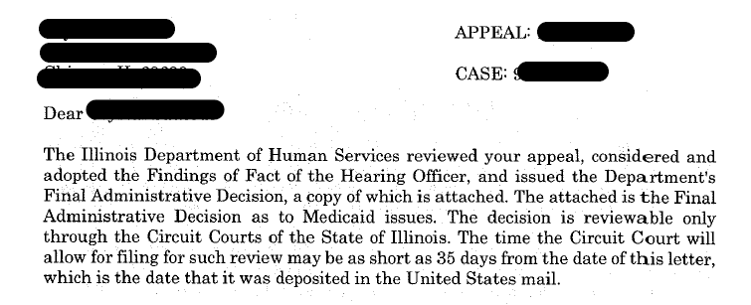
Step 4
Final Administrative Decision
If you and DHS cannot agree, and the judge holds a full hearing, the judge will issue a written decision. It usually takes at least 30 days before we receive the written decision.
The final decision should be issued within 60 days (SNAP only) or 90 days (all other cases) from the date the appeal was filed, but extended for any hearing delays caused by the person who filed the appeal.
Increase of food assistance should be issued within 10 days after the FCRC receives the hearing decision.
Appeals of FAD must be filed in Circuit Court within 35 days after the date on the FAD

Slide 20

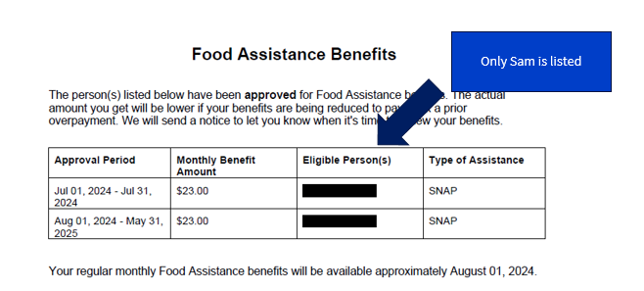
Example 2
Sam is married to Payton, who just got Legal Permanent Residency Status. They recently had a baby, Raya. Sam submitted a Change Report, asking DHS to add Raya to her SNAP case.
In response, DHS issued this notice. What can Sam do?

Slide 21
File an appeal for inaction!
Engage the FCRC
Submit all of the evidence you need to win to BAH and FCRC
Show appeal was filed on time
Show that DHS made an error or otherwise should reopen case
Prepare for Hearing
Write down your arguments and why your evidence supports them.
Prepare any witnesses that need to testify
Hearing Day
Final Administrative Decision
Pre-Hearing
Hearing
Appealing bad decisions
Enforcing good ones
Explain why you think DHS made an error or should otherwise reopen case and ask them to do it without needing a hearing
Do not withdraw until you get what you think you’re entitled to receive!

Slide 22
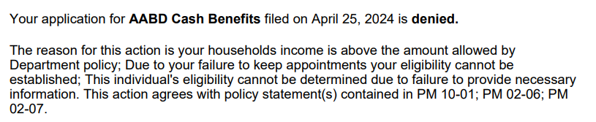

Example 3
Rhondi applied for AABD Cash benefits. When she got home from visiting her family, she realized that DHS had sent her a Verification Checklist asking for proof of assets, and the deadline for responding to the Verification Checklist had passed. The next day, August 20, 2024, she got this notice.
What can she do?

Slide 23
Missed verification
Step 1
File Appeal –
Deadline!
PM 01-07-08: If notice denies/terminates benefits based on a missed verifications and appeal is timely filed, IDHS must accept any information or verifications presented during the appeal process, treat that information and those verifications as if they were available at the time of the original decision, and reverse or modify their decision.
60 days
Decision related to cash or medical
90 days
Decision related to food
No deadline
IDHS fails to send a required notice
IDHS fails to timely
IDHS fails to notify the client that a request was denied

Slide 24
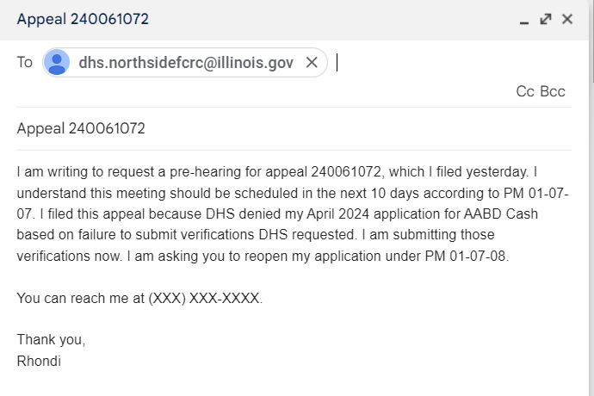
Step 2
Engage the FCRC
DHS “must” schedule a pre-appeal meeting with the client within 10 days after the appeal is received (or 2 days for expedited SNAP). PM 01-07-07.
Ask them to contact you for pre-hearing meeting.
Tell them WHY you are appealing.
Submit any proof you have.
Ask them to send you proof if they think you are wrong.
Include Authorization form for Appeals, if you are representing someone else: https://www.dhs.state.il.us/onenetlibrary/12/documents/Forms/IL444-0960.pdf

Slide 25
Step 2
Engage the FCRC
Common Responses | Possible Replies
“You missed the deadline. We don’t have to reopen the application. You have to apply again. You should withdrawn your appeal.” | “No. PM 01-07-08 says that if DHS denies benefits based on a missed verifications and appeal is timely filed, IDHS must accept any information or verifications presented during the appeal process, treat that information and those verifications as if they were available at the time of the original decision, and reverse or modify their decision.”
“The documents you sent us aren’t what we were looking for. You need to apply again. You should withdraw your appeal.” | “No. Please let me know what is wrong with the documents I sent so I can try to send new ones.”
“We are still missing proof of income. You need to apply again. Do you want to withdraw your appeal?” | “No. Are there any other documents you need to prove my eligibility?”
Do not withdraw until you get what you think you’re entitled to receive!

Slide 26
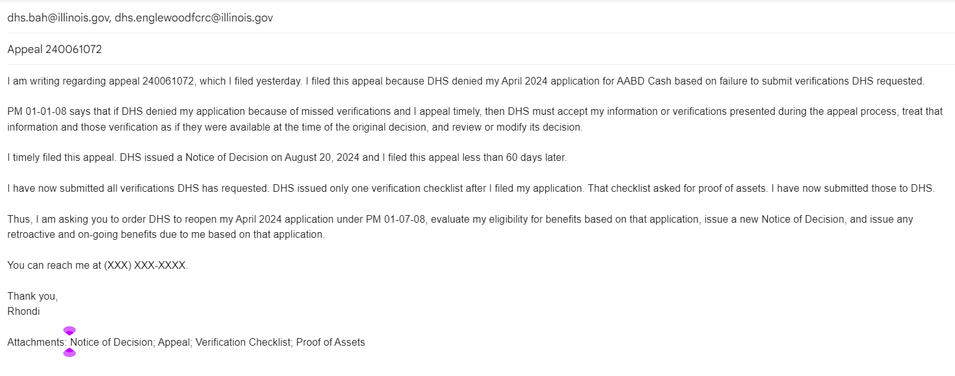
Step 2
Prepare for Hearing
Do not withdraw until you get what you think you’re entitled to receive!

Slide 27
Missed
Verifications
Step 3
Hearing day
General Hearing Tips
Keep the emails you’ve sent handy. You’ve already written out your arguments there so you can just read them!
Keep a checklist of what you need to prove so you can make sure you get all of them in
Wait until it’s your turn to talk. If you feel like you need to interject, ask the judge first. Generally, direct your comments and arguments to the judge.
You have a right to cross-examine the FCRC Representative. But it is best not to argue with them.
You do not need to convince the FCRC Rep that you are right. It’s up to the judge now!
Notice of Decision
Appeal Filed
Verification Checklist
Missing Verifications
Never refused to submit
Do not withdraw until you get what you think you’re entitled to receive!

Slide 28
overview
Engage the FCRC
Contact the FCRC. Tell them what you are appealing and why. Give them any evidence. Tell them you hope to resolve this case without needing a hearing. Ask for a pre-hearing conference
Submit all of the evidence you need to win to BAH and FCRC
Jurisdiction
Prepare for Hearing
Write down your arguments and why your evidence supports them.
Prepare any witnesses that need to testify.
Do not withdraw until you get what you think you’re entitled to receive
Did you file on time?
Is this the kind of the judge has power to decide?)
Substantive Arguments –
What did DHS do wrong?
What proof do you have?
Hearing Day
Final Administrative Decision
Pre-Hearing
Continuances
What happens in the hearing
Appealing bad decisions
Enforcing good ones

Slide 29
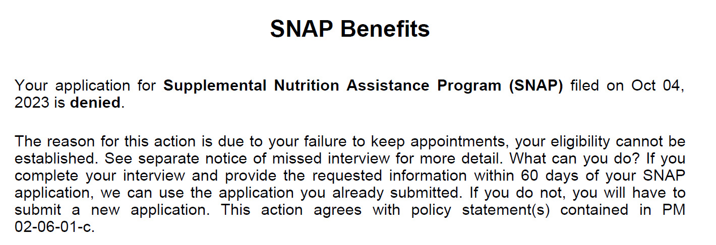
Missed interview
PM 01-07-08: If notice denies/terminates benefits based on a missed application, and the notice is timely appealed, then IDHS must reschedule the interview. If the client appears for the interview and provides all required information, IDHS will reopen the application back to the original date and provide benefits as if all benefits were available at the time of the original decision.
PM 01-07-08

Slide 30
Missed interview
I would also submit the following or have it ready to submit:
Proof of income
ID
Anything else you think, based on your experience, DHS might ask for
Notice of Decision
Appeal Filed
Never refused to complete interview

Slide 31
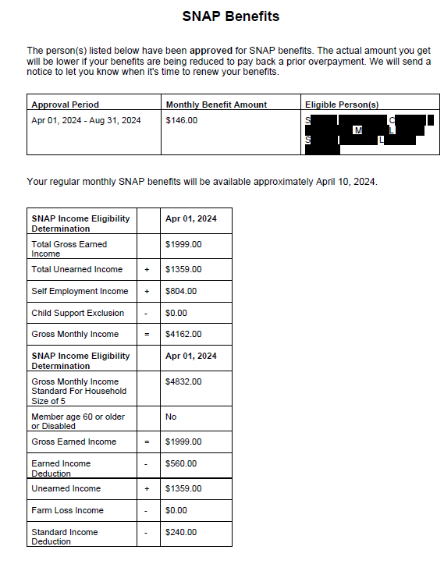
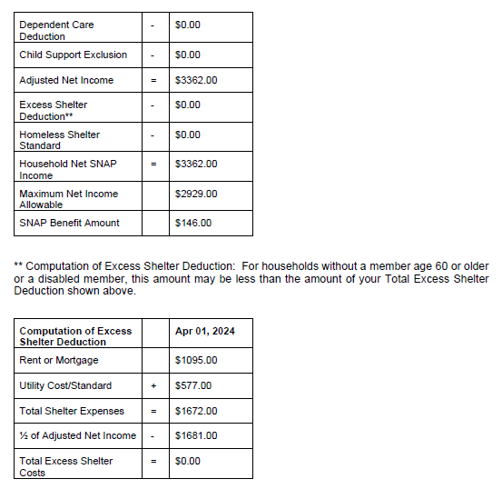
Factually incorrect notices
Incorrect Income
Incorrect Rent

Slide 32
Factually incorrect notices
During pre-hearing meetings, if DHS still disagrees with you, ask:
What information are they using?
To send you copies of anything they are looking at that conflicts with the information you have
Notice of Decision
Appeal Filed
Evidence to show DHS
is wrong; e.g. Proof of
Income

Slide 33
Evidence issues
I didn’t do something
Testify at the hearing
DHS didn’t do something
Cross-examine at the hearing: “Isn’t it true DHS didn’t issue a notice of decision in response to my April application?”
Print out from MMC
Affidavit
Ask DHS representative to produce it
DHS documents
Ask Judge to ask DHS for it
Ask Judge to issue a subpoena; difficult and likely only successful if you can explain what other efforts you’ve made to obtain it
Someone else’s documents
Ask DHS to get it
Ask Judge to issue a subpoena; difficult and likely only successful if you can explain what other efforts you’ve made to obtain it and why it is critical for your case
DHS notices

Slide 34
What’s next:
November | December
Healthcare options beyond Medicaid: Marketplace Health Insurance & Medicare | “Ask an Attorney” We will be answering your questions regarding your client’s IDHS and SSA benefits, what changes we’re expecting, how to get more help when you need it, etc. *NOTE: We cannot provide legal advice in this or any other training.

Slide 35

questions
Gwynne Kizer Mashon
gmashon@legalaidchicago.org

