Slide 1
Submitting DHS Benefit Applications using ABE
Beth warner
Paralegal, Public Benefits Outreach and Enrollment
bwarner@legalaidchicago.org
January 2024
Notes:
Run of Show/Script
GKM Welcome and Open
Recap
Pass to SHPA
Thank Yous
Housing keeping
Introduce BW
Welcome
We are excited that you are joining us for the third training in our 12 part Main Stream Benefits training series, Submitting DHS benefits applications using ABE
I'm Gwynne Mashon – Gwynne introduce yourself
Recap on previous trainings?
Thank you’s
Supportive Housing Providers Association, David Esposito
Illinois Office to Prevent and End Homelessness
Housekeeping
We are recording these sessions
50 minutes presentation with 10 minutes for questions
Link to training will be sent out after training
Send copy of PowerPoint at the end
Cameras are on but participants do not have access to their microphone or a general chat
All Questions can be posted in the Q&A section on teams. You can locate the Q&A section at the top of your teams screen on the left. Any further questions can be sent to me or Beth. I will drop our emails in the Q&A section.
Introduce Beth
Beth Warner is a Paralegal in the Public Benefits Outreach and Enrollment project at Legal Aid Chicago. Beth’s work focuses on connecting our cities most vulnerable people to food, medical and cash benefits through the Department of Human Services.
They are a survivor of homelessness and human trafficking in the City of Chicago. They utilize their experience as a survivor of homelessness and human trafficking in the City of Chicago, to inform their current work assisting people who are experiencing homelessness connect to legal services.
Beth has presented at state and national conferences on the topic of Lived Experience and Legal Services.
They received their undergraduate degree in English Literature from Northwestern University.

Slide 2








Children & Families
Consumer
Legal Aid Chicago is a private non-profit that provides free civil legal services to people with limited income in Cook County, securing their rights to economic stability, affordable housing, personal safety, fair working conditions, and basic healthcare.
Criminal Records
Relief
Public Benefits
Long-Term Care
Immigrants & Workers’
Rights
Housing
Notes:
GWYNNE can you add description?

Slide 3



What I hope you’ll learn
Overview of what ABE can do
How to create an ABE User ID and Password
How to submit an application via ABE
Complete Identity Proofing
Provide Key Information to unlock services and maximize DHS benefits
Notes:
Our goal is to help applicants and providers working with applicants submit applications that will help them maximize their access to the public benefits they qualify for and are entitled to receive. The purpose of this training is to provide tips and information when using ABE to apply for public benefits.
Provide Key Information to unlock services and maximize DHS benefits
What does this mean?
Things that can affect the outcome of an application:
Not selecting all programs clients are eligible for.
Incomplete applications.
Not submitting required docs, incorrect names, how to fill out applications SSN not required but it speeds up the process.
AND MORE IMPORTANTLY DOB AND SSN LINK TO YOUR CURRENT CASE.
We will discuss:
What ABE can and cannot do
Create ABE User ID and Password
Link User ID and Password login information to case information
Complete Identity Proofing (federal requirement)
Submitting an application
Using ABE
Submitting an appeal
We will not discuss:
VTTC applications
Specific questions related to program eligibility
Technical questions related to the functioning of ABE

Slide 4
Illinois' Application for Benefits Eligibility (ABE) has three portals to support applicants with their benefits:
Apply for Benefits
ABE is the State of Illinois’ web based portal for applying for and managing health coverage, SNAP and cash benefits online, anytime.
Manage My Case (MMC)
MMC is a section on the Application for Benefits Eligibility (ABE) website that lets you check on, change, and renew your Medical, SNAP, and case benefits online, anytime.
Appeals
The ABE Appeals portal allow users to file and manage appeals via the web based portal. The Appeals portal can be accessed through MMC or directly:
https://abe.illinois.gov/abe/access/appeals
Notes:
ABE Born 2013/4, ABE stands for the Application for Benefits Eligibility. ABE is the State of Illinois’ web-based application portal for Medicaid, SNAP and cash benefits. Anyone can apply for Medicaid, SNAP, cash benefits and the Medicare Savings Program through ABE
We strongly encourage to apply for Medicaid, SNAP, cash assistance and the Medicare Savings Program online through ABE for the fastest service.
This overview will familiarize you with some of ABE’s features and explain how to set up your user account and submit an application.
ABE does not replace the need for caseworker interviews for SNAP and cash benefits; Applicants will be contacted within 14 days for this interview. In most cases, interviews can be completed over the phone.
ABE & the Integrated Eligibility System (IES)
The Integrated Eligibility System (IES) is the caseworker portal for eligibility determination and case management.
Once you submit an application in ABE, you can no longer make changes to it in ABE, but you are able to view the application as it was submitted. Applicants should contact the office where the application was sent for processing to report any changes.
The new application will appear in an electronic inbox where a caseworker will take it from the queue and register it.
The caseworker will schedule an interview with the customer, if necessary, and complete the data collection process. Interviews are required for SNAP and Cash Assistance.
IES includes electronic tools that interface with State and Federal data sources to verify information provided in the ABE Application. Applicants will be asked to provide required documentation for any information that cannot be verified electronically
The caseworker will then complete the determination of eligibility and the Applicant will receive a written notice of the decision in the mail.

Slide 5
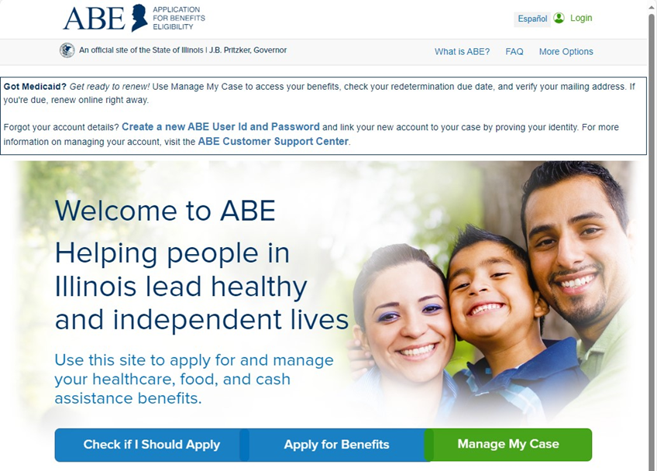
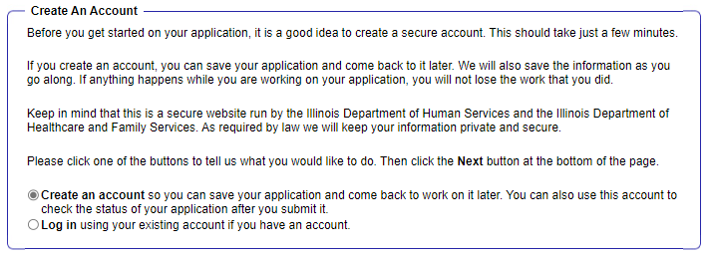
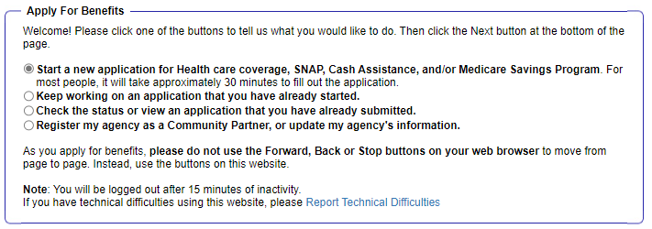
SETTING UP ABE LOgIn
2
3
1
Notes:
After an Applicant clicks "Apply for Benefits" they will be brought to this screen. To start a new application or to go on to create a User ID or password, click "Start a New Application" option.
For the purpose of this training we are working with a first time applicant of DHS benefits and a first time user of ABE. In our next training, we will learn more about using Manage My Case when applicants do have existing cases.
If this is your first visit to ABE, you will need to create an ABE User Account.
From the ABE Homepage, click the Apply for Benefits button in the middle of the page.
Next Choose [Start a new application for Health care coverage, SNAP, Cash Assistance, and/or Medicare Savings Program.]
On the next screen choose [Create Account].
If client has a User ID and Password, they will be prompted to update the PW and secret questions to meet new security requirements
If client doesn’t have a User ID and PW, they will need to create one.
Link their User ID and Password login information to their case information
Go through Identity Proofing (federal requirement). The service is through Experian. Clients can submit applications without completing identity proofing, but will not be able to see electronic verification results or access MMC without successfully going through Identity Proofing.
Only the HOH can use MMC
You can repeat this process if you lose your login details

Slide 6
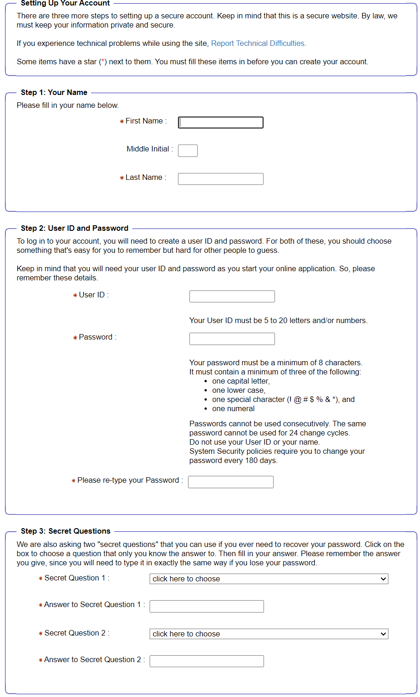
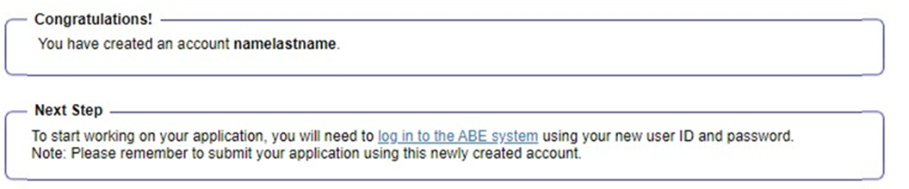
SETTING UP ABE login
Notes:
The first time Applicants enter ABE, they will need to create an account so they can come back to ABE later to check their application status or save their information and return to the application later.
Enter your name, and then choose an ABE User ID and Password. The state will not be able to recover your User ID if you forget it – pick an ID you will remember, save it and keep in a secure location.
Select Secret Questions and enter your answers to those secret questions. If you forget your password you will be asked to answer your Secret Questions to reset it. Don’t forget the answers to your Secret Questions! You will need them to reset your password every 6 months.
Click [Create Account]. A Congratulations! message displays.
Click on the Log in to the ABE System link on the confirmation page to return to the Login page.
Enter your User ID and Password. Click [Login]
Answers to secret questions are needed for password reset and are case sensitive. If customer does not know User ID or cannot remember answers to secret question the only solution is to create a new account. I recommend writing down User ID, password and answers to secret questions, being sure to indicate upper or lower case, but also to store securely as access to this information potentially exposes the customer’s PII and PHI. If you use a date or phone number for an answer to one of the questions, make sure you remember how you enter the number.

Slide 7
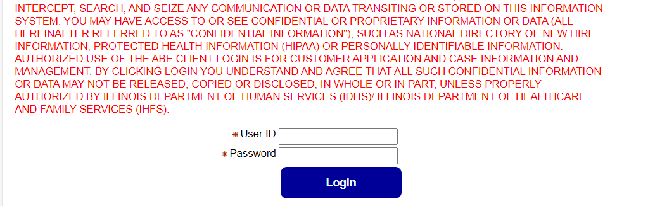
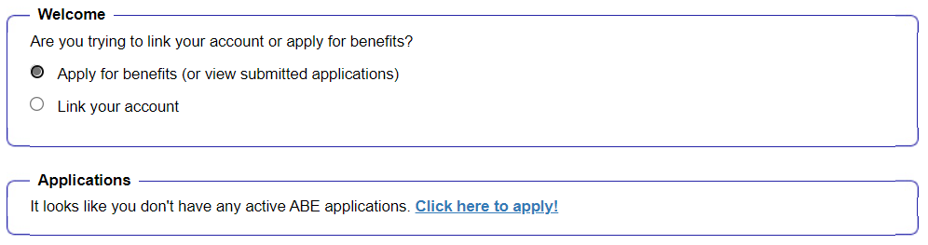
Logging in
2
Once logged in for the first time, you will see this screen:
Notes:
Enter your User ID and Password. Click [Login]
You will see a screen with two options here, Apply for benefits or link your account. For the purpose of this training, we are working on an application for someone who have never applied for DHS benefits and does not have any existed cases. For our next training we will be covering the capability's of MMC in depth).
If you enter the wrong User ID and/or password 3 times you will be locked out of your ABE account for sixty minutes. If you forget your User ID, or cannot reset your password you will need to create an all new ABE account.

Slide 8
Identity Verification
Applicants are required to verify their identity when applying for IDHS benefits or using MMC for the first time. This process is called Identity Proofing. Three (3) ID Proofing services are available.
They appear in the following order:
1. Secretary of State (SoS) – Verifies a SoS IL Driver’s License or State ID information.
2. Experian – Randomly generated questions based on previous addresses, tax data or ownership details.
3. Manual ID Proofing – Paper form process with DHS/HFS.
Notes:
I wanted to cover identity proofing before we move on. When submitting an application for the first time you will be asked to complete ID proofing. It usually occurs towards the end of the application.
ID proofing = There are Three (3) ID Proofing services.
Drivers Lisence/state ID
Experian
Manual ID proofing
ID proofing must be completed successfully in order for you to use ‘Manage My Case’.
If the identify proofing is successful, once the application is submitted, ABE will list what information could be verified electronically and what documents are still needed that can be uploaded with the application.
If you cannot complete the ID Proofing process and choose “Verify Identity Later”, don’t worry. You can still submit your application and it won’t affect your eligibility. ABE just won’t be able to electronically verify your information – a caseworker will do it in the office. If you receive the pop-up page below, click [Verify Identity Later] to continue with your application
Identity proofing is NOT required, the applicant can still submit an application by clicking the box that says “Verify Identity Later” at the bottom of the page. If someone cannot go through ID proofing to set up MMC, they can log back into their ABE Account and check the status of their application.

Slide 9
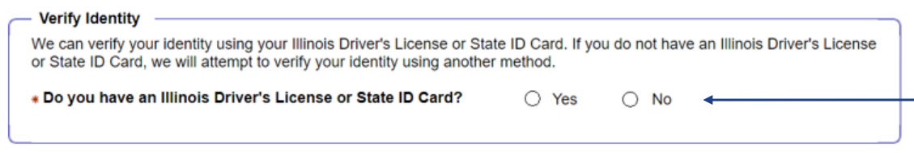
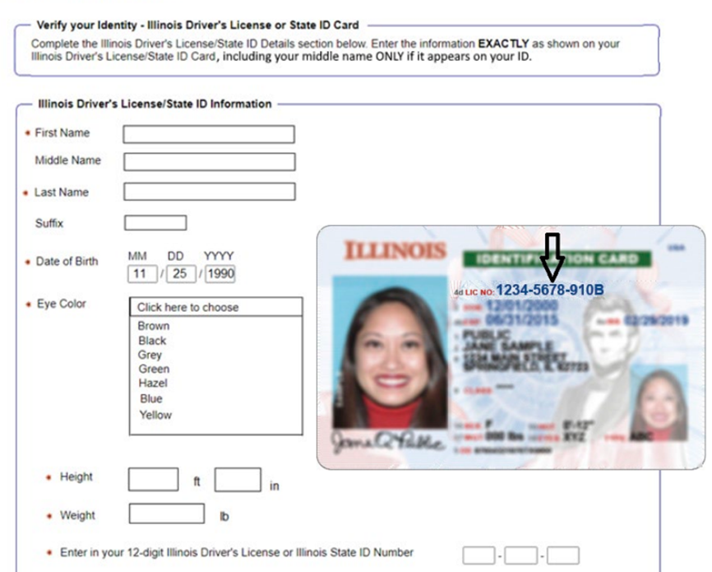
Identity proofing – Secretary Of State
If customer answers, ”YES”, they will advance to the SoS ID Proofing process.
If applicant answers, ”NO”, they will advance to the Experian Identity Proofing process
Notes:
Beginning in March 2023, the IL Secretary of State process became available
Must be exact down to height and weight! If information is not exact will not match what the SoS has. Only middle name if on ID. No “.” period after middle initial

Slide 10
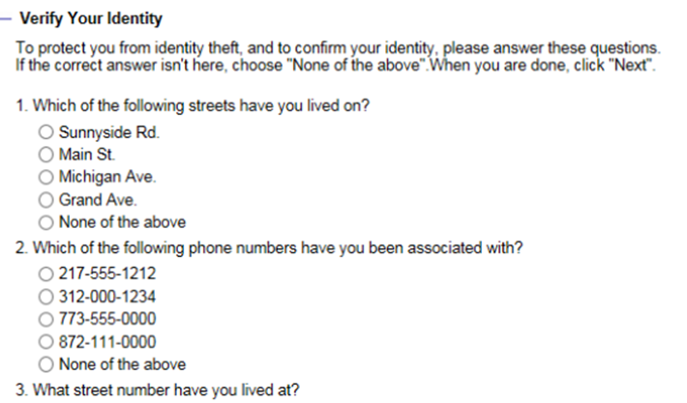
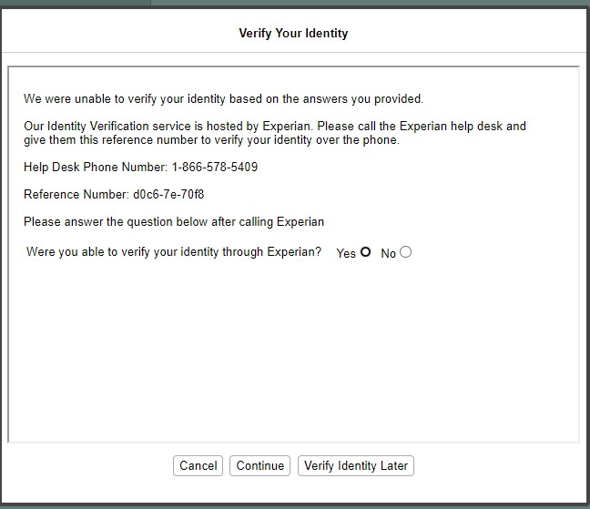
Identity proofing - Experian
Multiple-choice questions will display that only the applicant would know the answer to, thus “proving” the customer identity.
2
If the ID Proofing service is ABLE to use the customer’s answers to verify identity, applicants see the information that ABE was able to verify electronically, or their case will be linked and they will see the MMC homepage.
If the customer is UNABLE to answer the questions correctly or if the service does not have enough information to offer questions, the customer will be asked to contact the Experian Help Desk with a reference number for additional questions to answer.
2
Notes:
Familiar screen for many Experian is the process we have used MMC went live.
The ID proofing process uses a person’s credit history
You may not be able to complete the electronic ID proofing process if you do not have a credit history or if you are unable to answer to the questions:
Immigrants who have recently relocated to the United States
Children under age 18
Persons who do not have bank accounts
ABE will access the third-party identity proofing service, Experian, and display a set of multiple choice questions that only the applicant would know the answer to, things like past addresses, family members names, etc.
*I will say, I have not had luck with calling Experian, if you are not able to use this ID proofing method, move on to Manual Identity proofing*
Experian ID proofing is used when:
Customer does not have IL Driver’s License or
ID Identity Verification fails through SOS
If you cannot complete the ID Proofing process and choose “Verify Identity Later”, don’t worry. You can still submit your application and it won’t affect your eligibility. ABE just won’t be able to electronically verify your information – a caseworker will do it in the office. If you receive the pop-up page below, click [Verify Identity Later] to continue with your application.

Slide 11
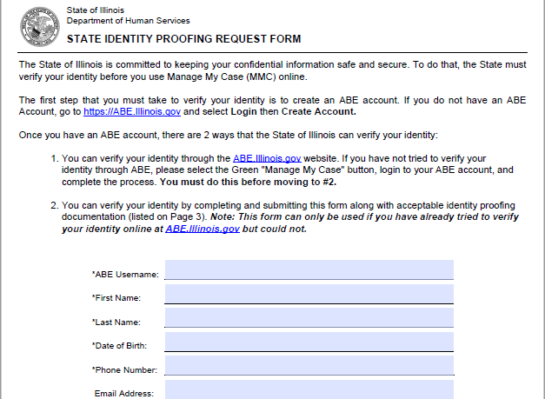
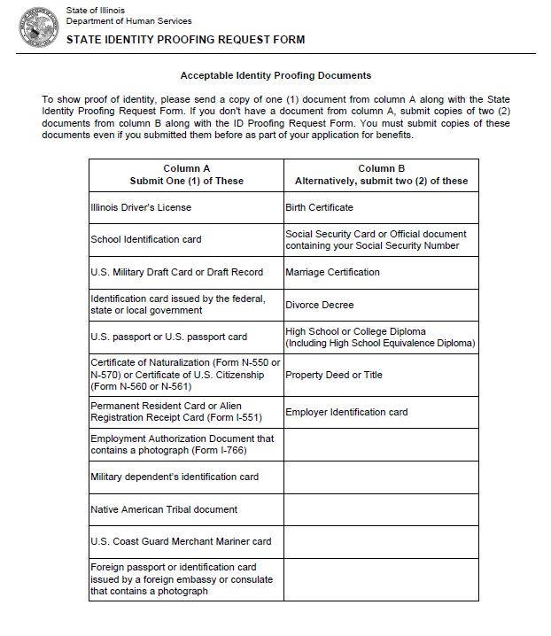
Identity proofing - Manual
1. To request State Identity Proofing, fill out, sign, and return the State Identity Proofing Request Form (pdf), and proof documents (listed on page 3 of the form).
2. Proof documents - you will need a copy of:
one (1) document from Column A or
two (2) documents from Column B from the list of Acceptable Identity Proofing Documents.
3. Return the completed form and proof documents to:
Illinois Department of Human Services
Attn.: ID Proofing Unit
600 E. Ash, Building 500, 5th Fl.
Springfield, IL 62703
or
Return the form to your local FCRC
Allow 6-8 weeks to hear back from the state.
If there are questions, email: ABE.Questions@illinois.gov
Notes:
This is a hard stop – applicants will not be able to use MMC unless they go through manual identity proofing process.
If an applicant has tried to set up MMC, but could not pass Identity Proofing in ABE, there is a process to request manual State Identity Proofing.
You must have an ABE User Account before returning this form to the state. Every section of the form must be completed or it will not be processed.
Requesting Manual State Identity Proofing to Access Manage My Case
Proof documents - you will need a copy of one (1) document from Column A or two (2) documents from Column B from the list of Acceptable Identity Proofing Documents.
Return the completed form and proof documents to:
Illinois Department of Human Services
Attn.: ID Proofing Unit
600 E. Ash, Building 500, 5th Fl.
Springfield, IL 62703
or
Return the form to your local FCRC
Fax it to 217-557-1370
The form cannot be emailed and should NOT be sent to Central Scanning
Allow 6-8 weeks to hear back from the state. May not take the full 6-8 weeks – depending on any backlog the ID proofing unit may have. Manual ID proofing numbers are down since we have been using SOS
If there are questions, email: ABE.Questions@illinois.gov
the State will mail you a notice to tell you if your manual Identity Verification has been approved.

Slide 12
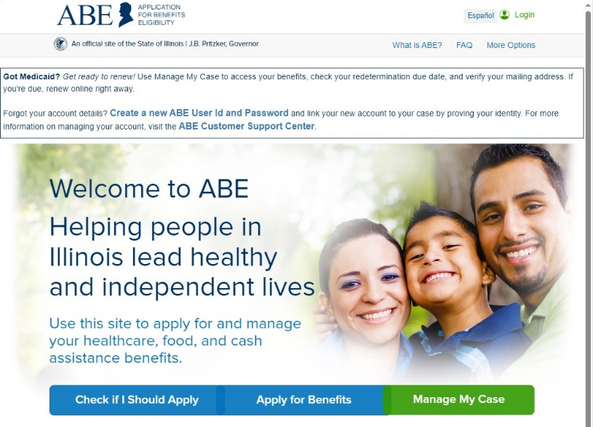
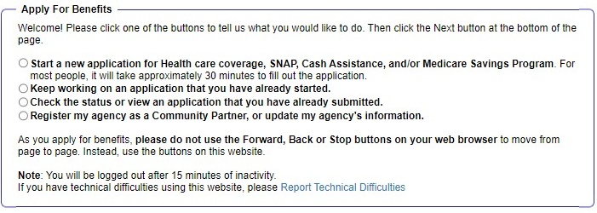
DHS programs – how to apply
2
1
Notes:
So let’s now review the actual application process. The first step is to go the application portal https://abe.illinois.gov/ and click on Apply for Benefits.
Click on the button for “Start a new application” and hit “Next”
What to bring: ID, SSNs for all household members, proof of immigration status, proof of income for last 30 days

Slide 13
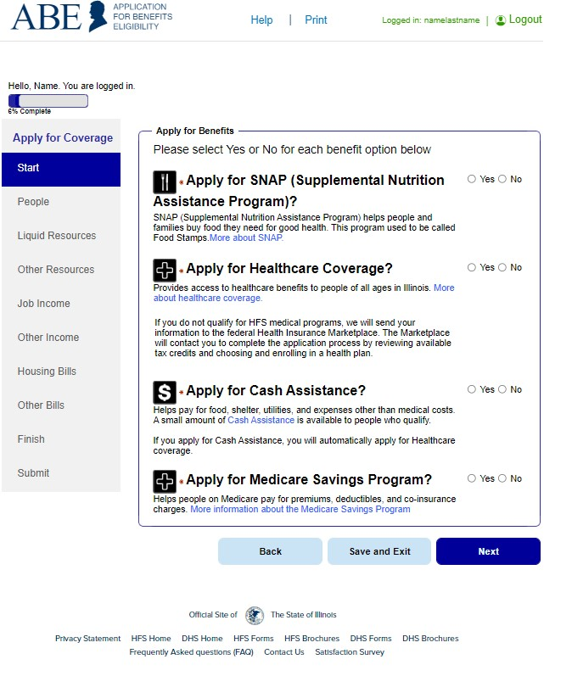
OVERVIEW OF APPLICATION
Shows the percentage of the application complete
These are the sections of the applications
How many people in the household, review of rights, who is filing app?
Who is in the home?
Assists, income recourses
Expenses
Review of answers
Submit application
Notes:
DHS asks a variety of questions
When applying for DHS benefits, you do not determine your eligibility, DHS does. DHS determines your eligibility based on the responses you provide in this application.
ABE will ask for several categories of information. The labels on the left navigation bar indicate the section you are visiting. A check mark will indicate the sections you have completed. A summary page displays at the end of each section you complete to allow you to review the information entered and make changes.
Applicants can save their data at any point and return to finish the application later. At the end of each data collection "module," the Applicant will review a summary of the information entered and have the opportunity to go back and make changes.
The following pages are just a sample of the types of questions included in ABE. We are unable to present every question in ABE but we are highlighting some key tips

Slide 14
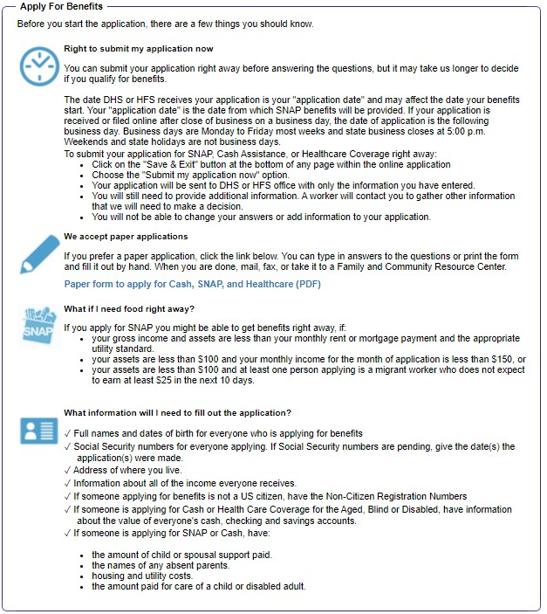
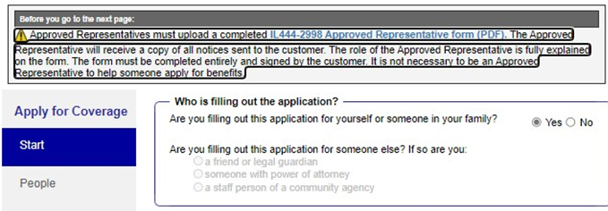
Who is submitting this application?
Indicate if someone is assisting with the application. If not, simply click "Next".
Notes:
If you are filling out the application for yourself or someone else in your family, pick Yes next to the Are you filling out this application for yourself or someone in your family? question. Click [Next]. If you are not filling out the application for yourself or someone in your family, pick NO and choose the option that best describes your role.
Assisting with an ABE application may require that Applicants share sensitive personal and health information. Before assisting someone with an ABE application, be sure to review your organization's policies and procedures related to privacy and handling of confidential information including personally identifiable information (PII) and protected health information (PHI). Community Partners are expected to uphold strict privacy and confidentiality standards.

Slide 15
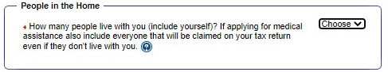
People in the home
Include everyone in the Household when applying for benefits.
Notes:
5. Enter the number of people in your home. Include everyone in the Household when applying for benefits.
People in Your Home
How many people live in your home?
DHS asks this question to help them figure out what kinds of help each person might be able to get. In general, please count everyone who lives in your home – and don’t forget to count yourself!
If applying for Healthcare Coverage, include people that live in your household AND include anyone you claim as a dependent on your federal tax return (even if they don't live with you).
If you are age 19 or over and only applying for Healthcare Coverage, always include yourself and your spouse and children if they live with you. ONLY include your parents and others in the household IF they will claim you or you will claim them on your taxes.

Slide 16
Selecting programs
Select yes for every program*
*Unless you do not want to apply or know you are ineligible. You can always cancel DHS benefits you do not want
Notes:
Select the checkbox next to all the benefits you or anyone else in your household is applying for on the Apply for Benefits page. Click [Next].
It is ok to select all of the programs if your are unsure that that you are eligible for a program.
There is no penalty for selecting a program for which DHS determines you ineligible. However, you must provide truthful information in the application so that DHS can calculate whether you qualify for the program.
ABE is a "smart" application. It will dynamically "build" the application based on the benefits requested and answers to application questions. If you opt out of programs in the beginning of the application, questions that assess for those programs will not smart populate and you will not be able to submit answers those questions.
Applicants can save an application in process and return to it later to complete and submit it. Unfortunately, once an application is submitted changes cannot be made through ABE. Instead, applicants should communicate changes to the office that is processing the application. This information can be found on the summary page of the ABE application.

Slide 17
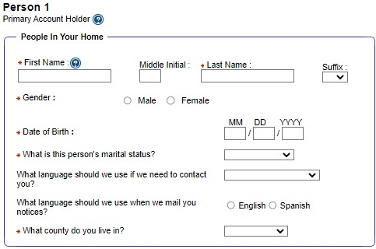
Personal information
Applicants will be asked identifying information. The red asterisks (*) indicate required information.
Notes:
To be treated as an application, all the form needs is your name and signature. You may submit an application for benefits with only your name, address and electronic signature (agreeing to benefit terms and entering your name in the signature section at the end of application). (Though practically, DHS also needs a way to contact you.)
You will be asked to provide information later so the state can process the application. Including as much information as possible when completing the ABE application will reduce the time it takes to approve your application.
In the People in Your Home section, enter information and answer the corresponding questions for each of the individuals included in the application, starting with Head of Household/Primary Account Holder.
Language The application will ask you if the State should mail notices to you in English or Spanish. English and Spanish.
If your primary language is not English or Spanish, enter what language you prefer and indicate that you need an interpreter in the “Comments” section.
Written notifications will be sent to you in English, but the State may be able to use an interpreter for other communications with you.
The process to access interpreters may vary by local office. It is best to note this as part of the application so appointments may be scheduled.

Slide 18
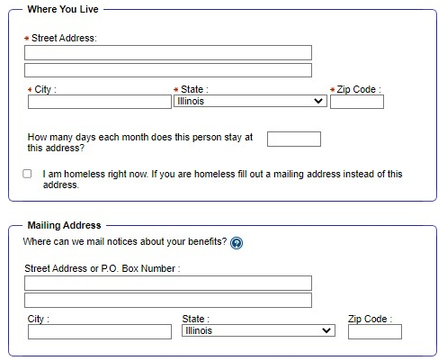
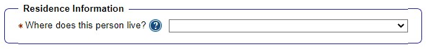
address
Check this box to indicate whether you are homeless and leave the address blank.
3
If you do not have a mailing address you can use the rule below to use your local FCRC.
WAG 06-04-03: Homeless Benefits
Mailing Address
Obtain approval of the LOA to use the Family Community Resource Center address for a customer with no permanent address.
Notes:
Indicate you are homeless by checking this box here
Who is homeless?
HOMELESS DEFINITIONS
PM 06-04-01: Definition of Homeless (Cash, Medical) WAG 06-04-01
A person is considered homeless if they lack a regular and adequate nighttime residence. A person whose residence is a public or privately operated temporary shelter is considered homeless.
PM 06-04-02: Definition of Homeless (SNAP) WAG 06-04-02
A person is considered homeless if they lack a fixed and regular nighttime residence or if their main nighttime residence is:
a supervised shelter that provides temporary accommodations; or
a halfway house or similar facility that provides temporary residence for persons intended to be institutionalized; or
a place not normally recognized as a place to sleep (a hallway, bus station, library, car, etc.); or
a temporary stay in the residence of another person. Persons are considered homeless for no more than 90 days when they are residing temporarily in the home of another person
If you do not have a mailing address you can use the rule below to use your local FCRC as your mailing address. Your DHS mail will be kept at your local FCRC. If you are using your local FCRC for your mailing address, you can also get new link cards issued on the spot.
WAG 06-04-03: Homeless Benefits
[Enter the address of your local FCRC in the Mailing address space

Slide 19
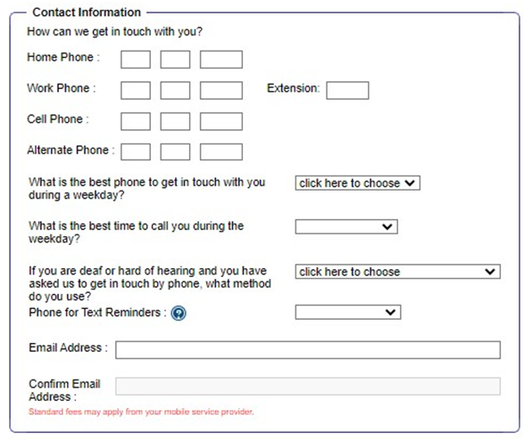
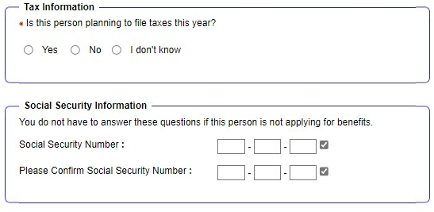
Contact information
Notes:
It is important to provide accurate contact information so that DHS can reach you.
If DHS cannot reach you to complete your interview, you made be denied benefits.
If you do not have a phone, applicants can go into their local FCRC and request their interview on the spot

Slide 20
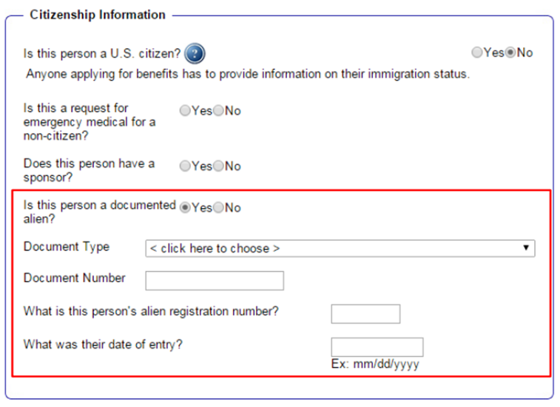
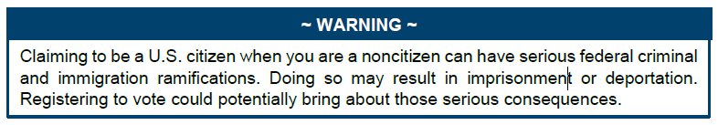
Citizenship
If you are not a U.S Citizen: Select NO
---
If you are a documented non-citizen, select YES
If you are undocumented select NO
(selecting NO does not automatically disqualify you from receiving benefits).
---
Select document type, ex:
  Permanent Resident (I-551)
  Arrival/Departure record (I-94)
For document number – enter the full number on the documentation you have, ex: Alien number, certificate of naturalization number, etc.
Upload the document at the end of the application when it asks for documentation under the citizenship tab if you are able to – this will speed up processing your application.
If you are a U.S Citizen: Select YES
Notes:
As you complete the People section of the application, you will be asked for the Social Security Number (SSN) and Citizenship status for each person.
While you are not required to give an SSN on ABE when you apply, most applicants will need to provide the SSN or proof that they applied for an SSN to receive benefits. Supplying a SSN with the application can reduce the time it takes to approve your application.
If you are a U.S Citizen select YES
If you are not a U.S Citizen select NO
If you are a documented non-citizen select YES, if you are undocumented select NO (selecting NO does not automatically disqualify you from receiving services).
Select document type, ex: Permanent Resident (I-551), Arrival/Departure record (I-94) • For document number – enter the full number on the documentation you have, ex: Alien number, certificate of naturalization number, etc. 14
Upload the document at the end of the application when it asks for documentation under the citizenship tab if you are able to – this will speed up processing your application.
• If you have a lawful immigration status or are a documented noncitizen, enter your USICS number (or A#) and document number.

Slide 21
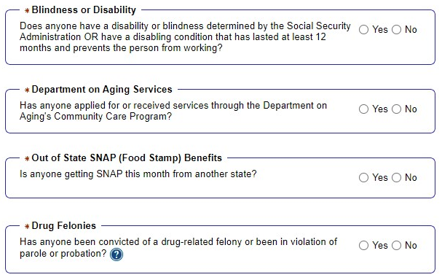
More about your household
Notes:
This page shows a question regarding AABD cash eligibility.
Out of state food stamps
To receive AABD cash benefits, a person who is age 65 or older must meet one of the following criteria:
receive SSI; or
be ineligible for SSI due to income; or
be a noncitizen who was legally residing in the U.S. on 08/22/96, and who was denied SSI due to a finding of "not disabled," and who meets the immigration requirements for medical assistance; or
be a noncitizen ineligible for SSI due to expiration of the federal 7-year limit.
To receive AABD cash benefits, a person who is under age 65 must meet one of the following criteria:
receive SSI or
be ineligible for SSI due to income and was found disabled; or
be a noncitizen ineligible for SSI due to expiration of the federal 7-year limit.

Slide 22
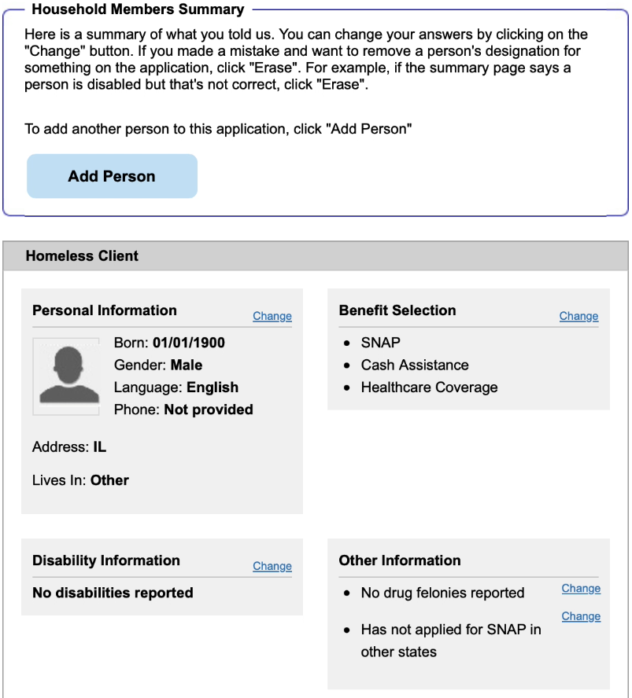
SUMmARY Review
At the end of each section, DHS gives you the opportunity review your answers.
If anything is wrong, click the button on the right side of the screen to fix it. Keep in mind that if you change an answer, you may be asked another question or two.
Notes:
7. Once you have answered the questions for all of the household members, click [Next] and the Household Summary page comes up. Review the information, check if it is correct, and make any changes. Once all information is correct, click [Next].

Slide 23
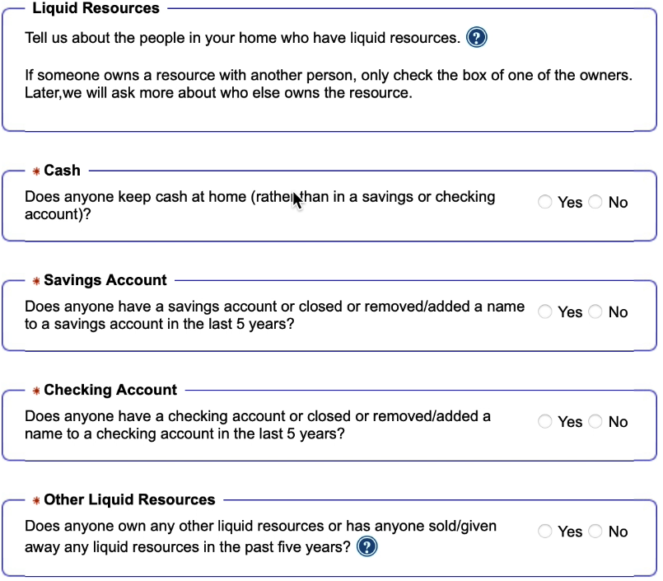
Liquid Resources
Depending on the benefits you applied for and your responses to earlier questions, you will be asked for information about your
resources (assets)
Be sure to include ALL income on the form. If you are applying for medical benefits only, for most people all that is considered is your monthly income. Assets are considered for some groups such as Seniors.
** For some programs, like SNAP, you must report resources but DHS doesn’t actually consider them when they determine whether you’re eligible.

Slide 24
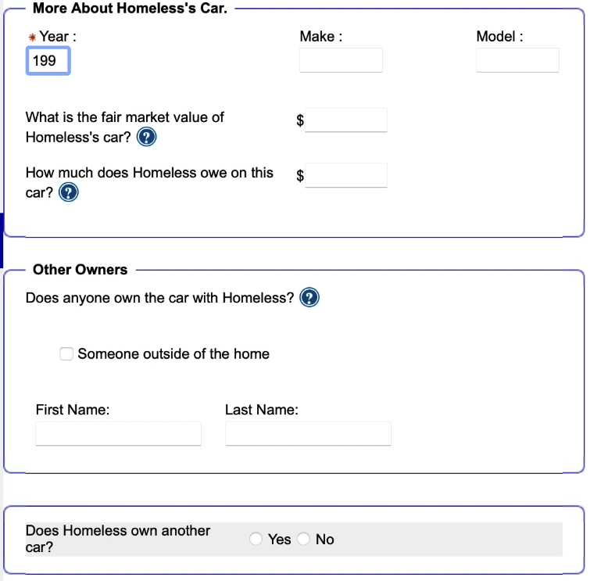
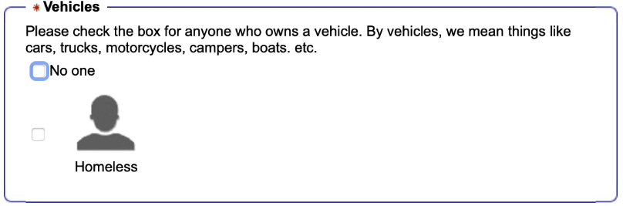
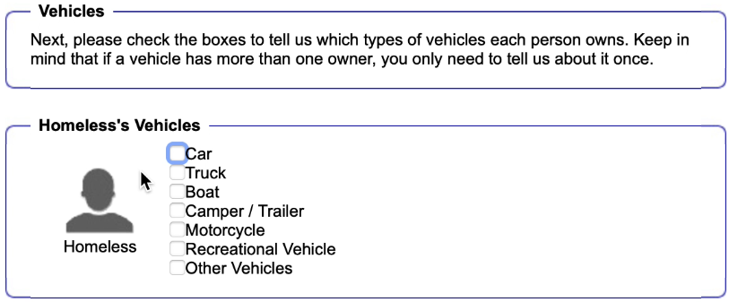
Other Resources
Notes:
Here is an example of the expanded questions if you select that you have a vehicle.
If you own more than one car or other vehicle, you should count any extra vehicles as assets. The cash value of the vehicle is the amount of money you would get if you sold it. If you owe money on the vehicle, you should only count any profit you would make from selling the vehicle.
(Also but not shown here) an important note about Life Insurance
Some kinds of life insurance may affect whether the elderly (65 or older), blind or disabled people in your home can get low- or no-cost health care.
If your life insurance is "term" insurance, it does not have a cash value. It will not affect whether you can get low- or no-cost health care. If your life insurance does NOT have a cash value, you don’t need to check the box.
If your life insurance is "whole life" insurance, it does have a cash value. This may affect whether you can get low- or no-cost health care. Keep in mind that there are many special rules about life insurance with a cash value. Even if you do have life insurance with a cash value, you may still be able to get Medicaid.

Slide 25
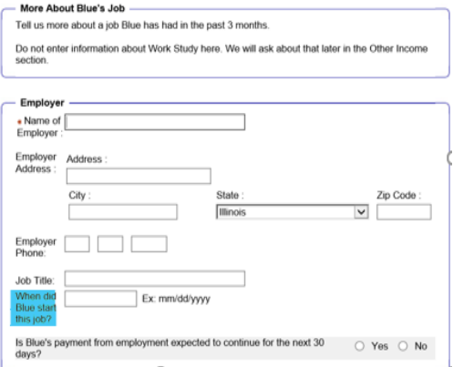
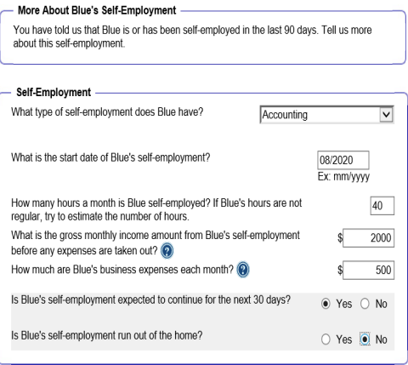
Income from employment
Notes:
The most important thing to keep in mind is that DHS needs to know the amount each person earns before any taxes or other deductions are taken out of their paycheck. This amount is called "gross pay".
When you take the next step and apply for benefits, you may need to provide proof of your income. If you don’t know the exact answer to a money question, give the best answer you can. Keep in mind that by giving us more accurate information, we can give you a more accurate answer.
If no one in your home gets money from a job right now, check the box for "No one."
Be sure to check the box if someone is self-employed. Self-employment is money you earn directly from your own business, rather than getting money by working for an employer.
A few notes for people who are self-employed:
If you have more than one kind of business, use different job lines to tell us about each business.
No matter how you report your self-employment income, enter the amount of income you will earn after subtracting business expenses but before taking out taxes, social security or other deductions.

Slide 26
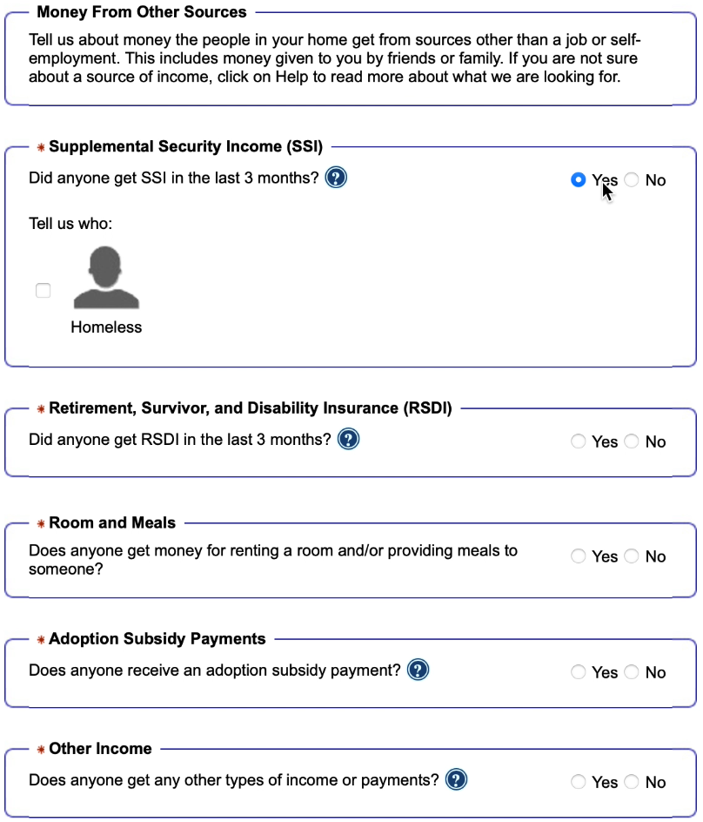
Other income
Supplemental Security Income (SSI) - SSI is a monthly payment for people with very low incomes who are at least 65 or blind or disabled. SSI is not a retirement benefit and it is not the same as Social Security.
Social Security - By Social Security, we mean retirement payments and some disability payments. Don’t include SSI income in this box.
Child Support - Child support is the money that you or your children receive from a parent who is not living in your home.
Unemployment payments - Unemployment payments are payments you may receive from the state if you have recently lost your job.
Other sources - Some examples are worker’s compensation, veteran’s benefits, pensions, tribal per capita payments.
Notes:
Supplemental Security Income (SSI) - SSI is a monthly payment for people with very low incomes who are at least 65 or blind or disabled. SSI is not a retirement benefit and it is not the same as Social Security.
Social Security - By Social Security, we mean retirement payments and some disability payments. Don’t include SSI income in this box.
Child Support - Child support is the money that you or your children receive from a parent who is not living in your home.
Unemployment payments - Unemployment payments are payments you may receive from the state if you have recently lost your job.
Other sources - Some examples are worker’s compensation, veteran’s benefits, pensions, tribal per capita payments. Some sources of money don’t count at all.
If someone receives income from one of these sources, you don’t have to tell us about it: Income from a loan.
One-time payments such as an income tax refund,
a one-time insurance settlement,
a security deposit refund, or
an emergency assistance payment.
Keep in mind that there are many other kinds of income that may not count. If you receive a type of income that isn’t listed here, it’s a good idea to ask your caseworker about it when you apply for benefits.

Slide 27
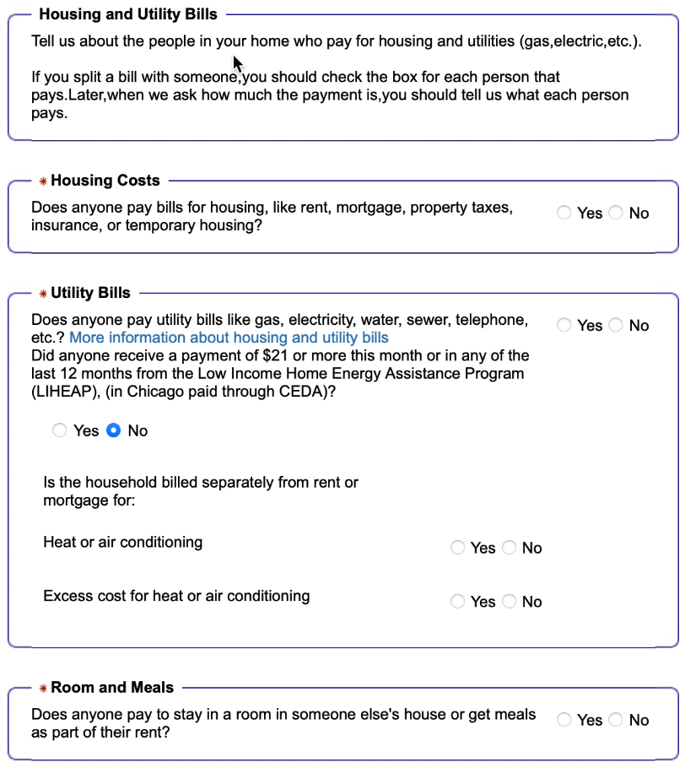
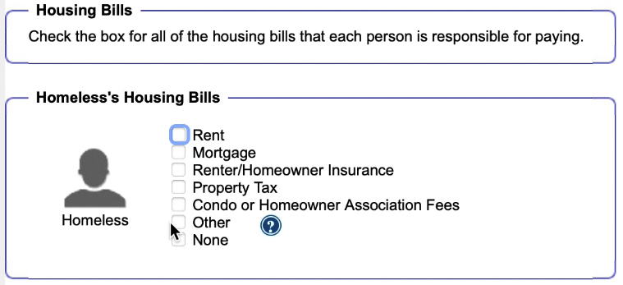
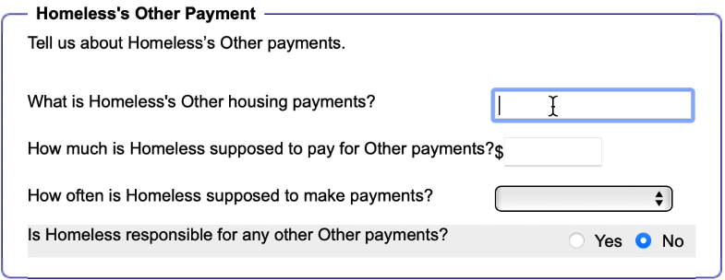
Housing bills
Notes:
Housing
If you are renting your home, answer the question by typing in the amount you and other adults in your home pay each month in rent.
If you live in a trailer, you should include lot rent as well as any rent or mortgage payment you make on your trailer.
If you own your home, answer the question by typing in the total amount you and other adults in your home pay each month for mortgage, property taxes, and home insurance. If you only pay property taxes and/or insurance, just include that amount.
Be sure to only count the amount that you actually pay for housing.
For example, if your rent amount is $600 but you get $400 in rental assistance, you should type in $200.

Slide 28
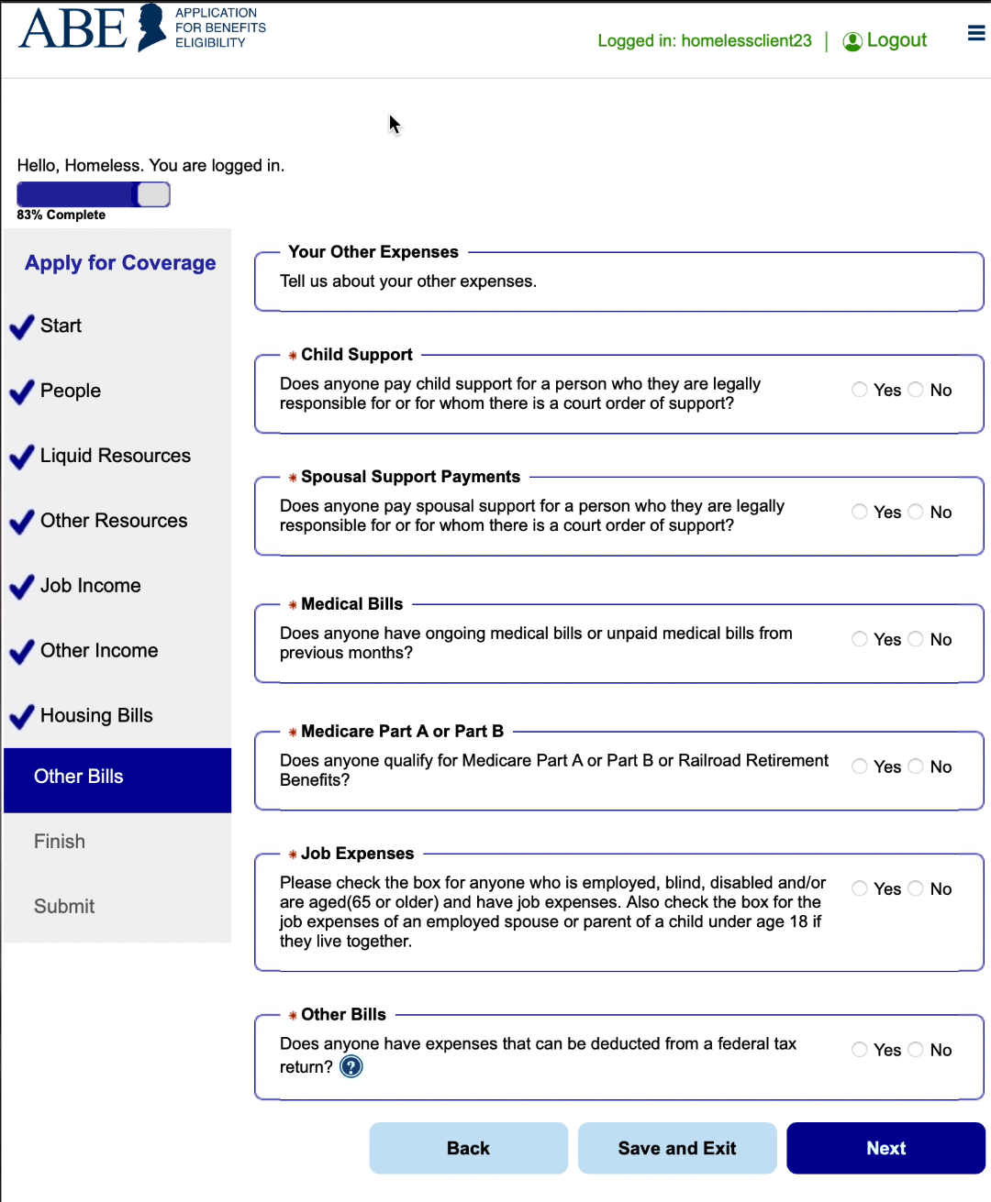
Other Bills
Notes:
Child Support Child support is money that a court has ordered you to pay to children who don’t live with you.
If your child support payments are taken out of your paycheck, tell us how much is taken out of your check each month.
If you give money to your children but it’s not ordered by a court, please don’t include it.
Keep in mind that we’re asking about child support that the adults in your home pay, NOT child support that you or your children receive from someone outside of your home.
Medicare Part A and Part B
for programs like MSP

Slide 29
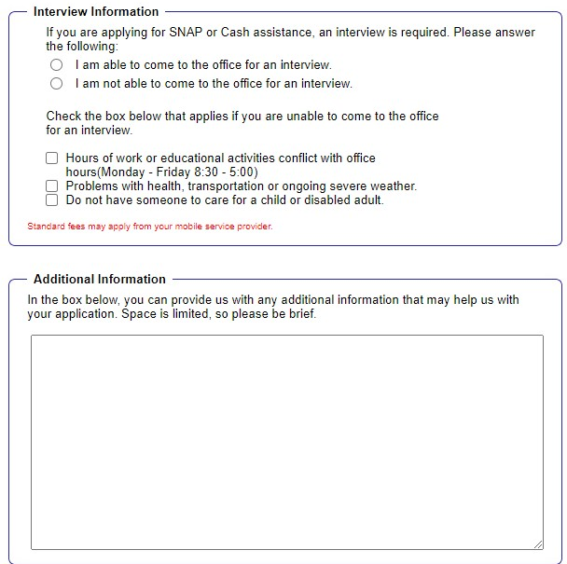
interview information
What are these blank white boxes for?
Notes:
If you are applying for SNAP or Cash Benefits, you will be asked about your availability to come into a local Family Community Resource Center (FCRC) to be interviewed or you may request a SNAP interview by phone
What are these blank white boxes for?
Here is an opportunity for you to add comments you would like the caseworker reviewing your application to see. What kind of things can you
That someone is homeless, and needing to use FCRC as address
if you need language assistance
.

Slide 30
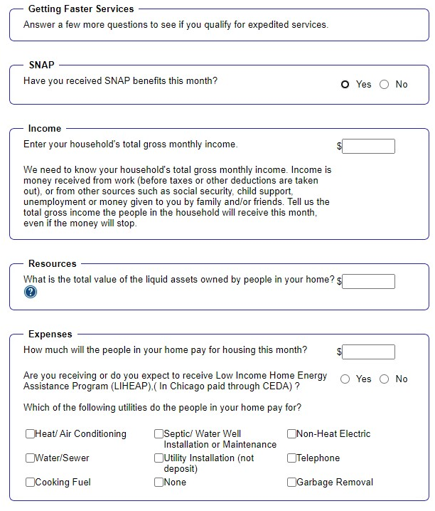
Getting Faster Services
PM 02-08-01: Who Can Get Expedited Service
Give SNAP applicants expedited service when:
the SNAP household's gross nonexempt income and liquid assets are less than their monthly rent or their mortgage payment and the appropriate utility standard; or
the SNAP household has liquid assets of $100 or less and gross monthly income for the month of application is less than $150; or
the SNAP household has liquid assets of $100 or less and at least one person applying is a migrant who is "out of funds."
Notes:
▪ If it looks like you may be eligible for Expedited SNAP benefits, you will be asked a few more questions.
PM 02-08-01: Who Can Get Expedited Service
Give SNAP applicants expedited service when:
the SNAP household's gross nonexempt income and liquid assets are less than their monthly rent or their mortgage payment and the appropriate utility standard; or
the SNAP household has liquid assets of $100 or less and gross monthly income for the month of application is less than $150; or
the SNAP household has liquid assets of $100 or less and at least one person applying is a migrant who is "out of funds.“

Slide 31
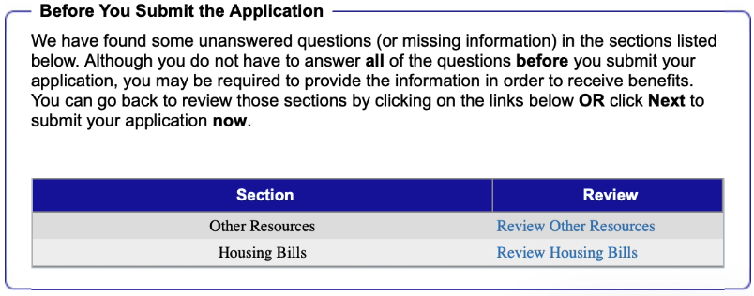
Before you submit your application

Slide 32
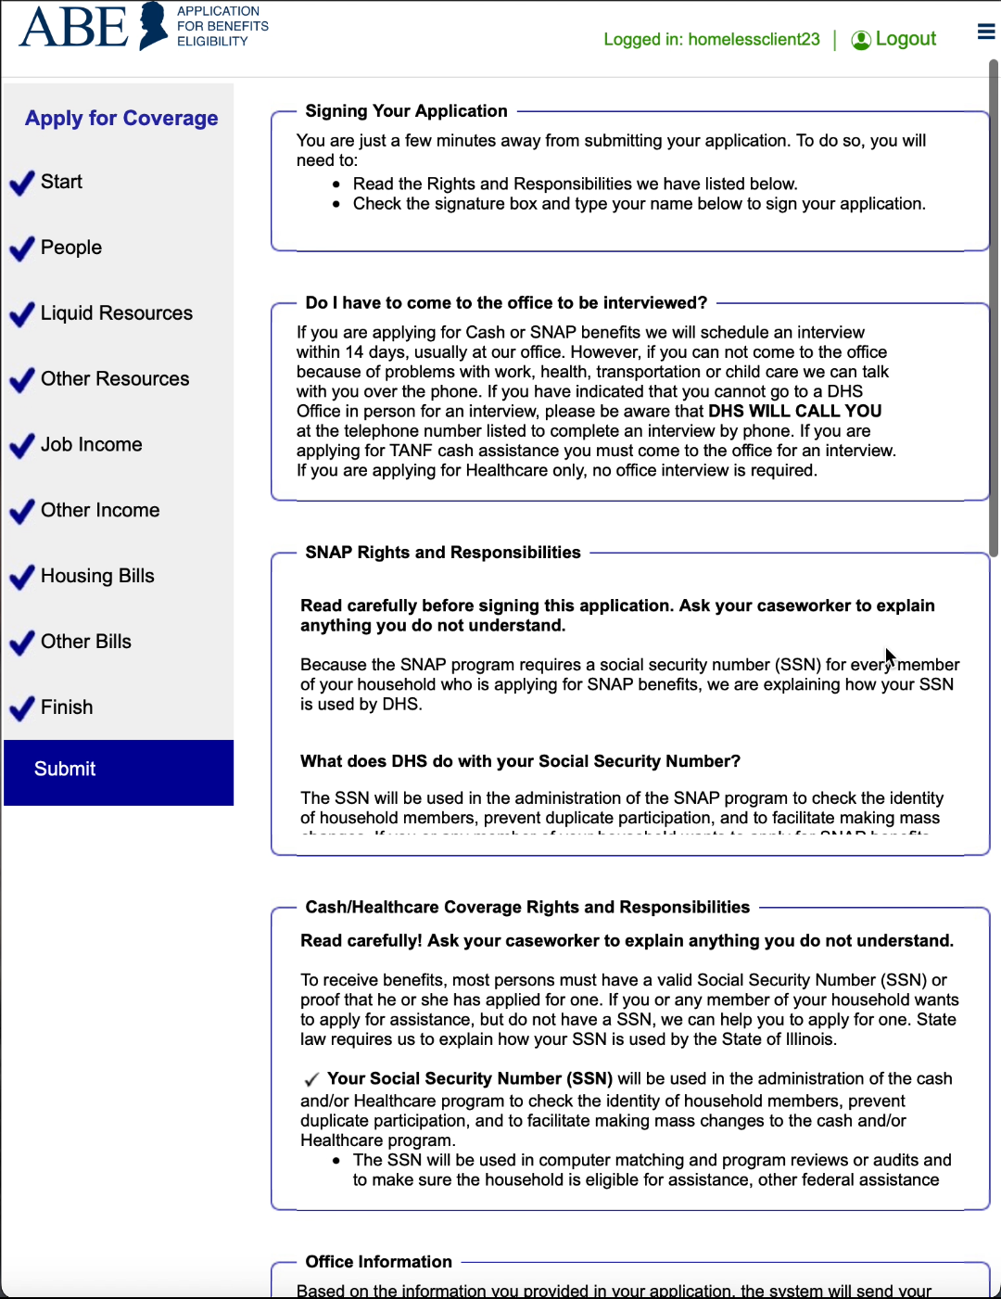
Submit
Notes:
When you’ve finished answering all of the questions, the Signing Your Application page displays. Take time to review the Rights and Responsibilities section. The office that will process your application will also show on this page This assignment is made based on your zip code and sometimes program requests. Unless the application is being sent to a special program office, you have the option to choose any office in the State using the Service Office drop-down list. If you apply for healthcare coverage only and are approved, your application will be sent to a different (central) office to maintain the case after it’s processed.

Slide 33
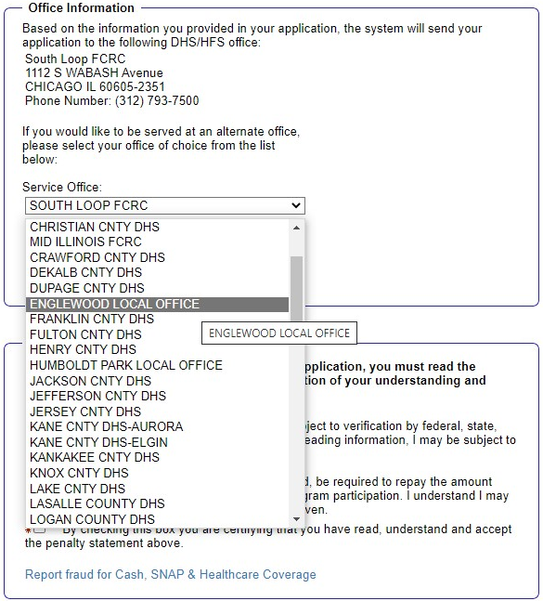
Submit

Slide 34
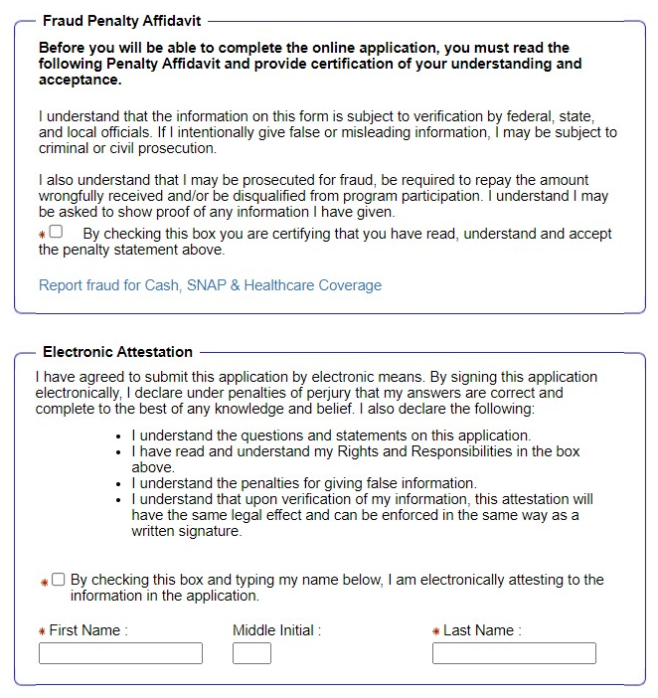
Submit
Notes:
12. At the bottom of the Signing Your Application page, read the Fraud Penalty Affidavit and acknowledge by selecting the checkbox. 13. Enter your First Name and Last Name in the fields and acknowledge the Electronic Attestation as your electronic signature by clicking the checkbox. Click [Submit]. 14. The submission of your application may take a few moments. Do not click the [Back] button or leave the page before your
The Applicant, not someone assisting with the application, should read and indicate understanding and acceptance of the Fraud Penalty Affidavit. receive a confirmation.

Slide 35
Print submitted page
When the application has been successfully submitted, an Application Summary page comes up with your Application Number.
You may also print a copy of the application by clicking the [Print My Application] button.
Notes:
15. When the application has been successfully submitted, an Application Summary page comes up with your Application Number. You may also print a copy of the application by clicking the [Print My Application] button. 16. Review the What’s Next Guide for helpful information, including communication time frames, and how to access new benefits. We recommend that you print this guide. 17. If you have “Proof” documents to submit with your application, click [Next]. Otherwise, click [Logout] to end your session.
After clicking "Submit," the Applicant will be given a tracking number and the option of printing a copy of the application. The Applicant can log out or upload verification documents by clicking "Next" from this page.
If an Applicant needs time to gather proof documents, he or she can log back into ABE to upload documents up until a caseworker begins processing the application. See page 32 of this Guide for instructions.
After completing questions and entering any changes orcomments, the customer clicks [Next]and the Final Stepspage displays.
The customer should keep the tracking number in case they need to speak with a Caseworker.
The customer should upload supporting documents.
Not uploading supporting documents could lead to delay or denial of benefits.

Slide 36
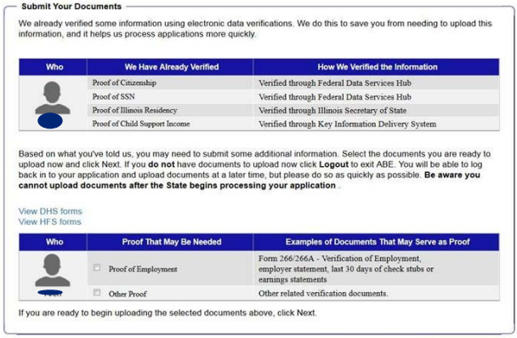
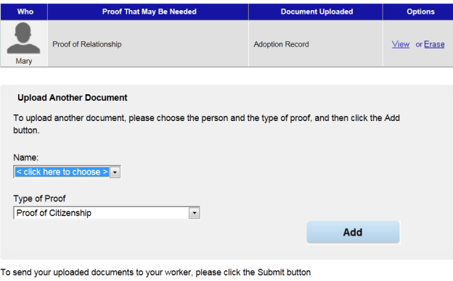
Upload required docs
Be sure to click the [Add] button and the [submit] button
Notes:
If you were able to complete the Identity Proofing process, after you submit your application, a page will display listing what was checked electronically and the documentation you may still need to provide.
Uploading Documents What documents do you need to upload with your application?
If you entered a valid Social Security Number (SSN) or immigration information, a lot of the information you entered in the application will be verified electronically.
If you did not complete the Identity Proofing process, a caseworker will verify your information using the same electronic data sources. We recommend uploading proof of expenses and recent paystubs showing the past 30 days, especially if you recently changed jobs.
From the Application Summary page, click [Next ] and the Submit Your Documents page displays.
Review the categories and types of proof documentation available. Be sure to label the documents correctly so they will not be missed by the Caseworker. Click [Next]
Select category(s) of documents you would like to submit. Click [Next].
Indicate the type of document you have, in this example, the category is Proof of Relationship and the document is an Adoption Record.
Choose the file from your computer using the [Browse] button. Indicate whether you have additional documents for this person in this category. Click [Next].
TIP: If you are planning to upload proof documents, upload them to the computer prior to beginning your Application
You can add up to 10 documents at a time. The largest possible size of each document is 2MB. Select the person on the application the document is associated with and the document category from the drop downs. Click [Add].
Once all of your documents are uploaded, click [Submit]. The documents are now available for caseworkers to review along with your application. 8. Be sure to Logout of ABE if you have finished. Once you have submitted an Application you can set up a Manage My Case Account in ABE. Refer to the Manage My Case Guide for more information

Slide 37
Questions?
Gwynne Mashon
gmashon@legalaidchicago.org
Beth Warner
bwarner@legalaidchicago.org
For technical assistance reach out to DHS
abe.questions@illinois.gov

