Slide 1
Maximizing Cash Benefits for People with Disabilities
Gwynne Kizer Mashon
Supervisory Attorney, Public Benefits Practice Group
gmashon@legalaidchicago.org
December 2023

Slide 2
Children & Families
Consumer
Legal Aid Chicago is a private non-profit that provides free civil legal services to people with limited income in Cook County, securing their rights to economic stability, affordable housing, personal safety, fair working conditions, and basic healthcare.
Criminal Records
Relief
Public Benefits
Long-Term Care
Immigrants & Workers’
Rights
Housing

Slide 3
What I hope you’ll learn
What federal and state benefits are designed to help people with severe disabilities?
How can you tell what benefits your client is getting?
How can you tell if there might be other benefits (or more benefits) that they’re not getting?
How does your client apply for benefits their not getting?
How can you increase cash benefits they are getting?
We will touch on but, because of time, will not discuss in detail…
What to do if Social Security reduces benefits because it says it overpaid you
How does working impact eligibility for (or monthly benefits for) state and federal cash programs, and what can you do to
Financial planning for individuals who do not meet the asset limit for SSI or AABD Cash
How to use the appeals process when SSA or DHS isn’t giving you all the benefits they should

Slide 4
Federal: Social Security
For most people who are too disabled to work, SSA income is the their primary income source. But many people do not actually understand what benefits they receive.
Understanding these benefits can help you maximize both federal and state cash benefits:
Are you maximizing the kinds of SSA benefits you receive?
Are you maximizing the amount of SSA benefits you receive?
Are you eligible for state cash benefits for people with disabilities?

Slide 5
“DISabled” according to Social Security
Unable to engage in substantial gainful employment
Most show they cannot work any jobs, not just the jobs they’ve held in the past
Diagnosis is not enough. Conditions must result in symptoms and limitations that prevent a person from working.
Evidence used: statements by the claimant and others who know the claimant; objective evidence documented in medical and other treatment records
Strongest evidence is medical records, objective testing, and doctor’s observations
If client declines a treatment because of side effects, or fear of side effects, or the inability to pay for or access a treatment, or some other legitimate reason, that needs to be documented by the medical provider; otherwise, SSA might decline the application
Must have lasted or be expected to last for at least 12 months
Social Security Disability
Certain Social Security Survivors Benefits
Supplemental Security Income (SSI)

Slide 6
Social Security Benefit for People with Disabilities | Who qualifies | Maximum (average) monthly benefit in 2023* | Common reasons gross benefits reduced | When paid?
Supplemental Security Income (SSI) | Has one ore more conditions that together prevent the person from engaging in “substantial gainful employment”, or is blind, or is over 65 years old; AND meets SSI income and asset caps | $914 ($657) | Other income Others paying for shelter and food Repayment Overpayment | 1st of the month
Disability | Has one or more conditions that together prevent the person from engaging in “substantial gainful employment” and has earned enough SSA work credits | $3,627 ($1,483)** | Miscalculation of benefits Early retirement Garnishment for federal debts (taxes, criminal restitution fees), overpayments, or student loans Child support or alimony Repayment of overpayment Family maximum for survivors Earned income | Some day other than the first of the month
Retirement | Is at least 62 years old and has earned enough SSA work credits [At 65 years old, Disability automatically converts to Retirement] | $4,555 ($1,827)**
Survivors of Workers | Certain surviving spouses and ex-spouses 60+, or 50+ if survivor is disabled and disabled before or within 7 years of worker’s death, or Any age if the widow or widower hasn’t remarried & caring for the deceased’s child who is < 16 receiving child’s benefits Adult children with disabilities: Children 20+ who Developed a disability before age 22 Have at least one parent who receives Social Security retirement benefits And, are unmarried | $4,555 ($1,704)**
* Most do not get the maximum amount. The reasons amount might be lower then the maximum
vary by benefit type. Maximums amounts for all benefits change every year.
** Actual benefit amount depends on work record of the worker who earned the benefit.

Slide 7
Julia
61 years old
Tells you she gets $436/month in SSI

Slide 8
What ssa benefit is it?
Ask if they have Medicare (“red, white, and blue” card.)
If they do AND if they are under 65 years old, then they are getting something other than SSI (but they might also be getting SSI)
Look at how much they get paid
Ask the client when they get paid
1st of the month = SSI
Any other day = Not SSI
If they get two checks, they have SSI and some other SSA benefits
SSI max ($914 in 2023): Most likely SSI
SSI max + $20 ($934 in 2023): Most likely SSI and something else
> SSI max + $20 ($934 in 2023): Something other than SSI
< SSI max ($914 in 2023): You will need to do more investigation – Likely is eligible for additional benefits!
Look at the client’s SSA award letter.
Sometimes, the letter will state what benefit the person is getting. Examples on the following slides…

Slide 9
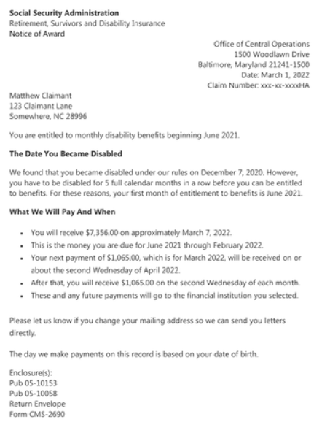
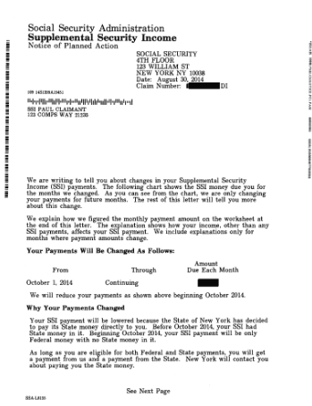
What ssa benefit is it?
This is not SSI
This is SSI

Slide 10
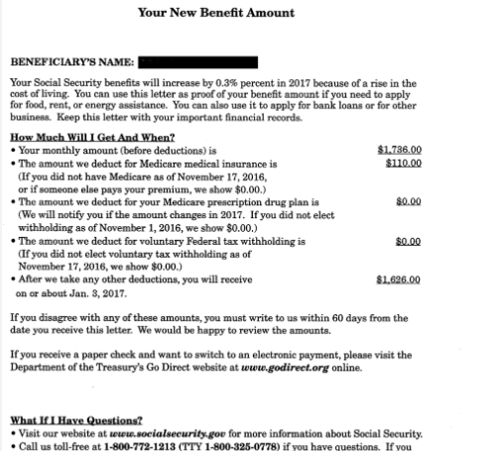
What ssa benefit is it?
Gross SSA income; Not SSI
Medicare Part B monthly Premium Deducted
Net income client receives in their account

Slide 11
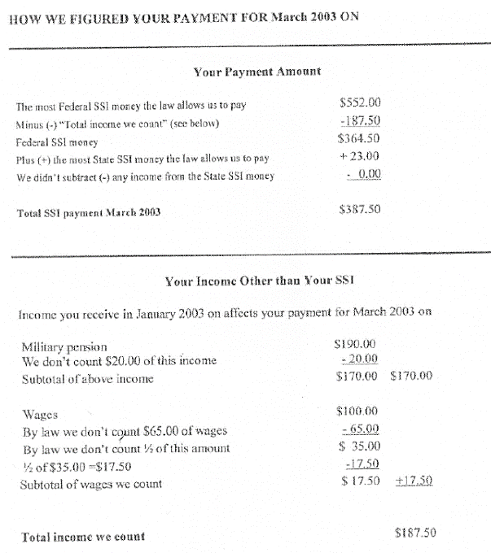
What ssa benefit is it?
SSI maximum (note this is from 2003)
Net SSI income
Non-SSI income SSA thinks the recipient receives

Slide 12
Julia
61 years old
Tells you she gets $436/month in SSI
Look at what she’s getting
Less than SSI maximum of $914
Could be reduced SSI or something else
When is she paid?
3rd of the month
Not SSI
Does she have Medicare?
Yes. Note she is under 65 years old.
Julie has SSA Disability (SSDI)
Look at her SSA award letter
Only deduction is for Medicare premium
Julie’s SSDI is not being garnished

Slide 13
Social Security Benefit for People with Disabilities | Maximum (average) monthly benefit in 2023* | How income might make someone ineligible or reduce monthly benefits. NOTE: Rules around what work counts, what income counts, etc. are more complicated than they appear here. If someone is earning over the limits above, they might want to discuss their case with someone with expertise in SSA rules. | Other common reasons gross benefits reduced
Supplemental Security Income (SSI) | $914 ($657) | Both earned and unearned income can reduce monthly benefits. If you earn enough money from certain kinds of work, SSA might determine you are no longer disabled. | Others paying for shelter and food Repayment Overpayment Deemed income
Disability | $3,627 ($1,483) | Earned income: Monthly benefits are not reduced, but if you earn enough money for enough months, SSA might determine you are not longer disabled SSA has work incentives and the Ticket to Work program. Make sure you understand all requirements and document your compliance with these programs if you participate. Unearned income: no effect | Miscalculation of benefits Early retirement Garnishment for federal debts (taxes, criminal restitution fees), overpayments, or student loans Garnishment for child support or alimony Repayment of overpayment
Retirement | $4,555 ($1,827) | Earned income: No limit on earned or unearned income if you’ve reached full retirement age (In December 2023, that includes everyone born in 1957 or earlier). If not a full retirement age, benefits decreased if you earn over a certain amount. Unearned income has no effect.
Survivors of Workers | $4,555 ($1,704)

Slide 14
Maximizing SSA benefits
Overpayments:
SSA miscalculations, mischaracterizations
Appeal SSA decisions. I recommend consulting someone with expertise in SSA rules for these situations.
Appeal the overpayment (if SSA is wrong)
Request a Waiver (waives overpayment even if recipient was overpaid)
Non-SSI income less than the SSI maximum + $20
Apply for SSI (NOTE: You cannot apply online!)
If ineligible for SSI because of assets, consider financial planning to reduce countable assets
SSI reduced because someone else is paying for shelter & food
SSI recipient can start paying some money for rent – best to have a written contract to prove they are a boarder and report that expense to SSA
Overpayment repayment plan (doesn’t change overpayment but can spread payments out to reduce monthly deduction.)

Slide 15
Julia
61 years old
Tells you she gets $436/month in SSI
You determined that’s NOT SSI. She’s getting Social Security Disability. You also determine that her gross income is actually $600/month but $165/month is deducted for Medicare Premiums.
You help her apply for SSI. (NOTE that you do NOT need to do a SOAR application because SSA already decided Julia is disabled.)
After her application is approved,
Julia’s net income is increased to $796/month ($934/month gross)

Slide 16
Barb
40 years old
Tells you they gets $1200/month in SSI
To make sure Barb is getting all the benefits they can from Social Security, Barb can:
Review their award letter – esp. the last pages where there might be calculations – to see if there are deductions that shouldn’t be there
Review their Social Security statement to make sure SSA is using all of their work history to calculate their monthly benefit.
Look at what she’s getting
More than SSI maximum+$20 of $934
Social Security Disability

Slide 17
James
80 years old
Tells you he gets $633/month in SSI
Look at what he’s getting
Less than SSI maximum of $914
Could be reduced SSI or something else
When is he paid?
1st of the month
SSI
Look at his SSA award letter
Deduction for in-kind support and maintenance because he lives with daughter and does not contribute to rent or food

Slide 18
James
80 years old
Tells you he gets $633/month in SSI
James’s daughter could start charging James rent to live in her home. If she did, then:
SSA would no longer reduce James’s SSI; assuming there’s no other deductions, he would receive the SSI maximum ($914 in 2023)
The rent paid might count as income for James’s daughter. This might impact her tax liabilities, as well as her and her family’s eligibility for benefits, if they receive any.

Slide 19
George
35 years old
Tells you he gets $500/month in SSI
Look at what he’s getting
Less than SSI maximum of $914
Could be reduced SSI or something else
When is he paid?
3rd of the month
Not SSI
Does she have Medicare?
No.
Unclear
Look at his SSA award letter
Deduction for child support
George has SSDI

Slide 20
George
35 years old
Tells you he gets $500/month in SSI
You determined that’s NOT SSI. He’s getting Social Security Disability. You also determine that his gross income is actually $1200/month but $700/month is deducted for child support.
Because of gross SSDI income, George is over-income for SSI.
Unless George can do something about the underlying child support obligation, there is nothing he can do to increase FEDERAL disability income.
He might consider talking to a family law attorney about the child support obligation.

Slide 21
Aaron and Chrissy
Aaron and Chrissy just got married. Both are 55 years old.
Before marriage:
Aaron received $914/month in SSA benefits
Chrissy received $1100/month in SSA benefits
After marriage, Aaron’s benefits were reduced to $257/month.
So, what happened?
Once they got married, SSA treated part of Chrissy’s income as available to Aaron, reducing his monthly SSI benefit.
Look at what they’re getting
Aaron had SSI max
Chrissy had more than SSI max + $20
Aaron has SSI and Chrissy has Social Security Disability

Slide 22
Other federal disability benefits
VETERANS
VA service-connection: Monthly cash benefit for certain veterans to compensate for current physical and/or mental conditions that were caused or exacerbated during military service
VA pension: Monthly cash benefit for certain veterans who have low-incomes, few assets, and are either totally disabled or over 65 years old
RAILROAD WORKERS
Railroad: Similar to Social Security Disability/Retirement for railroad workers who are totally disabled, occupationally disabled or over 65 years old.
*** Before receiving SSI, someone must maximize all other income sources.

Slide 23
State cash benefits from IL Department of human services
Cash Assistance for Elderly and People with Disabilities
Cash Assistance for Non-Citizen Victims of Trafficking, Torture, or Other Serious Crimes
Cash Assistance for Low-Income Families
AABD Cash
Cash assistance benefit for low-income Illinois residents with severe disabilities and those over 65 years old (no disability required.)
Benefits are usually issued on a LINK card, but can be paid via Direct Deposit.
Payment via Direct Deposit might be more beneficial for some clients because funds in bank accounts have higher levels of protection than funds on LINK cards.

Slide 24
Who might be eligible for aabd cash?
Applicant must meet the SSA’s definition of aged, blind, or disabled
AND one of the following:
Receiving SSI
“Over-Income” for SSI
Have become ineligible for SSI when a period of eligibility based on refugee/asylee status expired. (Rules for this category are different and will not be discussed today. See PM 11-04-00.)
Be a noncitizen over 65 years old who was legally residing in the U.S. on 08/22/96, and who was denied SSI due to a finding of "not disabled," and who meets the immigration requirements for AABD medical assistance
DHS must determine if the application meets the “aged, blind, disabled” requirement only when SSA declined an application based on income and did not make a disability determination. This is most likely where someone is over-income for SSI but ineligible for Title II disability benefits.
In some situations, even people with very low amounts of Title II income are over-income for SSI.
In both of these situations, because applicants are required to “avail themselves of all potential income”, if client is not receiving SSI and has income under the SSI max + $20, they will need to prove that SSA found them over-income for SSI.
PM 11-01-00: Categories of eligibility for AABD Cash
PM 01-02-03: Clients must apply for and receive any other financial benefits that they may qualify for.

Slide 25
Other requirements
Countable assets must be under the AABD Cash asset limit:
Applicant must maximize all other potential income sources
In some cases, this means the applicant must apply for SSI before then can qualify.
PM 07-02-01: Asset Limits
PM 07-02-01-a: Whose assets count
PM 07-02-00: What assets count
1 person | 2 people | Additional people
$ 2,000 | $ 3,000 | Add $ 50 for each add'l

Slide 26
Financial eligibility: Budgeting
Budgeting is the method by which non-exempt income is compared to the AABD Cash Standard (“Allowances”) to determine the amount of the monthly assistance payment for the assistance unit.
If monthly assistance payment < $1, then ineligible for AABD Cash benefits.
Unearned income
+ Earned income
minus generous disregards for work-related expenses
+ Income deemed to applicant
if they live with a spouse or parent who has large enough income
- Exempt Income
e.g. income used to pay court-ordered child support, or Social Security overpayments
- Income diverted from applicant
if they live with a spouse or minor child who has little or no income
- Deductions
______________________________________________
Countable Income
Food
Clothing
Housing Supplies
Laundry
Personal Essentials
Phone
Rent/Mortgage
Utilities
AABD Cash Standard
- Countable Income
Monthly assistance payment
Fun fact
Most of the dollar amounts for these allowances haven’t been updated since the 1980s!

Slide 27
Financial eligibility: cash standard
Some special rules for allowances that can have a big impact:
Restaurant Meals
$102.63 food allowance (replaces standard food allowance; $63.95 net increase for individual in separate household without a prescribed diet)
Need to prove:
Therapeutic Diet
Up to $17.82 food allowance in addition to the standard food allowance
Must submit evidence that doctor has prescribed the diet.
Excess Shelter Allowance
Additional allowance on top of the standard shelter allowance equal to the difference between actual rent paid and the standard shelter allowance.
Must submit form signed by doctor stating that the client has conditions that prevent then from navigating stairs (and proof that no suitable housing is available for $97/month, if on appeal.)
Has no facilities for preparing food OR
Is unable to cook and has no one who will prepare their meals.
Appears as a separate allowance in the notice
Included in food allowance in the notice
Appears as a separate allowance in the notice
PM 11-01-01-a: Restaurant Meals & Therapeutic Diet Allowances
PM 11-01-02-b: Excess Shelter Allowances; Ill. Admin. Code tit. 89, § 113.308

Slide 28
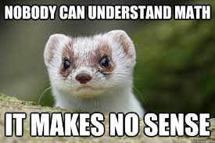
Reviewing the notice
Common allowance errors to look for:
Are all allowance categories included?
Are they related to the correct months?
Unless a third party is paying for utilities, are all allowances for utilities included either as separate line items or are they included in rent?
If someone lives alone, Rent/Shelter allowance will equal $97-125 regardless of how much a person pays for rent. (This is prorated if they live with other people.)
If the person has a disability that prevents them from using stairs, there should be an “excess shelter” allowance.
If the person has no kitchen, OR is unable to prepare their own food and has no one to do it for them, they should get a “restaurant meals” allowance.
NOTE:
Unfortunately, under state law, people who are street homeless are unlikely to qualify for significant amounts of AABD Cash unless their income is lower than the SSI maximum or if they have a dependent child or spouse.

Slide 29
James
James took your advice. He’s now paying $300/month for rent to his daughter. Social Security increased his SSI benefits to $914.
You suggest James should apply for AABD Cash. But he says he applied before. He doesn’t think he’ll qualify because he’s earning even more money now.
But you know… When James applied before, IDHS treated him as living in a “shared household” and with no rental costs.
You learn James:
Pays $300/month rent
Pays $40/month for phone service
Has no countable assets
You encourage him to apply again.
DHS approves his application and awards him $92/month in AABD Cash.
Altogether, you helped James increase his monthly income by $373/month!

Slide 30
George
You already helped George figure out that he’s getting Social Security Disability of $1,200/month.
Because of court-ordered child support, he’s only receiving $500/month from Social Security each month.
You learn George:
Pays $170/month rent
Pays $40/month for phone service
no countable assets
If George applies for AABD Cash, he will likely be eligible for:
$505/month
That would increase his total monthly net income to: $1,005/month

Slide 31
Barb
You already helped Barb determine that the $1,200 they receive each month is Social Security Disability benefits.
You also learn Barb:
Pays $800/month rent (all utilities included in rent)
Pays $40/month for phone service
no countable assets
Is prescribed to use a wheelchair because of medical conditions
If Barb applies for AABD Cash, the could be eligible for about:
$440/month
That would increase their total monthly net income to: $1,640/month!

Slide 32
Aaron and Chrissy
We learned there was nothing we could do to help the newlyweds increase their SSA benefits. You advise them to give AABD Cash a shot.
You learn:
Aaron receives $257 in SSI benefits
Chrissy received $1100/month in SSDI benefits
They live in a home Chrissy inherited and only have to pay property taxes and homeowners insurance. Together, that averages $600/month.
Chrissy and Aaron should BOTH apply for AABD Cash. If they do, then IDHS would likely find that:
Chrissy is financially ineligible for AABD Cash.
Aaron is eligible for $429/month in AABD Cash.

Slide 33
Felix
Receives $914/month in SSI
Has no dependents
Recently street homeless and is now staying in an emergency shelter while you are working on connecting him to permanent supportive housing.
Has a free “government phone”
Unfortunately, because of how AABD Cash is calculated, Felix is most likely ineligible for AABD Cash because the sum of his AABD Cash allowances would be less than his income.
But wait… you connected him to housing! Felix will pay 1/3 of his income (about $300/month) toward his rent.
If Felix applies for AABD Cash after he starts paying rent, he could be eligible for about $35/month in AABD Cash. Or, if he has a condition that prevents him from using stairs, about $235/month.

Slide 34
Julia
You have already helped Julia increase Social Security income to $796/month ($934/month gross)
You also learn Julia:
Pays $400/month rent (all utilities included in rent)
Pays $40/month for phone service
no countable assets
Has some back and knee problems but doesn’t think it interferes with her ability to use stairs.
You helped Julia apply for AABD Cash, but DHS denied her application. After reviewing the notice of decision with your friendly neighborhood legal aid attorney, you learn that the denial is most likely correct.
Is there anything else you can do to help Julia?
YES!

Slide 35
Help paying medicare costs
EXTRA HELP
Apply through the Social Security Administration
Starting in January 2024, everyone who has Extra Help will get the same benefits
Asset limits (2023): $16,600 (single); $33,240 (married)
Income limits (2023): $12,870 (single); $29,580 (married)
$0 Premium and $0 Deductible
Low out-of-pocket costs for prescription drugs
Waiver of late enrollment penalties while on Extra Help
MEDICARE SAVINGS PLANS
Apply through the Illinois Department of Human Services
Asset limits (2023): $7,080 (single); $10,620 (2 people)
Income limits:
Automatic enrollment in Extra Help
QMB: $1,215 (single); $1,639 (2 people)
Other MSP: $1,639 (single); $2,218 (2 people)
Benefits:
State pays Part B Premiums
For QMB Only: State pays Part A Premiums, assistance with Co-pays, Balance Billing Protections
State pays any late enrollment penalties associated with premiums it is paying
All except QMB: Up to three months retroactive benefits

Slide 36
Julia
After apply for the IDHS Medicare Savings Program, the state of Illinois starts paying Julia’s monthly Medicare premiums.
Julia will see a $164 increase in her monthly Social Security benefits.
Thanks to your help,
Julia is now receiving $934/month in SSA benefits (that’s almost $500 more than she was getting before she met you.)
Also – if Julia’s knee or back conditions get worse, so that she can no longer navigate stairs, she can apply for AABD Cash again and might be eligible for another $250/month in AABD Cash benefits.

Slide 37
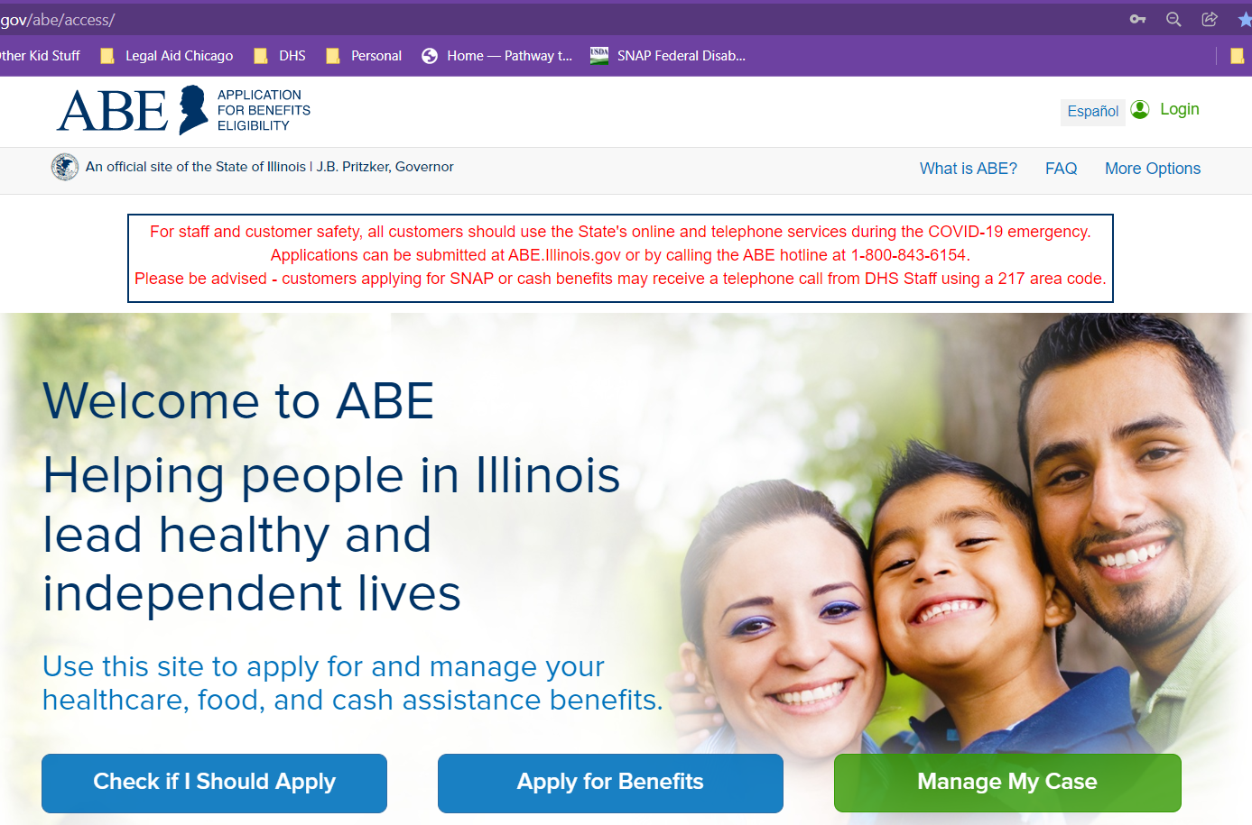
DHS programs – how to apply
Apply online on ABE: https://abe.Illinois.gov
Apply at Local IDHS Office. “Family Community Resource Center” locator at: http://www.dhs.state.il.us/page.aspx?module=12
What to bring: ID, SSNs for all household members, proof of immigration status, proof of income for last 30 days
Legal Aid Chicago PBOE referrals– more on this later
To be treated as an application, all the form needs is your name and signature. (Though practically, DHS also needs a way to contact you.)

Slide 38
Questions?
Gwynne Mashon
gmashon@legalaidchicago.org

Slide 39
College students
Financial assistance is excluded from income and resources including Pell grants, federal education loans and work study programs.
Income from a paid internship likely would count as earned income under both SSI and SSDI rules
Another consideration is whether SSA would consider recipient no longer disabled

Slide 40
Other resources
Some people asked about other resources like help paying for utilities and phone, or help with housing.
That question is outside of the scope of this training and my expertise. If there’s time, we will open the floor to others.

