Slide 1
Medicaid in a Post Pandemic World
Gwynne Kizer Mashon
Supervisory Attorney, Public Benefits Practice Group
gmashon@legalaidchicago.org
October 2023

Slide 2
Children & Families
Consumer
Legal Aid Chicago is a private non-profit that provides free civil legal services to people with limited income* in Cook County, securing their rights to economic stability, affordable housing, personal safety, fair working conditions, and basic healthcare.
Criminal Records
Relief
Public Benefits
Long-Term Care
* No financial eligibility requirements for seniors or victims of domestic or sexual violence; higher income limits for certain populations or legal issues, including veterans, people living with HIV, and others.
Immigrants & Workers’
Rights
Housing

Slide 3
My goal is help You HELP Your clients overcome these barriers:
By the end of this training, I hope you can answer these questions:
What changes are happening to Medicaid this year?
How can I help my clients handle common problems related to end of pandemic protections?

Slide 4
End of pandemic protections for Medicaid
Medicaid is a joint federal-state programs.
During the pandemic, the federal government let each state give recipients extra benefits and greater flexibility so low-income families could afford medical care during the pandemic. Many of these protections and flexibilities are ending soon.
But there are things your clients can do to protect their benefits!

Slide 5
Medicaid
Redeterminations Resuming
During the pandemic, Illinois was not supposed to terminate Medicaid benefits unless someone died or asked for the benefits to stop.
For people in Medicaid Spend-down, if they met one month of Spenddown during the pandemic, they kept Medicaid coverage without having to meet the Spenddown again.
In mid-2023, redeterminations resumed
SNAP beneficiaries are renewed when they go through the SNAP redetermination process
30-40% of Medicaid recipients are renewed ex parte
Date of renewal will be their “regular” renewal date
Redetermination Application/Verification checklist
Notice of Decision
Source: Illinois HFS

Slide 6
Medicaid
Resource Limit Resuming for Aged Blind and Disabled Medicaid
During the pandemic, Illinois did not consider someone’s resources when determining eligibility for any Medicaid or Medicare Savings Program benefit
In May, “regular” resource limits resumed
What is the resource limit?
$17,500 (note that this is significantly higher than the resource limit pre-pandemic)
Does the resource limit apply to all Medicaid programs?
NO! The asset limit only applies to people in certain programs – those designed to meet the needs of the elderly and people with disabilities, as well as immigrants who don’t qualify for federally-funded Medicaid programs
What can I do to keep Medicaid coverage is I have countable resources over the resource limit?
Spend-Down Medicaid
Convert countable resources into exempt resources
Spend-Down resources on other expenses – but be careful if you might need nursing home care in the next five years

Slide 7
What is Illinois Medicaid?
IL Medicaid
Aged, Blind and Disabled
MAGI
State-funded benefits to certain immigrants
People 65+, people receiving Social Security benefits
Adults who do not fit into other categories
Children up to age 19
Pregnant Women (up to 12 months after birth)
Non-Citizen Victims of Trafficking Abuse and Other Serious Crimes
Immigrants 65+
Immigrants 42+
Partial Medicaid
Medicaid Presumptive Eligibility (Pregnancy)
Emergency Medical for non-citizens
Long-Term Care
Family Planning
And others
Nursing Home Care
Home & Community Based Services (Waiver Programs)
We will not cover theses or other programs in today’s training

Slide 8
Aged Blind and disabled
Who?
Receiving Social Security or Railroad benefits based on disability or blindness, or
Denied Social Security benefits based on income but otherwise meeting Social Security’s definition for disability or blindness, or
Over 65 years old
Income Limit* 100% FPL (2023 limits below)
1 | $1,215
2 | $1,643
4 | $2,500
Citizenship/Immigration
US Citizens
Refugees, Asylees
Legal Permanent Residents (5 year wait)
VAWA applicants (5 year wait)
Some immigrants from Cuba, Haiti, Vietnam, Iraq, and Afghanistan
Others listed in IDHS PM 03-01-02
Asset Limit*
1 | $17,500
2 | $17,500
4 | $17,500
Household
Applicant, their spouse, and dependent minor children who live together

Slide 9
Aged Blind and disabled income/assets
Income Limit* 100% FPL (2023 limits below)
1 | $1,215
2 | $1,643
4 | $2,500
Common Exceptions:
Self-Employment expenses
Reasonable and necessary rental expenses
Certain deductions from earned income
SSI lump sum payments
Income In-Kind
Can “spend-down” if over income
Asset Limit*
1 | $17,500
2 | $17,500
4 | $17,500
Common Exceptions:
Homestead property
Vehicle if needed for employment, medical transportation, or transportation for daily essentials
Personal effects and household goods of less than $2000
Wedding and engagement rings
Can “spend-down” if over asset

Slide 10
Aged Blind and disabled Spenddown
If someone meets other requirements for Aged, Blind, Disabled Medicaid but is over-income and/or over-asset, they cay “spenddown” the amount they are over-income or over-asset. Medicaid enrollment begins on the day the spenddown is met.
Spenddown Amount = Amount the person is over-income or over-asset. Spenddown is met by providing medical bills or receipts for eligible medical expenses to the FCRC equal to the monthly spenddown amount (unless in Pay-in Spenddown).
Can include medical bills received within the last six months.
Bills can only be used to meet Spenddown once.
Bills do not have to be paid but Medicaid will not cover bills used to meet Spenddown.
Common Expenses used to meet Spenddown
Medicare or medical insurance premiums
Deductibles, coinsurances or copayments
Medical transportation (24 cents/mile in their own car or actual costs of other forms of transportation)
Over the counter drugs or items, if prescribed by a physician

Slide 11
MAGI (1) Adults
Who?
Adults 18-64 years old and
Not receiving Medicare
Income Limit*** 138% FPL (2023 limits below)
1 | $1,677
2 | $2,268
4 | $3,450
Citizenship/Immigration
US Citizens
Refugees, Asylees
Legal Permanent Residents (5 year wait)
VAWA applicants (5 year wait)
Some immigrants from Cuba, Haiti, Vietnam, Iraq, and Afghanistan
Others listed in IDHS PM 03-01-02
Asset Limit
1 | none
2 | none
4 | none
Household
Based on tax filing status
If the applicant will not file taxes and will not be claimed as an independent on someone else’s taxes, then: individual + spouse + children/step-children under age 19 who live together

Slide 12
MAGI (2) children
Who?
Children up to 19 years of age
Income Limit*** 318% FPL (2023 limits below)
1 | $3,864
2 | $5,226
4 | $6,588
Citizenship/Immigration
None
Asset Limit
1 | none
2 | none
4 | none
Household
Based on tax filing status
If the applicant will not file taxes and will not be claimed as an independent on someone else’s taxes, then: individual + spouse + children/step-children under age 19 who live together

Slide 13
MAGI (3) moms and babies
Who?
Pregnant or up to 12 months post-partum or
Infant under 1 year old born to a woman receiving Medicaid or
Infant under 1 born to a woman who was approved for Medicaid back to the month of the infant’s birth
Income Limit*** 213% FPL (2023 limits below)
1 | n/a
2 | $3,500
4 | $5,325
Citizenship/Immigration
None
Asset Limit
1 | none
2 | none
4 | none
Household
Based on tax filing status
If the applicant will not file taxes and will not be claimed as an independent on someone else’s taxes, then: individual + spouse + children/step-children under age 19 who live together
Fetus is treated as a household member when determining relevant income limit

Slide 14
MAGI income limits
Income Limit*** 213% FPL (2023 limits below)
 | Adults 19-64 | Children up to 19 | Moms and Babies
1 | $1,677 | $3,864 | n/a
2 | $2,268 | $5,226 | $3,500
4 | $3,450 | $6,588 | $5,325
How Income is determined:
Income counting rules are based on IRS income counting method with some modifications (adding in certain non-taxable income)
Common Exempt income includes: Child Support paid, gifts/inheritances, SSI, workers compensation, VA benefits
Common income deductions: pre-tax deductions, student loan interest paid (limited), tuition and fees (limited), contributions to an IRA or qualified Health Savings Account

Slide 15
Non-Citizen Victims of Trafficking Abuse and Other Serious Crimes
Who?
Ineligible for other Medicaid programs AND
Preparing to apply for or has applied for (but has not received a response to) an application for asylum or a T-Visa
Preparing to apply for, has applied for or has received a U-Visa – until application for U-Visa is denied or individual becomes eligible for other Medicaid programs
Income Limit* 100% FPL (2023 limits below)
1 | $1,215
2 | $1,643
4 | $2,500
Household
Applicant, their spouse, and dependent minor children who live together
Asset Limit*
1 | $17,500
2 | $17,500
4 | $17,500

Slide 16
Health benefits for immigrant seniors
Enrollment in program currently paused
Income Limit* 100% FPL (2023 limits below)
1 | $1,215
2 | $1,643
4 | $2,500
Who?
Ineligible for other Medicaid programs AND
65 years or older
Asset Limit*
1 | $17,500
2 | $17,500
4 | $17,500
Household
Applicant, their spouse, and dependent minor children who live together

Slide 17
Health benefits for immigrant adults
Enrollment in program currently paused
Income Limit 138% FPL (2023 limits below)
1 | $1,677
2 | $2,268
4 | $3,450
Who?
Ineligible for other Medicaid programs AND
42-64 years old
Asset Limit
1 | none
2 | none
4 | none
Household
Based on tax filing status
If the applicant will not file taxes and will not be claimed as an independent on someone else’s taxes, then: individual + spouse + children/step-children under age 19 who live together

Slide 18
Medicaid
Who Qualifies (non-exclusive list) | Income Limits (2023) | Asset Limit | Other
US citizens and most LPRs under 65 years old; and (noncitizens 42-64 years old*) | 138% FPL $1,677 for an individual $3,450 for a family of 4 | None
Children | 318% FPL $3,864 for an individual $7,950 for a family of 4 | none
Medicare beneficiaries; US citizens and most LPRs over 65 years old; (noncitizens 65+**); Non-Citizen victims of trafficking, torture or other serious crimes | 100% FPL $1,215 for an individual $2,500 for a family of 4 | $17,500 | Can spenddown excess income/assets to become eligible for Medicaid
Medicare beneficiaries; US citizens and most LPRs under 65 years old | None | None
Pregnant Women and their babies (until baby is 12 months old) | 213% FPL $3500 for a family of 2 $5,325 for a family of 4 | None
2022 amounts
*Earlier this year, IL paused new enrollments for noncitizens 42-64 in this category.
** IL will pause new enrollments for noncitizens 65+ in this category starting November 5, 2023.

Slide 19
What can you do to protect your or your client’s Medicaid?
Help ensure clients receive and read notices
Update address with DHS
Recommend clients sign up for text messaging
Pay special attention to notices where DHS asks for responses
Notice of Decision
Interview
Verification Check List
Redetermination Application
Remind clients that they need to open and read notices as soon as they receive them
Review and document assets
Ensure clients have access to proof of assets
Review assets to determine if they can and want to make purchases or investments that will protect Medicaid eligibility

Slide 20
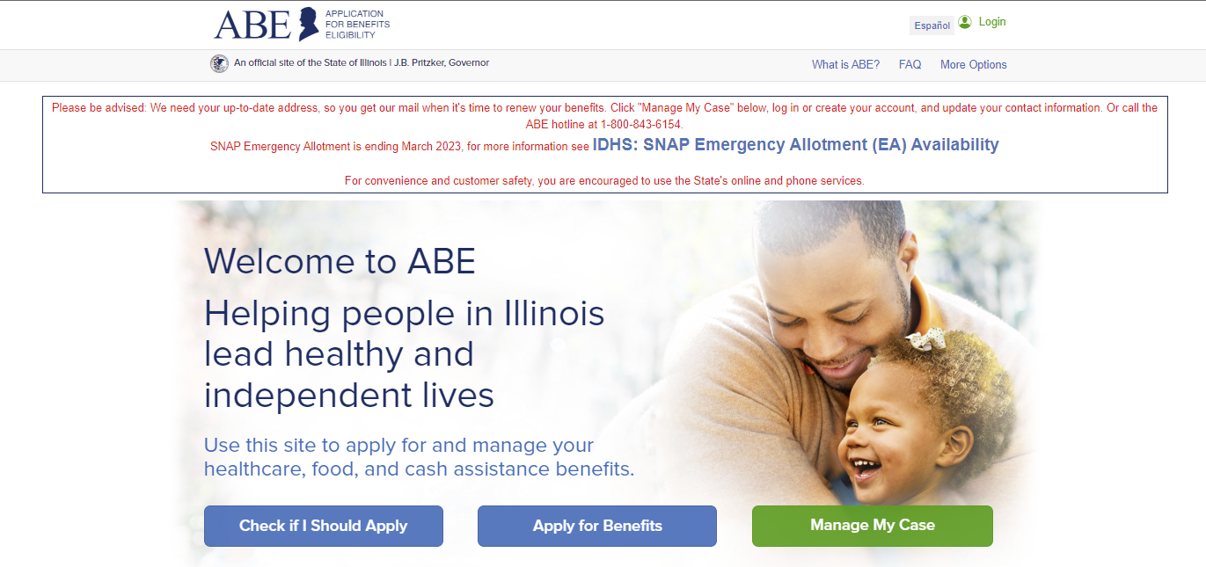
Updating addresses
@ local FCRC
Call DHS Help Line: 1-800-843-6154
For Medicaid only: https://www2.illinois.gov/hfs/MedicalClients/Pages/addresschange.aspx
Manage My Case in ABE https://abe.illinois.gov/

Slide 21
Signing up for text alerts
Manage My Case in ABE https://abe.illinois.gov/

Slide 22
Where to find notices & DEADLINES
Call 1 (855) 828-4995 with client’s recipient ID number (RIN).
Using numeric keys, input dates to verify eligibility for each month.
Manage My Case in ABE https://abe.illinois.gov/
Notices to the client

Slide 23
Where to find notices & DEADLINES
Notice of Decision
Appointment Notice
Redetermination
Click on image to download a pdf of the notice

Slide 24
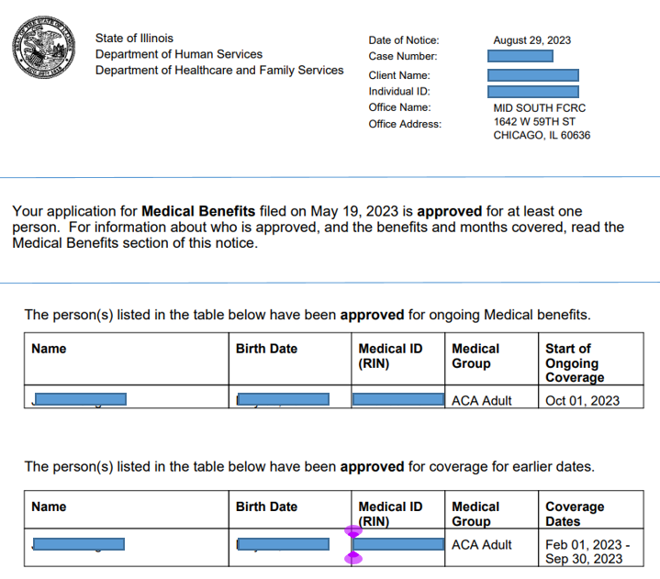
Date of Notice
Make sure notice includes all household members and that start of ongoing coverage is satisfactory
Notice does not indicate when redetermination might be due
Some notices also include previous dates of coverage but most do not

Slide 25
Submitting Redetermination Application
In order of how highly we recommend using this method:
Manage My Case at abe.Illinois.gov
Fax Redetermination form to 1-844-736-3563
Mail to PO Box 19138; Springfield, IL 62763 (return receipt, if possible)
In person at the FCRC processing the case
By phone at (800) 843-6154

Slide 26
What if my Medicaid is terminated
Review reason for termination to see if you agree with WHY DHS terminated your medical benefits. The reason should be listed in the notice.
If DHS was wrong, you have two options to protect your Medicaid coverage (you can do one or both):
If DHS’s decision was correct, file a new application. Request up to 3 months of retroactive coverage in your application if needed.
 | Pros | Cons
Appeal DHS’s decision | Full reversal of benefits can get Medicaid reinstated all the way back to the termination date Can request continuing benefits while you are waiting for DHS to resolve your appeal | Deadline to file is 60 days after the date on the Notice of Decision. After 60 days, you might lose your right to argue that DHS’s decision was incorrect. Timeframe to resolve the matter can range from 10 days to several months
File a new application | Can request up to 3 months of retroactive coverage. You must request it in the application. | Can take up to 60 days to get a new decision While your application is pending, you do no have medical benefits

Slide 27
Does Medicaid pay for your Medicare premium?
2023 income standards | Part B Premium Only | Part B + Part A + Assistance with Deductible, CoPays, and other out of pocket costs
 | 100-135% FPL | 100% FPL
1 | $1,216-$1,639 | <$1,216
2 | $1,644 - $2,218 | <$1,644

Slide 28
Qualifying for Medicare and Medicaid
Who qualifies | Covers | Monthly Costs (2023) | How to apply online | How to apply by phone
People 65 years old or older Receiving Social Security Disability (2 year waiting period) End-state Renal Disease ALS (Lou Gehrig’s Disease) | Part A: Hospital Part B: Doctor’s Visits Part C: Combined Parts A and B (and D), provided through a private insurance company Part D: Prescriptions | Part A: up to $506; free to most Part B: $165-560 Part C: Combined Parts A and B (and D), average in IL is regular Medicare premiums + $71 Part D: Plan Premium + $12-76 | https://secure.ssa.gov/iClaim/rib | Apply through the Social Security Administration

Slide 29
Qualifying for Medicare and Medicaid
The Medicare-Medicaid Alignment Initiative (MMAI) demonstration project provides coordinated medical care to seniors and to persons with a disability who receive both Medicaid and Medicare.
Persons who choose to enroll in the MMAI program will keep getting their Medicare and Medicaid benefits.
There is different Managed Care Organization (MCO) plans to choose from under MMAI depending on where you live.
https://www.dhs.state.il.us/page.aspx?item=69036
Income Limit* 100% FPL (2023 limits below)
1 | $1,215
2 | $1,643
4 | $2,500
Asset Limit*
1 | $17,500
2 | $17,500
4 | $17,500

Slide 30
If a person is not eligible due to income limit is there a direct person(s) with DHS who will assist them with applying for the Market Place Health Insurance (Affordable Care Act Insurance).
https://localhelp.healthcare.gov/

Slide 31
What other benefits would a Medicaid participant be eligible for?
Food Assistance
Medical Assistance
Cash Assistance for Low-Income Families
Cash Assistance for Elderly and People with Disabilities
Cash Assistance for Non-Citizen Victims of Trafficking, Torture, or Other Serious Crimes
Women, Infants, and Children (WIC): https://www.dhs.state.il.us/page.aspx?item=30513

