Slide 1
Public Benefits Overview
Gwynne Kizer Mashon
Supervisory Attorney, Public Benefits Practice Group
gmashon@legalaidchicago.org
October 2023

Slide 2
Children & Families
Consumer
Legal Aid Chicago is a private non-profit that provides free civil legal services to people with limited income in Cook County, securing their rights to economic stability, affordable housing, personal safety, fair working conditions, and basic healthcare.
Criminal Records
Relief
Public Benefits
Long-Term Care
Immigrants & Workers’
Rights
Housing

Slide 3
AGENDA
Administrative Agency | Topics we will discuss
Social Security Administration | What benefits do they administer Who qualifies What do people who qualify for the benefit get How to apply
Medicare
VA Administration
IL Department of Human Services
IL Department of Healthcare and Family Services
Caveat: All of these programs have a lot of complicated rules which have exceptions, exceptions to those exceptions,
and so on. Thus, we cannot cover all of the rules for any of these programs today.

Slide 4
Applying for benefits Generally
Application
Written decision
Opportunity for Appeals if the decision isn’t fully favorable
Agency confirms eligibility:
No cost to apply
No negative consequences for applying for something you don’t qualify for
No punishment for wrong answers as long as you’re not lying or misleading on purpose
The agency will lose things!

Slide 5
Applying for benefits Generally
Financial eligibility factors:
Gross income, not net
Not all kinds of income and assets are counted
Some things you might not consider income might be treated as income
Requests for information:
Applications can be denied if information isn’t submitted by deadlines
Respond to ALL requests
Ask for help if you don’t understand something or have trouble getting needed documents
Agency errors are not uncommon.
Agencies make errors
Interviews
Required for many programs
If interviews are missed, request a rescheduling as soon as possible
If the agency denies an application or awards less than what the person thinks they should get, they can and often should appeal.
There is usually a deadline for filing appeals. In some situations, appeals can be filed after those deadlines; but it is always best to meet them.

Slide 6
Social security
Benefit Type | Who qualifies | Maximum (average) monthly benefit in 2023* | How to apply online | How to apply by phone
Retirement | Is at least 62 years old and has earned enough SSA work credits | $4,555 ($1,827) | https://secure.ssa.gov/iClaim/rib | Call (800) 772-1213
Disability | Has one or more conditions that together prevent the person from engaging in “substantial gainful employment” and has earned enough SSA work credits | $3,627 ($1,483) | https://secure.ssa.gov/iClaim/dib
Survivors | Certain surviving spouses and ex-spouses, parents, and children | $4,555 ($1,704) | No online application
Supplemental Security Income (SSI) | Has one ore more conditions that together prevent the person from engaging in “substantial gainful employment”, or is blind, or is over 65 years old; AND meets SSI income and asset caps | $914 ($657) | Application can be started at https://secure.ssa.gov/ben16/prtflui/ssiprtfl but application cannot be completed online
* Most do not get the maximum amount. The reasons amount might be lower then the maximum
vary by benefit type. Maximums amounts for all benefits change every year.

Slide 7
Social Security
Unable to engage in substantial gainful employment
Most show they cannot work any jobs, not just the jobs they’ve held in the past
Diagnosis is not enough. Conditions must result in symptoms and limitations that prevent a person from working.
Evidence used: statements by the claimant and others who know the claimant; objective evidence documented in medical and other treatment records
Strongest evidence is medical records, objective testing, and doctor’s observations
If client declines a treatment because of side effects, or fear of side effects, or the inability to pay for or access a treatment, or some other legitimate reason, that needs to be documented by the medical provider; otherwise, SSA might decline the application
Must have lasted or be expected to last for at least 12 months

Slide 8
Social Security
Typical Process for applying for SSI and Disability (SSD)
Complete SSI and SSD application
SSA determines if client has enough work history for SSD
DDS sends claimant a lot of documents to complete
Claimant returns documents
DDS schedules “consultative exam(s)”
DDS determines whether the claimant meets SSA disability standards
If “disabled”, SSA determines if claimant meets SSI financial requirements
SSA transfers case to DDS
Approx. 9 months!

Slide 9
Social Security
Application
Reconsideration
Administrative Hearing
Appeals Council
Federal Court
Appeals Process for applying for SSI and Disability (SSD)
Only about 30% of applications are approved on the first application so encourage your client not to feel too defeated if their application is not approved initially.
Deadline for filing appeals at each level is 65 days after the date on the notice denying benefits
Appeals add anywhere from 6 months to several years to processing time.

Slide 10
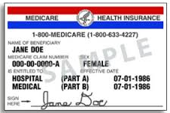
medicare
Apply through the Social Security Administration
Monthly Costs (2023)
People 65 years old or older
Receiving Social Security Disability (2 year waiting period)
End-state Renal Disease
ALS (Lou Gehrig’s Disease)
Part A: Hospital
Part B: Doctor’s Visits
Part C: Combined Parts A and B (and D), provided through a private insurance company
Part D: Prescriptions
Part A: up to $506; free to most
Part B: $165-560
Part C: Combined Parts A and B (and D), average in IL is regular Medicare premiums + $71
Part D: Plan Premium + $12-76
Covers
Enrollment Deadlines
Part A: ≤10%; lasts for 2x the number of years you didn’t sign up
Part B: 10% for every year you did not sign up; last as long as you have part B
Who Qualifies
3 months before - 3 months after you turn 65, unless you qualify for special enrollment
Severe penalties for missing deadlines
Penalties
Part D: One 1% for every month you didn’t sign up; lasts as long as you have Part D

Slide 11
Help paying medicare costs
EXTRA HELP
Apply through the Social Security Administration
Starting in January 2024, everyone who has Extra Help will get the same benefits
Asset limits (2023): $16,600 (single); $33,240 (married)
Income limits (2023): $12,870 (single); $29,580 (married)
$0 Premium and $0 Deductible
Low out-of-pocket costs for prescription drugs
Waiver of late enrollment penalties while on Extra Help
MEDICARE SAVINGS PLANS
Apply through the Illinois Department of Human Services
Asset limits (2023): $7,080 (single); $10,620 (2 people)
Income limits:
Automatic enrollment in Extra Help
QMB: $1,215 (single); $1,639 (2 people)
Other MSP: $1,639 (single); $2,218 (2 people)
Benefits:
State pays Part B Premiums
For QMB Only: State pays Part A Premiums, assistance with Co-pays, Balance Billing Protections
State pays any late enrollment penalties associated with premiums it is paying
All except QMB: Up to three months retroactive benefits

Slide 12
IL Department of human services
Food Assistance
Medical Assistance
Cash Assistance for Low-Income Families
Cash Assistance for Elderly and People with Disabilities
Cash Assistance for Non-Citizen Victims of Trafficking, Torture, or Other Serious Crimes
Cash Assistance Programs

Slide 13
Certain pandemic-related protections ended this year
Monthly benefits: Under “regular” rules, monthly benefits are based on income and certain expenses, not just on household size.
College students: Under “regular” rules, students enrolled in higher education half-time or more are ineligible for SNAP unless they meet certain exceptions, e.g.:
Working an average of 20 hours/week
Participating in a federally-funded work study program
Responsible for the care of a young child
Receiving TANF
Income limit:
165% FPL (currently $2,005 for a single person as of 10/23)
200% FPL (currently $2,430 for a single person as of 10/23) if 60+ or disabled*
Asset limit:
There is no asset limit for most households in Illinois
SNAP “Households” live and prepare food together
Covers food: only can be used for unprepared foods
*** SNAP Restaurant Meals Pilot is on track to expand access to people who cannot prepare their own meals
Benefit Amount:
Based on household size, income and certain expenses

Slide 14
TANF cash
Usually requires a relative caretaker and a minor child
Lots of complicated rules and requirements BUT exemptions to some requirements for
people with disabilities
experiencing domestic violence
Caring for child under 1 year old
Benefits Amount:
Based on household size and income. Maximum for a family of four people is $875/month (as of October 2023).
Big changes are coming related to child support payments.

Slide 15
AABD Cash
FOR PEOPLE AGE 65+ OR MEETS SSA’S DEFINITION OF “DISABLED”
Most recipients are receiving SSI
But can also qualify if you are over-income for SSI under SSI’s rule
If someone is getting less than the SSI maximum, they might need proof that they applied for SSI and were denied for being over-income
Can make up difference for people with SSI overpayments, child support obligations, etc.
Asset Limit: $2000 individual/$3000 married couple
Income Limit: no set limit
Benefit Amount:
Based on income and certain expenses
The average is about $60-$70/mo; but can be much more – no limit – some people get $500-$700/mo.

Slide 16
VTTC Cash
FOR NON-CITIZEN VICTIMS OF TRAFFICKING, TORTURE, OR OTHER SERIOUS CRIMES
For immigrants who do not meet immigration requirements for federally-funded programs
U-Visa applicants, U-Visa holders, and those who got Legal Permanent Resident status after they got a U-Visa
T-Visa applicants
Asylum applicants
People preparing to file an application for a U-Visa, T-Visa, or Asylum
Benefit Amount:
Based on household size and income. Maximum for an individual adult is $106/month.

Slide 17
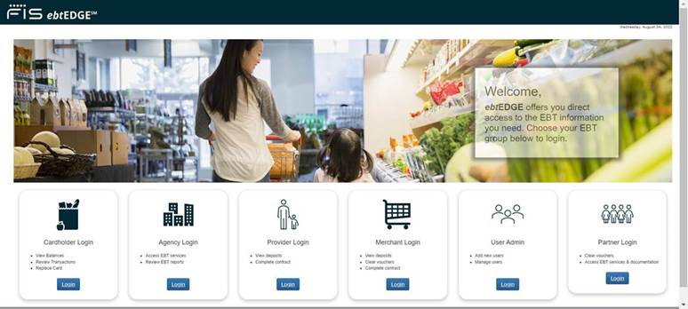
Illinois Link card fraud
Link theft seems to be more and more common.
Protect Yourself
Report Theft
Request replacement SNAP benefits (DHS currently states that it cannot reimburse other benefits.)
https://www.dhs.state.il.us/page.aspx?item=35280
https://www.ebtedge.com/gov/portal/PortalHome.do

Slide 18
Medicaid
Who Qualifies (non-exclusive list) | Income Limits (2023) | Asset Limit | Other
US citizens and most LPRs under 65 years old; and (noncitizens 42-64 years old*) | 138% FPL $1,677 for an individual $3,450 for a family of 4 | None
Children | 318% FPL $3,864 for an individual $7,950 for a family of 4 | none
Medicare beneficiaries; US citizens and most LPRs under 65 years old; (noncitizens 65+); Non-Citizen victims of trafficking, torture or other serious crimes | 100% FPL $1,215 for an individual $2,500 for a family of 4 | $17,500 | Can spenddown excess income/assets to become eligible for Medicaid
Medicare beneficiaries; US citizens and most LPRs under 65 years old | None | None
Pregnant Women and their babies (until baby is 12 months old) | 213% FPL $3500 for a family of 2 $5,325 for a family of 4 | None
2022 amounts

Slide 19
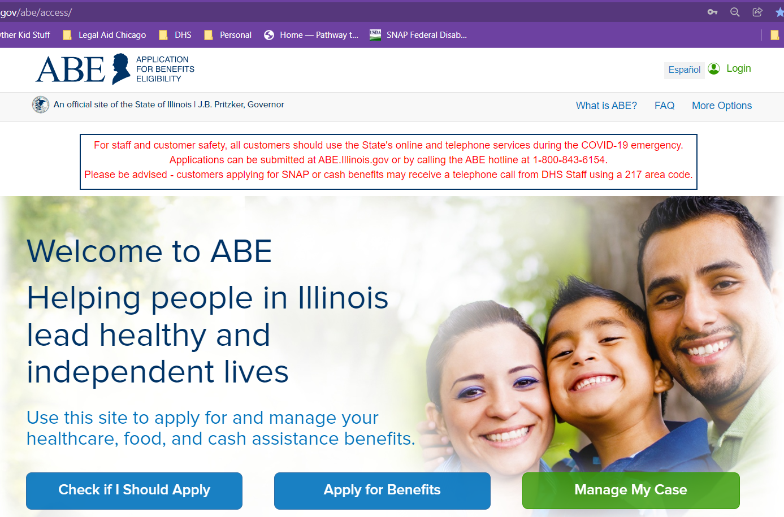
DHS programs – how to apply
Apply online on ABE: https://abe.Illinois.gov
Apply at Local IDHS Office. “Family Community Resource Center” locator at: http://www.dhs.state.il.us/page.aspx?module=12
What to bring: ID, SSNs for all household members, proof of immigration status, proof of income for last 30 days
Legal Aid Chicago PBOE referrals– more on this later
To be treated as an application, all the form needs is your name and signature. (Though practically, DHS also needs a way to contact you.)

Slide 20
Application process
Application
Verification/Agreement to benefits requirements
Notice of Decision
Interview (for SNAP and CASH programs)
TANF: 45 days
AABD Cash: 45 days
Medicaid: 45 days
SNAP: 30 days or 5 days if expedited
An applicant qualifies for expedited processing in a few situations, including when liquid assets are less than $100 and gross monthly income or the month of application is less than $150

Slide 21
Appealing dhs decisions
What is appealed?
Incorrect decision
No decision within the processing time (“Inaction”)
Time to File
AABD Cash, MSP, TANF, or Medical: 60 days*
SNAP: 90 days*
How to File
Through “Manage my Case” https://abe.Illinois.gov
Inaction for any benefit: No deadline
phone: 1-800-435-0774 or 312-793-2618
Fax: 312-793-3387
DHS.BAH@Illinois.gov
Decisions where benefits are denied because of missing verifications or a missed interview!
*If the notice is legally insufficient, these deadlines arguably do not apply.

Slide 22
VA Pension
Pension is a monthly benefit for wartime veterans who service was not dishonorable, who have low-income, few assets, and are totally disabled or over age 65.
Benefit Amount: Max Annual Pension Rate (Single Veteran) = $16,037 (or $1,336 per month)
Minimum active-duty service requirement, including at least 1 day during a wartime period
Prior to 1980, 90 days of service
After 1980, 2 years or full term of service
Disabled
Age 65 or older
Totally and permanently disabled
A patient in a nursing home receiving skilled nursing care
Receiving SSI or SSDI
Low-income
Means-tested program. The maximum VA Pension rate is reduced by any other income or benefits
Higher maximum Pension rates for veterans who have dependents, are housebound, or who require Aid & Attendance performing activities of daily living
Net Worth Limit
$150, 538
Net worth = assets + annual income

Slide 23
VA Service-Connected compensation
Current diagnosis
In-Service incurrence or aggravation of a disease or injury
Nexus between the current symptoms and the in-service event
*Service-connected disability compensation is not restricted by the veteran’s income
**Amounts are higher if the veteran has dependents. Aid and attendance and/or housebound status increases it further.
Disability Rating | Monthly compensation
100% | $3,757.00
70% | $1,757.06
50% | $1,108.82
30% | $548.05
10% | $165.92

Slide 24
Other state and federal benefits for veterans
Medical care
Mental health care
Burial benefits
Help purchasing/paying for a home
Residential veterans facilities
Treatment courts
Life Insurance
Education benefits
And more…

Slide 25
Cash assistance Triage
Note this is triage only. Clients must still meet other eligibility requirements.
Majority of People over 65 Years Old | Social Security Retirement or Survivors Benefits Supplemental Security Income (SSI) AABD Cash
Surviving Spouses (and some exes) over 60 years old or Surviving Minor Children without a disability | Social Security Survivors Benefits
People under 65 Years Old with Disabilities | Social Security Disability (or Survivors Benefits) Supplemental Security Income (SSI) AABD Cash
Certain Veterans (any age) | Veterans Service Connection Veterans Pension
Families with Minor Children or Pregnant Moms | Temporary Assistance for Needy Families (TANF)
Non-Citizen Victims of Trafficking, Torture, or Other Serious Crimes | VTTC Cash

Slide 26
Medical Assistance Triage
Note this is triage only. Clients must still meet other eligibility requirements.
Over 65 Years Old (Generally only U.S. Citizens or people who have held LPR status for at least 5 years) | Medicare Medicare Savings Programs Long-Term Care
Veterans | VA Medical Services
Non-Citizen Victims of Trafficking, Torture, or Other Serious Crimes
People under 65 Years Old with Disabilities that prevent them from working for at least 12 months (Generally only U.S. Citizens or people who have held LPR status for at least 5 years) | Medicare Medicare Savings Programs Long-Term Care
Anyone * Non-citizens subject to immigration status requirements | Medicaid or Marketplace

Slide 27
Food Assistance Triage
Note this is triage only. Clients must still meet other eligibility requirements.
Families with Children under 5 years old, or Pregnant Moms | WIC
Anyone (Generally only U.S. Citizens or people who have held LPR status for at least 5 years) | SNAP

Slide 28
Questions?
Gwynne Mashon
gmashon@legalaidchicago.org

