Slide 1
Submitting DHS Benefit Applications using ABE
January 2024

Slide 2








Children & Families
Consumer
Legal Aid Chicago is a private non-profit that provides free civil legal services to people with limited income in Cook County, securing their rights to economic stability, affordable housing, personal safety, fair working conditions, and basic healthcare.
Criminal Records
Relief
Public Benefits
Long-Term Care
Immigrants & Workers’
Rights
Housing

Slide 3



What I hope you’ll learn
Overview of what ABE can do
How to create an ABE User ID and Password
How to submit an application via ABE
Complete Identity Proofing
Provide Key Information to unlock services and maximize DHS benefits

Slide 4
Illinois' Application for Benefits Eligibility (ABE) has three portals to support applicants with their benefits:
Apply for Benefits
ABE is the State of Illinois’ web based portal for applying for and managing health coverage, SNAP and cash benefits online, anytime.
Manage My Case (MMC)
MMC is a section on the Application for Benefits Eligibility (ABE) website that lets you check on, change, and renew your Medical, SNAP, and case benefits online, anytime.
Appeals
The ABE Appeals portal allow users to file and manage appeals via the web based portal. The Appeals portal can be accessed through MMC or directly:
https://abe.illinois.gov/abe/access/appeals

Slide 5
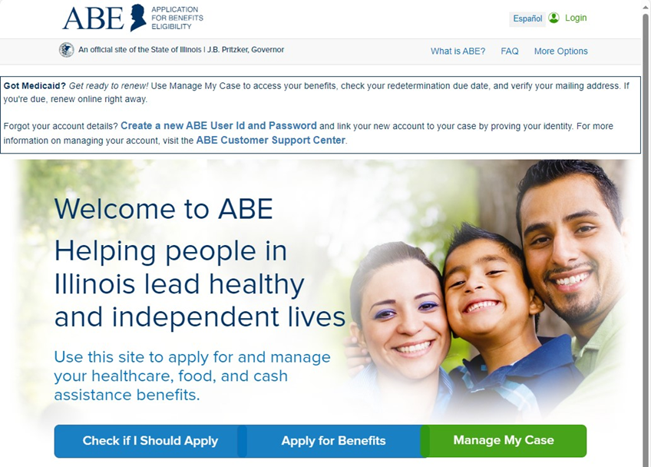
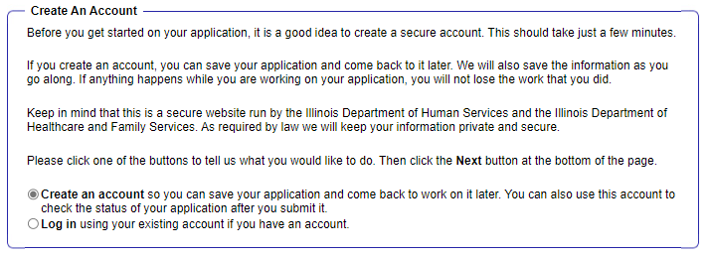
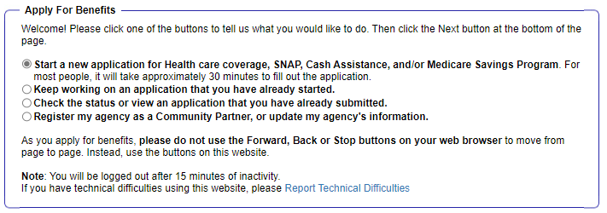
SETTING UP ABE LOgIn
2
3
1

Slide 6
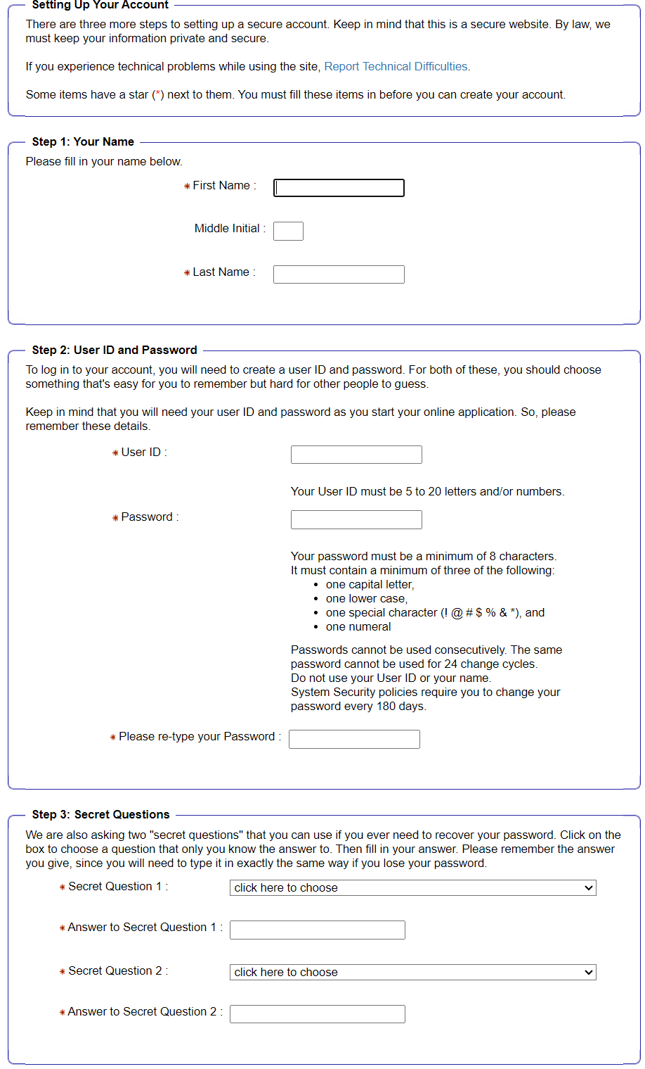
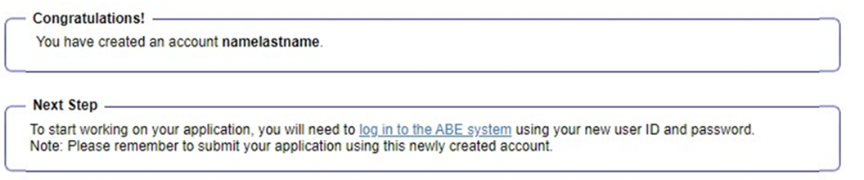
SETTING UP ABE login

Slide 7
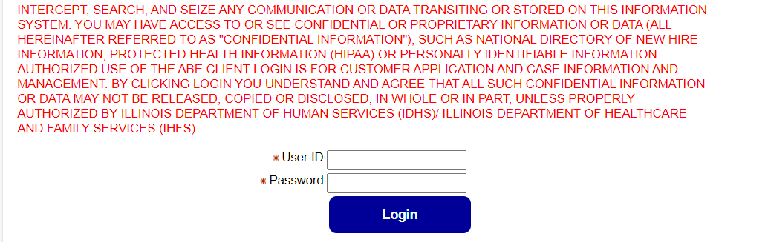
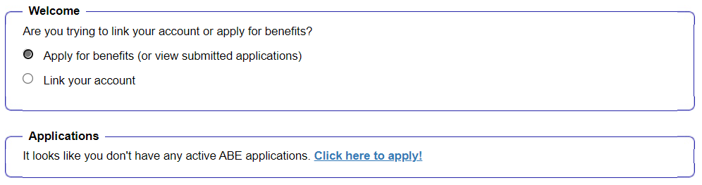
Logging in
2
Once logged in for the first time, you will see this screen:

Slide 8
Identity Verification
Applicants are required to verify their identity when applying for IDHS benefits or using MMC for the first time. This process is called Identity Proofing. Three (3) ID Proofing services are available.
They appear in the following order:
1. Secretary of State (SoS) – Verifies a SoS IL Driver’s License or State ID information.
2. Experian – Randomly generated questions based on previous addresses, tax data or ownership details.
3. Manual ID Proofing – Paper form process with DHS/HFS.

Slide 9
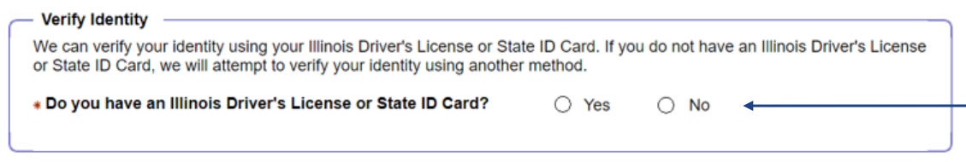
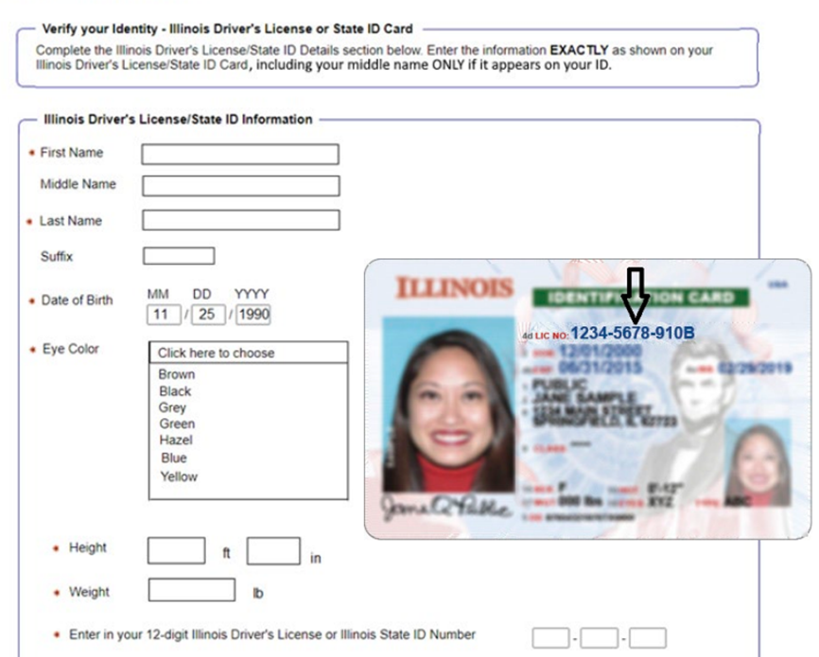
Identity proofing – Secretary Of State
If customer answers, ”YES”, they will advance to the SoS ID Proofing process.
If applicant answers, ”NO”, they will advance to the Experian Identity Proofing process

Slide 10
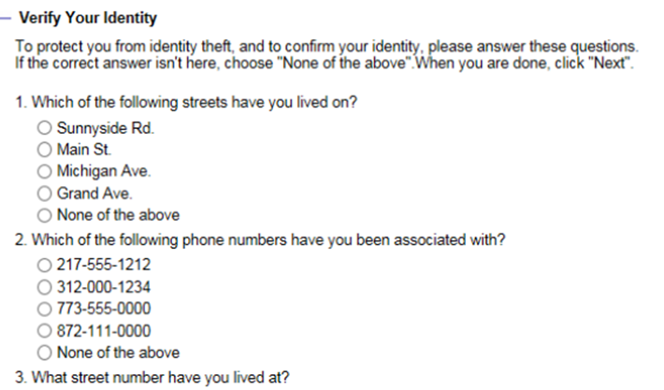
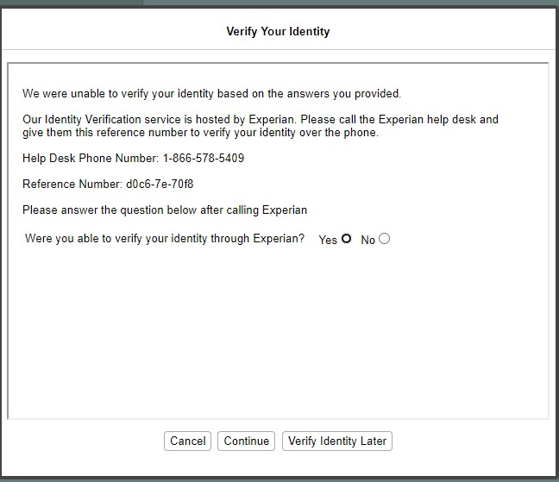
Identity proofing - Experian
Multiple-choice questions will display that only the applicant would know the answer to, thus “proving” the customer identity.
2
If the ID Proofing service is ABLE to use the customer’s answers to verify identity, applicants see the information that ABE was able to verify electronically, or their case will be linked and they will see the MMC homepage.
If the customer is UNABLE to answer the questions correctly or if the service does not have enough information to offer questions, the customer will be asked to contact the Experian Help Desk with a reference number for additional questions to answer.
2

Slide 11
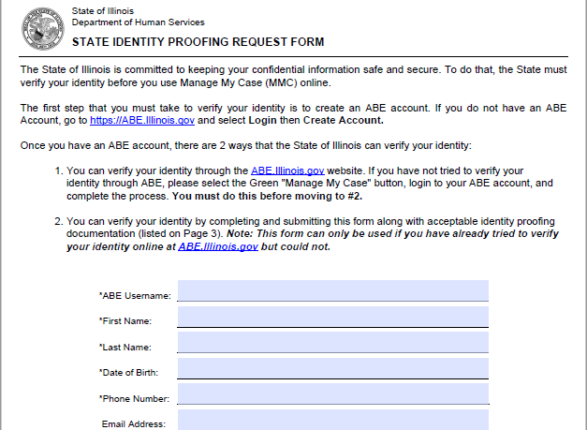
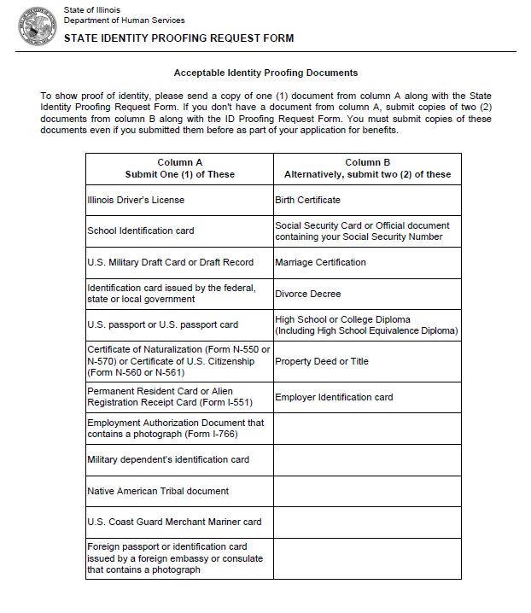
Identity proofing - Manual
1. To request State Identity Proofing, fill out, sign, and return the State Identity Proofing Request Form (pdf), and proof documents (listed on page 3 of the form).
2. Proof documents - you will need a copy of:
one (1) document from Column A or
two (2) documents from Column B from the list of Acceptable Identity Proofing Documents.
3. Return the completed form and proof documents to:
Illinois Department of Human Services
Attn.: ID Proofing Unit
600 E. Ash, Building 500, 5th Fl.
Springfield, IL 62703
or
Return the form to your local FCRC
Allow 6-8 weeks to hear back from the state.
If there are questions, email: ABE.Questions@illinois.gov

Slide 12
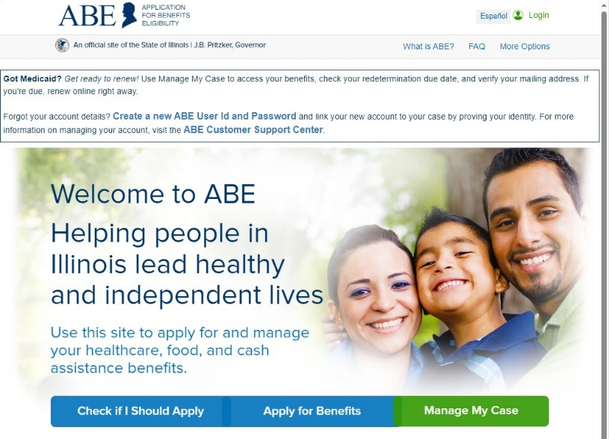
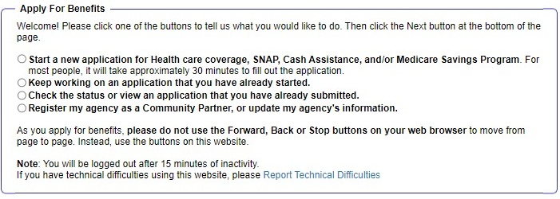
DHS programs – how to apply
2
1

Slide 13
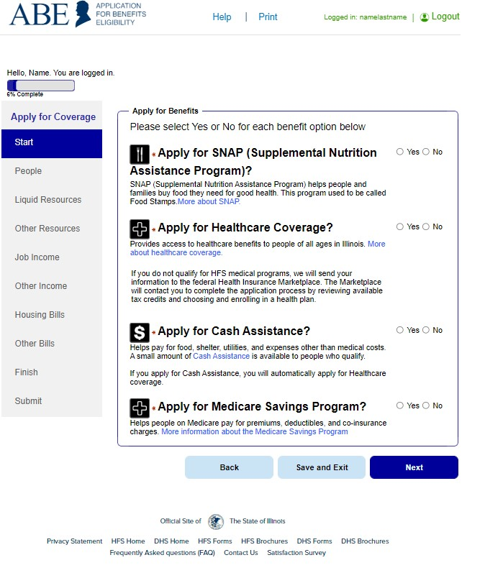
OVERVIEW OF APPLICATION
Shows the percentage of the application complete
These are the sections of the applications
How many people in the household, review of rights, who is filing app?
Who is in the home?
Assists, income recourses
Expenses
Review of answers
Submit application

Slide 14
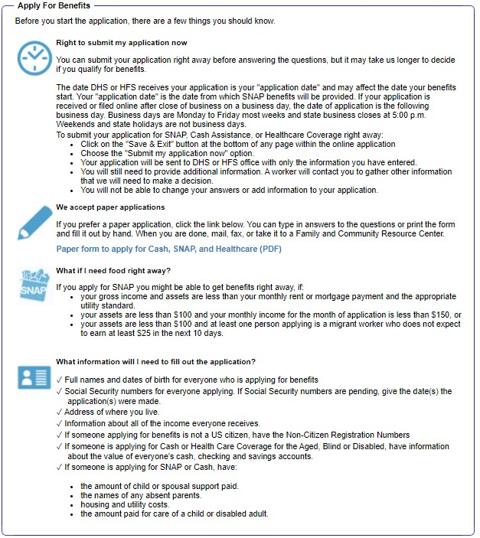
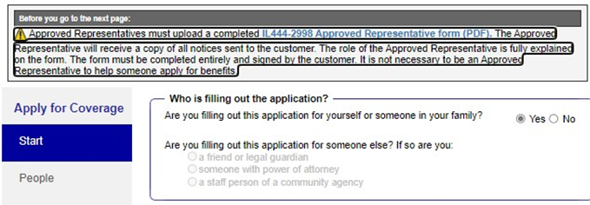
Who is submitting this application?
Indicate if someone is assisting with the application. If not, simply click "Next".

Slide 15
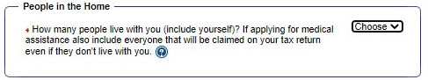
People in the home
Include everyone in the Household when applying for benefits.

Slide 16
Selecting programs
Select yes for every program*
*Unless you do not want to apply or know you are ineligible. You can always cancel DHS benefits you do not want

Slide 17
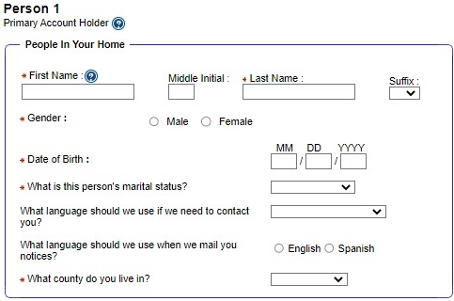
Personal information
Applicants will be asked identifying information. The red asterisks (*) indicate required information.

Slide 18
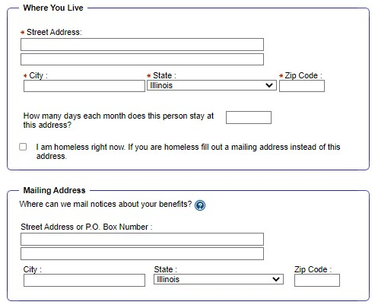
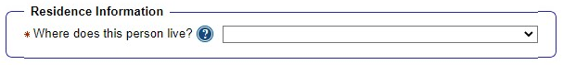
address
Check this box to indicate whether you are homeless and leave the address blank.
3
If you do not have a mailing address you can use the rule below to use your local FCRC.
WAG 06-04-03: Homeless Benefits
Mailing Address
Obtain approval of the LOA to use the Family Community Resource Center address for a customer with no permanent address.

Slide 19
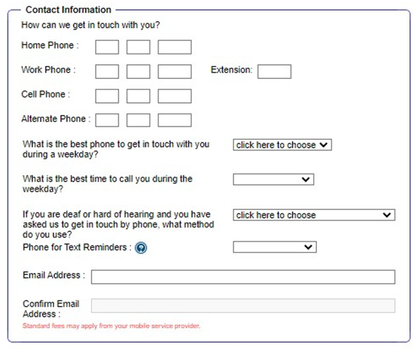
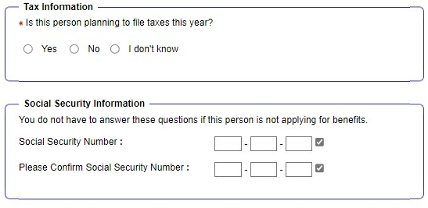
Contact information

Slide 20
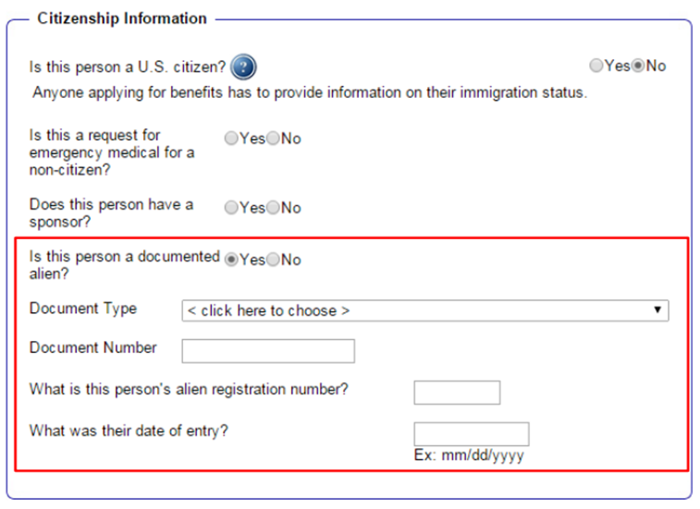
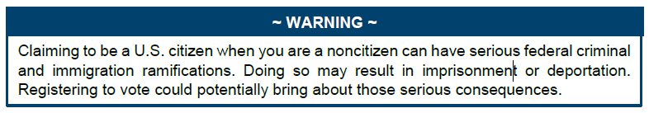
Citizenship
If you are not a U.S Citizen: Select NO
---
If you are a documented non-citizen, select YES
If you are undocumented select NO
(selecting NO does not automatically disqualify you from receiving benefits).
---
Select document type, ex:
  Permanent Resident (I-551)
  Arrival/Departure record (I-94)
For document number – enter the full number on the documentation you have, ex: Alien number, certificate of naturalization number, etc.
Upload the document at the end of the application when it asks for documentation under the citizenship tab if you are able to – this will speed up processing your application.
If you are a U.S Citizen: Select YES

Slide 21
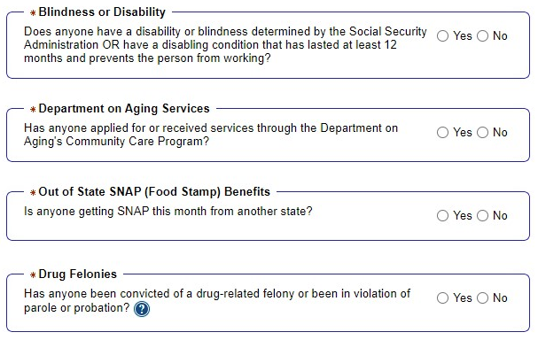
More about your household

Slide 22
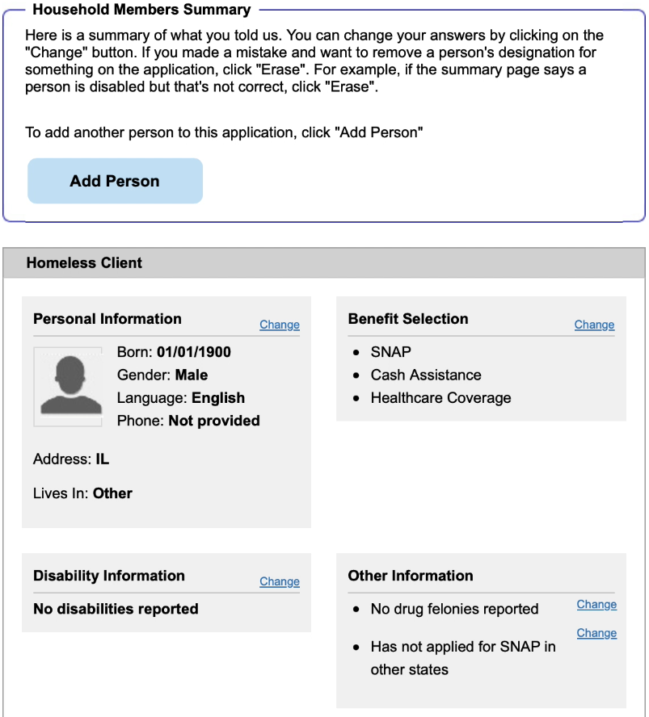
SUMmARY Review
At the end of each section, DHS gives you the opportunity review your answers.
If anything is wrong, click the button on the right side of the screen to fix it. Keep in mind that if you change an answer, you may be asked another question or two.

Slide 23
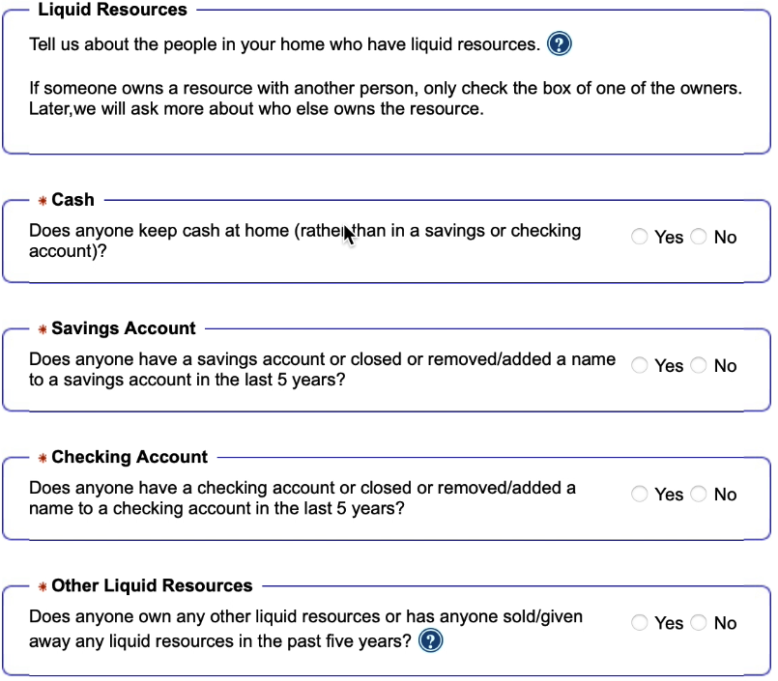
Liquid Resources
Depending on the benefits you applied for and your responses to earlier questions, you will be asked for information about your
resources (assets)
Be sure to include ALL income on the form. If you are applying for medical benefits only, for most people all that is considered is your monthly income. Assets are considered for some groups such as Seniors.
** For some programs, like SNAP, you must report resources but DHS doesn’t actually consider them when they determine whether you’re eligible.

Slide 24
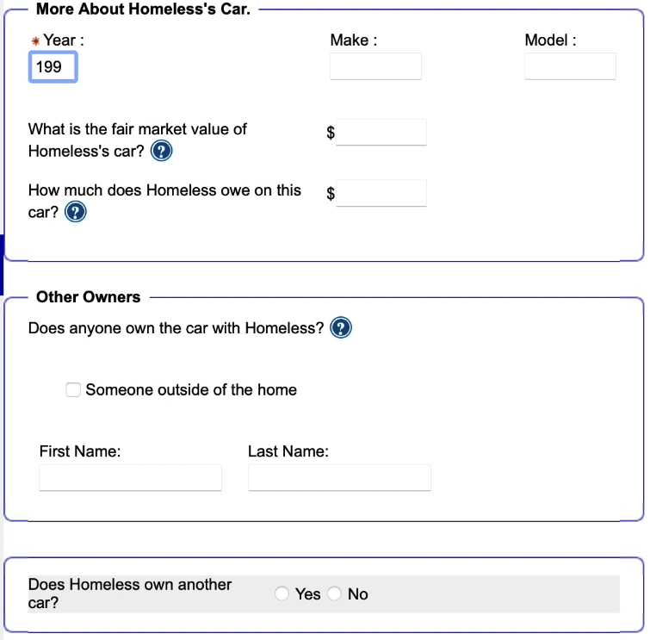
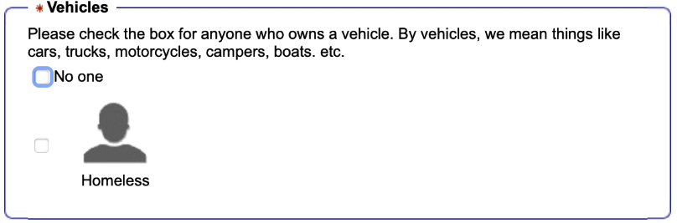
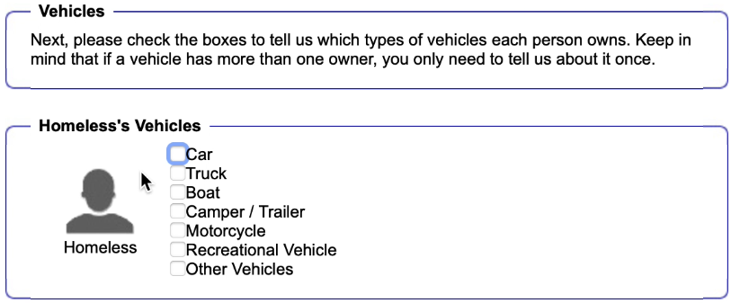
Other Resources

Slide 25
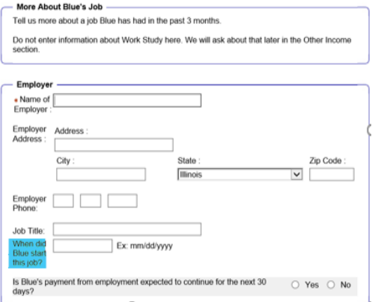
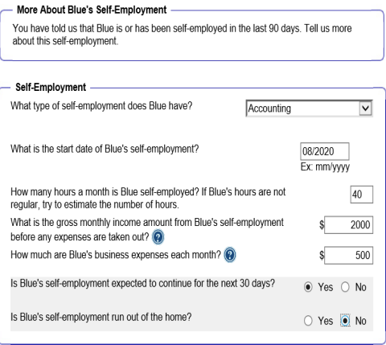
Income from employment

Slide 26
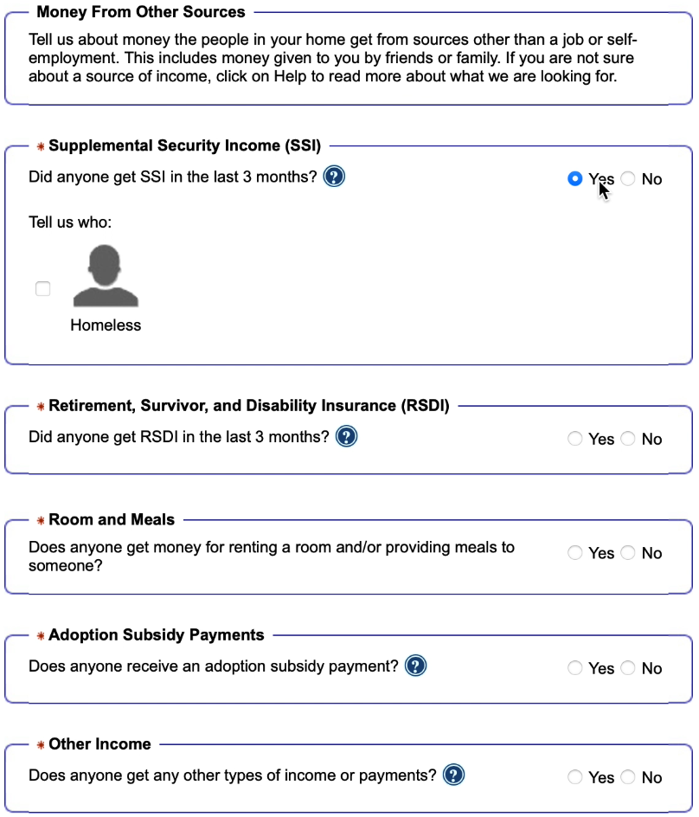
Other income
Supplemental Security Income (SSI) - SSI is a monthly payment for people with very low incomes who are at least 65 or blind or disabled. SSI is not a retirement benefit and it is not the same as Social Security.
Social Security - By Social Security, we mean retirement payments and some disability payments. Don’t include SSI income in this box.
Child Support - Child support is the money that you or your children receive from a parent who is not living in your home.
Unemployment payments - Unemployment payments are payments you may receive from the state if you have recently lost your job.
Other sources - Some examples are worker’s compensation, veteran’s benefits, pensions, tribal per capita payments.

Slide 27
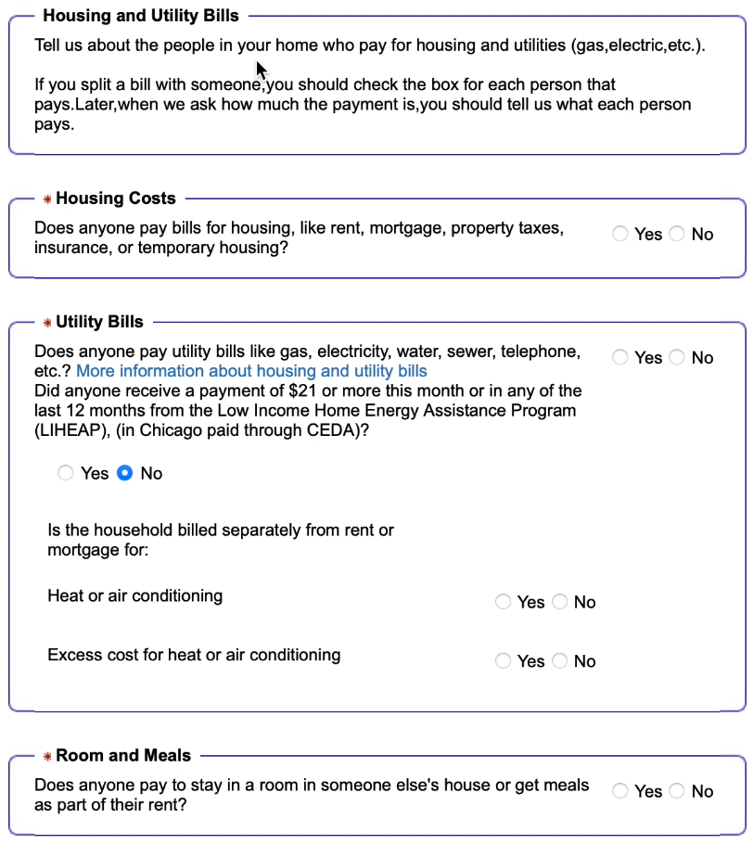
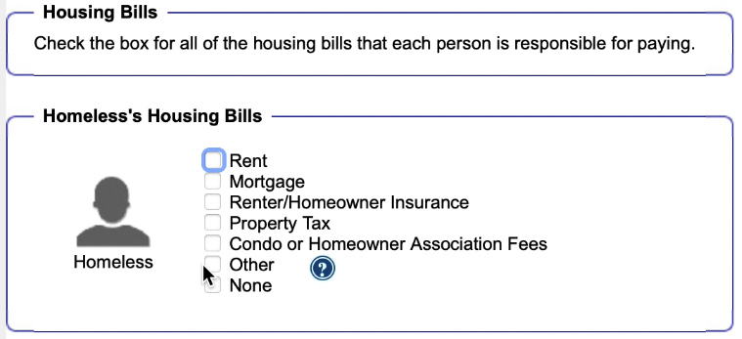
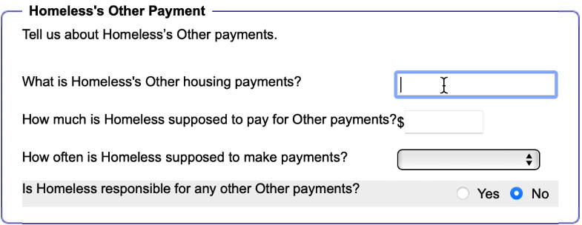
Housing bills

Slide 28
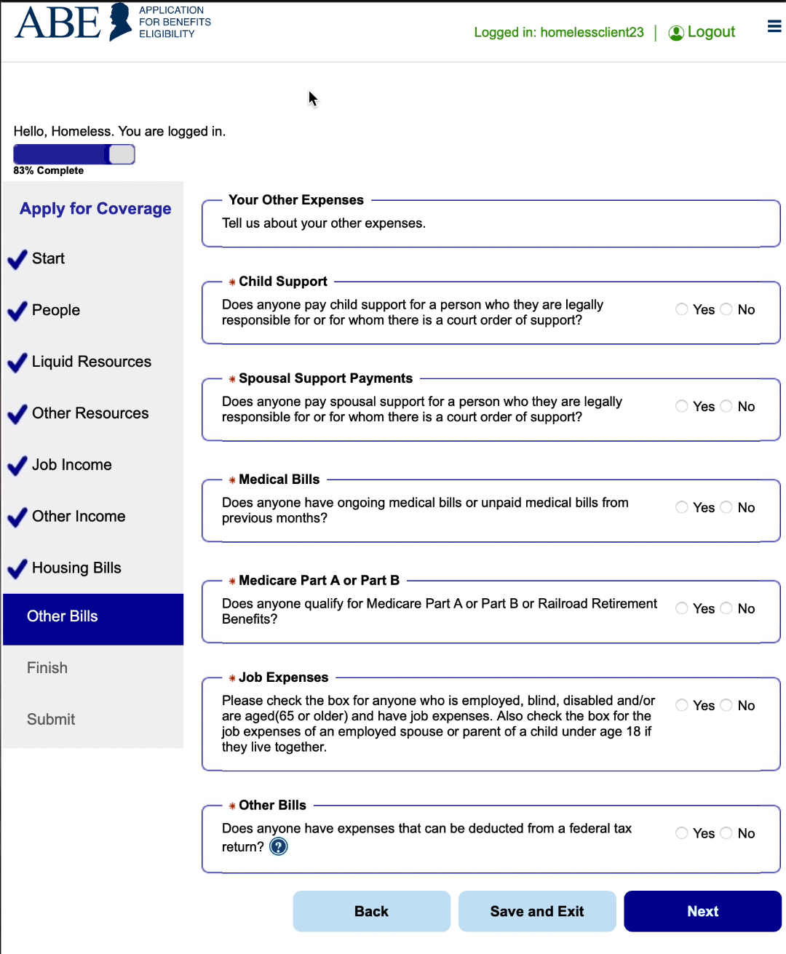
Other Bills

Slide 29
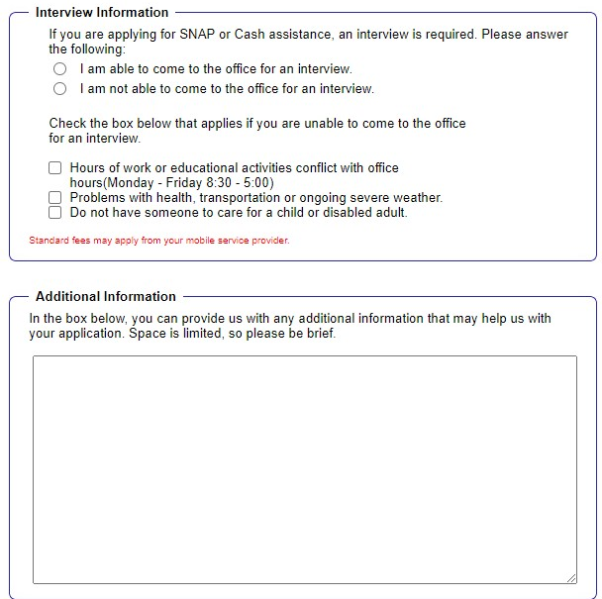
interview information
What are these blank white boxes for?

Slide 30
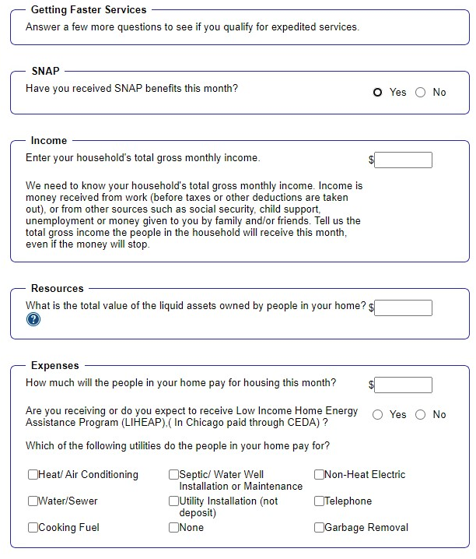
Getting Faster Services
PM 02-08-01: Who Can Get Expedited Service
Give SNAP applicants expedited service when:
the SNAP household's gross nonexempt income and liquid assets are less than their monthly rent or their mortgage payment and the appropriate utility standard; or
the SNAP household has liquid assets of $100 or less and gross monthly income for the month of application is less than $150; or
the SNAP household has liquid assets of $100 or less and at least one person applying is a migrant who is "out of funds."

Slide 31
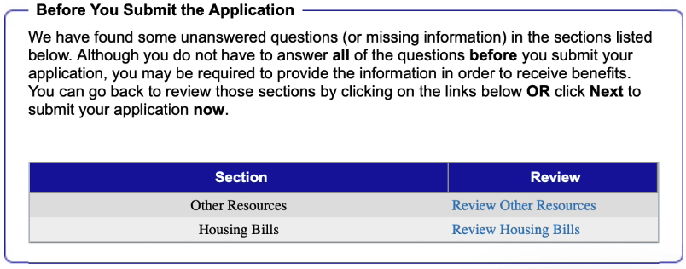
Before you submit your application

Slide 32
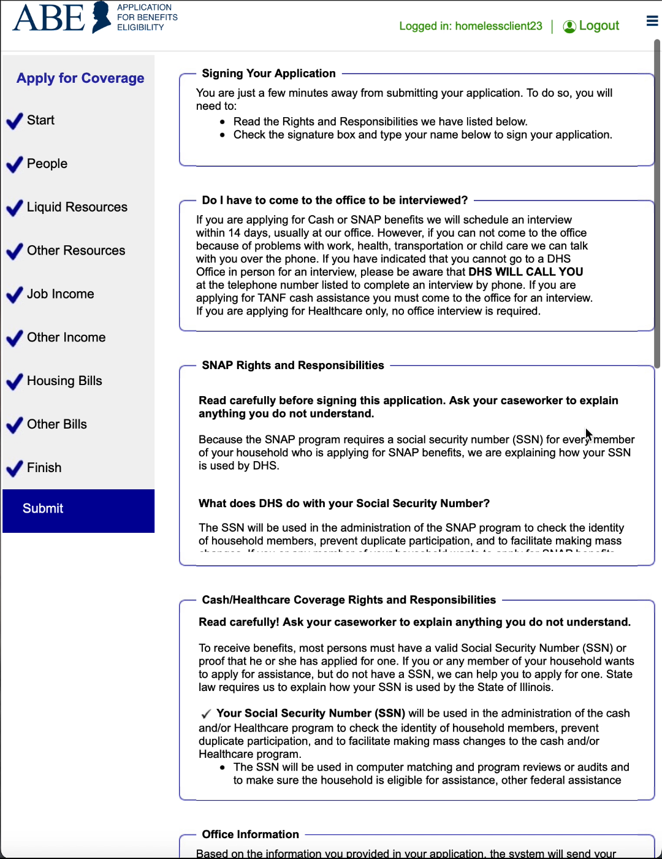
Submit

Slide 33
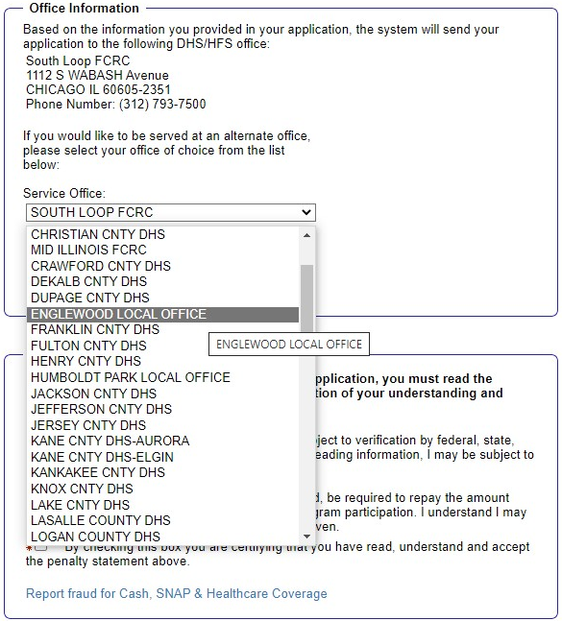
Submit

Slide 34
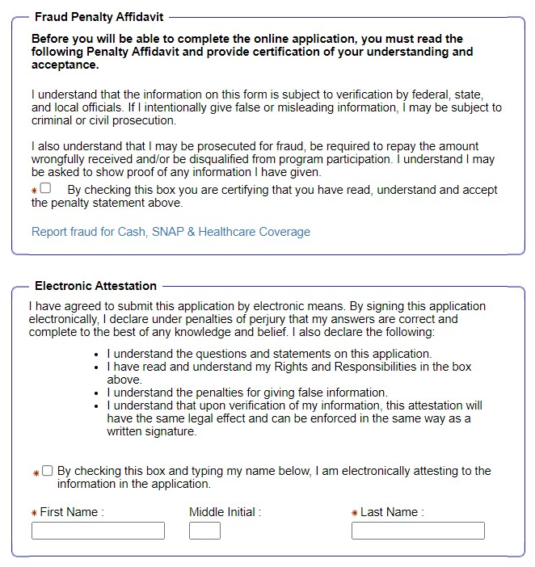
Submit

Slide 35
Print submitted page
When the application has been successfully submitted, an Application Summary page comes up with your Application Number.
You may also print a copy of the application by clicking the [Print My Application] button.

Slide 36
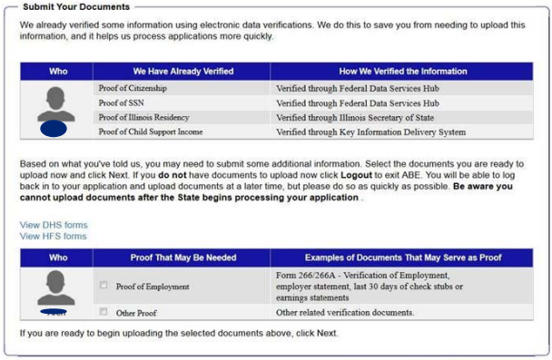
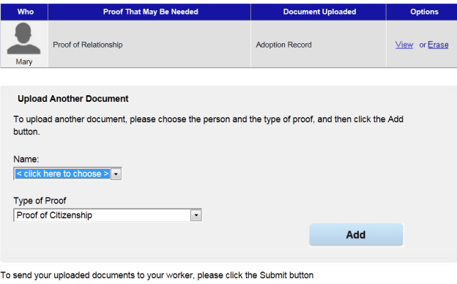
Upload required docs
Be sure to click the [Add] button and the [submit] button

Slide 37
Questions?
Gwynne Mashon
gmashon@legalaidchicago.org
For technical assistance reach out to DHS
abe.questions@illinois.gov

